Slide 1


M.Tech Program
Advanced Industry Integrated Programs
Jointly offered by University and LTIMindTree
Review 2
24-09-2026
CampusResolve-AI: A Multilingual Explainable Complaint Intelligence System with Duplicate Detection, Priority Forecasting, and Resolution-Time Prediction
PREMKUMAR S
251011012
T9964
Knowledge partner | Implementation partner

Slide 2
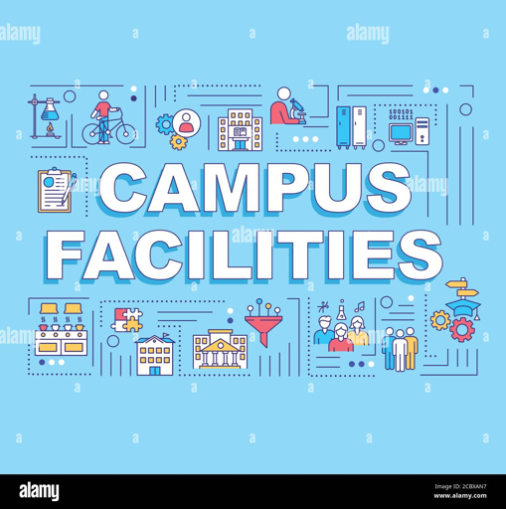
CampusResolve-AI
Introduction
• Campus complaints are often handled manually
• Delayed routing affects resolution quality
• Duplicate reports increase staff workload
• Multilingual complaints are harder to analyse
• AI can support faster staff decisions

Slide 3
CampusResolve-AI
Objective
• Support multilingual complaint submission
• Predict category and department
• Forecast complaint priority
• Estimate resolution time
• Identify duplicate complaints
• Improve transparency and tracking

Slide 4
CampusResolve-AI
Core Module
• Complaint submission and tracking
• AI recommendation engine
• Duplicate detection
• Complaint workflow management
• Role-based access and audit logs
• Impact verification

Slide 5
CampusResolve-AI
Methodology
Complaint Input
Text Preprocessing
Multilingual AI Analysis
Database and Audit Trail
Staff Review and Action
Predictions and Similarity Check
AI recommends; authorized staff make final decisions.

Slide 6
CampusResolve-AI
Data preprocessing & EDA
• Complaint text and language
• Location and affected population
• Safety and repeat-report indicators
• Text cleaning and normalization
• Categorical and numeric validation
• Category and priority analysis

Slide 7
CampusResolve-AI
Approach/Algorithms/Tools
AI Approach:
Tools:
Multilingual text embeddings
Category prediction
Department routing
Priority forecasting
Resolution-time estimation
Semantic duplicate detection
• Python and FastAPI
• Streamlit dashboard
• SQLite and SQLAlchemy
• JWT authentication
• Scikit-learn and NLP
• Pytest, Git, GitHub

Slide 8
CampusResolve-AI
Project plan/ Mile stones Progress
Completed | In Progress | Planned
Core AI workflow | Dashboard authentication | Incident intelligence
Backend APIs | Staff verification UI | Comparative evaluation
Database design | Timeline improvements | Final report and demo
Role-based access | UI polish | Deployment
Current validation: Automated regression suite — 88 tests passed.

Slide 9
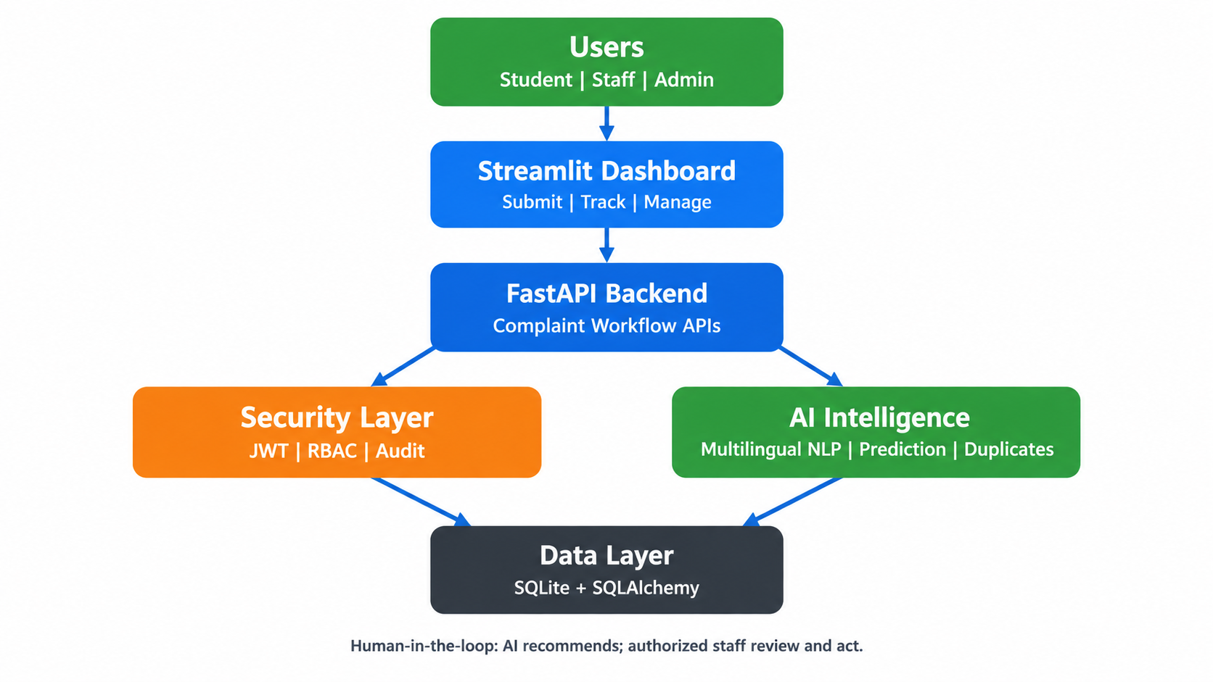
CampusResolve-AI
Pipeline structure

