Slide 1


M.Tech Program
Advanced Industry Integrated Programs
Jointly offered by University and LTIMindTree
Review III, 08.10.2026
CampusResolve-AI: A Multilingual Explainable Complaint Intelligence System with Duplicate Detection, Priority Forecasting, and Resolution-Time Prediction
PREMKUMAR S
251011012
T9964
Knowledge partner | Implementation partner

Slide 2
CampusResolve-AI
Introduction
Campus complaints are often reported through disconnected and manual channels.
Manual routing can delay action, reduce visibility, and create inconsistent priority decisions.
Students need a simple way to report and track issues in English, Tamil, or Tamil-English.
Staff need one operational workspace to review, assign, update, and close complaints.
CampusResolve-AI provides multilingual, AI-assisted complaint triage with Staff-controlled decisions.
Student Complaint
AI Recommendation
Staff Review
Resolution Tracking

Slide 3
CampusResolve-AI
Project Objectives
1. Provide secure complaint submission and tracking for Students. | 4. Identify potential duplicate complaints using semantic similarity.
2. Support English, Tamil, and Tamil-English complaint descriptions. | 5. Provide Staff with role-based workflow controls for assignment, notes, escalation, and closure.
3. Recommend complaint category, responsible department, priority, and resolution-time estimate. | 6. Maintain status history and impact-verification records for accountability.
Student:
Report and Track
AI:
Recommend and Flag
Staff:
Verify and Resolve

Slide 4
CampusResolve-AI
Core Modules
Student Complaint Portal
Authenticated complaint submission and complaint-reference tracking.
Priority and Resolution Estimation
Suggests urgency level and estimated resolution duration.
Multilingual AI Analysis
Interprets English, Tamil, and Tamil-English complaint text.
Duplicate Detection
Flags semantically similar historic complaints for Staff review.
Complaint Routing
Recommends complaint category and responsible department.
Staff Operations Workspace
Supports queue management, updates, notes, escalation, and impact verification.
Report
Analyse
Route
Prioritize
Review
Resolve

Slide 5
CampusResolve-AI
Problem Statement
• Manual complaint handling can cause delays and incorrect routing.
• Similar campus issues may be reported repeatedly in different wording.
• Students have limited visibility into complaint status and progress.
• Staff need a unified system to prioritize, track, and resolve complaints.
• CampusResolve-AI provides secure, AI-assisted complaint management with Staff-controlled decisions.
Unstructured Complaint
Manual Interpretation
Delayed / Incorrect Routing
Repeated Reports
Limited Tracking and Accountability

Slide 6
CampusResolve-AI
CampusResolve-AI Workflow
1. Student logs in and submits a complaint with location, impact, and safety information.
2. The backend preprocesses the complaint text and operational inputs.
3. AI models recommend category, department, priority, and resolution-time estimate.
4. Semantic similarity search checks historic complaints for possible duplicates.
5. Staff review recommendations, assign responsibility, update status, and add notes.
6. The system preserves complaint status history and one final impact-verification record.
Student Login
Complaint Submission
AI-Assisted Analysis
Duplicate Similarity Check
Staff Review and Assignment
Status Update and Impact Verification
AI provides recommendations; Staff retain final operational authority.

Slide 7
CampusResolve-AI
Approach, Algorithms, and Tools
Approach:
• Text and operational-context analysis for complaint triage.
• Supervised machine-learning models for category and priority recommendation.
• Regression model for estimated resolution time.
• Sentence Transformer embeddings for semantic complaint representation.
• FAISS similarity search for potential duplicate detection.
• JWT authentication and role-based access control for secure workflows.

Slide 8
CampusResolve-AI
Approach, Algorithms, and Tools
Tools:
Python • FastAPI • Streamlit • SQLite • SQLAlchemy
scikit-learn • Sentence Transformers • FAISS • Pandas • Plotly
JWT • Argon2 Password Hashing • Docker Compose
Streamlit Dashboard
FastAPI Backend
SQLite Database
ML Models + FAISS Index

Slide 9
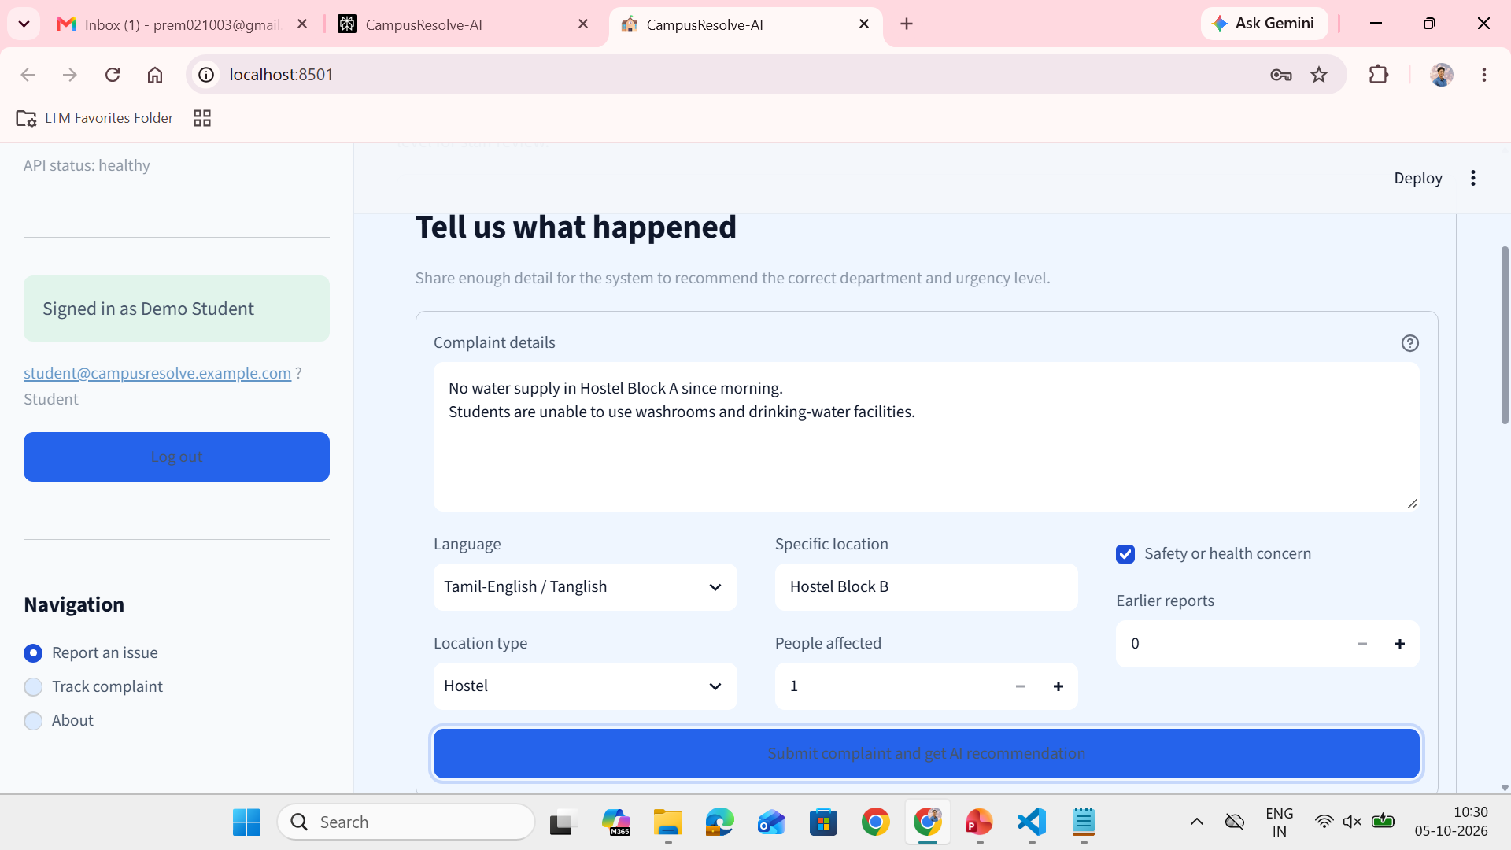
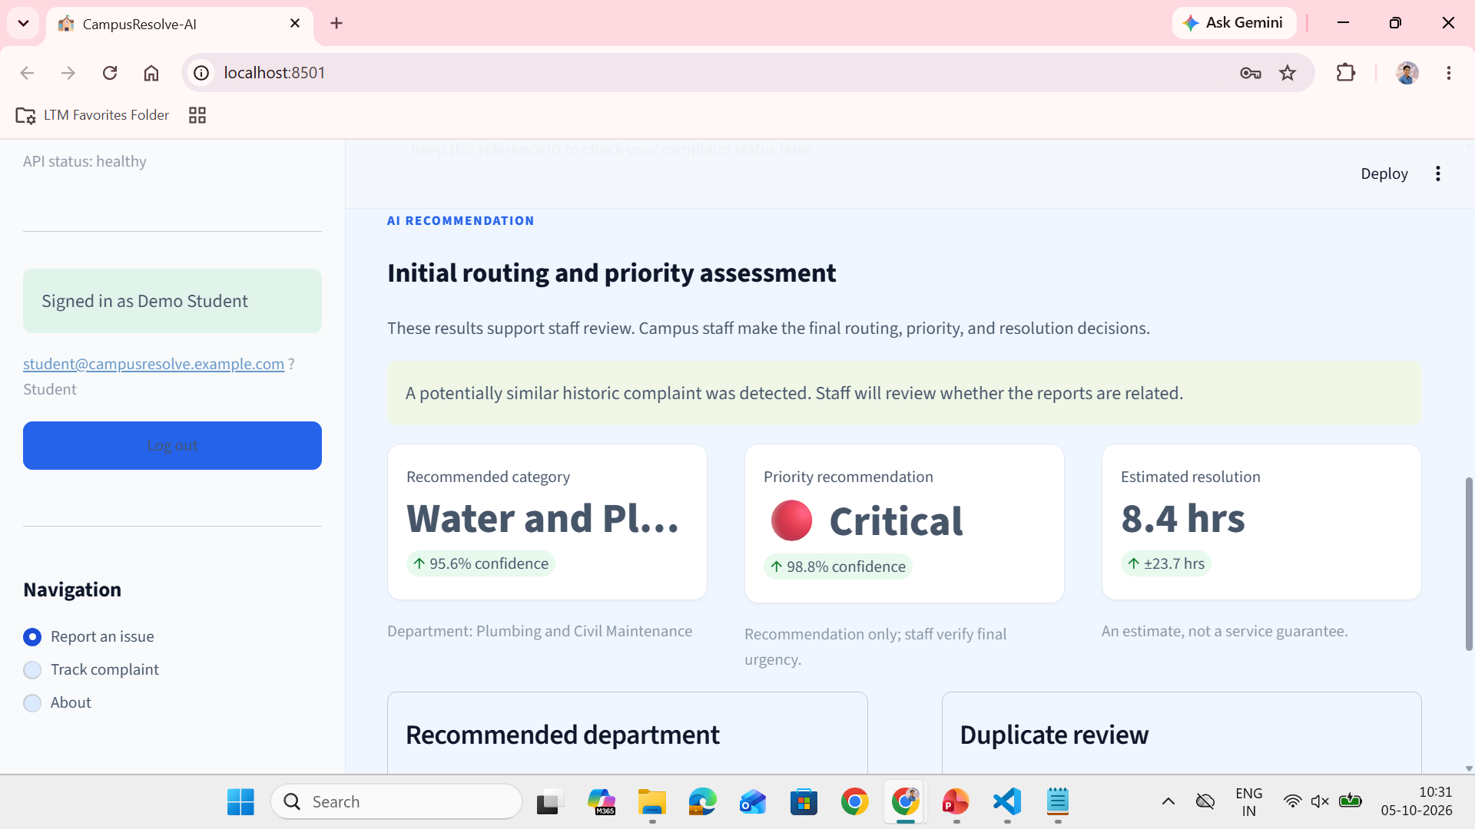
CampusResolve-AI
Findings and Results
Students can securely submit complaints and receive transparent AI-assisted routing and tracking information.

Slide 10
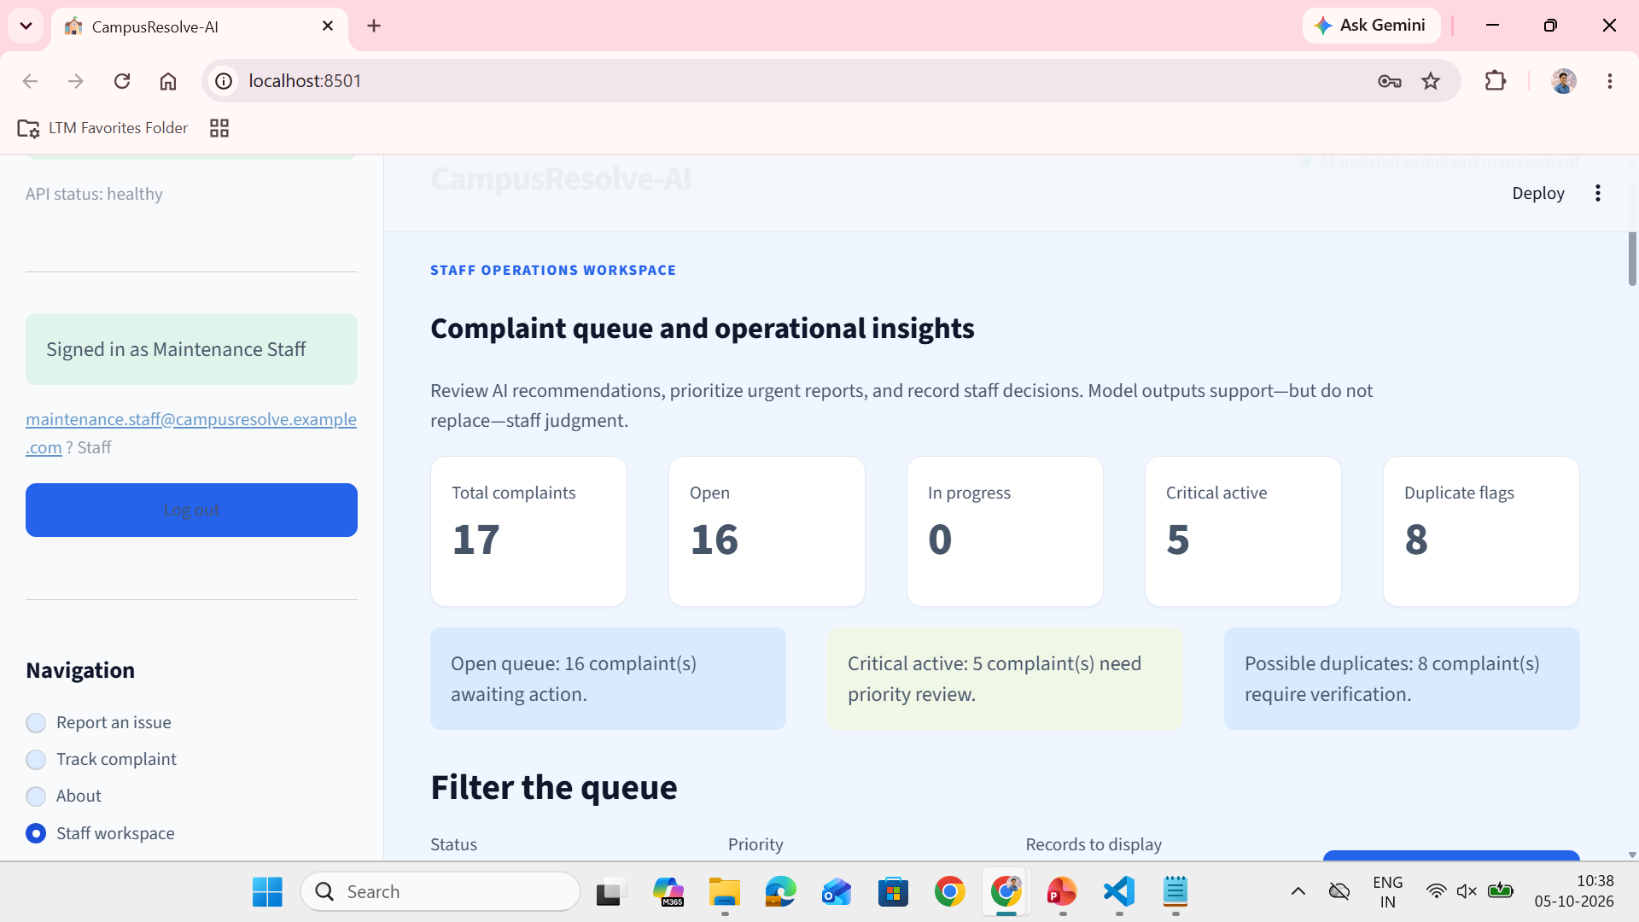
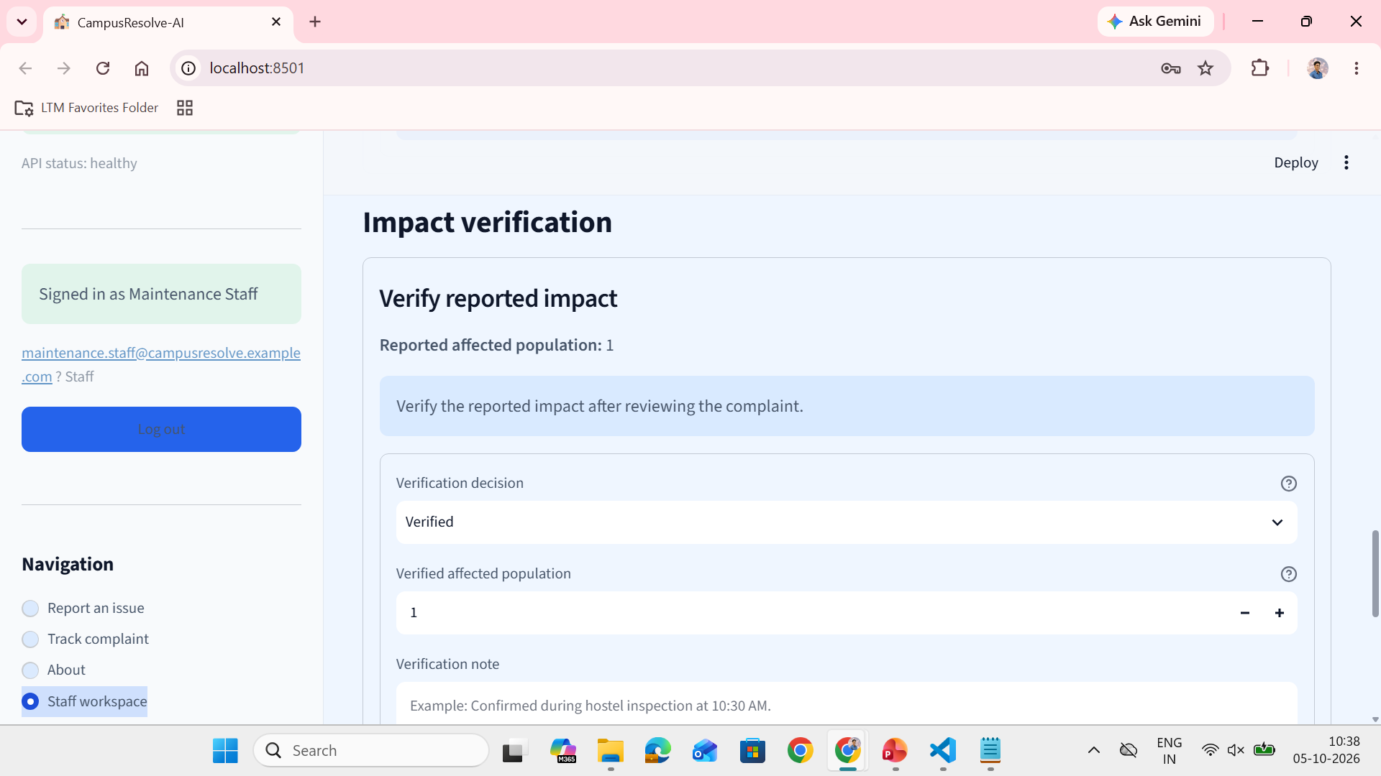
CampusResolve-AI
Findings and Results
Staff validate recommendations, manage complaint status, and preserve accountable operational records.

Slide 11
CampusResolve-AI
Validation Summary
88 Passed
Automated Tests
Automated Test Suite 88 automated tests passed. | Docker Compose Validation API and Dashboard run as separate services.
Local Application Validation FastAPI backend and Streamlit dashboard validated. | Health and Persistence • API health check coordinates startup. • SQLite data persists through a named Docker volume.
API Documentation Swagger/OpenAPI documentation available at /docs.
Docker Compose
Container Validation
FastAPI + Streamlit
Local Validation
Validation confirms implemented software workflows; model performance should be continuously evaluated with broader real campus data.

Slide 12
CampusResolve-AI
Conclusion
• CampusResolve-AI converts complaint handling into a secure, multilingual, and traceable digital workflow.
• Students can report and track issues through an authenticated portal.
• AI-assisted recommendations support routing, prioritization, duplicate detection, and resolution planning.
• Staff retain final authority to verify, assign, update, escalate, and close complaints.
• Status history and impact verification provide an auditable operational record.
AI-assisted triage improves campus complaint coordination while preserving Staff accountability.

Slide 13
CampusResolve-AI
Limitations and Future Work
Limitations
Model quality depends on available training data and labeling quality.
Duplicate detection flags possible matches; it does not automatically merge complaints.
SQLite is suitable for an academic prototype and small deployments.
Current language support focuses on English, Tamil, and Tamil-English.
Future work
Add more Indian languages and stronger code-mixed language support.
Integrate SMS, email, and WhatsApp notifications.
Add SLA tracking, departmental analytics, and workload forecasting.
Deploy with PostgreSQL, cloud hosting, CI/CD, monitoring, and secure secret management.

Slide 14
CampusResolve-AI
Acknowledgement
I sincerely thank Dr. Prasannakumari V, Professor, Department of Information Technology, Rajalakshmi Engineering College, for her valuable guidance and support throughout this project.
I also extend my sincere gratitude to Dr. Ganesa Ramachandran Arunachalam, L&T EduTech, Chennai, and all the classroom teachers and faculty members for their guidance, teaching, encouragement, and support.
Thank You
Questions and Discussion

Slide 15
CampusResolve-AI
Reference
[1] H. M. Mohamed, A. H. Mohamed, S. O. Hashi, H. N. Hassan, K. A. Barre, and B. A. Ahmed, “Automated University Complaint Management System by Leveraging Machine Learning and Natural Language Processing for Enhanced Efficiency and Accuracy,” Forum for Linguistic Studies, vol. 7, no. 2, 2025. doi: 10.30564/fls.v7i2.8162.
[2] N. Reimers and I. Gurevych, “Sentence-BERT: Sentence Embeddings using Siamese BERT-Networks,” Proceedings of EMNLP-IJCNLP, pp. 3982–3992, 2019.
doi: 10.18653/v1/D19-1410.

Slide 16
CampusResolve-AI
Reference
[3] Meta AI, “FAISS: A Library for Efficient Similarity Search and Clustering of Dense Vectors,” FAISS Documentation, 2026.
[4] FastAPI, “FastAPI Documentation: Features and Automatic OpenAPI Documentation,” FastAPI Project, 2026.
[5] Streamlit, “Streamlit Documentation,” Streamlit Inc., 2026.
[6] Docker, “Docker Compose Documentation,” Docker Docs, 2026.
[7] OpenAPI Initiative, “OpenAPI Specification,” Linux Foundation, 2025.

