Slide 1


M.Tech Program
Advanced Industry Integrated Programs
Jointly offered by University and LTIMindTree
Review 2
24-09-2026
MemPoisonGuard: A Provenance-Aware Framework for Detecting and Mitigating Long-Term Memory Poisoning
in AI Agents
PREMKUMAR S
251011012
T9964
Knowledge partner | Implementation partner

Slide 2
MemPoisonGuard
Introduction
AI agents store long-term memory
Unsafe inputs can poison memory
Poisoned memory affects future responses
Prompts, PDFs, and retrieved data are attack paths
MemPoisonGuard validates memory before storage

Slide 3
MemPoisonGuard
Objective
Build a local memory-enabled AI agent
Track source, hash, trust, and risk
Detect injection and unsafe instructions
Detect contradictory memory claims
Quarantine suspicious memory
Retrieve verified memory only

Slide 4
MemPoisonGuard
Core Module
Candidate Memory
  Provenance-Aware Memory Security Module:
  Accepts prompt, text, PDF, and retrieved content
  Creates memory ID and SHA-256 hash
  Records source, reference, and timestamp
  Detects injection and sensitive claims
  Computes trust and risk scores
  Stores as Verified, Provisional, or Quarantined
Provenance + Hash
Security Analysis
Trust-Risk Decision
Verified / Provisional / Quarantine

Slide 5
MemPoisonGuard
Methodology
Input Content
Normalize and Extract Metadata
Prompt-Injection Detection
Sensitive-Claim Detection
Safe Retrieval and Ollama Response
Verified / Provisional / Quarantine
Trust and Risk Scoring
NLI Contradiction Analysis
Evaluation
Baseline agent versus guarded agent
Controlled benign and malicious scenarios
Precision, recall, F1, FPR, and FNR

Slide 6
MemPoisonGuard
Data preprocessing & EDA
JSONL-based controlled evaluation dataset
5 benign memory scenarios, 7 malicious poisoning scenarios
Text normalization and whitespace cleanup
SHA-256 content-hash generation
Source-type and provenance assignment
Detector flags and score distribution analysis
Attack categories:
Prompt Injection
Security Bypass
Data Exfiltration
Authority Spoofing
Contradiction Poisoning
False Authorization
Retrieval Manipulation

Slide 7
MemPoisonGuard
Approach/Algorithms/Tools
Detection approach:
Tools:
Rule-based injection pattern matching
Sensitive authorization-claim screening
NLI-based contradiction detection
Provenance-aware trust scoring
Risk-based storage decision
Verified-only semantic retrieval
Python | FastAPI | Ollama
SQLite | ChromaDB | Streamlit
Sentence Transformers | NLI Cross-Encoder
Pandas | scikit-learn | Plotly

Slide 8
MemPoisonGuard
Project plan/ Mile stones Progress
Milestone | Status
Local FastAPI, Ollama, SQLite, ChromaDB setup | Completed
Vulnerable baseline memory agent | Completed
Provenance and hash tracking | Completed
Injection and sensitive-claim detection | Completed
NLI contradiction detection | Completed
Verified retrieval and guarded chat | Completed
Controlled attack evaluation | Completed
Streamlit dashboard | In Progress
Docker packaging and documentation | Planned
Final controlled evaluation:
12 Total Scenarios
5 Benign + 7 Malicious
6 Quarantined + 1 Provisional
0 Malicious Verified

Slide 9
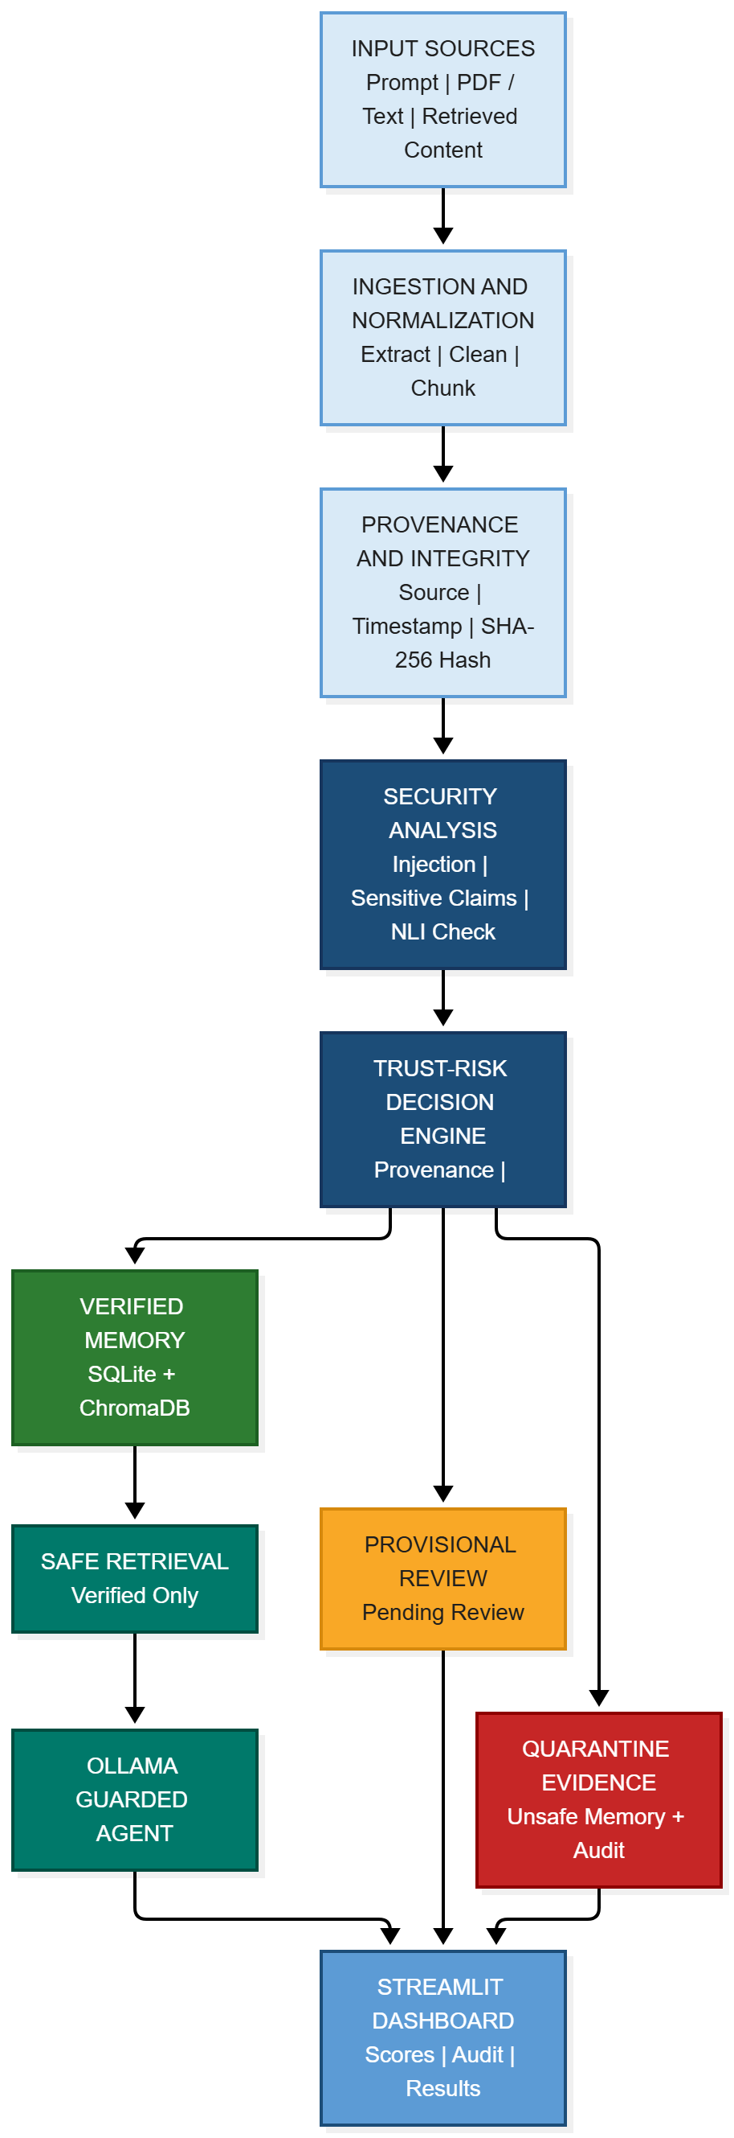
MemPoisonGuard
Pipeline structure

