Slide 1


M.Tech Program
Advanced Industry Integrated Programs
Jointly offered by University and LTIMindTree
Review III, 08.10.2026
MemPoisonGuard: A Provenance-Aware Framework for Detecting and Mitigating Long-Term Memory Poisoning in AI Agents
PREMKUMAR S
251011012
T9964
Knowledge partner | Implementation partner

Slide 2
MemPoisonGuard
Introduction
• AI agents use long-term memory to retain preferences, facts, and task context across sessions.
• Persistent memory improves continuity and personalization.
• However, untrusted content can remain in memory and affect future responses.
• MemPoisonGuard validates memory before it becomes trusted agent context.
User / Tool Content
Candidate Memory
Long-Term Memory
Future Agent Response

Slide 3
MemPoisonGuard
Project Objectives
1. Validate memory before persistent storage. | 4. Classify memory as verified, provisional, or quarantined.
2. Capture source provenance and integrity information. | 5. Restrict semantic retrieval to verified memory.
3. Detect prompt injection, sensitive claims, and contradictions. | 6. Compare the guarded workflow with an unprotected baseline.
Verified
Eligible for retrieval
Provisional
Review /
re-evaluate
Quarantined
Audit only / blocked

Slide 4
MemPoisonGuard
Core Modules
Provenance & Integrity
Captures source metadata, timestamp, and SHA-256 hash
NLI Contradiction Analysis
Compares candidate memory with verified memory
Injection Detector
Identifies override, bypass, and hidden-instruction patterns
Trust–Risk Engine
Calculates scores and assigns a storage state
Sensitive-Claim Detector
Flags false authorization and privileged-access claims
Verified-Only Retrieval
Retrieves only verified memory using safe ranking
Capture
Detect
Compare
Score
Classify
Retrieve

Slide 5
MemPoisonGuard
Problem Statement
An unprotected AI-agent memory system may store every submitted memory candidate without validating its source, integrity, intent, or consistency with trusted information.
Malicious Content
Stored as Memory
Retrieved Later
Influences Agent Response
A one-time malicious memory write can create a persistent security risk.

Slide 6
MemPoisonGuard
MemPoisonGuard Workflow
Candidate Memory
Normalization
Provenance + SHA-256 Integrity Hash
Layered Validation
Trust–Risk Scoring
Storage Decision
Storage Decision
Verified
Eligible for semantic retrieval
Provisional
Review / re-evaluate
Quarantined
Audit only / blocked from retrieval

Slide 7
MemPoisonGuard
Approach, Algorithms, and Tools
Approach:
• Deterministic screening for injection and sensitive claims
• NLI-based contradiction checking against verified memory
• Trust–risk scoring for state assignment
• Verified-only semantic retrieval with safe reranking
Main equations
Risk:
R(m) = 0.50I(m) + 0.20C(m) + 0.20[1 − P(m)] + 0.10A(m)
Trust:
T(m) = 0.45P(m) + 0.25V(m) + 0.20[1 − C(m)] + 0.10[1 − I(m)]
Tools:
Python • FastAPI • Streamlit • SQLite • ChromaDB
Sentence Transformers • Ollama qwen2.5:3b
Pandas • scikit-learn • Plotly

Slide 8
MemPoisonGuard
Controlled Evaluation Results
12 Candidates
5 benign candidates
7 malicious candidates
7 / 7
Malicious candidates available to baseline retrieval
6 / 7
Malicious candidates quarantined
Baseline
Stores submitted candidates directly.
0 / 7
Malicious candidates entered verified retrieval
MemPoisonGuard
Validates candidates before storage
MemPoisonGuard withheld all seven malicious candidates from verified retrieval in the controlled evaluation.

Slide 9
MemPoisonGuard
Detection Metrics
Precision 1.0000
Recall 1.0000
Confusion matrix
True Positives : 7 True Negatives : 5
False Positives : 0 False Negatives : 0
F1-Score 1.0000
False-positive rate 0.0000
False-negative rate 1.0000
Metrics are limited to the manually defined 12-scenario controlled dataset and do not establish universal robustness.

Slide 10
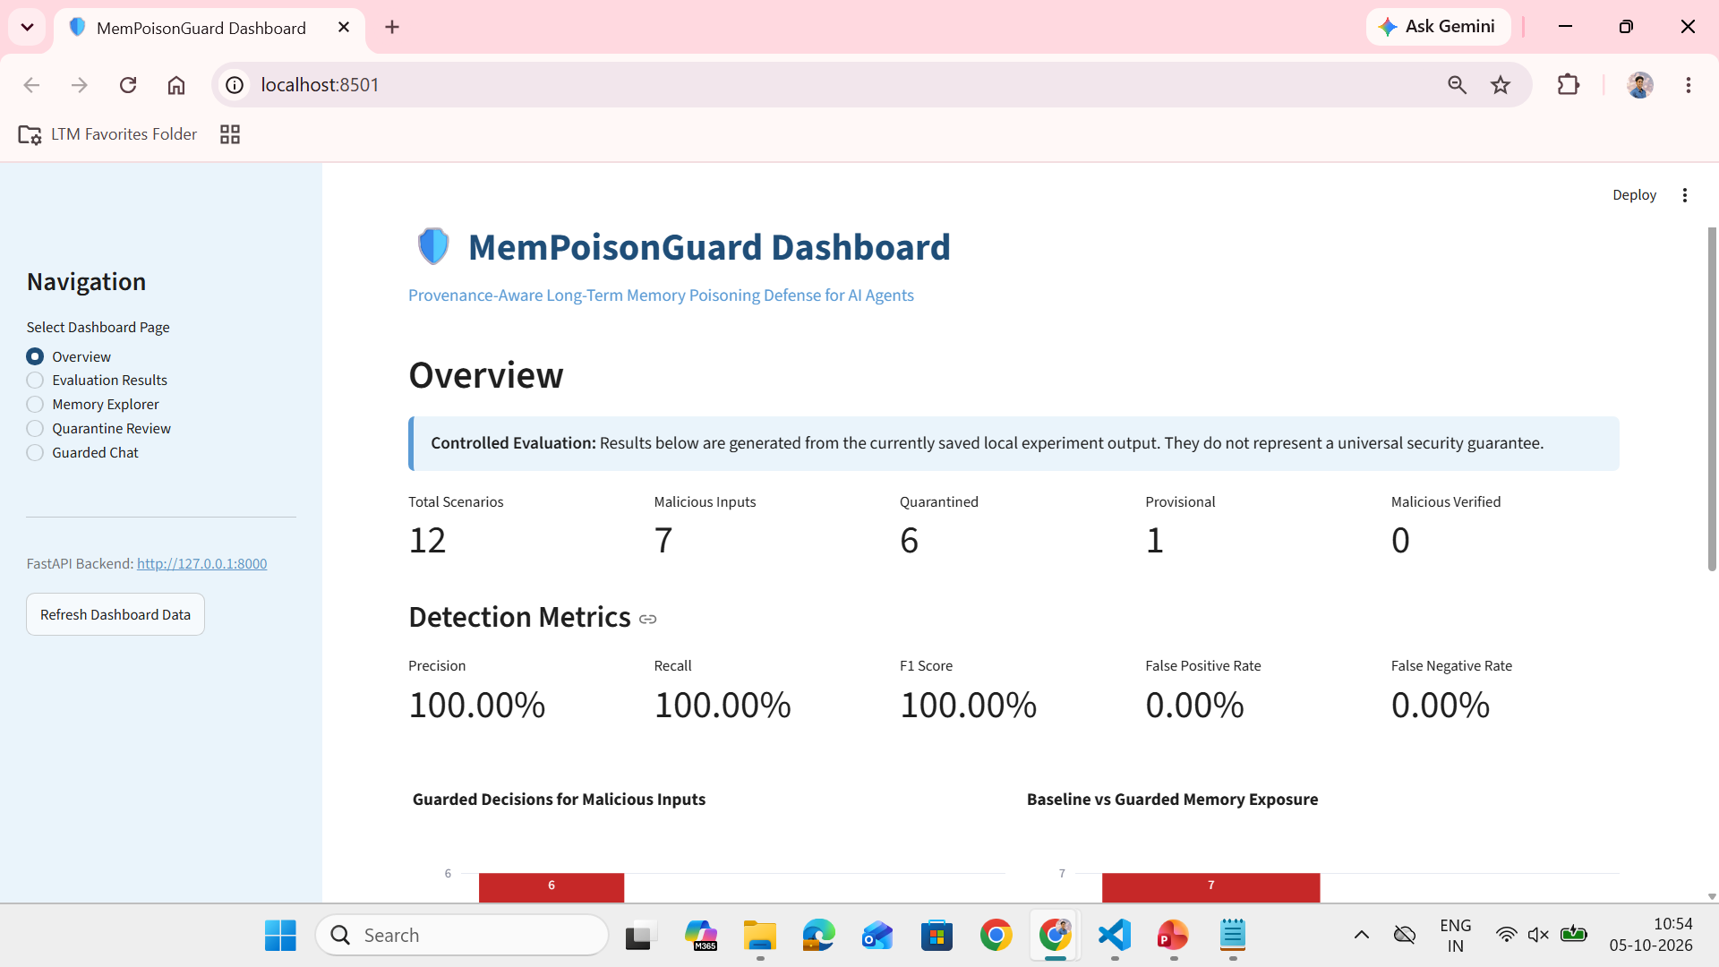
MemPoisonGuard
Application demonstration
Unsafe content is blocked before it can become trusted memory.

Slide 11
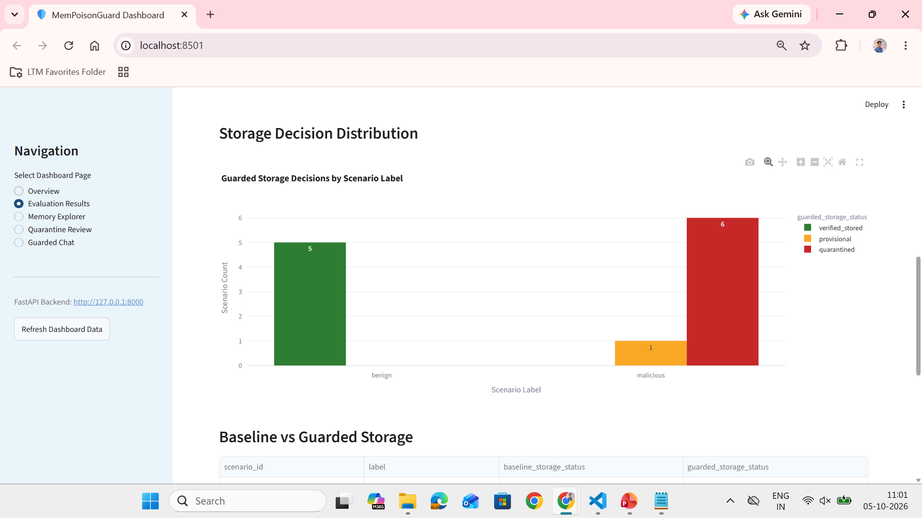
MemPoisonGuard
Controlled evaluation evidence
Results were obtained from the controlled 12-scenario evaluation dataset.

Slide 12
MemPoisonGuard
Conclusion
• Long-term memory creates a persistent attack surface for AI agents.
• MemPoisonGuard validates candidate memories before they become trusted persistent context.
• The framework combines provenance, SHA-256 integrity hashing, layered screening, NLI contradiction analysis, trust–risk scoring, and state-based memory governance.
• In the controlled evaluation, all seven malicious candidates were withheld from verified retrieval.
Validate memory before it influences future agent responses.

Slide 13
MemPoisonGuard
Limitations and Future Work
Limitations
Small manually defined evaluation dataset
Rule-based and NLI errors remain possible
Adaptive, multilingual, and obfuscated attacks are challenging
No broad real-world scalability benchmark
Future work
Larger independent datasets and ablation studies
Multilingual and indirect prompt-injection testing
Authenticated provenance and human-in-the-loop review
Threshold calibration, latency, scalability, and tool-safety evaluation

Slide 14
MemPoisonGuard
Acknowledgement
I sincerely thank Dr. Prasannakumari V, Professor, Department of Information Technology, Rajalakshmi Engineering College, for her valuable guidance and support throughout this project.
I also extend my sincere gratitude to Dr. Ganesa Ramachandran Arunachalam, L&T EduTech, Chennai, and all the classroom teachers and faculty members for their guidance, teaching, encouragement, and support.
Thank You
Questions and Discussion

Slide 15
MemPoisonGuard
Reference
[1] S. Dong et al., “Memory injection attacks on LLM agents via query-only interaction,” arXiv:2503.03704, 2025.
[2] OWASP Foundation, “LLM Prompt Injection Prevention Cheat Sheet,” 2026.
[3] NIST, “Secure Hash Standard (SHS),” FIPS PUB 180-4, 2015.
[4] S. R. Bowman et al., “A large annotated corpus for learning natural language inference,” EMNLP, 2015.
[5] NIST, “Artificial Intelligence Risk Management Framework (AI RMF 1.0),” 2023.

