Slide 1
NAME : PREMKUMAR P
Regd No : 2428C0500
NMID :
COURSE : B.Sc. AI&ML
COLLEGE : KPR College of Arts Science and Research,
Coimbatore.

Slide 2
Fashion Designer Digital Portfolio (Using HTML, CSS, JavaScript)

Slide 3
AGENDA
Problem Statement
Project Overview
End Users
Tools and Technologies
Portfolio design and Layout
Features and Functionality
Results and Screenshots
Conclusion
Github Link
3/21/2024 Annual Review

Slide 4
PROBLEM STATEMENT
Traditional resumes are static and lack interactivity.
Recruiters prefer a modern, engaging portfolio over plain text.
Difficulty in showcasing projects, skills, and achievements in a creative way.
Need for a personalized digital space to highlight professional identity.

Slide 5
PROJECT OVERVIEW
A fashion designer digital portfolio website built using HTML, CSS, and JavaScript.
Provides an interactive way to showcase About Me, Projects, Skills, and Contact.
Designed to be simple, beginner-friendly, and responsive.
Can be easily extended with more sections or styles.

Slide 6

WHO ARE THE END USERS?
Students – to display projects and skills.
Job seekers – to share resumes and achievements online.
Freelancers/Developers – to showcase their work to clients.
Recruiters/Employers – to quickly evaluate candidate profiles.

Slide 7
TOOLS AND TECHNIQUES
HTML5 – structure and content of the portfolio.
CSS3 – styling, colors, and layout.
JavaScript – interactivity (e.g., alert on form submission).
Browser – Chrome/Edge/Firefox to run the project.
GitHub – version control & hosting.
VS Code – editor used for coding.

Slide 8
PORTFOLIO DESIGN AND LAYOUT
Header Section → Title + Navigation Menu.
About Me Section → Short introduction.
Project Section → Two sample project boxes.
Skills Section → List of skills (HTML, CSS, JS).
Contact Section → Simple contact form.
Footer → Copyright information.
8

Slide 9
FEATURES AND FUNCTIONALITY
Navigation links to different sections.
Responsive two-column project layout.
Skills displayed in neat boxes.
Contact form with Name, Email, Message.
JavaScript alert on form submission.
Beginner-friendly, easy to edit and update.

Slide 10
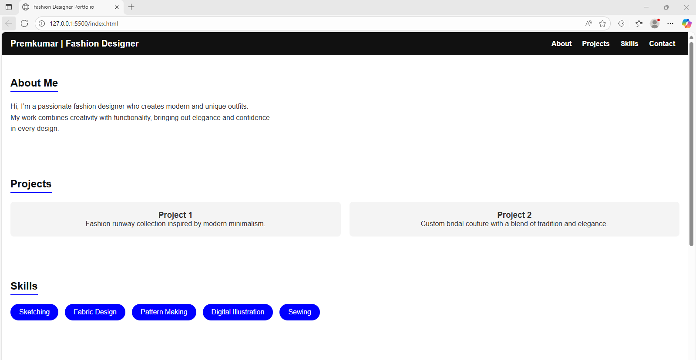
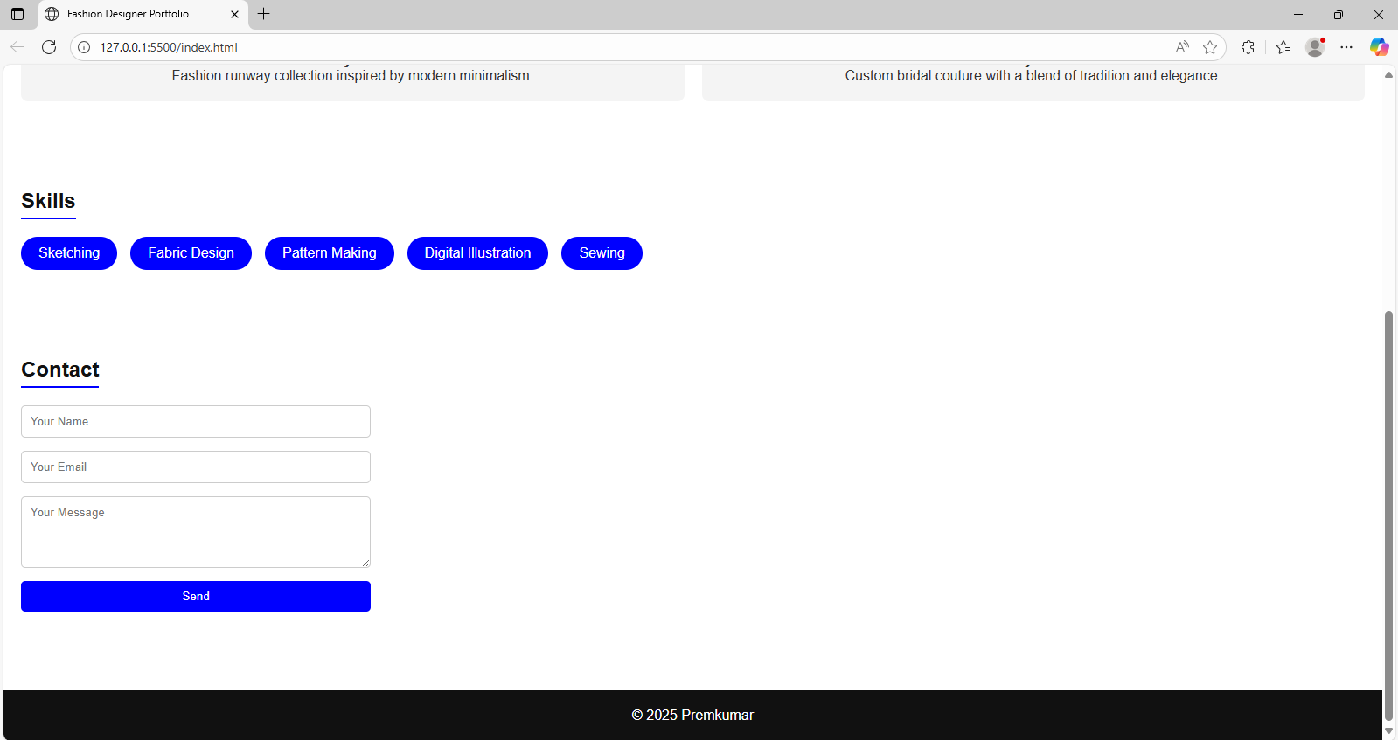
RESULTS AND SCREENSHOTS
A simple and interactive fashion designer portfolio website created using HTML, CSS, and JavaScript.
Well-structured sections such as Header, About Me, Projects, Skills, Contact, and Footer.
The portfolio is beginner-friendly, easy to update, and serves as a personal showcase of skills and projects.
10

Slide 11
CONCLUSION
Created a working digital portfolio using HTML, CSS, JS.
Helps in personal branding and career opportunities.
Easy to maintain and expand in the future.
Provides a base for learning web development fundamentals.
11

Slide 12
GITHUB LINK
https://github.com/prem19-wq/prem-nm.git

