Slide 1
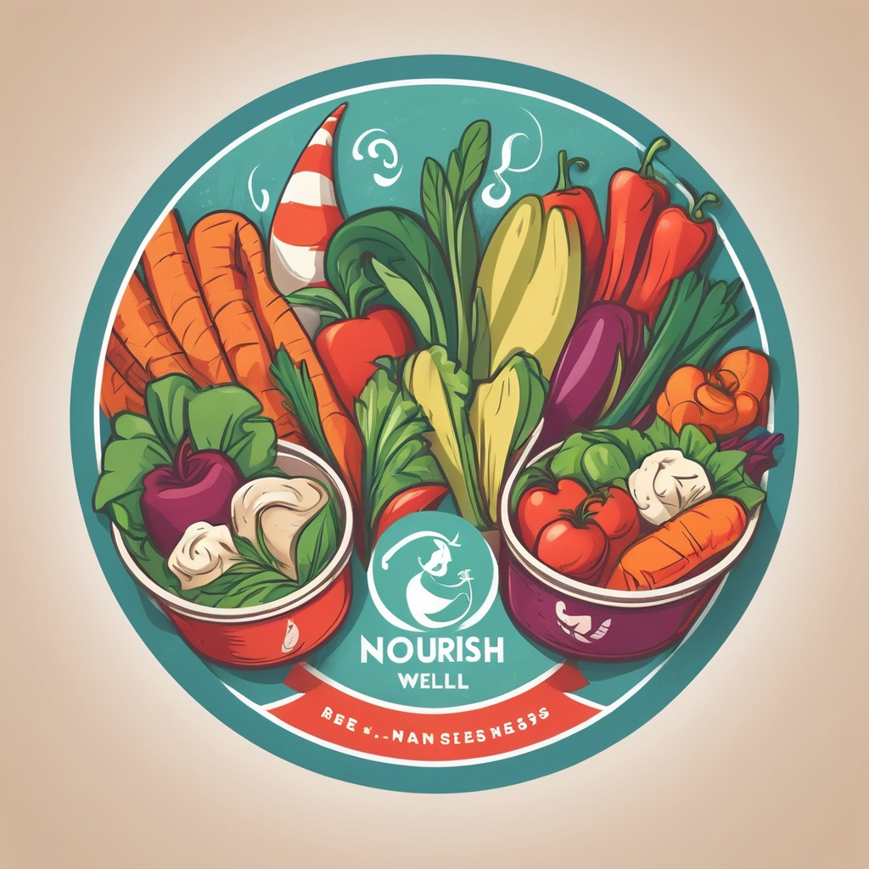
NourishWell: Revolutionizing Meal Prep
Created by
Status200

Slide 2
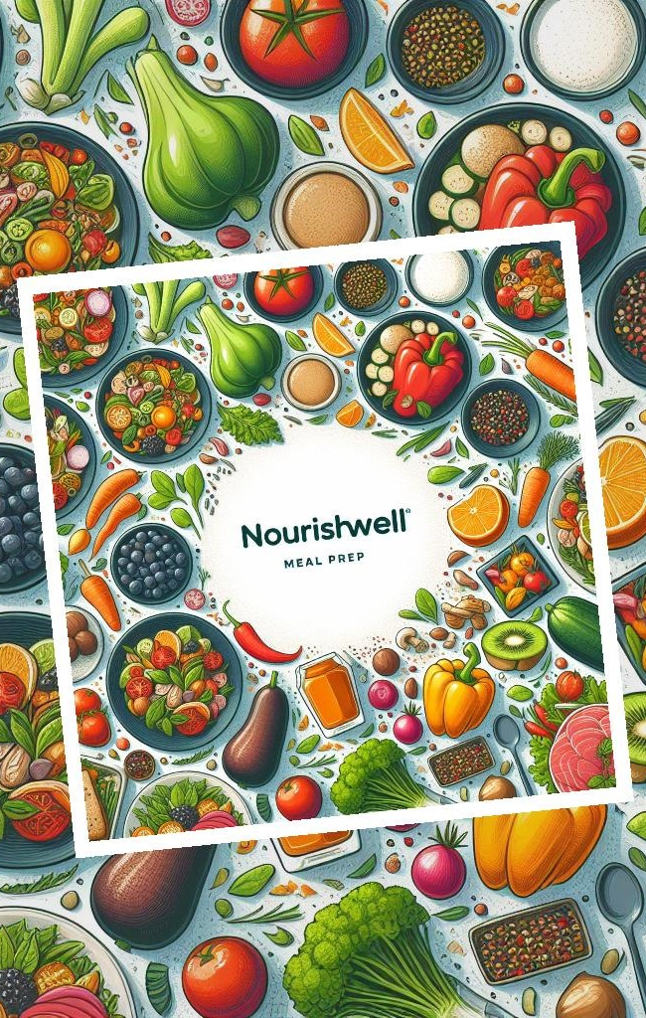
Problem Statement: Challenges Addressed by NourishWell
1. Lack of time to prepare healthy meals at home.
2. Difficulty in finding affordable and nutritious food options.
3. Limited customizability in pre-packaged meals.
4. Uncertainty about calorie counts and nutritional information.
5. Inconvenience of meal planning and grocery shopping.
NourishWell solves these problems by providing fast, healthy, affordable, and customizable meal solutions with transparent calorie counts.

Slide 3
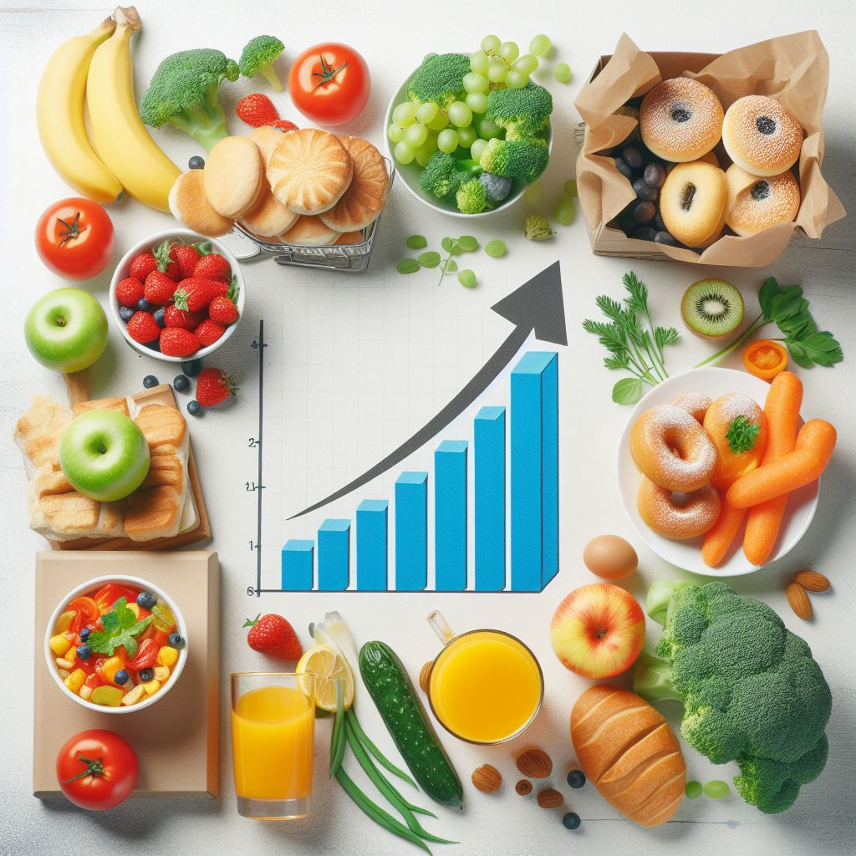
Market Demand for Healthy Pre-made Meals
Growing Demand
Convenience
The market for healthy pre-made meals is rapidly expanding as consumers increasingly prioritize convenience and health. This trend is fueled by busy lifestyles and a heightened awareness of the importance of balanced nutrition.
Consumers seek ready-to-eat meals that not only offer nutritional benefits but also save time and effort in meal preparation. This growing demand reflects a shift towards hassle-free, healthy eating options.

Slide 4
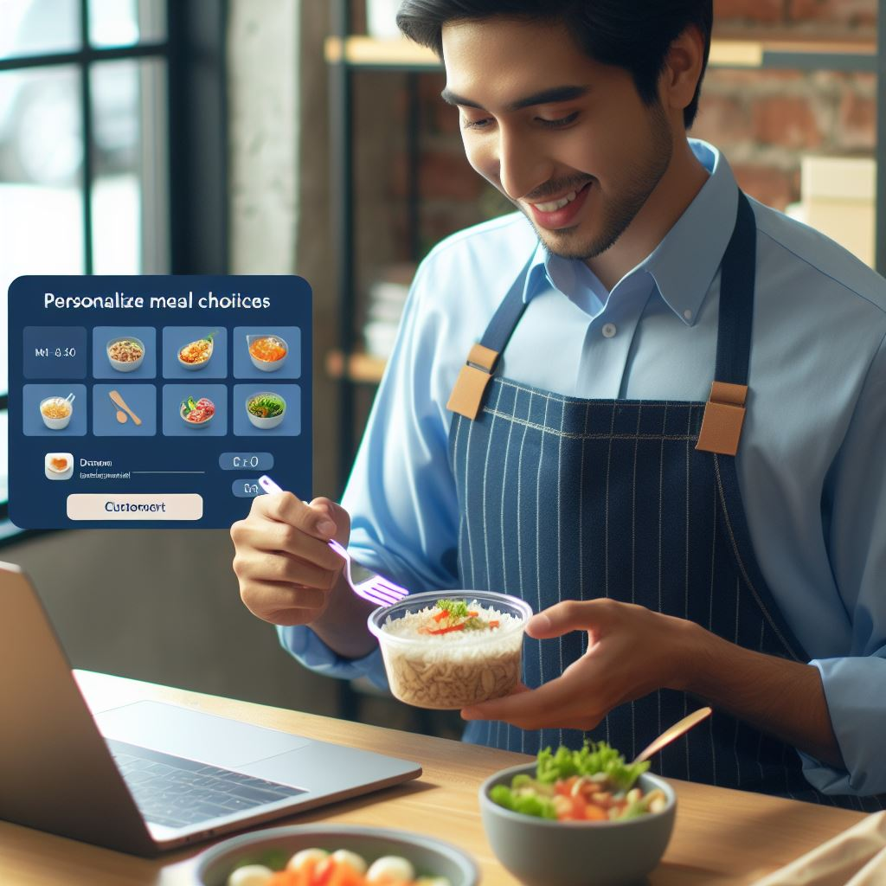
NourishWell's Unique Offerings
Diverse Range
Customization
NourishWell offers a diverse range of protein-rich and nutrient-dense meal options to cater to various dietary needs and preferences. From lean meats to plant-based dishes, there's something for everyone.
Customers can personalize their meal choices, including portion sizes and ingredient preferences. This customization ensures that individuals can tailor their meals to their specific nutritional goals.

Slide 5

Affordability & Accessibility
Convenient Locations
Affordable Pricing
NourishWell's strategically located outlets, in addition to delivery services, ensure widespread accessibility, making it easy for individuals to access nutritious meals regardless of their location or schedule.
NourishWell prioritizes affordability, making healthy eating accessible to a wider demographic. Through competitive pricing, customers can enjoy wholesome meals without overspending.
Photos provided by Pexels

Slide 6

Quality Ingredients & Nutritional Value
Premium Ingredients
Exceptional Nutrition
NourishWell prides itself on using premium, high-quality ingredients that are free from additives and preservatives. Each ingredient is carefully selected to ensure freshness and optimal nutritional value.
The meals are expertly crafted to deliver exceptional nutritional value, with a balance of macronutrients, vitamins, and minerals. The emphasis is on creating meals that not only taste great but also promote overall well-being.
Photos provided by Pexels

Slide 7

Customer Satisfaction & Testimonials
Positive Feedback
Testimonials
NourishWell has garnered an abundance of positive feedback from satisfied customers, highlighting the delicious flavors, convenience, and positive impact on their overall health and wellness.
Real customer testimonials underscore the transformative impact of NourishWell's meals on individuals' lifestyles, fostering a sense of trust and credibility in the brand.
Photos provided by Pexels

Slide 8
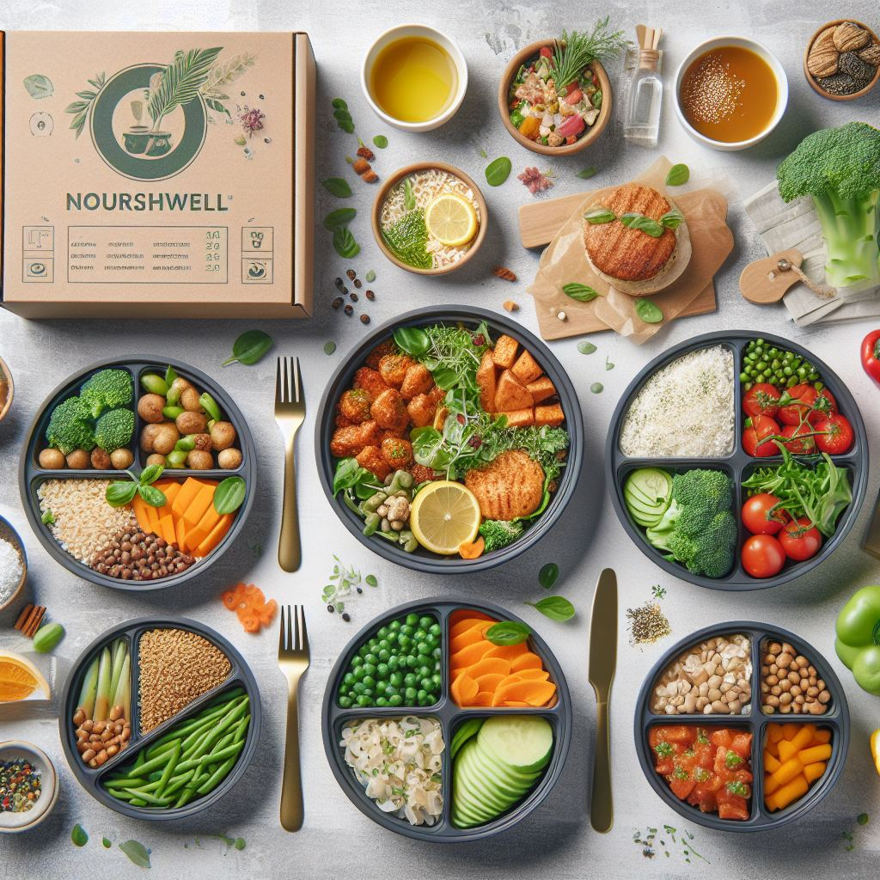
Why NourishWell Stands Out
Innovative Approach
NourishWell's innovative approach to meal prep integrates health, convenience, and sustainability, setting a new standard in the pre-made meal industry.
Holistic Well-being
NourishWell places a strong emphasis on nurturing holistic well-being, ensuring that each meal contributes to both physical and mental health while also supporting environmental stewardship.
Community Engagement
The company actively engages with the community, promoting education on nutrition, wellness, and sustainable living. This commitment goes beyond simply providing meals.

