Slide 1

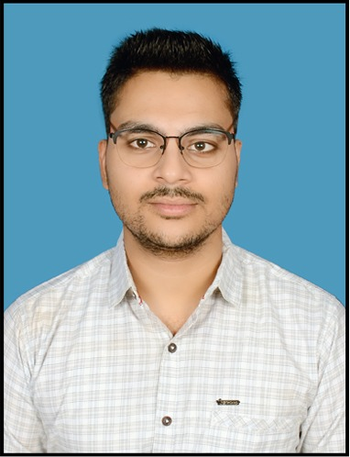

PREM KUMAR SOFTWARE DEVELOPER
+91 7979083191
prem.kumar15@infosys.com
Summary
A proactive team player with a proven track of meeting challenges under strict deadlines.
Experience in creating pixel perfect UI and high-quality user experience with Angular (7/9/12/13), HTML, SCSS.
Experience in creating Responsive User Interface (UI) across multiple browsers and multiple devices (mobile, tablet, laptop).
In-Depth awareness of cross-browser compatibility.
Experienced in Agile methodology.
Supported in estimation process using planning poker, T-shirt size techniques.
Experience in testing web applications.
Experience in creating different types of graphs using Amcharts.
Technical skills
Angular (7/9/12/13)
HTML5
CSS 3 | SCSS | SASS
JavaScript
TypeScript
Libraries
Angular Material | Prime ng
Bootstrap | Amcharts
Tools
Git | GitHub
Visual Studio Code
NPM
Qualification
Bachelor’s degree in Electronics and Communication Engineering from Oriental College of Technology, Bhopal.
Projects Summary
Client Quality Indicator
CQI is a tool which can be used to monitor the quality of different semi-conductor products manufactured across different platforms worldwide.
Roles and Responsibilities: Worked as an Angular developer, created Animation Line graphs to display the trend quality of different products. Enhanced the design of the application.
Technology Used: Angular 7, Bootstrap, SCSS, Angular Material, Amcharts.
BRENDA (Bug Records Enabled Debug Assistance)
It is an AI based application which is used to create summary of different types of bugs found by users during manufacturing and testing of processors. This application is used across different manufacturing platforms.
Roles and Responsibilities: Worked as an Angular developer, focused majorly on UI screen development. Built multiple pages to showcase data using various components like tables, graphs, cards.
Technology Used: Angular 12, Bootstrap, SCSS, Tailwind CSS, Angular Material.
OneValDashboard
This tool is used to create and monitor different test cases of semi-conductor devices where the Domain admin can configure data which the user needs to provide in the application.
Roles and Responsibilities: Analyzed client business requirements and developed the dashboard in the simplest way possible for great user experience.
Technology Used: Angular 7, Bootstrap, SCSS, Angular Material, MDB Bootstrap.

