Slide 1

Introduction to CasperJS

Slide 2

Hello!

Slide 3

What we will cover today

Slide 4

Outline
Overview
Installation
Up and running CasperJS with minimal Casper script
Web scraping with CasperJS
Scrape google news(trending)
Handle Javascript rendered sites
Event Handling

Slide 5
Outline
Advance concepts
Future Work

Slide 6

What is CasperJS?
CasperJS is an open source navigation scripting & testing utility written in JavaScript for the PhantomJS WebKit headless browser.

Slide 7
What is PhantomJS?
PhantomJS is a JavaScript API, headless browser used for automating web page interaction. Also enabling automated navigation, screenshots and user behavior.

Slide 8
Why CasperJS? (Features:)
Defining and ordering browser navigation steps
Filling and submitting forms
Clicking and following links
Capturing screenshot of a webpage or a part of the webpage.
Testing DOM
Downloading resources
Writing functional test cases

Slide 9

Installation
CasperJS
Download the CasperJS zip file from http://casperjs.org/
Unzip files in a folder “casperjs”
Add path of bin folder in System PATH variable like ;C:\casperjs\bin;
Check using casperjs --version
PhantomJS
Download the PhantomJS zip file from http://phantomjs.org/download.html
Unzip files in a folder “phantomjs”
Add path of bin folder in System PATH variable like ;C:\phantomjs\bin;
Check using phantomjs --version

Slide 10

Test CasperJs with Some example
Script with minimum Steps require in a casper module to run.

Slide 11
var casper = require('casper').create();
casper.start('https://www.google.com/', function(){
console.log("hello world");
});
casper.run()

Slide 12

Now lets do some Web scraping.
We will be scraping top headlines from google news and in next step we will visualize our data.

Slide 13
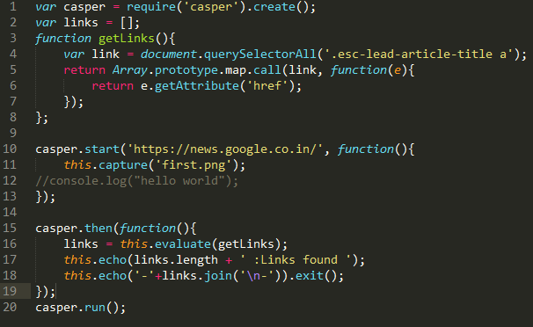

Slide 14

Some concepts
Selectors
CSS
Xpath
Client Scripts
We can inject some other scripts into the web page like jquery
Casper Configurations
Log level
User Agent
Page Settings
Load plugins

Slide 15
Dynamic Page rendering
CasperJS can handle dynamic web pages where date is coming from AJAX request

Slide 16
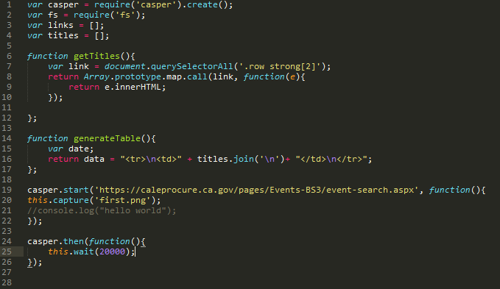

Slide 17
Event Handling
Fill forms
Click Events
Dropdown
Scrolling

Slide 18

Fill forms
Casper.fill(‘form#id’,
{values to fill},
true);

Slide 19
Event Chaining
Navigation Steps on the web page

Slide 20

Easy process
Fill form
Click buttons
Scrolling

Slide 21
Advance concepts
Handling Pagination
Parallel execution
Multiple urls in same module
back() , forward() and skip()
Integrate with jenkins
Download files

Slide 22

Thanks!
Any questions?

