Slide 1
Gauging Customer Satisfaction
TEAM V : Harshit Bishnoi, Ayush Gupta, Sidharth Jain, Pranshu Teckchandani

Slide 2
Current Challenge and Our Goal
Challenge
Analyse customer interaction transcript and algorithmically compute a customer satisfaction score.
Goal
Create a customer satisfaction scale, to understand the effectiveness of the customer support services

Slide 3
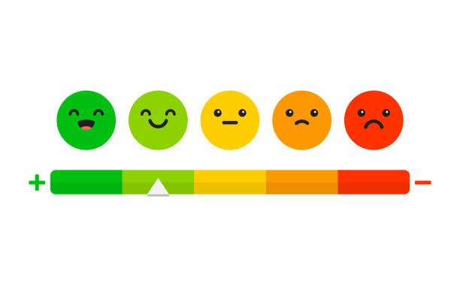
What makes for a Good Customer Experience?
Customer satisfaction is, being content with the services that have been rendered to them by a “service provider”,.
For a good customer experience a service should help the customer in a time efficient manner with maximum accuracy and resolve the issue at hand.

Slide 4

How does the average time vary across the dataset?
Average Run Time Analysis
Is the service able to keep the customer engaged?
Can it correctly identify the challenges of the customer ?
APPROACH
What is the accuracy of the solution provided by the service and is the customer satisfied by it?
Conversational flow
Problem Resolution

Slide 5
The Data Set
Customer Transcripts with the following information:
Timestamps
User Input Details
Chat type - Deflected/Live chat
Customer Service outputs
Machine internal codes for fixed states recognized by the customer service.

Slide 6
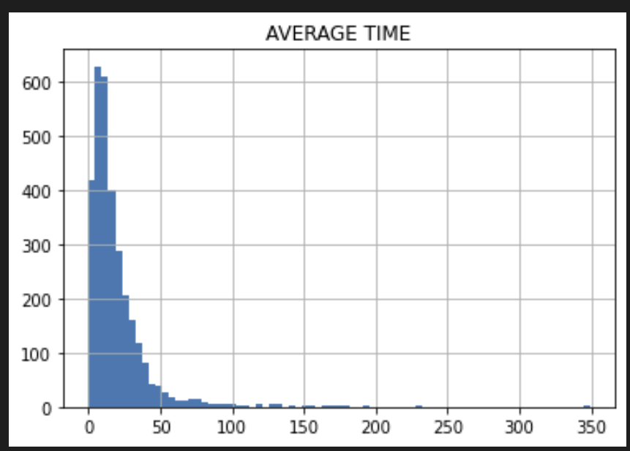
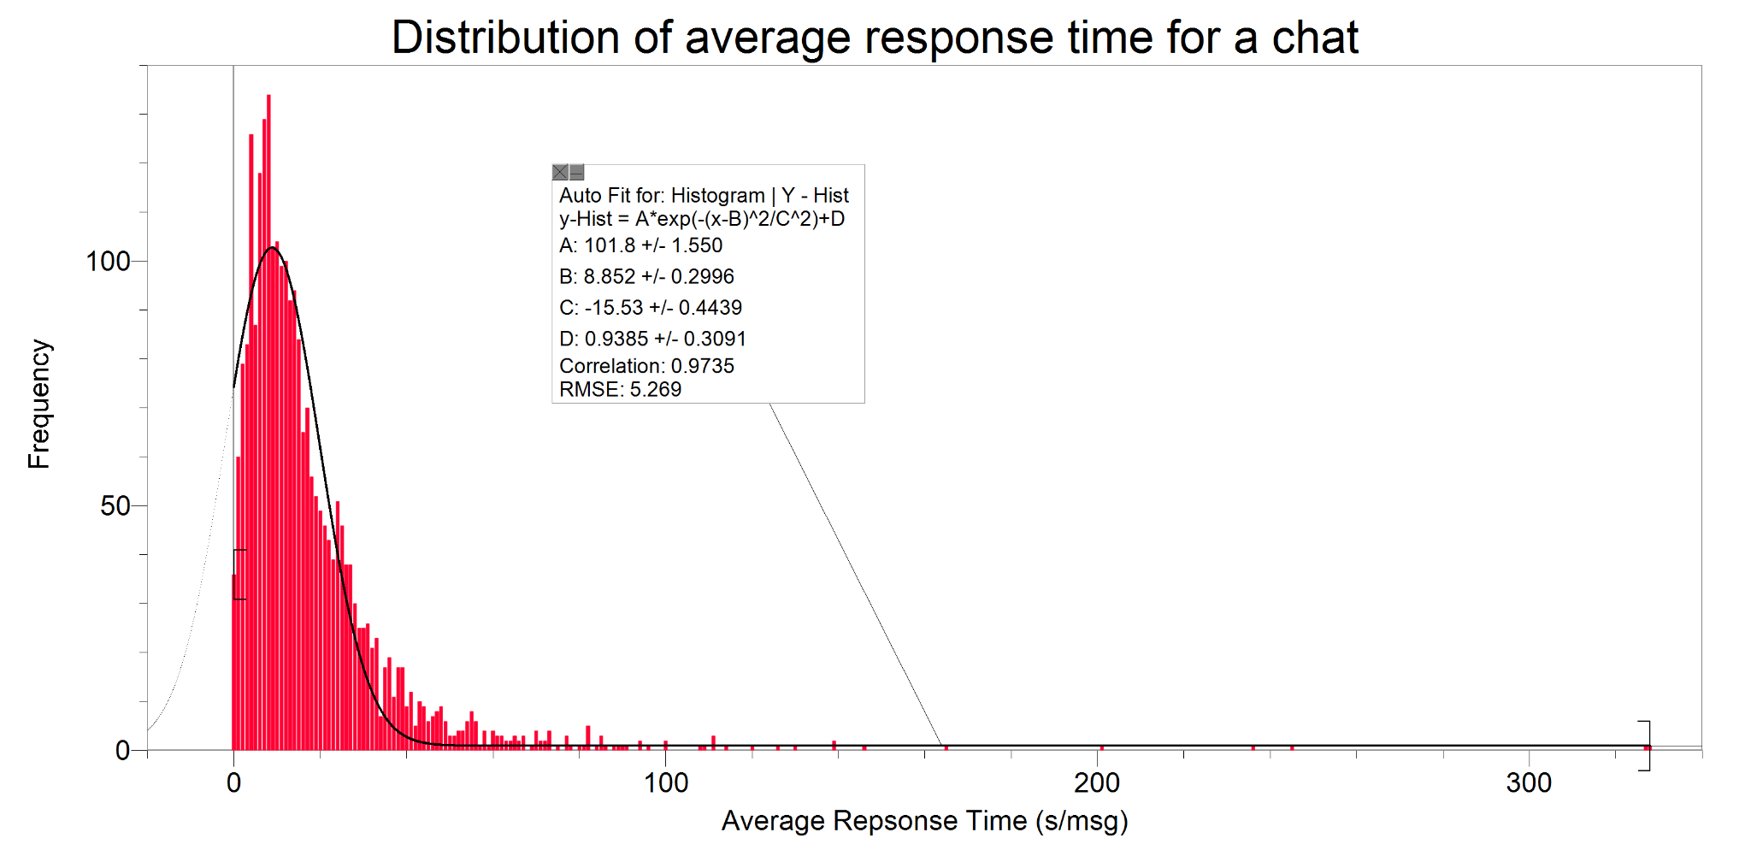
Average Response Time Analysis
Average response time is a great metric to see whether the customer was answered promptly.
Turnaround/Latency time is determined by looking at the timestamps as well as the net sum of events, inputs, and responses in one conversation.

Slide 7
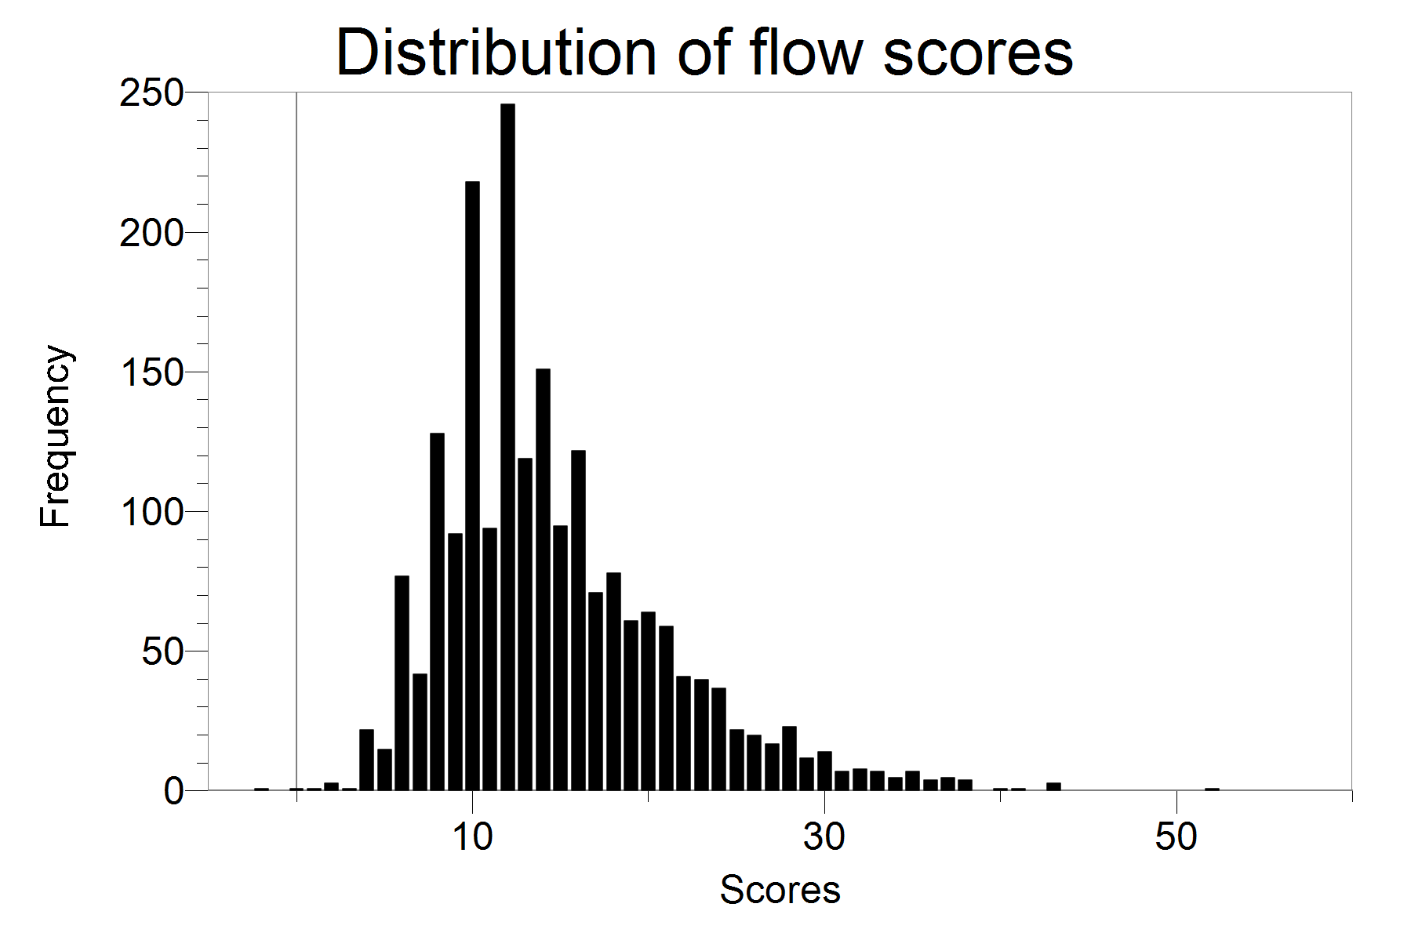
Conversational flow
A good conversational flow ensures an effortless progression of ideas between the customer and the service.
Our algorithm deduces the general flow of the conversation and looks for common indicators such as-
Lag (Number of non responsive inputs or breaks in time sequence)
Number of Unique elements
Statements indicating apology/incompetence

Slide 8
Problem Resolution
Resolving the query of the customer accurately and pointing them in the right direction is our top priority.
Solution accuracy is determined by the percentage match between the lemmatized synonyms of responses and user input
Tone analysis is used to judge customer satisfaction

Slide 9
Solution
Phase 5
Giving final scores to the chat and live customer supports based on our model set. Understanding merits and demerits of our model
Phase 3
Observing patterns, collecting and cleaning the data for easy access
Phase 1
Determining our fundamental factors for the rubric
Phase 2
Creating a rubric by weighing our variables, and establishing assumptions
Phase 4
Inferring the results of phase 3, normalizing, and passing them to our rubric

Slide 10
Satisfaction Meter
There is statistical evidence that the data is highly skewed towards low response time conversations and skewed right for conversational flow.
Based on this, the mean serves as a benchmark for satisfactory experiences.
Mean =0.33 * (mean_time_score) + 0.33 * (mean_conversational_flow_score) + 0.33 * (mean_similarity_tone_score)
Similarly, for the final score:
Final score = 0.33 * (time_score) + 0.33 * (conversational_flow_score) + 0.33 * (similarity_tone_score) [Every factor has been given the same weightage.]

Slide 11
THANK YOU

