Slide 1

Grocery Store Management

Slide 2
About me
  Name :
  Dhulipala Prem Aditya
  Background :
  B.Tech Graduate from Chalapathi Institute of Engineering and Technology college.
My Interest to learn Data Science :
    I want to learn data science to use data-driven insights for solving real-world problems
Work Experience :
Fresher - Currently learning Data Science & Analytics
LinkedIn - www.linkedin.com/in/prem-aditya-dhulipala-627a43268
GitHub – https://github.com/premaditya

Slide 3
Objective of the Project:
To design and implement a relational database for a grocery store system
To import and manage structured data using SQL
To analyze customer purchasing behavior and identify high-value customers
To evaluate product performance based on sales and revenue
To study sales trends over time for better business decision-making
To assess supplier and employee contributions to overall business performance
To derive meaningful insights using SQL techniques such as joins, aggregations, and filtering

Slide 4
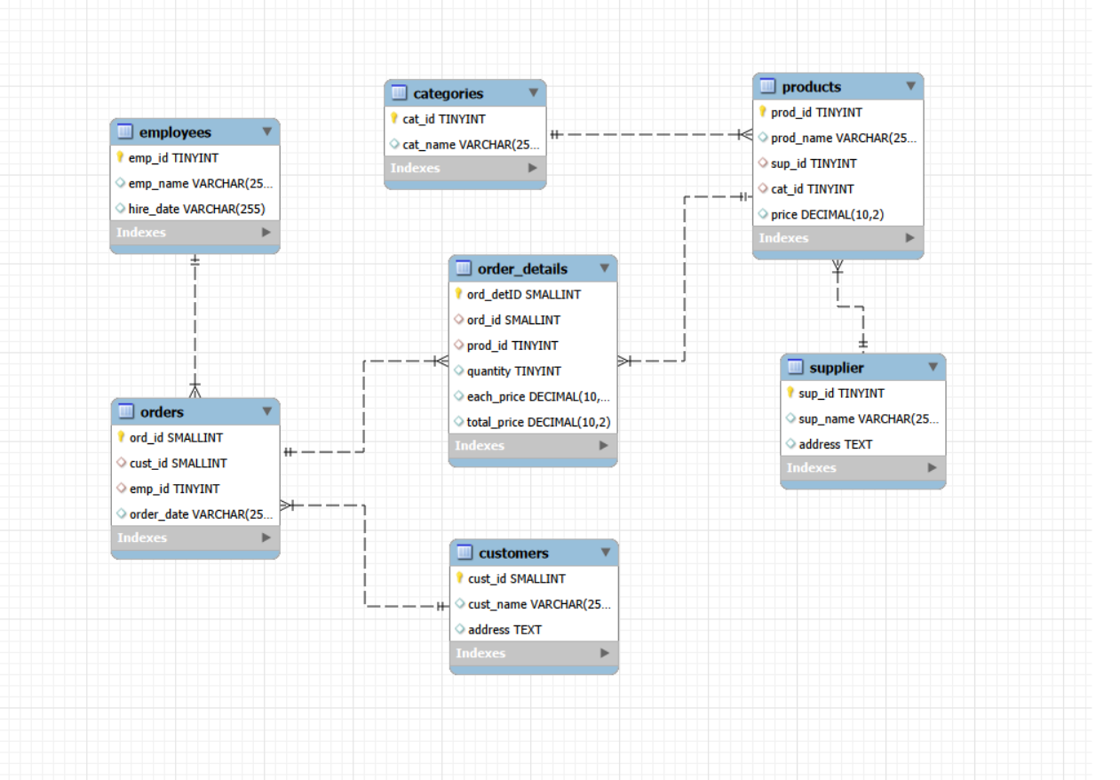
Entity Relationship Diagram:
The ER diagram represents the structure and relationships between different tables in the database.
It shows how entities like customers, orders, products, and suppliers are connected.
These relationships help in performing efficient joins and accurate data analysis.

Slide 5
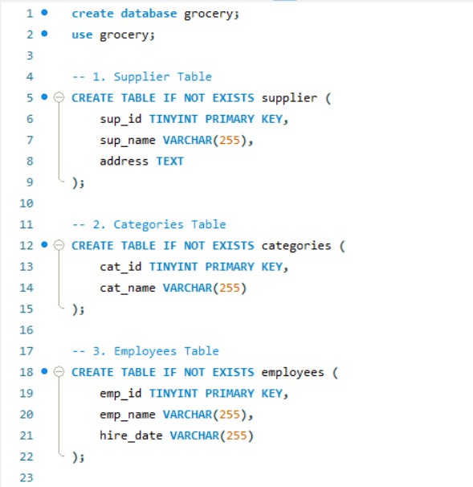
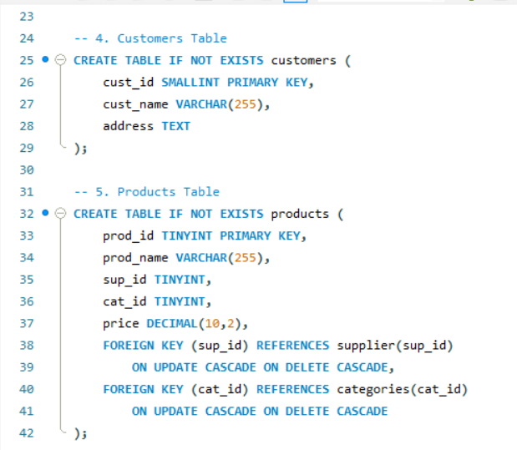
Database Schema Overview:
This query is used to list all the tables present in the database.
It helps in understanding the overall structure of the system.
The result shows all available tables in the grocery database.

Slide 6
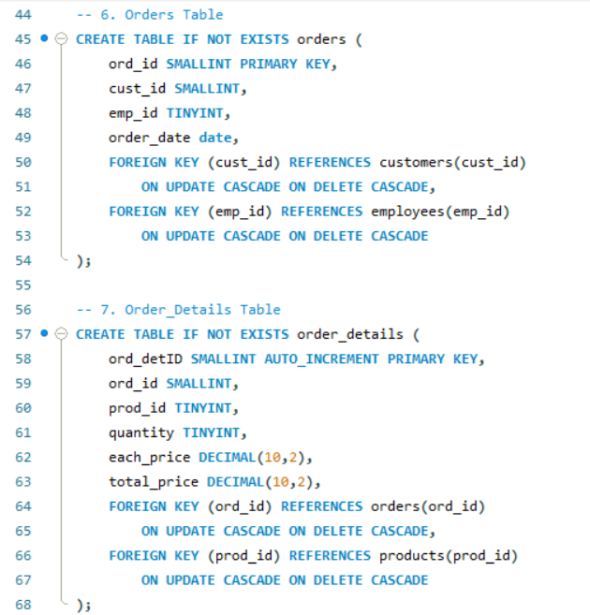
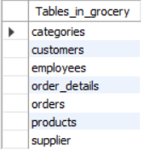
The result shows the schema details of key tables in the database.

Slide 7
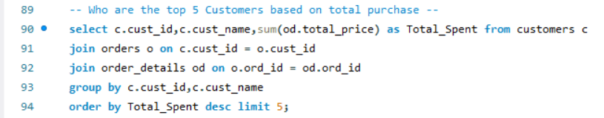
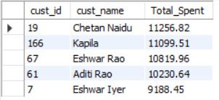
Top 5 Customers Based on Total Spend
This query identifies the top 5 customers who have spent the most on purchases.
It helps in recognizing high-value customers contributing significantly to revenue.
The result highlights customers who are most important for business profitability.

Slide 8
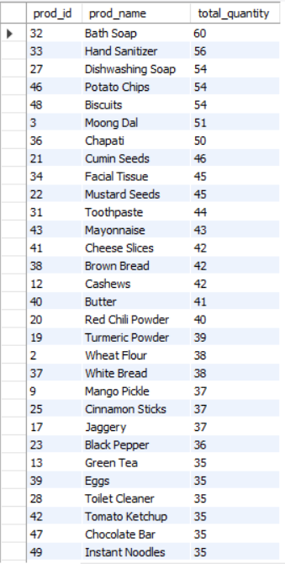
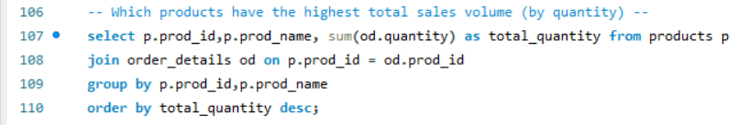
Products with Highest Sales Volume (By Quantity):
This query calculates total quantity sold for each product in descending order.
It helps identify the most in-demand and frequently purchased products.
The result shows which products have the highest sales volume.

Slide 9
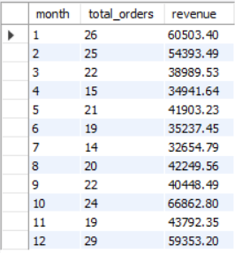
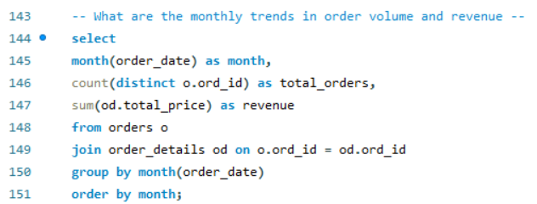
Monthly Trends in Order Volume and Revenue:
This query analyzes the number of orders and total revenue generated each month.
It helps in understanding seasonal trends and business performance over time.
The result shows how sales and orders vary across months.

Slide 10
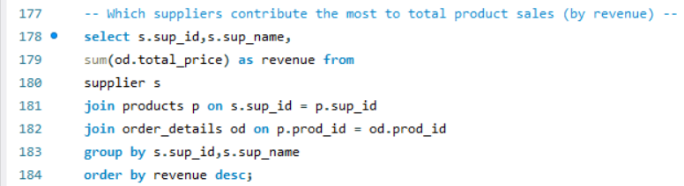
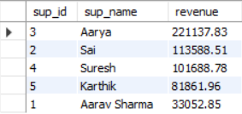
Top Suppliers by Total Product Sales:
This query evaluates supplier contribution based on total revenue generated from their products.
It helps identify suppliers that play a key role in business success.
The result ranks suppliers in descending order of their contribution.

Slide 11
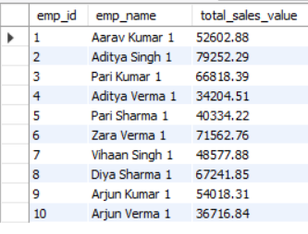
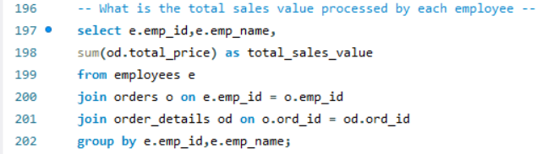
Total Sales Processed by Each Employee:
This query calculates total sales handled by each employee in descending order.
It helps measure employee performance and contribution to revenue.
The result highlights top-performing employees based on sales handled.

Slide 12
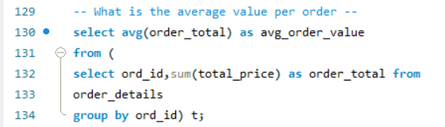

Average Order Value:
This query calculates the average value of all orders placed.
It helps understand the typical spending per order.
The result gives insight into overall customer purchasing behavior.

Slide 13
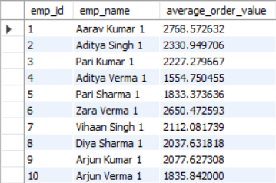
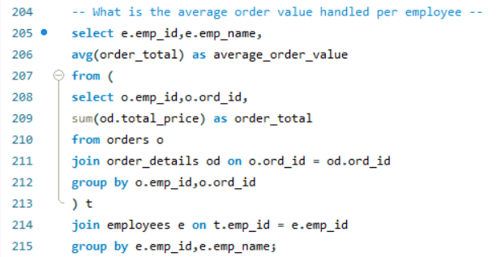
Average Order Value Handled by Each Employee:
This query calculates the average order value managed by each employee.
It helps evaluate how efficiently employees handle high-value orders.
The result compares employee performance based on average order value.

Slide 14
Conclusion:
The project successfully demonstrated how SQL can be used to analyze real-world business data
Key insights were identified regarding customer behavior, product performance, and sales trends
A small group of customers and products contributed significantly to overall revenue
Sales patterns over time highlighted opportunities for better inventory and demand planning
Supplier and employee performance played an important role in business outcomes
Overall, the analysis supports data-driven decision-making to improve efficiency and profitability

Slide 15
Experience & Challenges Faced:
Gained hands-on experience in designing relational databases and working with multiple related tables
Improved understanding of SQL concepts such as joins, aggregations, and subqueries
Learned how to extract meaningful insights from raw data for business analysis
Faced challenges in managing foreign key constraints during data import
Worked through errors in queries and improved debugging skills
Understood the importance of proper data types (especially handling date formats)
Overall, the project enhanced problem-solving and analytical thinking skills

Slide 16


Slide 17

THANK YOU

