Slide 1
EMPLOYEE ATTRITION ANALYTICS
Identifying the Drivers of Employee
Turnover at IBM
A predictive analytics study using the IBM HR Employee Attrition dataset
(1,470 employees) to identify and act on turnover risk factors.
Prepared by
Shourjo Ghosh • Kartik Mallya • Supriya Pani
Devarsh Shah • Prem
July 22, 2026 | Dataset: IBM HR Employee Attrition Data

Slide 2
AGENDA
What We'll Cover
01
Business Problem
Why attrition matters for a global technology company
02
Dataset & Methodology
1,470 employee records, logistic regression approach
03
Exploratory Findings
Who leaves, and what separates leavers from stayers
04
Model Building & Results
Variable selection, performance, and trade-offs
05
Recommendations
An evidence-based action plan for HR
IBM Employee Attrition Analysis
2

Slide 3
BUSINESS PROBLEM
Why Attrition Is a Strategic Risk for IBM
IBM operates in ~170 countries and depends on skilled, experienced employees as a core competitive asset. Losing trained staff is costly — in recruitment, onboarding, lost productivity, and institutional knowledge. Traditional exit interviews are reactive: by the time an employee resigns, the talent is already gone.
Recruiting Cost
$
Advertising, screening, interviewing, and onboarding every replacement hire
T
Productivity Lag
New hires need months to reach the output of experienced staff
From reactive to proactive
K
Knowledge Loss
Machine learning on historical HR data can surface hidden risk patterns — letting HR intervene with career growth, workload changes, or compensation review before an employee decides to leave.
Client relationships and project know-how leave with the employee
M
Team Morale
Remaining staff absorb workload, raising the risk of further exits
IBM Employee Attrition Analysis
3

Slide 4
EXECUTIVE SUMMARY
The Headline Numbers
1,470
16.1%
8
0.745
85.03%
Employees analyzed
Overall attrition rate
Statistically significant
drivers (p < 0.05)
Model AUC
Model Accuracy
Turnover concentrates among younger, lower-tenure, lower-income, and single employees. A logistic regression model built on Age, Monthly Income, Distance From Home, Marital Status, Numbers of company worked, Job Satisfaction, Environment Satisfaction, and Work-Life Balance confirms these factors carry real predictive signal.
Recommendation focus: targeted retention for early-career & single employees, pay-band review, and continued investment in satisfaction & work-life balance.
4

Slide 5
THE DATASET
IBM HR Analytics Employee Attrition Data
1,470
13
0
16% / 84%
Employee records
Variables captured
Missing values
Attrition Yes / No
Target variable breakdown
Data quality notes
No missing or null values identified
Categorical variables are consistently labelled
Numeric fields fall within plausible business ranges — no evident outliers
Target variable (Attrition) is imbalanced: majority did not leave
Dataset is suitable for classification modelling after preprocessing
IBM Employee Attrition Analysis
5

Slide 6
METHODOLOGY
A Reproducible, Five-Step Workflow
Built end-to-end in Orange Data Mining — logistic regression, since Attrition (Yes/No) is categorical and the goal is a probability, not a continuous value.
1
2
3
4
5
Data Cleaning & Validation
Selecting Columns
Data Sampling
Model Building
Testing & Evaluation
→
→
→
→
Checked missing values, data types, and category levels for all fields
Removed variables with weak significance (p > 0.05) using PSPP
Split into training and testing sets at a 70:30 ratio, stratified
Trained Logistic Regression on the 70% training sample
Scored the model on the held-out 30% test sample
Logistic regression model form
log( y / (1 − y) ) = β₀ + β₁x₁ + β₂x₂ + β₃x₃ + …
y = Dependent Variable (attrition) | β = fitted coefficients | x = predictor variables
IBM Employee Attrition Analysis
6

Slide 7
EXPLORATORY ANALYSIS
Who Is Most Likely to Leave?
Age
Job Satisfaction
Monthly Income
Leavers skew younger. Attrition share is highest among employees in their 20s and declines steadily with age — older staff appear more settled.
Levels 3–4 hold most employees, but attrition is heaviest at levels 1–2. Dissatisfaction is uncommon, but strongly linked to leaving when present.
Income is right-skewed; leavers cluster almost entirely in the lower salary bands and become rare above roughly $10,000/month.
Attrition rate by job satisfaction level
Mean monthly income: leavers vs. stayers
IBM Employee Attrition Analysis
7

Slide 8
FEATURE SELECTION
Ranking the Predictor Variables
Rank widget scores: Gain Ratio and Gini Decrease — higher scores indicate a stronger statistical relationship with attrition.
Kept vs. dropped
✓
Top scorers
Monthly Income, Marital Status, and Age lead the ranking and go straight into the model.
✗
Weakest signal
Education scores a Gini of 0.000 — no usable signal. Education Field and Department are also weak.
Job Satisfaction & Distance From Home rank low but are retained — HR can act on both directly.
IBM Employee Attrition Analysis
9

Slide 9
MODEL SETUP
Final Variables & Train/Test Split
Variable roles
Data split (stratified, replicable)
Role | Variables
Target | Attrition (Yes / No)
Predictors (8) | Age, Distance From Home, Environment Satisfaction, Job Satisfaction, Marital Status, Monthly Income, Num Companies Worked, Work-Life Balance
Metadata (4) | Department, Education, Education Field, Years at Company
Years at Company (ranked #2) was moved to metadata: it overlaps heavily with Age and Monthly Income, and correlated predictors entered together cause multicollinearity — unstable, hard-to-interpret coefficients.
1,029 training records fit the model; 441 held-back records are used only for evaluation. Stratified sampling preserves the 16% attrition rate in both subsets.
IBM Employee Attrition Analysis
10

Slide 10
MODEL RESULTS
The Accuracy Paradox
The same model looks very different depending on which question you ask it.
Averaged across both classes
Target class = "Left" (the question HR cares about)
85.0%
9.9%
Classification Accuracy • Recall 0.850 • F1 0.798
Recall on actual leavers • F1 drops to 0.175
Looks strong — but dominated by the 84% majority who stayed.
Of employees who genuinely left, the baseline model catches roughly 1 in 10.
With leavers at only 16% of the data, a model predicting “No” for everyone would still score 84% accuracy while catching zero at-risk employees. Accuracy alone is a misleading measure here — AUC, recall, F1, and MCC carry the real weight of evidence for this business problem.
IBM Employee Attrition Analysis
11

Slide 11
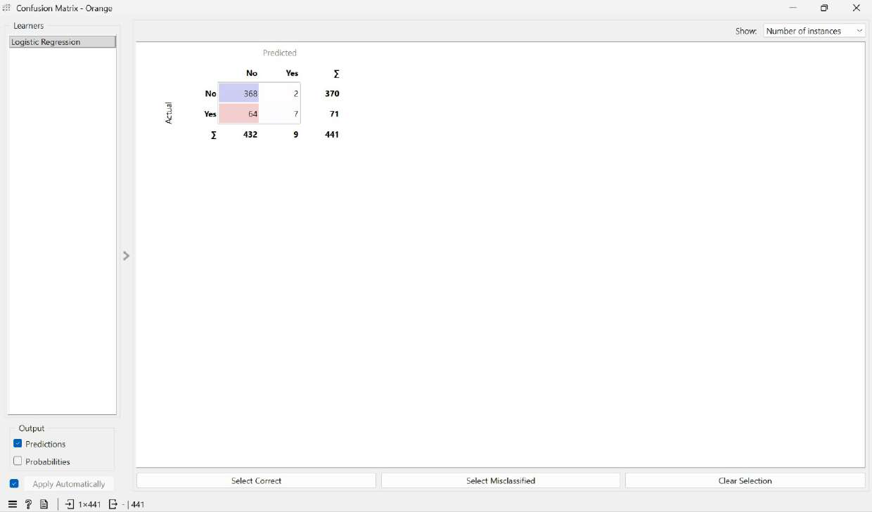
MODEL DIAGNOSTICS
Confusion Matrix: Where the Model Struggles
Actual \ Predicted | No | Yes | Total
Stayed (No) | 368 | 2 | 370
Left (Yes) | 64 | 7 | 71
Total | 432 | 9 | 441
99.5% of employees who stayed were classified correctly. But among employees who actually left, only 9.9% were identified — 90.1% were missed entirely.
The costs aren't symmetric. A false alarm (2 cases) means an unnecessary check-in with someone who wasn't leaving. A missed leaver (64 cases) means a resignation, a vacancy, and the full cost of recruitment and retraining — the baseline model is optimizing the wrong way round for this business problem. But the balanced model identifies roughly 7 out of every 10 employees who actually left, compared with 1 in 10 for the baseline.
Figure: Confusion matrix as a proportion of actual outcomes (Orange output).
IBM Employee Attrition Analysis
12

Slide 12
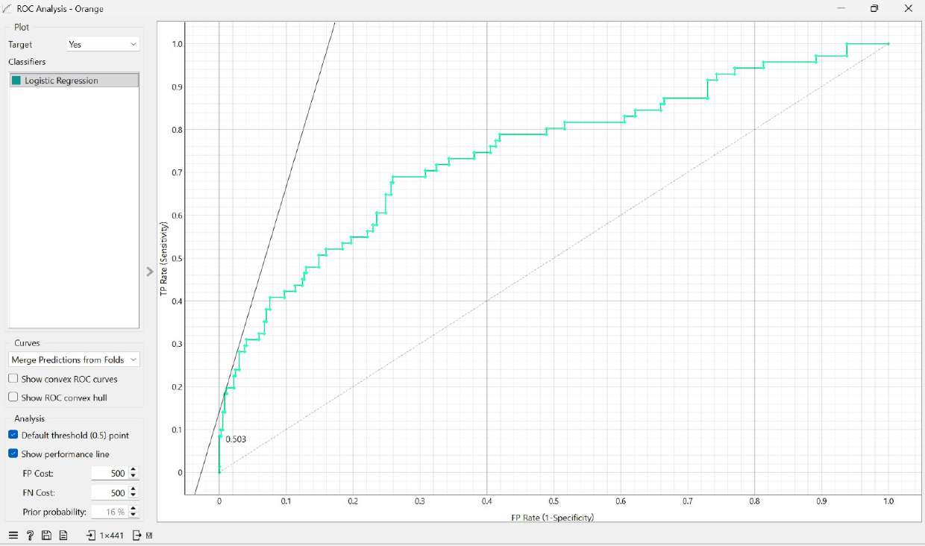
MODEL DIAGNOSTICS
ROC Curve: Separating the Threshold from the Model
AUC = 0.745
Given one random leaver and one random stayer, the model ranks
the leaver as higher-risk about 75% of the time.
The ROC curve evaluates performance across every possible decision threshold, separating the model's ranking ability from the choice of cutoff. It sits well above the diagonal (random-guess) line across its full length — a reasonable level of discrimination for HR data.
Figure: ROC curve with target class set to “Yes” (Orange output).
The key insight: AUC (0.745) and specificity (0.099) tell very different stories. The model ranks risk well — the default 0.5 threshold is simply set too high for a minority outcome. The problem lies in the threshold, not the underlying model.
IBM Employee Attrition Analysis
13

Slide 13
MODEL DIAGNOSTICS
What Drives the Prediction? Coefficient Analysis
Positive coefficients increase attrition risk; negative coefficients reduce it.
↑
Increases risk
Being single is the widest single swing in the model (+0.554). Each prior employer (+0.099) and each extra mile of commute (+0.031) also nudges risk upward.
↓
Reduces risk
Job Satisfaction (−0.305) and Environment Satisfaction (−0.306) are the strongest protective factors — and, unlike age or marital status, both are directly actionable by HR. Monthly Income's small per-unit coefficient adds up to roughly half a log-odds unit across a $5,000 salary gap.
IBM Employee Attrition Analysis
14

Slide 14
MODEL REFINEMENT
Class Balancing: Trading Accuracy for Detection
Reweighting the minority class during training — evaluated with target class = “Left”.
Recall: 0.099 → 0.704
The balanced model now identifies roughly 7 in 10 actual leavers, up from 1 in 10. F1 more than doubles, and AUC barely moves (0.745 → 0.744) — the model's underlying ranking ability is unchanged.
The trade-off
Accuracy falls from 85.0% to 66.7%, and precision drops to 0.284 — more false alarms. But for an HR early-warning system, a missed leaver (lost talent) costs far more than a false alarm (one extra conversation). The balanced model is the preferred choice, and underlies the recommendations ahead.
IBM Employee Attrition Analysis
15

Slide 15
SUMMARY OF FINDINGS
Four Things the Data Tells Us
No single cause
Attrition results from several factors acting together — marital status, age, pay, commute, satisfaction, and work-life balance. None dominates the others.
1
Compensation is the clearest gap
Leavers earned $4,787 on average vs. $6,833 for stayers (t = 7.495, p < 0.001), and Monthly Income ranks first among all 12 predictors.
2
HR has real levers
Job Satisfaction, Environment Satisfaction, and Work-Life Balance all carry strong protective coefficients — unlike age or marital status, these are directly actionable.
3
Metric choice matters most
85% accuracy hides that fewer than 1 in 10 leavers were caught. Balancing raises detection to 7 in 10 at the cost of accuracy — recall and AUC give the honest picture.
4
16

Slide 16
RECOMMENDATIONS
Turning Insight Into Action
Risk factors
Retention factors
Being Single
Workplace Happiness
The single biggest demographic factor — single employees quit far more often
Satisfaction with environment and job is the strongest tool for keeping people
Past Job-Hopping
Work-Life Balance
Employees with several prior employers are more likely to leave
Enough time for personal life outside work keeps employees around
Long Commutes
Age & Pay
Living far from the office raises the likelihood of quitting
Older, higher-paid employees are markedly less likely to quit
Action plan
0–30 Days
1–3 Months
6+ Months
"Stay interviews" with high-risk top performers (e.g. long commuters)
Pilot flexible/WFH policy; launch a first pulse survey on satisfaction
Embed the model in the core HR system for ongoing risk visibility
IBM Employee Attrition Analysis
17

Slide 17
CONCLUSION
Conclusion & Limitations
Using Logistic Regression within Orange, this study identified the key drivers of employee attrition at IBM — marital status, commute distance, monthly income, age, prior job mobility, work-life balance, and workplace/job satisfaction. The optimized model achieves an AUC of 0.745, with the class-balanced configuration recovering strong sensitivity for the minority (leaver) class.
Limitations
References
Unobserved external factors: regional economic conditions, competitor offers, and manager performance aren't in the dataset.
Cross-sectional scope: the data is a single point-in-time snapshot, not tracked across multiple financial quarters.
IBM HR Analytics Employee Attrition dataset — Kaggle
(yasserh/ibm-attrition-dataset)
Masai Data Analytics, GenAI & Execution — IIM Sirmaur lectures and study materials
Thank you
18

