Slide 1
Visualing employee attendance trends charts with Excel
STUDENT NAME: G.PREMA
REGISTER NO. : 312217029 (4054B7559CC33E68B19421236811288D)
DEPARTMEN : BCOM (General)
COLLEGE. :SHRI KRISHNASWAMY COLLEGE FOR WOMEN

Slide 2
PROJECT TITLE
Visualing employee attendence trend with Excel

Slide 3


AGENDA
Problem Statement
Project Overview
End Users
Our Solution and Proposition
Dataset Description
Modelling Approach
Results and Discussion
Conclusion
3/21/2024 Annual Review

Slide 4

PROBLEM STATEMENT
"Our organization struggles to effectively track and analyze employee attendance patterns, leading to:
Inefficient management of absenteeism and tardiness
Lack of insight into attendance trends and potential underlying causes
Inability to identify employees who may need support or intervention
Difficulty in making data-driven decisions to improve attendance and overall workforce productivity

Slide 5

PROJECT OVERVIEW
Design and develop an interactive visualization tool to track and analyze employee attendance patterns, providing insights to improve attendance management, employee engagement, and overall workforce productivity.
Collect and integrate attendance data from existing HR systems
Design and develop a user-friendly visualization dashboard
Implement interactive features for exploring attendance trends
Conduct analysis to identify patterns, anomalies, and correlations
Develop recommendations for improving attendance and productivity
.

Slide 6

WHO ARE THE END USERS?
:*HR Managers*: To identify attendance patterns, manage absenteeism, and develop strategies to improve employee engagement.
*Team Managers*: To monitor team attendance, identify trends, and address potential issues affecting team productivity.
*Department Heads*: To oversee attendance trends across departments, make informed decisions, and optimize workforce planning.
*Business Analysts*: To analyze attendance data, identify correlations, and provide insights for business improvement.
*Employees*: To view their own attendance records, understand company policies, and manage their own attendance.

Slide 7

OUR SOLUTION AND ITS VALUE PROPOSITION
Our solution provides an interactive and intuitive visualization tool that helps organizations:
*Gain insights*: Identify attendance patterns, trends, and anomalies to inform data-driven decisions.
*Improve attendance management*: Reduce absenteeism, tardiness, and turnover by addressing underlying causes.
*Enhance employee engagement*: Foster a positive work environment by recognizing and supporting employees with attendance challenges.
*Boost productivity*: Optimize workforce planning, reduce costs, and increase overall business performance.
*Simplify attendance tracking*: Integrate with existing HR systems for effortless data management.

Slide 8
Dataset Description
Here is a simplified version of the datasets description:_
*Employee Attendance*: Daily attendance records (Employee ID, Date, Attendance Status)
*Employee Info*: Basic employee information (Employee ID, Name, Job Title, Department)
*Attendance Trends*: Aggregated attendance data (Date, Total Present, Total Absent, etc.)
*Absence Reasons*: Reasons for absences (Reason, Frequency, Percentage)
*Employee Performance*: Performance ratings (Employee ID, Performance Rating, Review Date)

Slide 9

THE "WOW" IN OUR SOLUTION
Here's a simplified version of the "WOW" factor:- Interactive Heatmap: Visualize attendance patterns- AI-powered Insights: Predictive analytics for attendance- Real-time Alerts: Swift response to attendance issues- Employee Engagement Portal: Easy access to attendance records- Data-Driven Storytelling: Turn data into actionable stories
3/21/2024 Annual Review
9

Slide 10
MODELLING
Modeling Approach:_
Collect attendance data
Clean and prepare data
Extract relevant features
Group employees with similar attendance patterns
Predict future attendance trends
Identify unusual attendance patterns
Visualize attendance trends and insights
Modeling Techniques:
Regression
Decision trees
Clustering
Anomaly detection
Modeling Tools:
- Python libraries (Pandas, Scikit-learn, Matplotlib)
- Data visualization tools (Tableau, Power BI)
10

Slide 11
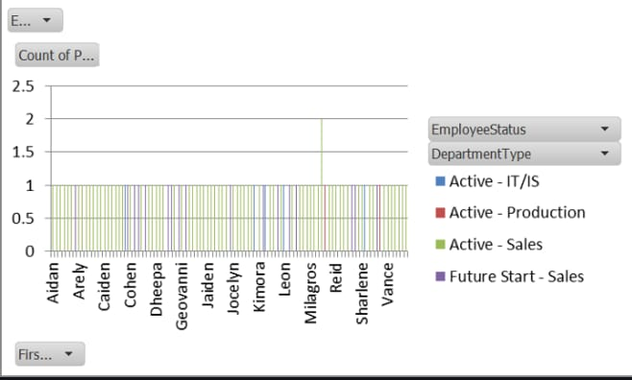
RESULTS
Results:
Better attendance insights
Increased employee engagement
Data-driven decision making
Improved productivity
Enhanced work-life balance force.
11

Slide 12
conclusion
Visualizing employee attendance trends helps organizations improve attendance, engagement, and productivity by identifying patterns, addressing underlying causes, and making data-driven decisions.

