Slide 1

AGERE AUTONOMOUS NAVIGATION STACK
Backseat Driver Model
STRATEGIC
AI-Supervised Autonomous Control System for PX4 Drones
EXECUTION
TACTICAL
Presented by: Premananda
Institute: NIELIT
Document: Version 2.0
Date: July 13, 2026
ARCHITECTURE PRESENTATION

Slide 2

Executive Summary
The Backseat Driver Model establishes a formal architectural framework for integrating Artificial Intelligence with the PX4 flight control system. This document outlines the separation of responsibilities, communication protocols, and system boundaries that enable safe, intelligent autonomous drone operations.
Version 2.0 Additions
Formalizes the Tactical/Middleware layer with concrete decision frameworks for ground-station communication loss during search-and-rescue operations.
Introduces a Work Index energy-margin model governing when the vehicle must abandon a task and preserve itself and its ability to be located.
AI ADVISOR
PX4 EXECUTOR
Strategic commander providing high-level reasoning, mission planning, and semantic perception without compromising flight safety.
Reliable frontline executing low-level control, stabilization, sensor fusion, and failsafes in real-time.
Specified as architecture and decision logic (states, thresholds, rules) — implementation is a follow-on phase.
Core Philosophy: PX4 as the reliable, real-time executor (frontline soldiers) while AI systems function as the strategic advisor (battalion commander).

Slide 3

The Chain of Command
The architecture follows a strict hierarchical separation with clearly defined responsibilities across three layers.
STRATEGIC LAYER
AI Advisor
Companion Computer
RESPONSIBILITY
HARDWARE
High-level reasoning, mission planning, semantic perception
NVIDIA Jetson, Raspberry Pi, etc.
TACTICAL LAYER
Middleware
Companion Computer
RESPONSIBILITY
HARDWARE
Command translation, safety enforcement, constraint checking, comms-loss decision logic, energy-margin arbitration
Companion Computer (same platform)
EXECUTION LAYER
PX4 Flight Stack
Flight Controller
RESPONSIBILITY
HARDWARE
Low-level control, stabilization, sensor fusion, failsafes
Pixhawk, Holybro, CUAV

Slide 4



Communication Bridge via uXRCE-DDS
All data exchange between the AI layer and PX4 occurs through the uXRCE-DDS (ROS 2) bridge. This establishes a robust, bidirectional communication channel.
AI / ROS 2 Node
uXRCE-DDS Agent
uXRCE-DDS Client
PX4 uORB
Flight Control
Source
Bridge Entry
Bridge Exit
Internal Bus
Executor
Downlink
Uplink
Telemetry Data flowing from PX4 to the AI Advisor
High-Level Commands flowing from AI to PX4
Real-time Position and Velocity
Continuous Setpoint Streaming
Vehicle Attitude and Orientation
Discrete Vehicle Commands
Battery Status and Power Draw
Mode Change Requests
System Health and Operational Status
Mission Update Instructions

Slide 5



Communication Link Taxonomy
Not all "loss of signal" is the same failure. The architecture distinguishes three independent links, each with a different correct response.
1. GROUND LINK
2. ONBOARD HEARTBEAT
3. POSITIONING SIGNAL
COMMUNICATION PATH
COMMUNICATION PATH
COMMUNICATION PATH
Ground Station
Companion Computer
Companion Computer
PX4
GPS/GNSS
EKF
Loss Behavior Owner
Loss Behavior Owner
Loss Behavior Owner
Tactical Layer (Middleware)
PX4 Failsafe (COM_OF_LOSS_T)
PX4 EKF Fallback / Vision Odometry
TYPICAL CAUSES
TYPICAL CAUSES
TYPICAL CAUSES
Radio range limitations, terrain occlusion, active jamming.
Software crash on companion, physical cable or serial fault.
GPS denial, urban canyon effects, indoor environments.

Slide 6
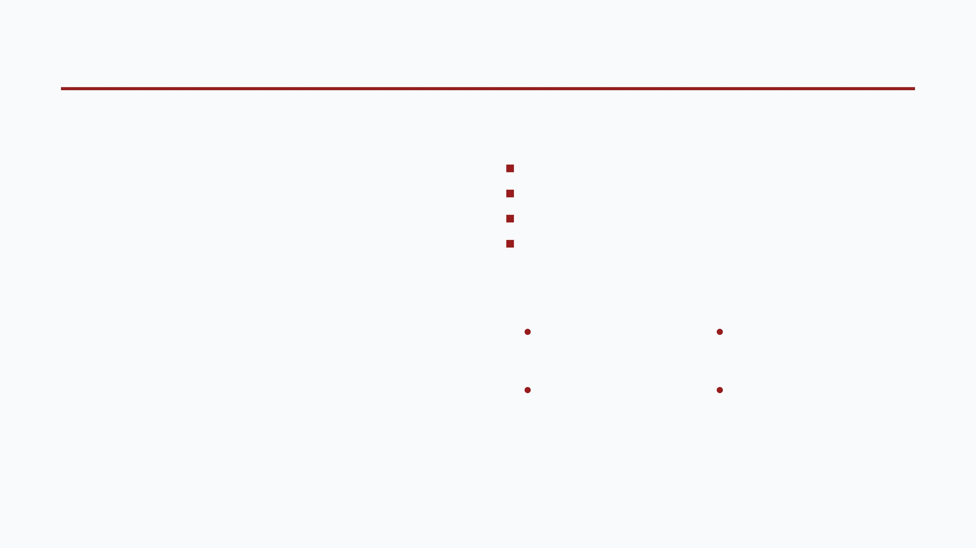
PX4 Capabilities
DATA HANDLING CAPABILITIES
SUPPORTED CONTROL MODES
1
Sensor Data Rate
Offboard Mode
Accepts external setpoints (Primary mode for AI control)
50 Hz to 1 kHz
Position Control
Internal PX4 loop tracking position setpoints
2
Control Loop Frequency
Velocity Control
Internal PX4 loop tracking velocity setpoints
200 Hz typical
Altitude Control
Internal PX4 loop tracking altitude
3
Internal Messaging
uORB bus with sub-millisecond latency
AI Extensibility
4
State Estimation
Offboard Mode
Distance Sensors
Extended Kalman Filter (EKF) fusing multiple sensors
External control via setpoint
Collision prevention using obstacle
streaming
data
Vision / Visual Odometry
Custom Flight Modes
EKF fusion for improved state
Experimental neural network
estimation
control (v1.17+)

Slide 7

Ground-Link-Loss Decision Framework
Loss of the ground station link does not mean loss of vehicle authority — the drone retains full onboard sensing, computing, and control. The design question is what the AI advisor should decide on its own.
MISSION PHASE
BEHAVIOR
RATIONALE
Preflight / Arming
Do not arm / abort arming sequence
No reason to launch a mission that cannot be monitored from the start
Transit
Continue transit; degrade telemetry rate; keep attempting reconnection
Low-stakes navigation phase, no irreversible decisions pending
GOVERNING PRIORITIES
1.
Do not act irreversibly on unconfirmed information without a human.
Active Search / Task
Continue autonomously,
strictly bounded
Autonomy exists precisely so operator dropout doesn't abort the mission
2.
Maximize the probability of the vehicle being found if it cannot continue the mission.
by pre-briefed geofence and energy margin
Candidate Detected
Do
Highest-stakes decision point. Unconfirmed detection risks misidentification or unsafe action
act. Loiter, log position + imagery, keep attempting reconnection.
NOT
Return-to-Base
Continue as planned
The decision to return was already made before link loss; nothing changes
Energy-Critical
Overrides all rules above (see Work Index)
Physical constraints take precedence over mission logic unconditionally

Slide 8

Timeout Ladder
A single "connected / disconnected" threshold is too crude — very short dropouts are normal RF behavior, not a real loss event. A graduated response is required.
< 10 s
10 s – 2 min
> 2 min
IGNORE
DEGRADED MODE
ESCALATE
No behavior change
Enter degraded autonomous mode
Re-evaluate current phase decision
Treated as normal link noise
Increase reconnection attempt rate
Abandon further search expansion
Reduce telemetry/logging rate to conserve link budget
Transition toward return or hold per decision frameworks
Continue current phase behavior
Note: The exact thresholds above are a starting proposal, not tuned values — they should be calibrated against the actual radio hardware's real-world dropout distribution during field testing before being treated as final.

Slide 9

AI Integration Patterns
The architecture supports five core AI functions that communicate with PX4 through standardized ROS 2 topics.
COMMAND TYPES
Setpoint Stream
1
Natural Language Command
/fmu/in/trajectory_setpoint
LLM interprets speech/text into structured flight commands via TrajectorySetpoint.
Continuous position, velocity, and acceleration targets.
Heartbeat Signal
2
Computer Vision Navigation
/fmu/in/offboard_control_mode
Detection models find obstacles/targets for path adjustment via TrajectorySetpoint.
Proves AI is alive; required for Offboard Mode operation.
3
RL-based Path Planning
Vehicle Commands
RL agent learns optimal routes in simulation for real deployment via TrajectorySetpoint.
/fmu/in/vehicle_command
Discrete actions: Arm, disarm, takeoff, land, mode changes.
4
Mission Orchestration
Obstacle Data
FSM/Behavior Tree managing complex multi-phase missions via VehicleCommand.
/fmu/in/obstacle_distance
Collision prevention information routed to PX4.
5
Semantic Perception
Understanding scene context, including detection confidence scoring for decision-making.

Slide 10

Sensor Data Pipeline
The sensor integration pipeline demonstrates how external perception data flows into the PX4 control system. External sensor data is processed on the companion computer, routed through ROS 2 and the uXRCE-DDS bridge, and finally consumed by PX4's internal modules.
LiDAR Sensor
Companion Computer
ROS 2 Node
uXRCE-DDS
PX4 EKF
Raw Data Source
Middleware
Bridge Protocol
State Estimation
Host Machine
PX4 CONSUMER MODULES
1
Collision Prevention
2
EKF Fusion
3
Offboard Control
Automatically slows or stops the drone to avoid obstacles based on incoming distance sensor data.
Improves position and velocity estimates without relying solely on GPS, by fusing external data into the Extended Kalman Filter.
Enables the AI to utilize real-time sensor data directly for dynamic path planning and navigation adjustments.

Slide 11
Onboard Heartbeat Failsafe Chain
This failsafe chain is distinct from ground-link loss and ensures PX4 always has a safety net. It governs the companion-computer ↔ PX4 link loss.
1
AI Freezes
2
PX4 Detects Loss
Software crash, hardware fault, or cable disconnection causes the heartbeat to stop.
PX4 flight stack detects the missing OffboardControlMode heartbeat signal.
3
Auto-Transition
4
Failsafe Landing
PX4 automatically transitions to Position Hold mode to maintain stability.
If conditions persist, PX4 executes a controlled autonomous landing sequence.
Base Guarantee: Even if AI crashes completely, PX4 continues flying safely and executes an autonomous landing. The Work Index and ground-link decision frameworks are additional layers of judgment on top of this base guarantee — they do not replace it.

Slide 12

Work Index Energy-Margin Model
PURPOSE & TERMS
Continuously determines whether the vehicle has enough remaining energy (flight-minutes) to complete its task and return or land safely.
Continuous Decision Rule
IF W_total >= W_op + W_return(t) + W_reserve: CONTINUE current task ELSE IF W_total > W_land_safe: ABORT further task expansion HEAD TOWARD base or pre-mapped safe landing zone ELSE: # W_total <= W_land_safe LAND IMMEDIATELY, in place ENTER BEACON MODE (sustain GPS + comms)
TERM
DEFINITION
W_total
Estimated flight-minutes remaining at current battery state and power draw
W_op
Minutes required to complete the remaining planned task from current position
W_return(t)
Minutes required to fly directly back to base from current position (re-evaluated continuously)
W_landing
Minutes of powered flight needed to execute a controlled landing
PRIORITY ORDERING
The decision rule is built to preserve this ordering for maximum recoverability:
W_beacon
Minutes of low-power beacon transmission (GPS + comms) to sustain after landing
1
Flying & Transmitting: Easiest to locate.
W_land_safe
The absolute floor below which the vehicle must stop flying regardless of anything else
2
Landed & Beaconing: Far easier to locate than a dead battery.
3
Battery Dead Mid-Flight: The scenario the Work Index model prevents at all costs.

Slide 13





Safety Philosophy
The architecture deliberately separates the two core components of the system to ensure that safety-critical flight control is never compromised by AI experimentation.
AI Advisor
PX4 Flight Stack
Non-deterministic: Probabilistic decision-making with varying outputs for the same inputs.
Hard real-time: Strict timing guarantees required for maintaining vehicle stability.
Compute-heavy: Requires significant processing power for inference and perception.
Deterministic: Predictable, repeatable behavior essential for control loops.
Experimental: Constantly evolving models and logic that may contain unknown edge cases.
Safety-certifiable: Built with rigorous testing and failsafe mechanisms to guarantee survival.
Base Guarantee: Even if AI crashes completely, PX4 continues flying safely and executes an autonomous landing. The Work Index and ground-link decision frameworks are additional layers of judgment on top of this base guarantee — they do not replace it.

Slide 14

Development Workflow
The recommended testing pipeline progresses through five stages, moving from pure simulation to full autonomous flight.
1
2
3
4
5
SIMULATION
HIL TESTING
TETHERED FLIGHT
SUPERVISED
AUTONOMOUS
Test AI logic with SITL and Gazebo, including injected ground-link dropouts and battery drain scenarios.
Hardware-in-the-loop testing with the real flight controller to validate control loops.
Real drone flight with a physical safety tether to prevent uncontrolled movement.
AI active with a human pilot ready to immediately override and take manual control.
Full AI control within a strictly defined and validated safe operational envelope.
RECOMMENDED TOOLS
ROS 2 Humble
PX4-Autopilot
Gazebo / Gz
uXRCE-DDS Agent
SITL

Slide 15
Recommended Hardware Architecture
The recommended hardware setup consists of three key components working in tandem to bridge AI reasoning with deterministic flight control.
1
Flight Controller
EXECUTION LAYER
Hardware: Pixhawk, Holybro, CUAV Purpose: Runs the PX4 real-time stack, handling low-level stabilization, sensor fusion, and safety failsafes.
COMMUNICATION LINK
The critical bridge between the companion computer and the flight controller.
2
Companion Computer
uXRCE-DDS bridge via USB/UART/Serial connection
STRATEGIC & TACTICAL LAYERS
Hardware: NVIDIA Jetson, Raspberry Pi 4, VOXL Purpose: Runs ROS 2, AI models, perception pipelines, and middleware decision logic (ground-link-loss and energy-margin frameworks).

Slide 16

Research vs. Production Considerations
Research Phase
Production Phase
AI INTEGRATION
AI INTEGRATION
Can experiment with replacing core control logic to test AI capabilities.
Must keep AI strictly on top as an advisor; never bypass the PX4 failsafes.
SAFETY MARGIN
SAFETY MARGIN
Accept some calculated risk during controlled, tethered tests.
Must be rigorously safety-certified and verified against all failure modes.
CODE QUALITY
Focus on rapid iteration, prototyping, and validating new algorithms.
CODE QUALITY
Focus on robustness, redundancy, and deterministic real-time performance.
TESTING
Primarily relies on simulation (SITL) and constrained physical environments.
TESTING
Requires extensive real-world validation, including HIL and supervised flight.
The Backseat Driver architecture provides a clear, structured path from research experimentation to production deployment, ensuring that safety boundaries are never compromised regardless of the development phase or AI maturity.

Slide 17
Next Steps and Project Roadmap
The immediate next steps for the Agere project focus on establishing a robust baseline, formalizing decision logic, and validating safety mechanisms before full AI deployment.
1
ESTABLISH BASELINE
2
DATA UNDERSTANDING
Run PX4 SITL with ROS 2 communication working to ensure the foundational bridge is stable.
Document and verify all PX4 ↔ ROS 2 topics to map the available telemetry and control interfaces.
3
MVP INTEGRATION
4
FORMALIZE DECISION LOGIC
Implement a simple "advisor" that sends basic setpoints to PX4 in Offboard mode.
Turn ground-link-loss and energy-margin frameworks into an explicit FSM/behavior tree with tuned constants.
5
AI TRAINING
6
SAFETY TESTING
Begin RL or LLM development in simulation to train the strategic advisor layer.
Validate failsafe mechanisms, including ground-link-loss and energy-margin scenarios from the design frameworks.

Slide 18




Key Takeaways and Conclusion
Clear Separation of Concerns
AI advises, PX4 executes — safety is never compromised by experimental logic.
Formal Decision Frameworks
Ground-link-loss behavior and energy-margin (Work Index) provide structured autonomous judgment.
This document serves as the formal specification for the Agere project's AI integration model, establishing the architectural boundaries and decision logic required for safe, intelligent autonomous operations.
Graduated Failure Handling
Three independent communication links with appropriate, distinct fallback behavior for each.
Progressive Development Path
A rigorous five-stage pipeline from simulation through supervised flight to full autonomy.
AGERE AUTONOMOUS NAVIGATION STACK
Research-to-Production Transition
The architecture scales from experimentation to certified deployment without compromising safety boundaries.

