Slide 1

HEALTHCARE · SECURITY · SOVEREIGNTY
MedLedger
Your Health Records.
Your Rules.
A patient-controlled vault that encrypts, stores, and shares
medical data — without trusting any single server.
CypherAegis Cryptographic Engine · FastAPI Backend · P-256 Elliptic Curve

Slide 2
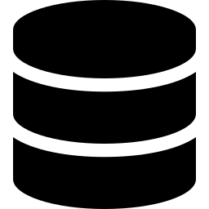



THE PROBLEM
Who Really Owns Your Medical Records?
Hospital Lock-in
Zero Visibility
Records siloed across dozens of institutions.
You can't take them anywhere.
You have no idea who accessed your records,
when, or why.
No Consent Layer
No Audit Trail
Hospitals share data for research, billing, and insurance
without granular patient consent.
Breaches go undetected. Nobody is accountable
when your PHI leaks.

Slide 3



THE SOLUTION
Encrypt First. Share by Choice.
MedLedger flips the model: data is encrypted on the patient's device before it ever touches a server.
Patient
Generates Key
File Encrypted
Locally (AES-256)
Encrypted File
Stored in Vault
Doctor Receives
Time-Limited Access
The server never sees plaintext. The key never leaves the patient.

Slide 4

ACCESS CONTROL
Consent That Actually Means Something
01
Patient holds the key
Sample Grant Payload
A P-256 keypair is generated once and stays with the patient. No server, no third party.
record_id
a3f9…d2c1
02
Grant is cryptographically signed
grantee
Dr. Priya Sharma
When the patient shares a file, a permission payload is ECDSA-signed — tamper-evident by design.
level
view_download
03
Access is time-bounded
Every grant has a hard expiry window. No permission lasts forever by default.
expires
48 hours
signature
ECDSA ✓ verified
04
Revoke instantly
One API call flips the grant. The doctor's access stops — no admin, no request, no delay.
Cryptographically verifiable at any time

Slide 5



UNDER THE HOOD
Security Without Compromise
ECIES
AES-256-GCM
ECDSA P-256
Hybrid encryption wraps
the file key for each recipient
Authenticated encryption
for every stored file
Digital signature on every
access grant
PBKDF2
Key Rotation
Audit Log
Password-hardened backup
of private key
One command re-wraps all
records, revokes all grants
Immutable timestamped log
of every vault operation

Slide 6
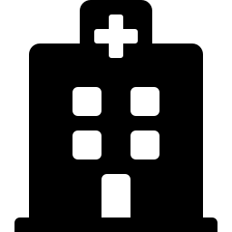
USE CASES
Built for Real Healthcare Workflows
The Patient
The Doctor
The Institution
Owns a single encrypted vault of their entire medical history
Receives a cryptographically signed access token
Stores only ciphertext — a breach exposes nothing
Grants doctors access for exactly the right time window
Downloads the file within the granted window
Full audit trail satisfies compliance (HIPAA-style)
Sees a complete audit log of every access
Access auto-expires — no admin needed to clean up
Modular backend: swap JSON → SQLite → Postgres
Rotates their key if they suspect compromise
Cannot access revoked or expired records
Open crypto layer (CypherAegis) auditable independently

Slide 7
ARCHITECTURE
Layered. Modular. Extensible.
API Layer
FastAPI Routers · JWT Auth · Rate Limiting
Service Layer
RegistrationService · Transceiver · Audit Logic
Crypto Engine (CypherAegis)
KeyManager · ECIES · ECDSA · AES-256-GCM · PBKDF2
Store Layer
Typed Schemas
JSON → SQLite → Postgres (swappable, zero service changes)
UserRecord · VaultRecord · Grant · AuditEntry

Slide 8
VISION
Healthcare data should serve
patients — not systems.
Portable medical records across any hospital or country
Consent enforced by cryptography, not policy promises
Breach resilience: stolen data is just meaningless ciphertext
Self-sovereign identity layer — patient as the root of trust
github.com/premananda-cloud/MedLedger · CypherAegis Crypto Engine

