Slide 1



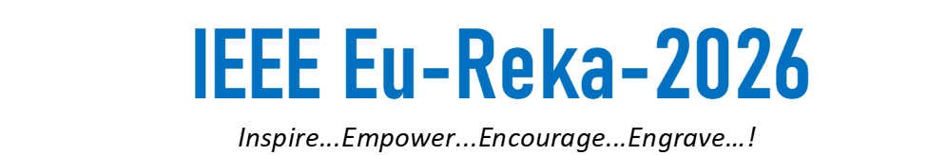
Project Name:
Interstate Corn Price Concurrency & Transmission Lag
Praxis
Mentor name:
Mayanglangbam Premananda
Naoroibam Thajaba
Asem Anjali Devi
Dr. Usham Sanjota Chanu

Slide 2
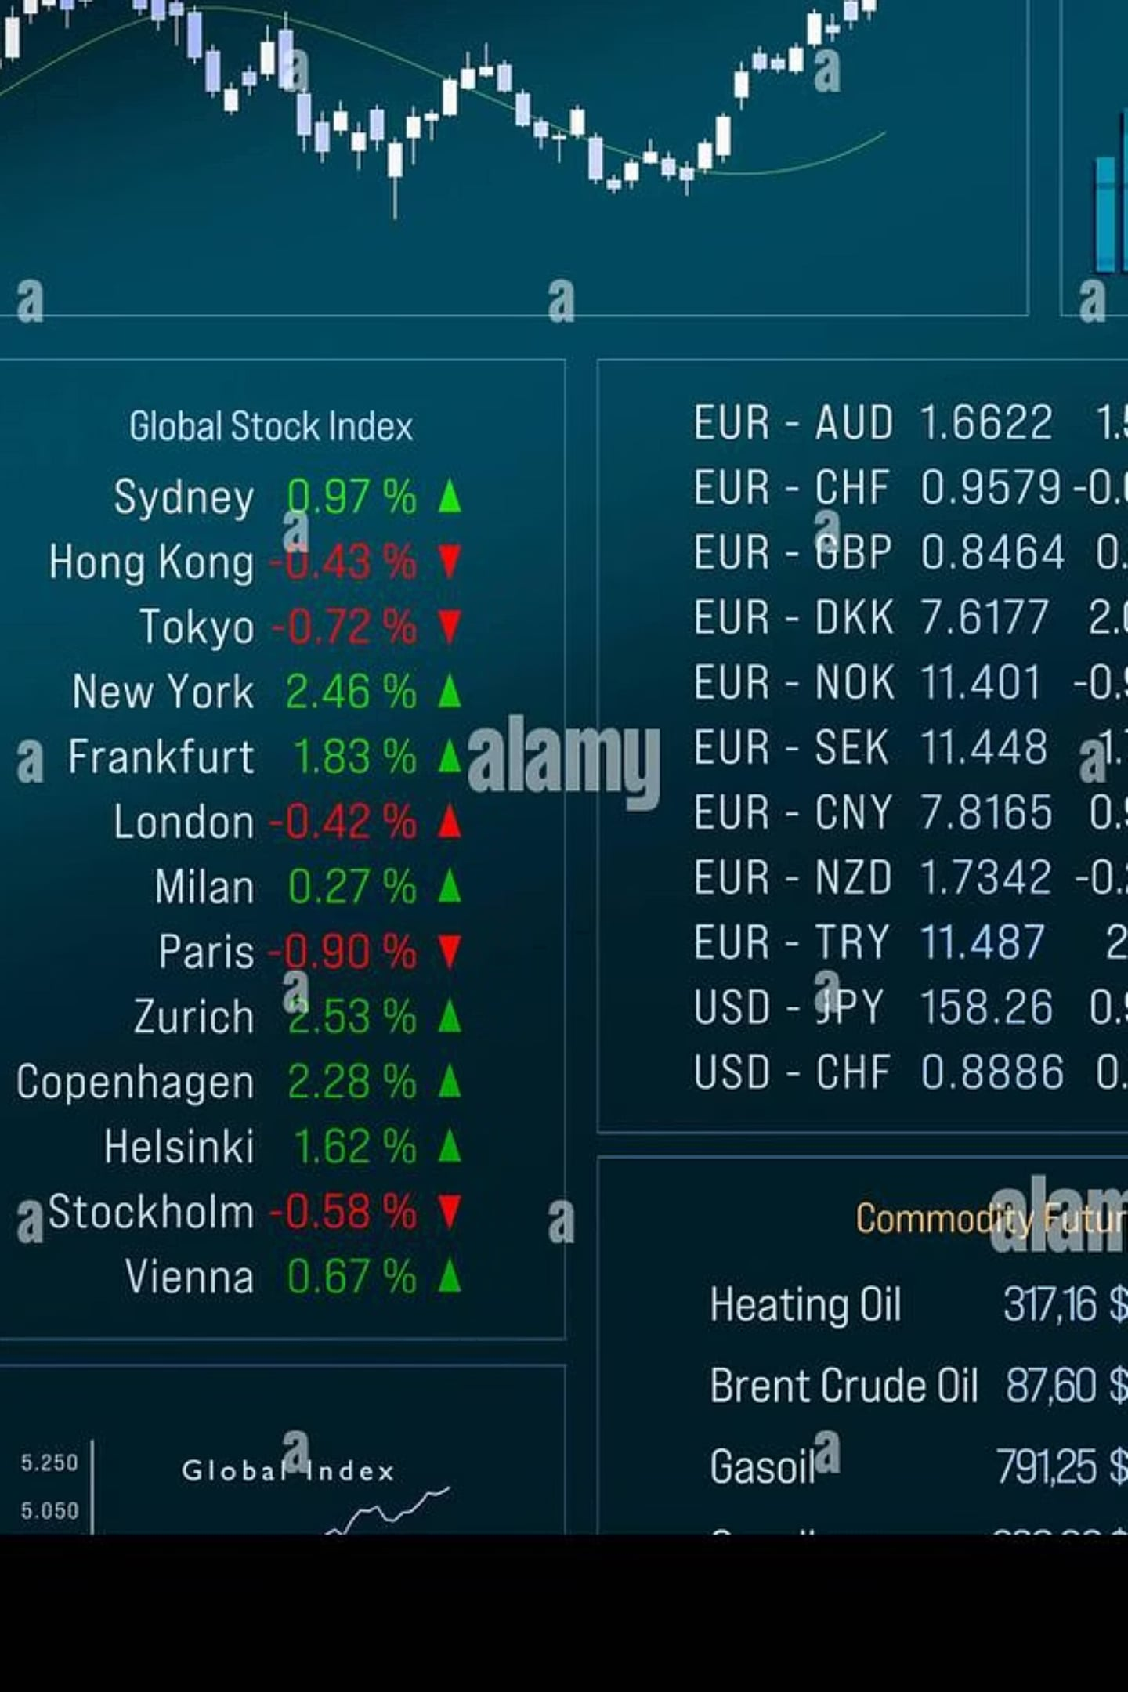
Introduction
Why Corn Prices Across States Matter
Spatial Price Transmission
Market Integration
How quickly price changes propagate across regional markets
Evaluates efficiency of agricultural commodity markets
Policy Relevance
Actionable insights for farmers, traders & policymakers

Slide 3
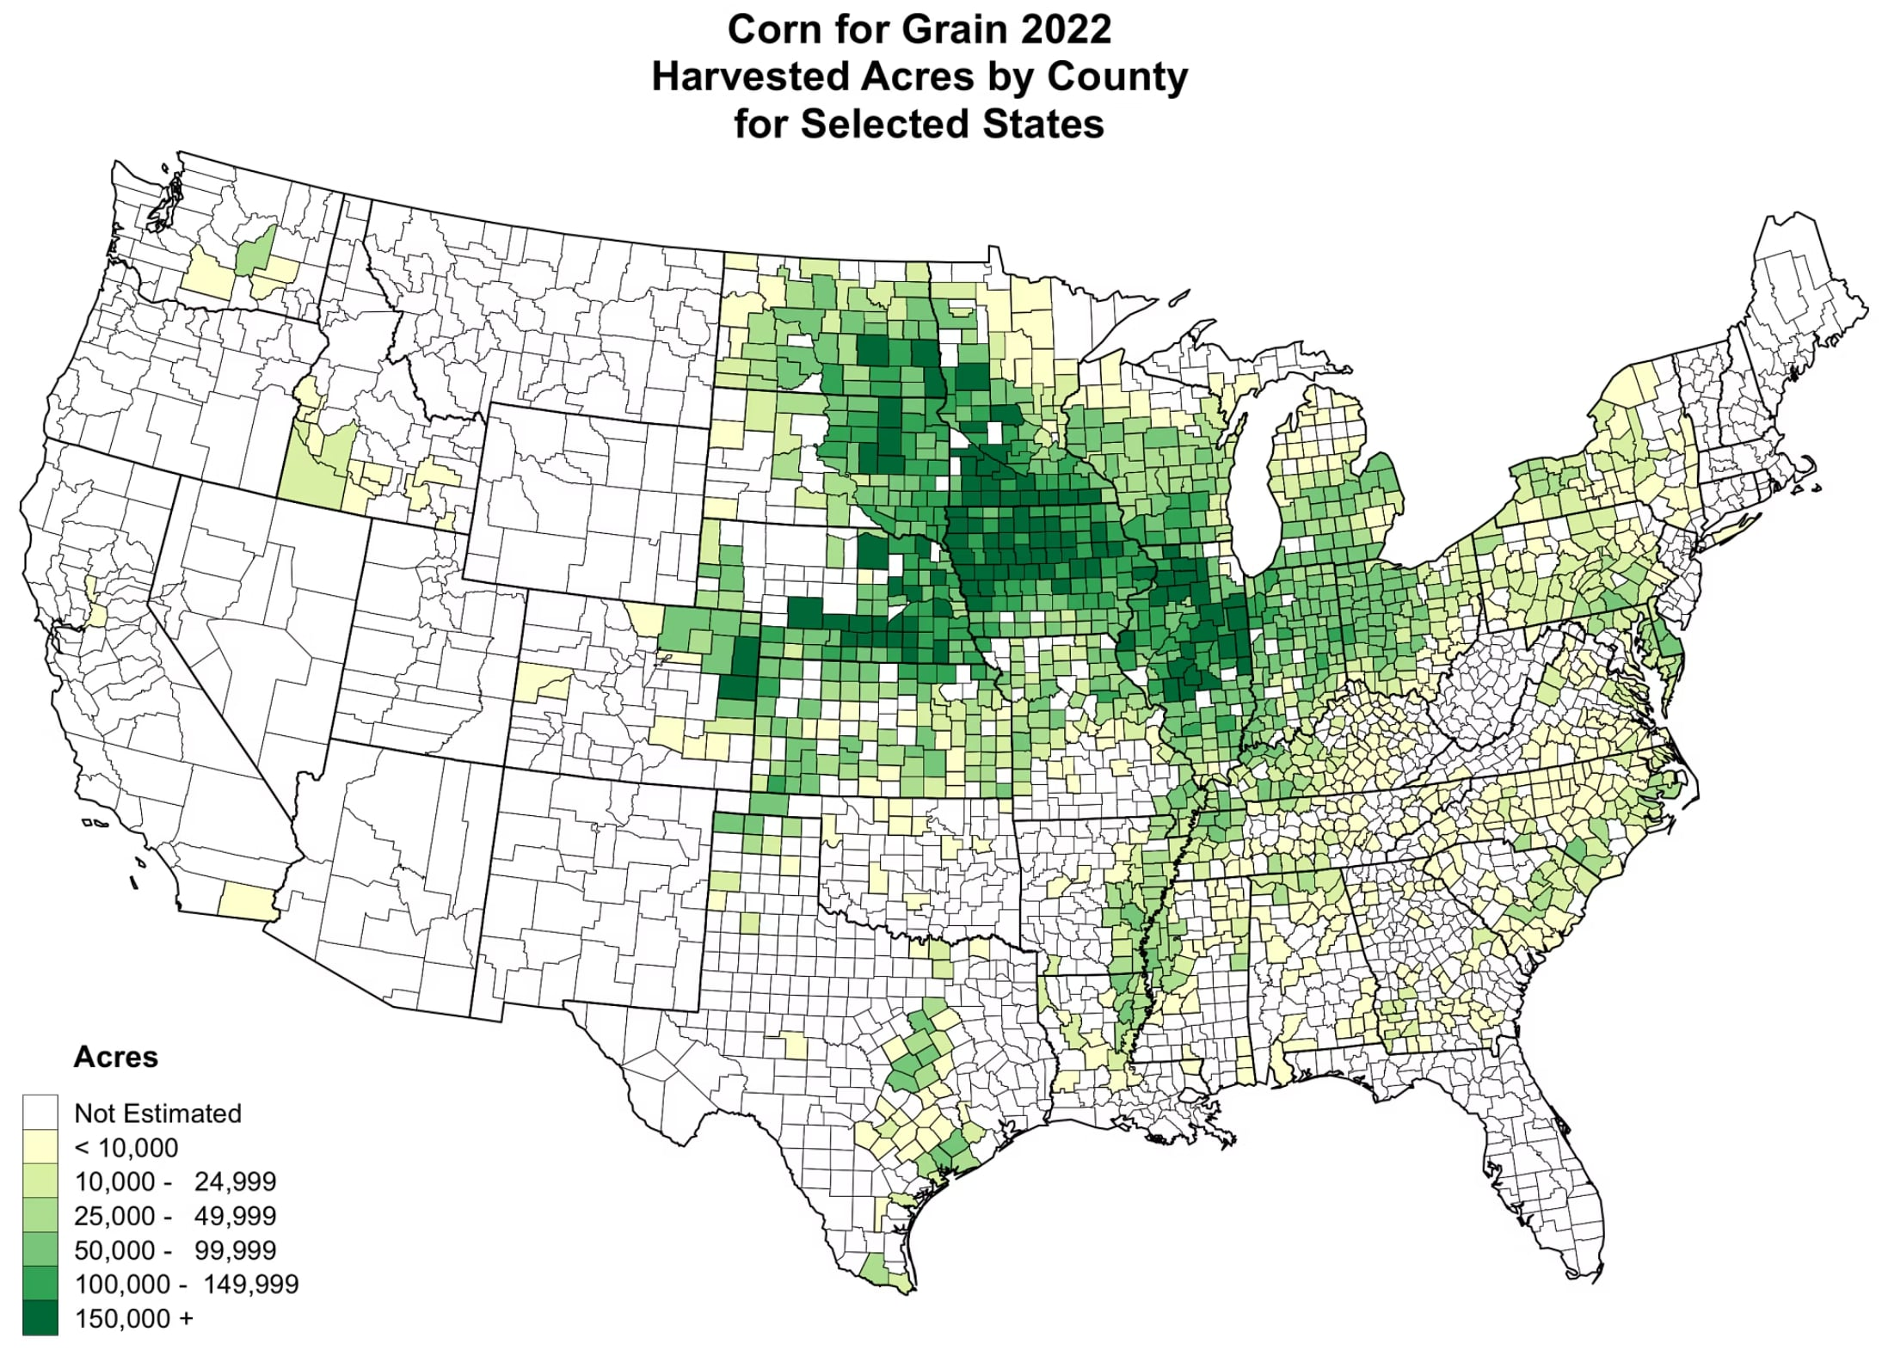
The Core Problem
What We Don't Know
Unknown transmission lag between Iowa and Ohio corn prices
Limited understanding of interstate market integration dynamics
Why It Matters
Evaluates market efficiency and price discovery speed
Supports evidence-based agricultural decision-making
Reusable framework for commodity market analysis

Slide 4

Scope Of Project
1
2
Detect Direction
Estimate Lag
Determine whether Iowa corn price movements influence Ohio prices
Quantify transmission lag using Time-Lagged Cross-Correlation (TLCC)
3
4
Validate Rigorously
Ensure Reproducibility
Granger Causality, Engle-Granger Cointegration, Bootstrap & holdout testing
Full pipeline using real USDA NASS monthly data (2015–2026)

Slide 5
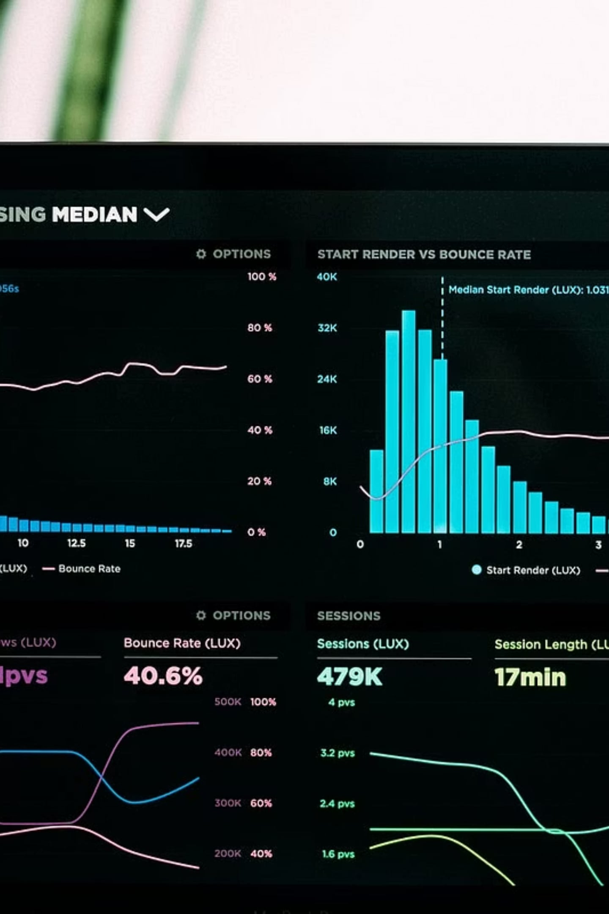
Key Analytical Methods
TLCC
Time-Lagged Cross-Correlation for lag estimation
Granger Causality
Tests if Iowa prices predict Ohio prices
Engle-Granger
Cointegration for long-run market relationship
Bootstrap
Confidence intervals for robust validation

Slide 6
Scope & Limitations
✅ What's Covered
⚠️ Known Limitations
USDA NASS monthly corn prices, 2015–2026
Iowa–Ohio interstate comparison
TLCC, Granger, Cointegration, Bootstrap
Holdout validation & lag analysis
Monthly resolution limits daily/weekly lag detection
Single commodity–state pair; broader validation pending
Cointegration sensitivity to analysis period
No rolling robustness across multiple state pairs yet

Slide 7
Implementation
Module architecture
fetch.py
clean.py
analysis.py
validation.py
NASS API client, multi-state, cached
Raw CSVs to aligned monthly panel
TLCC, Granger, cointegration
Train/holdout backtest
config.py — env vars, shared paths
pipeline.py orchestrates all four stages end-to-end for an arbitrary commodity/state pair.
Each module is independently runnable and testable via its own CLI.

Slide 8
Implementation
Setup and usage
Setup
Usage
python -m venv venv
source venv/bin/activate
pip install -r requirements.txt
echo "USDA_NASS_APIKEY=your_key_here" > .env
cd src
# check availability first
python fetch.py --scan --commodity CORN \
--states IOWA,OHIO,ILLINOIS
# full pipeline: fetch -> clean -> analysis
# -> validation, in one command
python pipeline.py --commodity CORN \
--hub IOWA --local OHIO \
--year-start 2015 --year-end 2026 \
--holdout-start 2024-01-01
Free NASS API key: quickstats.nass.usda.gov/api
Rerun without hitting the API again: add --skip-fetch to reuse cached data.

Slide 9
Implementation
Demonstration of functionality
End-to-end pipeline run
Rerun with --skip-fetch
Output consistency
Confirmed working
Confirmed working
Bit-identical
What a live run demonstrates
fetch.py pulls Iowa and Ohio corn price series from the NASS API and caches raw files
clean.py aligns both series into one monthly panel and computes returns
analysis.py runs TLCC, Granger causality, and cointegration on the full panel
validation.py reruns the same analysis on the training slice and compares against the full period

Slide 10
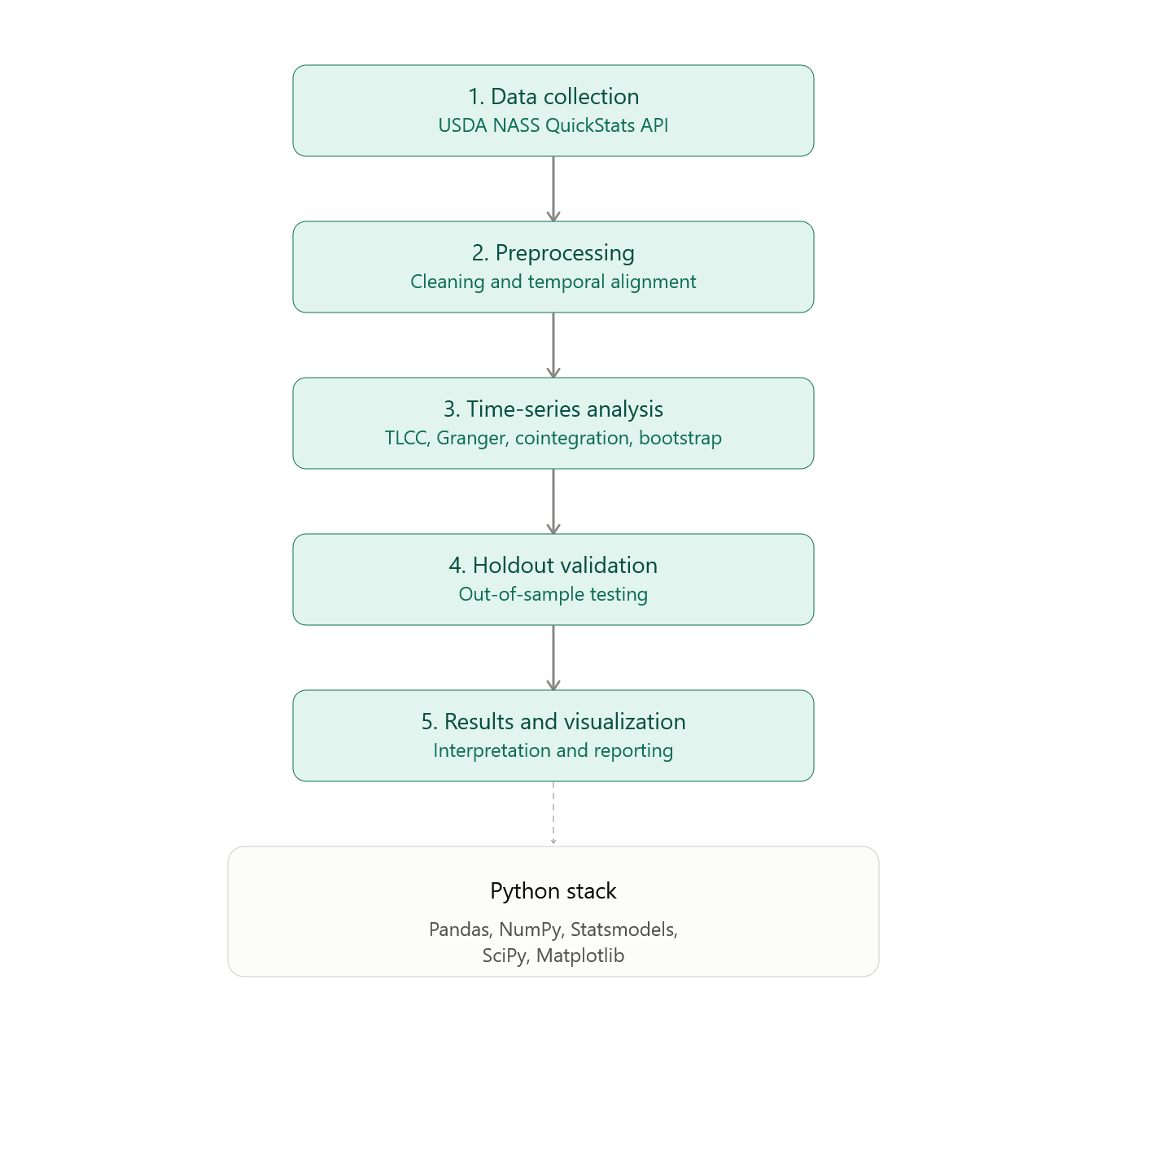
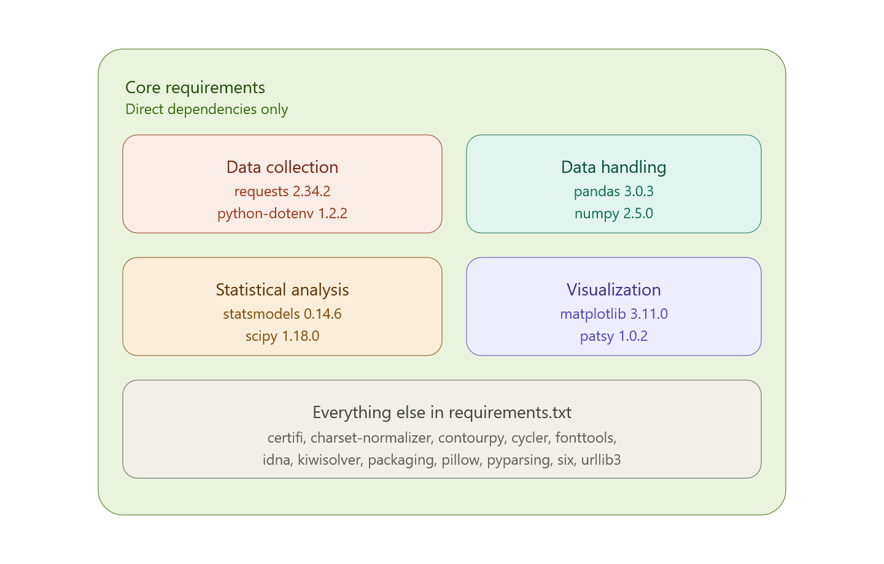
Methodology & Pipeline

Slide 11



Econometric Toolkit
Time-Lagged Cross-Correlation
Granger Causality
Identifies lag k maximizing price correlation between markets
Tests whether Iowa prices statistically predict Ohio prices
Engle-Granger Cointegration
Bootstrap Confidence Intervals
Confirms long-run equilibrium relationship between price series
Robust inference without strict distributional assumptions

Slide 12
Results
Iowa vs Ohio corn prices, 2015-2026
Peak correlation
Granger, Iowa to Ohio
Cointegration, full period
Rolling cointegration
0.840
Significant
Not detected
20 / 78
at lag k* = 0 months
lags 1 through 8
p = 0.1545
windows significant at 5%
Test outcomes
Bottom line
Stationarity (returns)
confirmed
Iowa price movements consistently lead Ohio's, holding up in both the training window and the full period. But the two series don't share a stable long-run equilibrium: cointegration appears in some slices of the data and not others.
Detectable lag (TLCC)
none at monthly resolution
Directional causality
Iowa leads Ohio
Structural break (spread)
not confirmed
Long-run equilibrium
not robust

Slide 13
Results detail
Stationarity and backtest comparison
3.1 Stationarity
3.6 Backtest: train vs full period
Series | ADF stat | p-value | Stationary @ 5%?
Iowa price (level) | -1.601 | 0.4829 | No (expected)
Ohio price (level) | -1.823 | 0.3691 | No (expected)
Iowa returns | -7.532 | 0.0000 | Yes
Ohio returns | -8.020 | 0.0000 | Yes
Metric | Train-only | Full period
k* (months) | 0 | 0
Peak correlation | 0.847 | 0.840
k* 95% CI | (0.0, 0.0) | (0.0, 0.0)
Min p, Iowa to Ohio Granger | 0.0045 | 0.0089
Cointegration p-value | 0.0004 | 0.1545
Reading
Stationarity, TLCC lag, and the Iowa-to-Ohio Granger asymmetry all came out as expected and held stable across both time windows. Cointegration is the exception: the full-period test and a 60-month rolling test (only 20 of 78 windows significant, hovering near the 5% boundary) both point to a marginal, noisy relationship rather than a stable equilibrium. This is a slice-sensitivity finding, not evidence of a structural break -- the Zivot-Andrews test found none.

Slide 14


Challenges & Solutions
Challenge
Initial dataset unsuitable; monthly resolution limited lag detection
Solution
Switched to USDA NASS QuickStats; applied robust preprocessing
Challenge
Ensuring statistical reliability across methods
Solution
Multi-method validation + holdout testing confirmed results

Slide 15


Skills Gained & Key Takeaway
Time-Series Analysis
Econometric Validation
Spatial price transmission, lag estimation, market integration
Granger, cointegration, bootstrap, reproducible research
Technical Stack
Python, USDA NASS API, Pandas, Statsmodels, SciPy, Matplotlib
Key Takeaway: Market relationships must be validated using multiple statistical methods to ensure reliable, reproducible findings.

Slide 16
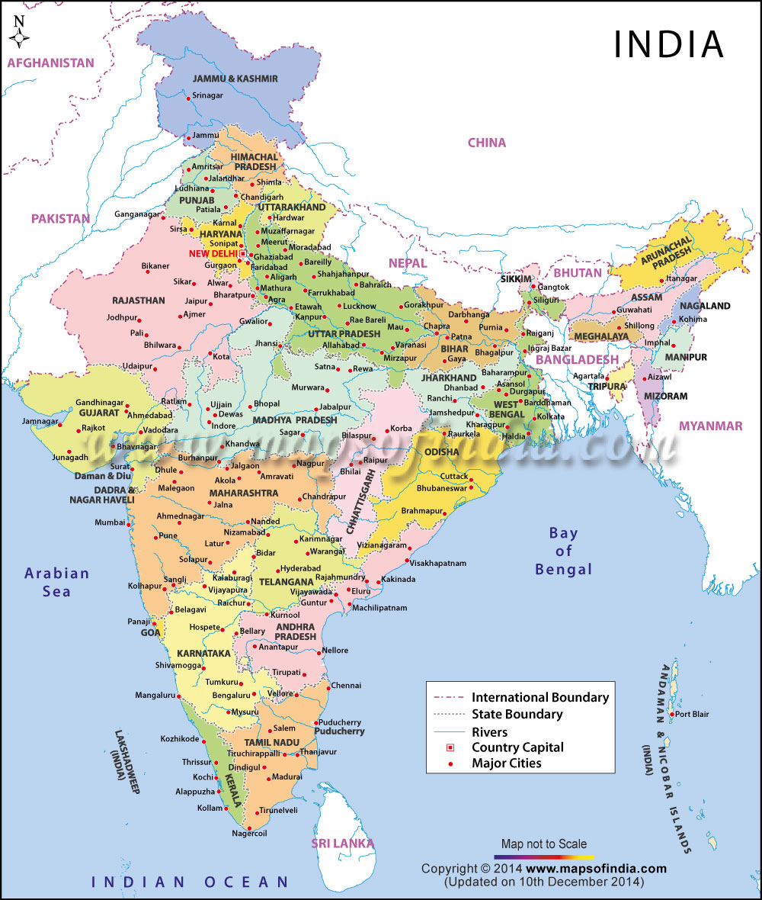
Future Scope & Conclusion
Expand
Expand INDIAN states & commodities
Higher Resolution
Daily USDA AMS data for finer lag analysis
Automate
Full pipeline + interactive dashboard
Key Finding
Strong same-month synchronization (k = 0) between the state

