Slide 1

Encapsulation ( Information Hiding )

Slide 2
Objectives
What is Encapsulation?
What encapsulation or information hiding approach provide in Object Oriented ?
General 3 different ways to Encapsulate data.
Advantages of Encapsulation.

Slide 3

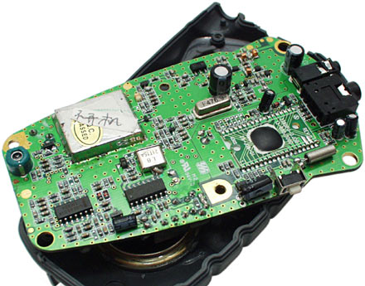
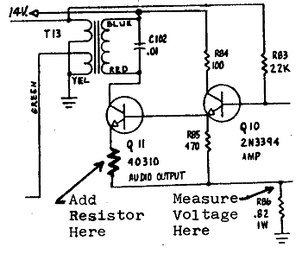
Encapsulation
“ to enclose in or as in a capsule ”
The object-oriented meaning of
encapsulation is to enclose related data,
routines and definitions in a class capsule.
Encapsulation is the ‘bundling together’
of data and behavior so that
they are inseparable.

Slide 4
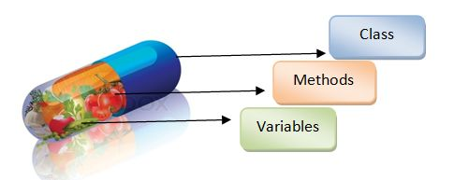
Why Encapsulation is also called information hiding ?
Encapsulation also called information hiding.
Encapsulation has ability to combine
data structure and behavior in a
single entity.
Notes:
Encapsulation (also called information hiding) consists of separating the external aspects of an object, from the internal implementation details of the object, which are hidden from other objects.
Encapsulation has ability to combine data structure and behavior in a single entity makes encapsulation cleaner and more powerful than in conventional languages that separate data structure and behavior.
The purpose of Information hiding is to make inaccessible certain details that should not affect other parts of a system

Slide 5
What encapsulation approach provides in Object Oriented?
The interface is the visible surface of the capsule.
The interface describes the essential characteristics of objects of the class which are visible to the exterior world.
Interface data – which should be visible from outside/other class or method.
The implementation is hidden in the capsule.
The implementation hiding means that data can only be manipulated, that is updated, within the class, but it does not mean hiding interface data.
Implementation data – which should be hidden from outside/other class or method.
Notes:
A function is an interface and has function definition, and A class is an implementation
and has its declaration includes all implementation details of data and function members.

Slide 6
General 3 ways to Encapsulate Data
Public member access specifier
Private member access specifier
Protected member access specifier

Slide 7
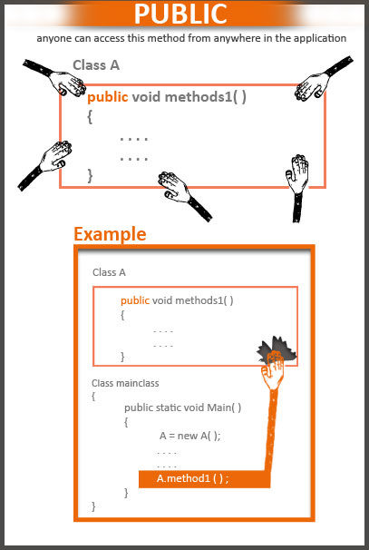
1. Public access specifier.
Syntax
public: <declarations>
A public member can be accessed
by any function.

Slide 8

2. Private member access specifier
Syntax
private: <declarations>
A private member can be accessed
only by member functions and
friends of the class in which
it is declared.

Slide 9
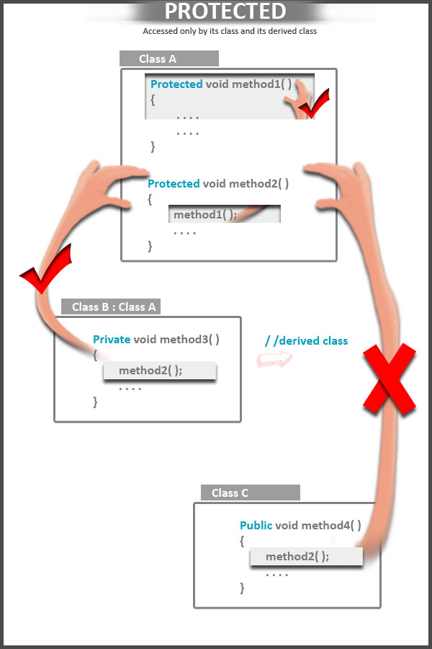
Protected access specifier
Syntax
protected: <declarations>
A protected member can be
accessed by member functions and
friends of the class in which it was
and by the classes derived

Slide 10
Advantages of Encapsulation
It prevents others from accessing the members directly.
It’s main aim is to prevent accidently occurring changes.
Notes:
The only thing that can manipulate the data in an object is that object’s method or member function.
It builds a protective wall (encapsulation) around the member data and member function of the class, and hiding implementation details of object. So It keeps data safe from accident.

Slide 11


