Slide 1
FCL: Framework Class Library

Slide 2
FCL
“The .NET Framework class library is a library of classes, interfaces, and value types that provide access to system functionality. It is the foundation on which .NET Framework applications, components, and controls are built.”

Slide 3
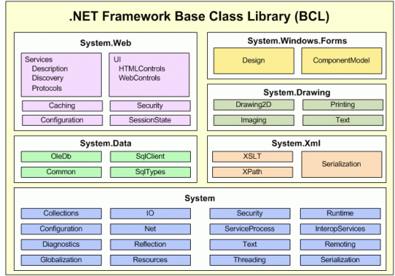
Base Class Library

Slide 4
System Library
The System Library contains fundamental classes and base classes that define commonly-used value and reference data types, events and event handlers, interfaces, attributes, and processing exceptions.

Slide 5
I/O library
Input/output library in System.IO namespace
Compiled into mscorlib.dll assembly
Support provided for:
file and directory management
text files
binary files

Slide 6
Part 2
Database access…

Slide 7
Database library
Database access provided by System.Data.* namespaces
Compiled into System.Data.dll assembly
Known collectively as ADO.NET
native support for SQL Server and Oracle
support for other databases via older OleDB technology
requires a knowledge of SQL
Core namespaces:
general: System.Data, System.Data.Common
SQL Server: System.Data.SqlClient
Oracle: System.Data.OracleClient
OleDB: System.Data.OleDb

Slide 8
Part 3
Data structures…

Slide 9
Collections library
Data structures in .NET are generally known as Collections
Located in the namespace System.Collections
Compiled into mscorlib.dll assembly
Defined in terms of object for generic use
Core classes:
Array
ArrayList
Hashtable
Stack
Queue

Slide 10
Thank You

