Slide 1
Inheritance

Slide 2
Inheritance
Inheritance is the capability of a class to use the properties and methods of another class while adding its own functionality.
Enables you to add new features and functionality to an existing class without modifying the existing class.

Slide 3
Inheritance
Base class and Subclass
A Baseclass or parent class is the one from which another class inherits attributes and behavior.
A subclass or child class is a class that inherits attributes and behavior from a Baseclass.

Slide 4
Inheritance
Employee
Manager
Secretary
Programmer

Slide 5
Types of Inheritance
Single inheritance
Subclass is derived from only one superclass.
Super class
/Base Class
(Parent)
Sub class
/Derived Class
(Child)

Slide 6
Types of Inheritance
Multiple Inheritance
A subclass is derived from more than one super class.
Super Class
(Parent 1)
Super Class
(Parent 2)
Sub Class
(Child)

Slide 7
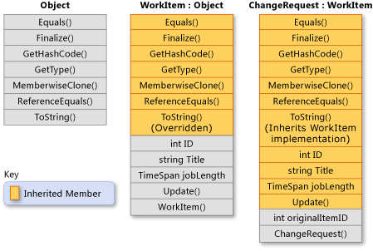
Examples
Class inheritance

Slide 8
Deriving Classes
Extending Base Classes
Accessing Base Class Members

Slide 9
Extending Base Classes
Syntax for deriving a class from a base class
A derived class inherits most elements of its base class
A derived class cannot be more accessible than its base class
class Token
{
...
}
class CommentToken: Token
{
...
}
Derived class
Base class
Colon

Slide 10
Accessing Base Class Members
class Token
{ ... class Outside
protected string name; {
} void Fails(Token t)
class CommentToken: Token {
{ ... ...
public string Name( ) t.name
{ ...
return name; }
} }
}
Inherited protected members are implicitly protected in the derived class
Methods of a derived class can access only their inherited protected members
Protected access modifiers cannot be used in a struct
û
✓

Slide 11
What really happens?
When an object is created using new, the system must allocate enough memory to hold all its instance variables.
This includes any inherited instance variables
In this example, we can say that an Employee "is a kind of" Person.
An Employee object inherits all of the attributes, methods and associations of Person
Person
- name: String
- dob: Date
Person
name = "John Smith"
dob = Jan 13, 1954
Employee
name = "Sally Halls"
dob = Mar 15, 1968
employeeID = 37518
salary = 65000
startDate = Dec 15, 2000
is a kind of
Employee
- employeeID: int
- salary: int
- startDate: Date

Slide 12
Thank you

