Slide 1

Wipro Capstone Project
Automation Testing using Java, Selenium, TestNG,
Cucumber, Jira, Zephyr, Jenkins, Git & GitHub
Presented by Prem Kumar | Java Selenium Batch - 03

Slide 2
Capstone Project – SauceDemo
SauceDemo is an e-commerce web application where end-to-end test automation is implemented.
The project covers login validation, product selection, cart management, and checkout flow.
It focuses on building a robust automation framework with detailed reporting and CI/CD integration.
Tools Used
Eclipse – IDE for development
TestNG – Test management & reporting
Maven – Build automation & dependency management
Cucumber - Behavior-Driven Development (BDD) framework for writing test cases in plain English (Gherkin syntax)
Jira & Zephyr – Test case management & tracking
Git & GitHub – Version control & collaboration
Jenkins – Continuous Integration/Delivery

Slide 3
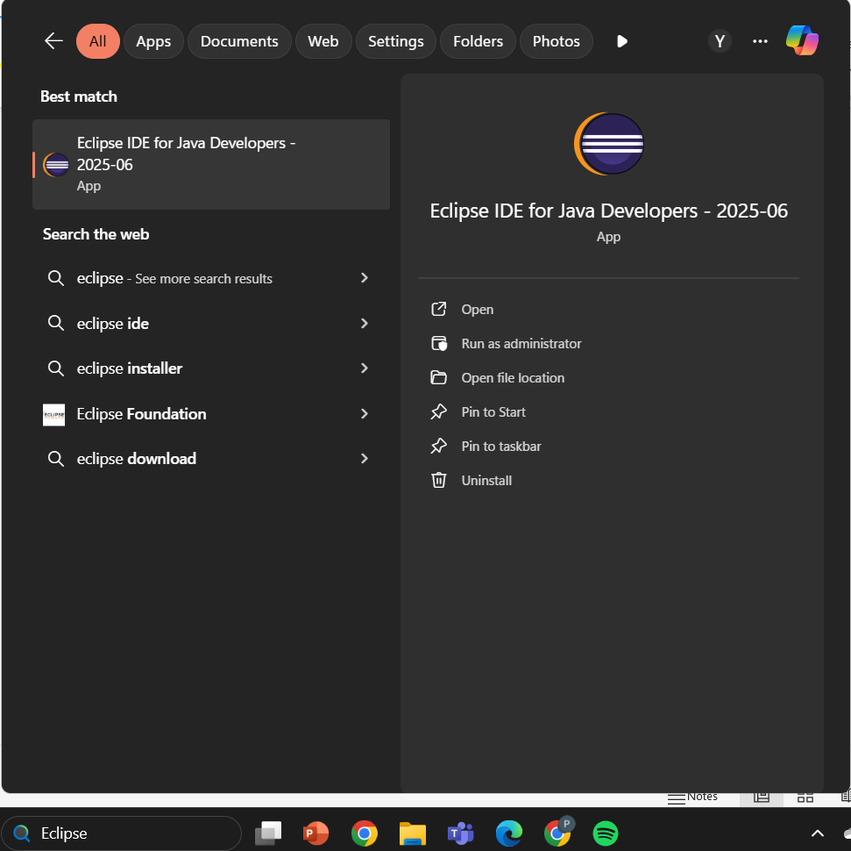
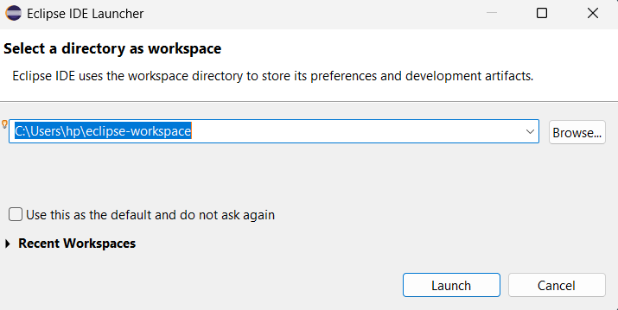
Run as Administrator
Click here to launch Eclipse

Slide 4
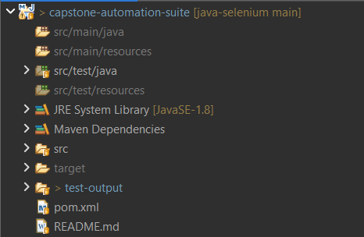
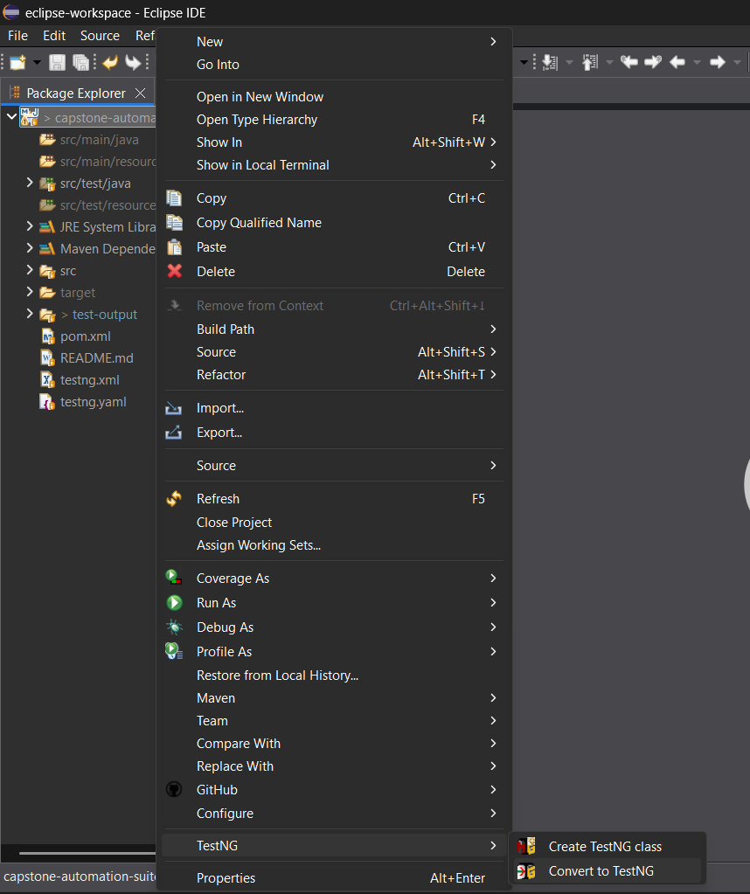
Converting into TestNG
Steps used to convert project into TestNg.

Slide 5
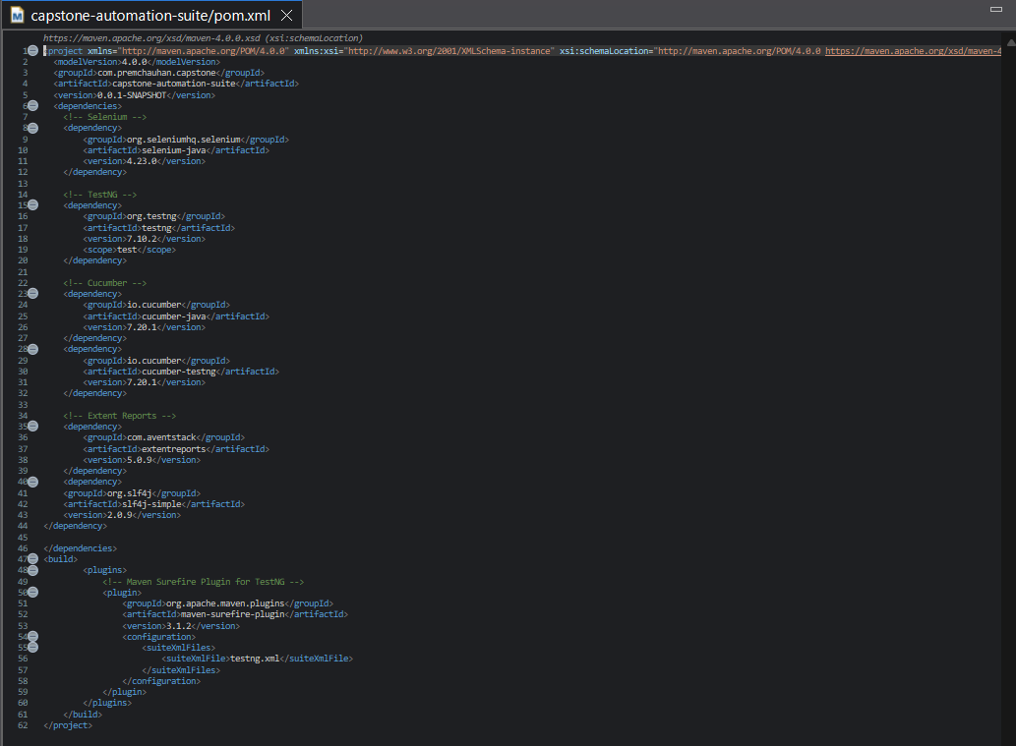
pom.xml
The pom.xml defines the Maven project capstone-automation-suite with version 0.0.1-SNAPSHOT.
Dependencies include Selenium, TestNG, Cucumber, Extent Reports, SLF4J, and Lombok for automation testing.
The Maven Surefire Plugin is configured to run the TestNG suite (testng.xml

Slide 6
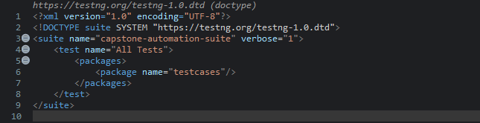
testng.xml
The TestNG file defines a suite named capstone-automation-suite.
It is set up to execute all automated tests together.
The suite points to the testcases package for running tests.
This ensures organized and efficient test execution in the project.

Slide 7
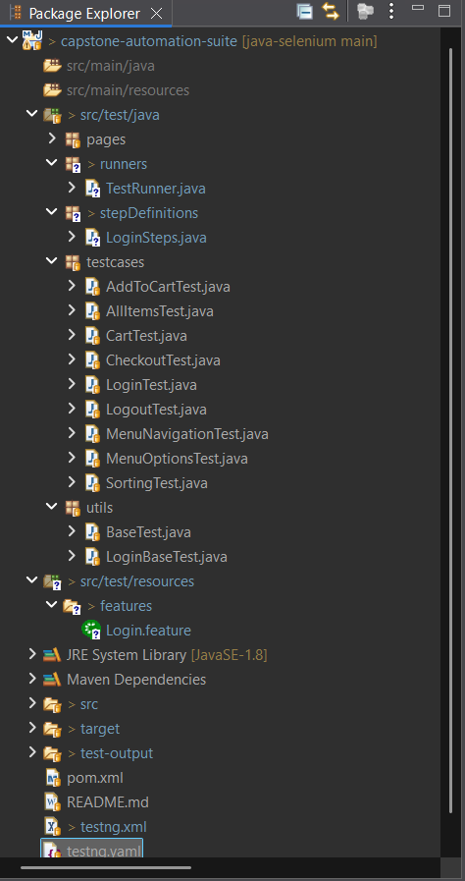
Project Structure
Configures Cucumber to run feature files and step definitions.
Contains all Step definition
Right now it show Cucumber step definitions for login scenarios.
📂 testcases folder → Contains all automation test files (TestNG & Cucumber) for Sauce Demo application. Each file validates specific functionality like login, cart, checkout, menu, sorting, and overall navigation.
📂 utils folder → Contains base classes for test setup. BaseTest manages WebDriver lifecycle, while LoginBaseTest extends it with login-specific setup for reusability.
📂 features folder → Contains Cucumber feature files written in Gherkin syntax, defining test scenarios such as login and other user workflows.

Slide 8
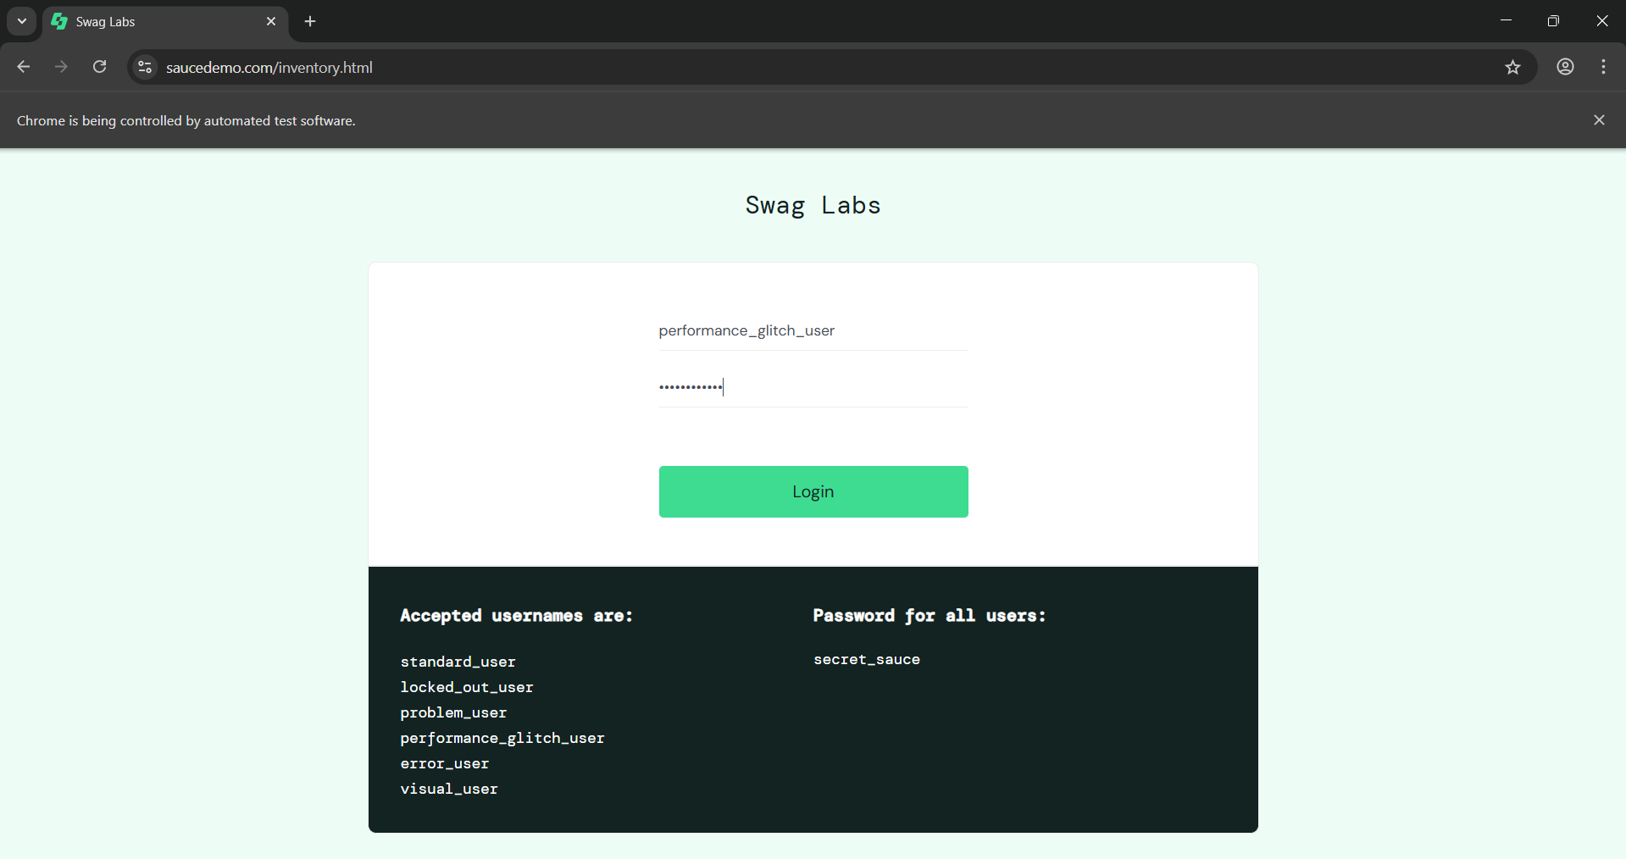
SauceDemo Login Page Automation
This Shows Site is under Automation using Chrome
This is the Swag Labs login page from SauceDemo, used for Selenium automation testing.
Multiple login scenarios are tested using different users like standard_user, locked_out_user, problem_user, performance_glitch_user, error_user, and visual_user.
The test automation verifies valid, invalid, and edge cases of login functionality
Example shown here:
login with performance_glitch_user to validate system performance under specific conditions.

Slide 9
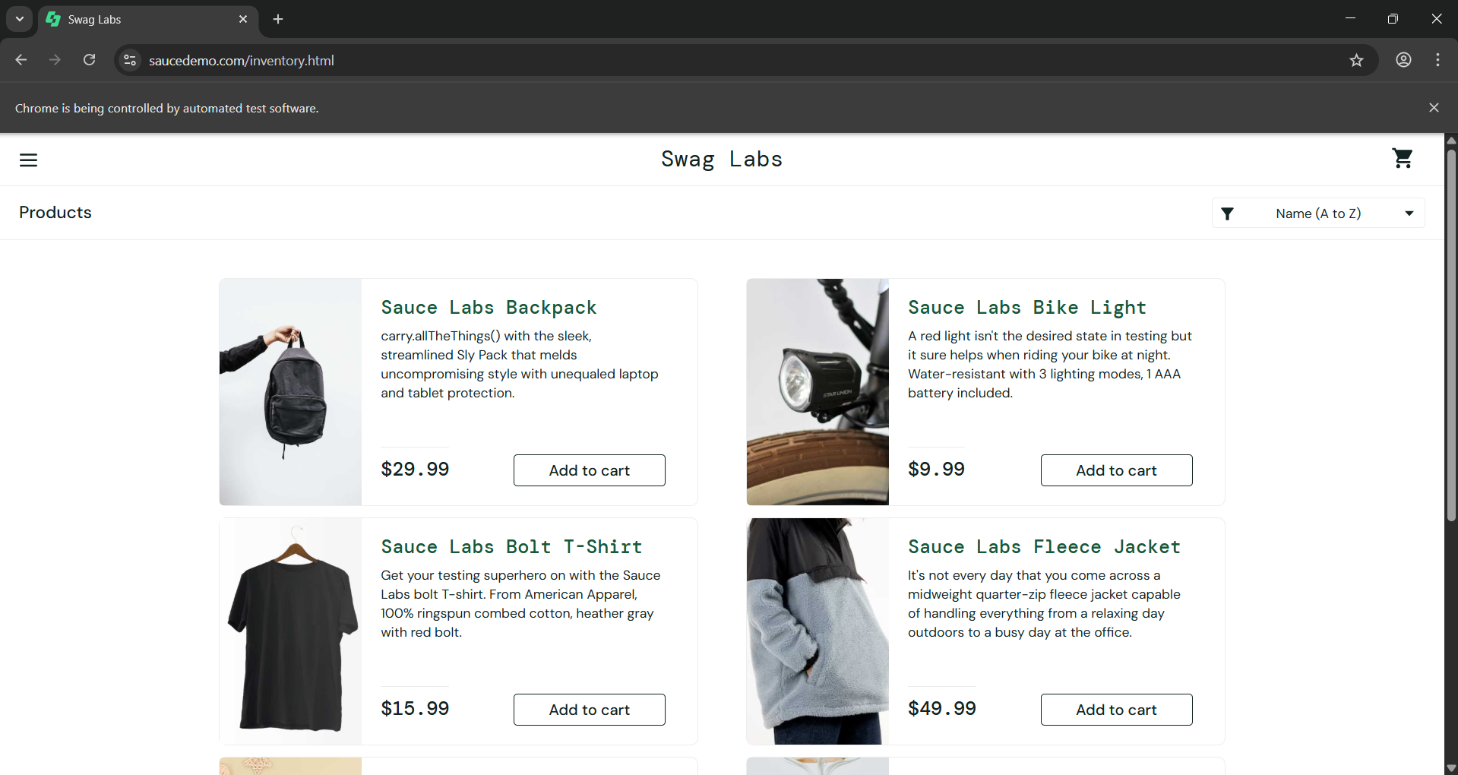
Showing Automation in Homepage
This Shows Automation in Homepage
This page displays a list of products available for purchase in Swag Labs (e.g., Backpack, T-Shirt, Bike Light, Jacket).
Automation scripts validate functionalities like sorting, filtering, and adding items to the cart.
Each product has a price and an “Add to cart” button, which is tested for correct cart operations.
Ensures that the e-commerce flow works smoothly from product selection to checkout.

Slide 10
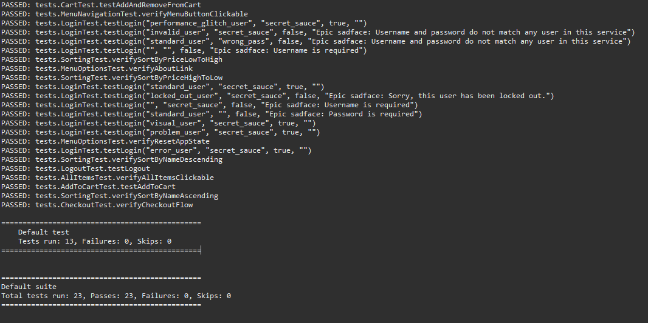
Test Logs/Console Result
Displays real-time execution logs of all Selenium TestNG test cases.
Each test result (Passed/Failed/Skipped) is clearly shown with method names.
Helps developers quickly verify login flows, navigation, and sorting features in the application.
Final summary provides total tests run, passed, failed, and skipped, ensuring full test coverage.

Slide 11
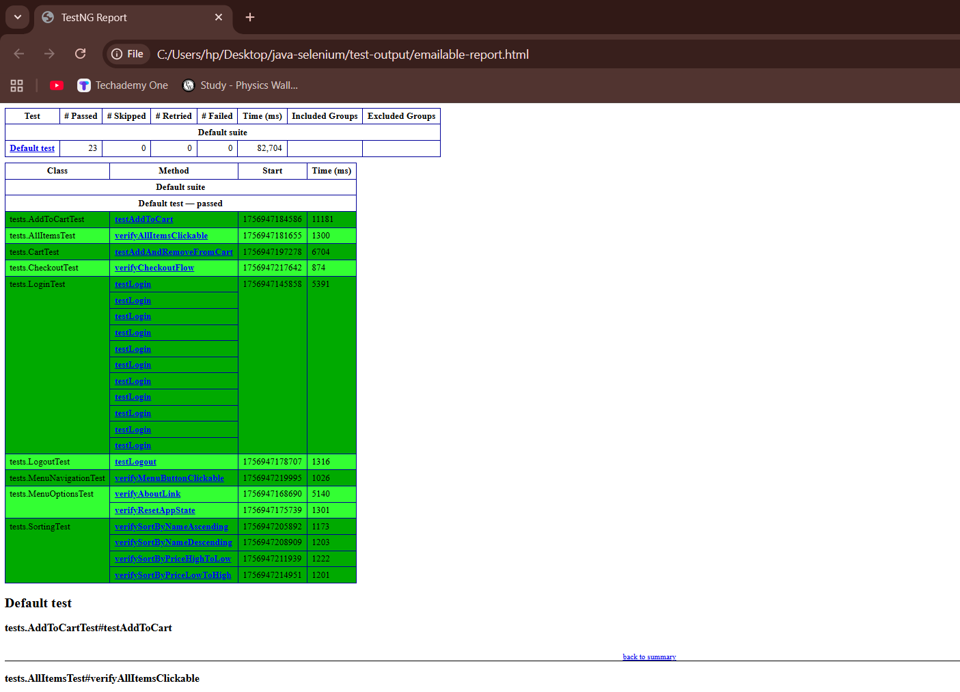
Emailable-report.html
This is a TestNG Automation Report generated after executing Selenium test cases in Eclipse.
It shows the number of passed, failed, skipped tests along with execution time.
Helps in tracking test results and validating whether all functionalities are working correctly.
Provides detailed logs for each test method, making debugging and reporting easier.

Slide 12
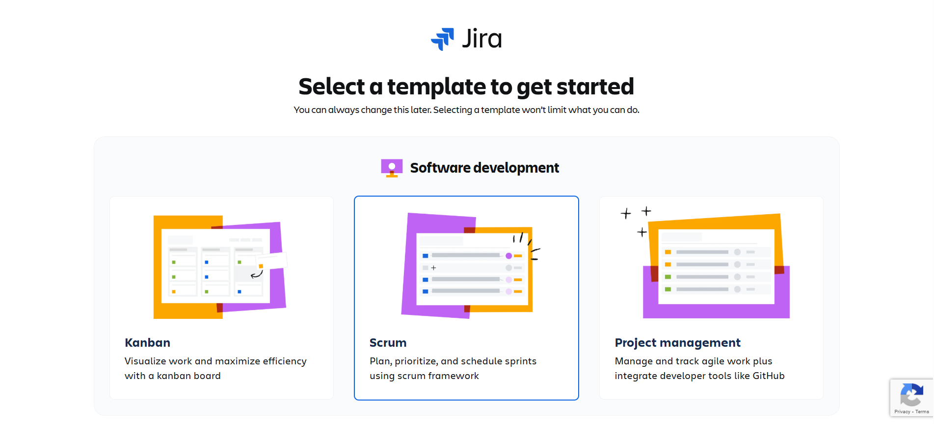
Jira
Project Management option provided for broader planning and control.
Kanban option also available for workflow visualization.
Selected Scrum framework for project tracking.

Slide 13
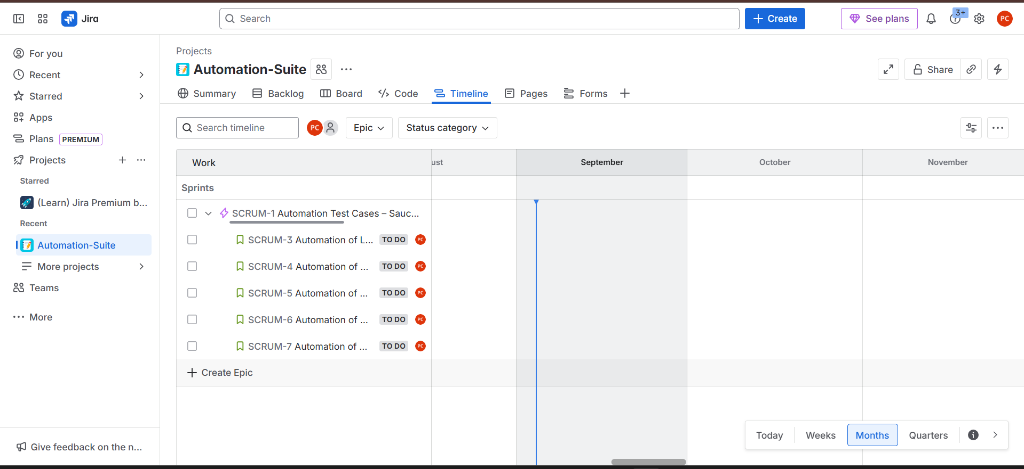
Epic And Stories
Epic created to represent the larger project goal .
User stories listed under the epic to track individual tasks and progress.

Slide 14
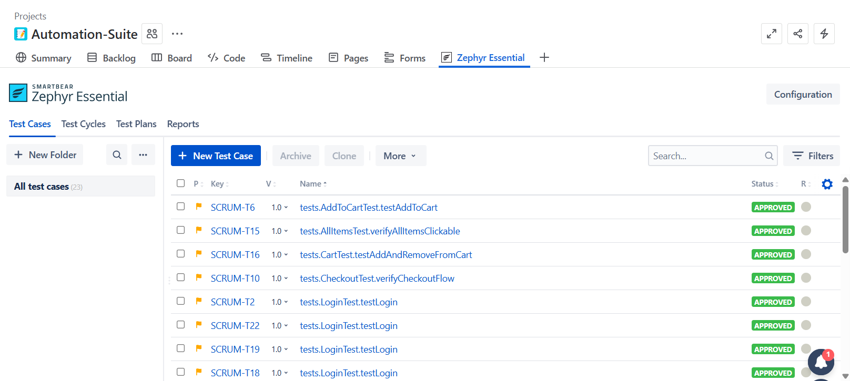
Zephyr
All test Cases Perform in Eclipse as Well
Status is Approved

Slide 15
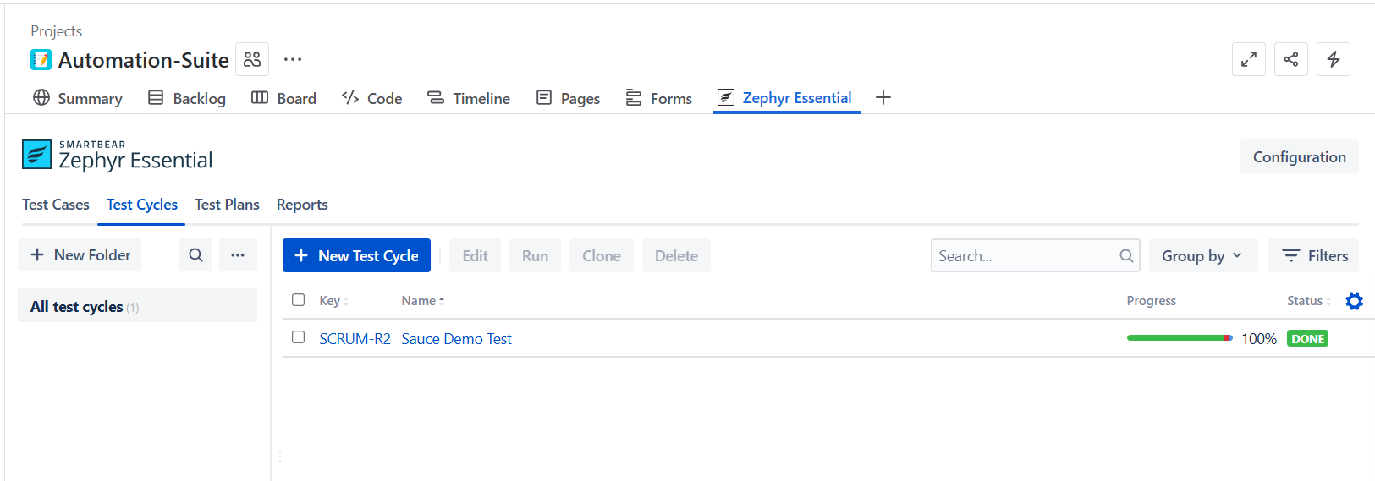
Test Cycle and Test Plans
Detailed execution results and metrics for tracking test progress and quality.
Individual test scenarios with defined steps and expected results.
A collection of multiple test cycles organized for broader test coverage.
A group of test cases executed together for a specific build or sprint.

Slide 16
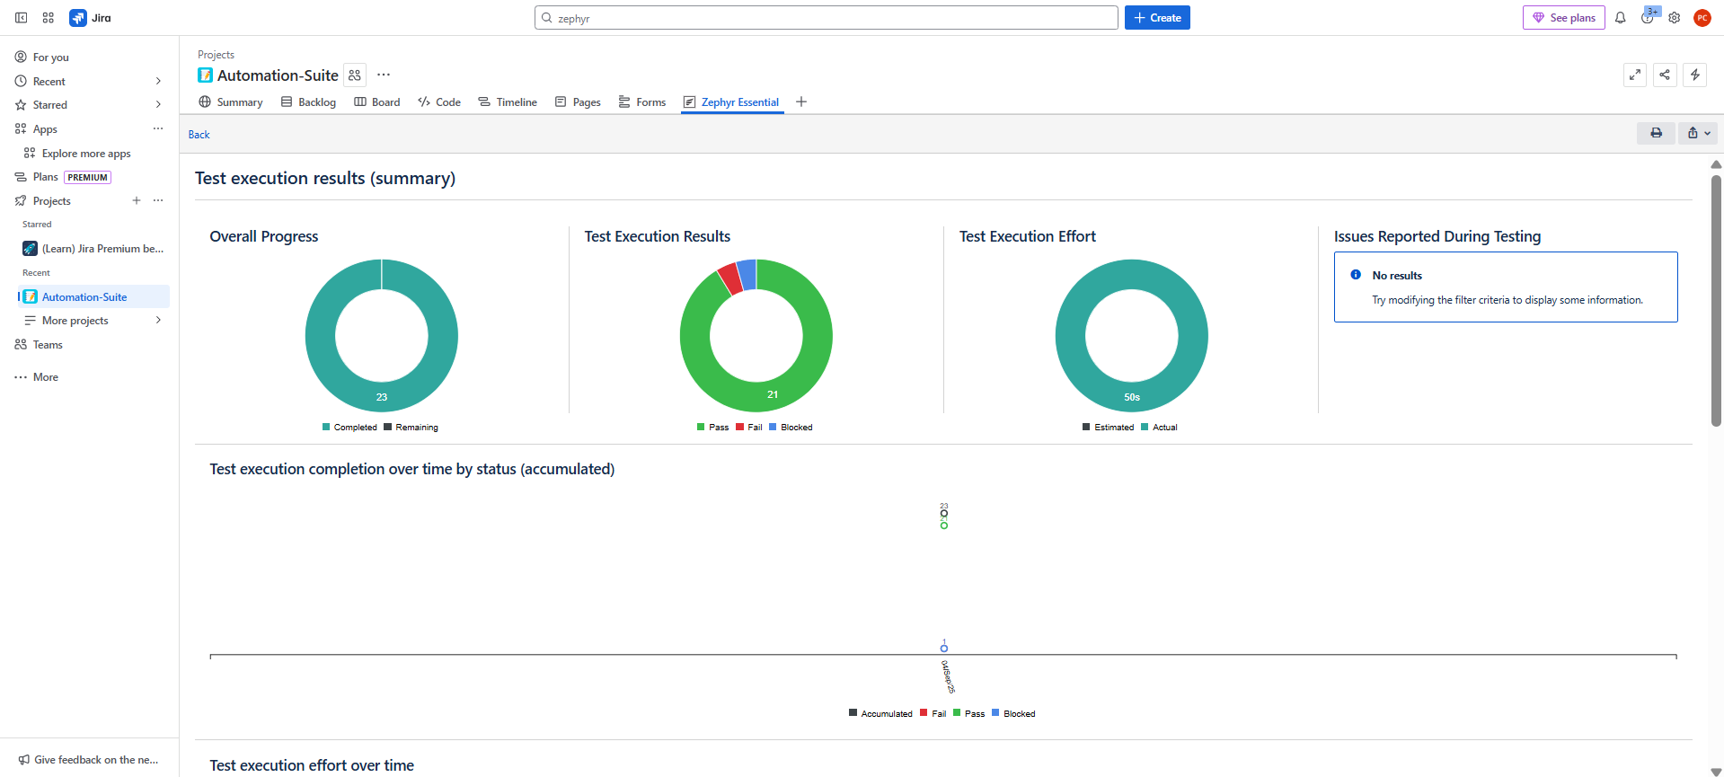
Test Execution Summary
Overall Progress: 23 test cases executed with all marked completed.
Execution Results: 21 tests passed, few failed/blocked.
Execution Effort: 50s estimated effort matched with actual execution.

Slide 17
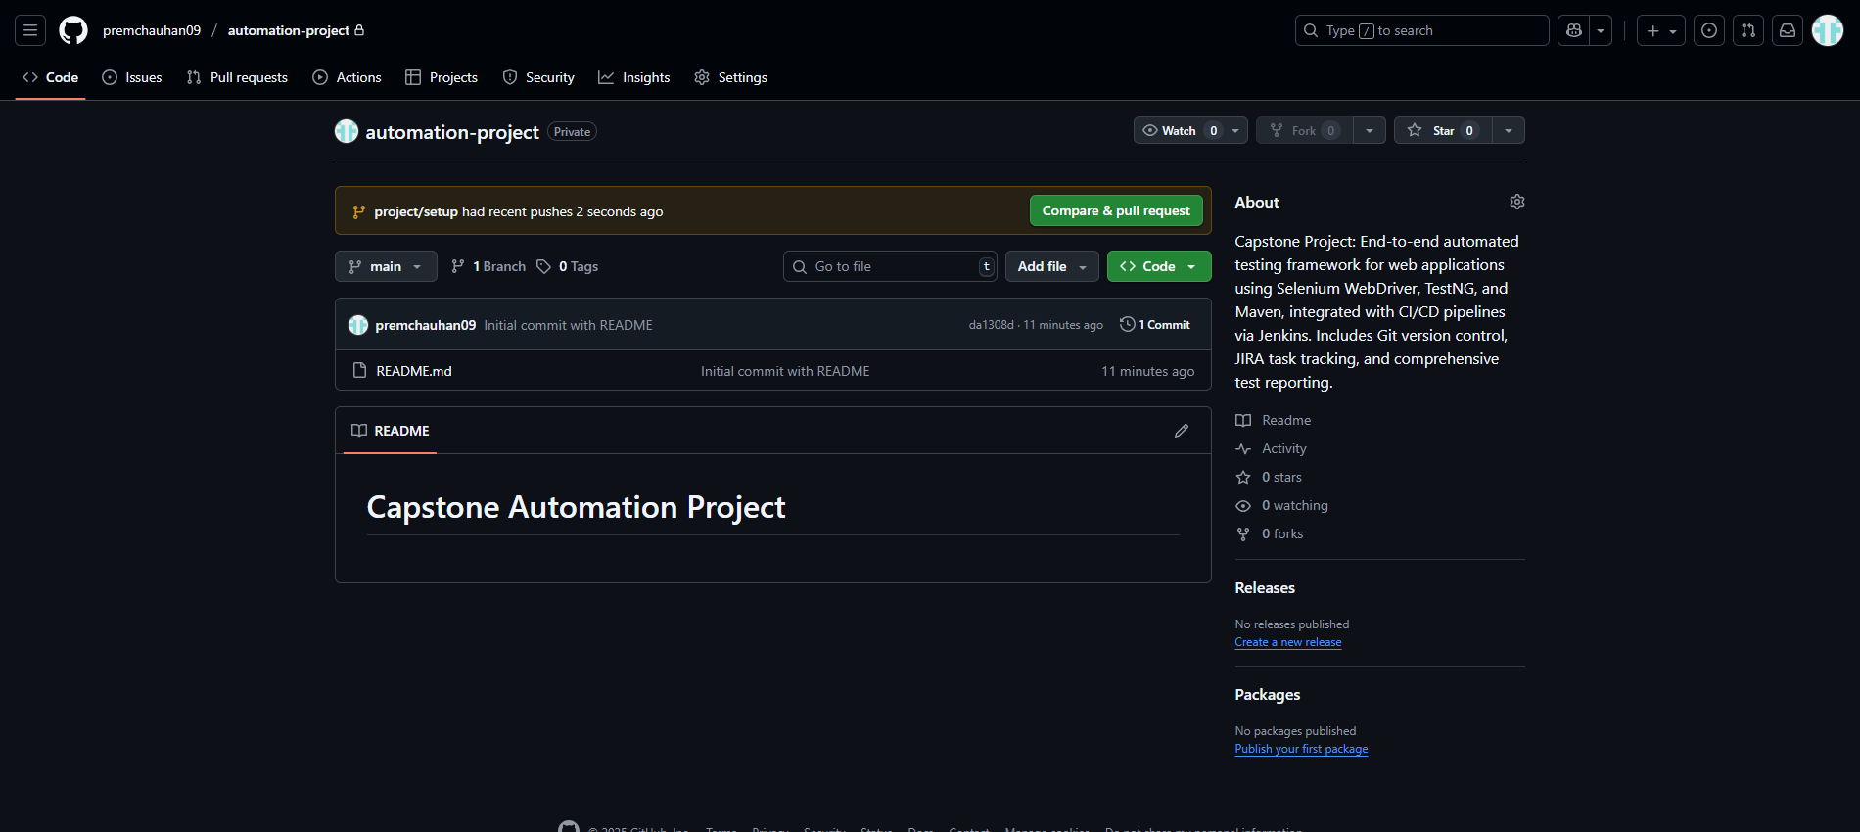
Git and GitHub
GitHub Interface
The GitHub repository has been initialized successfully, and a pull request has been created to propose changes.
The pull request is visible in the repository, ready for review and merging.

Slide 18
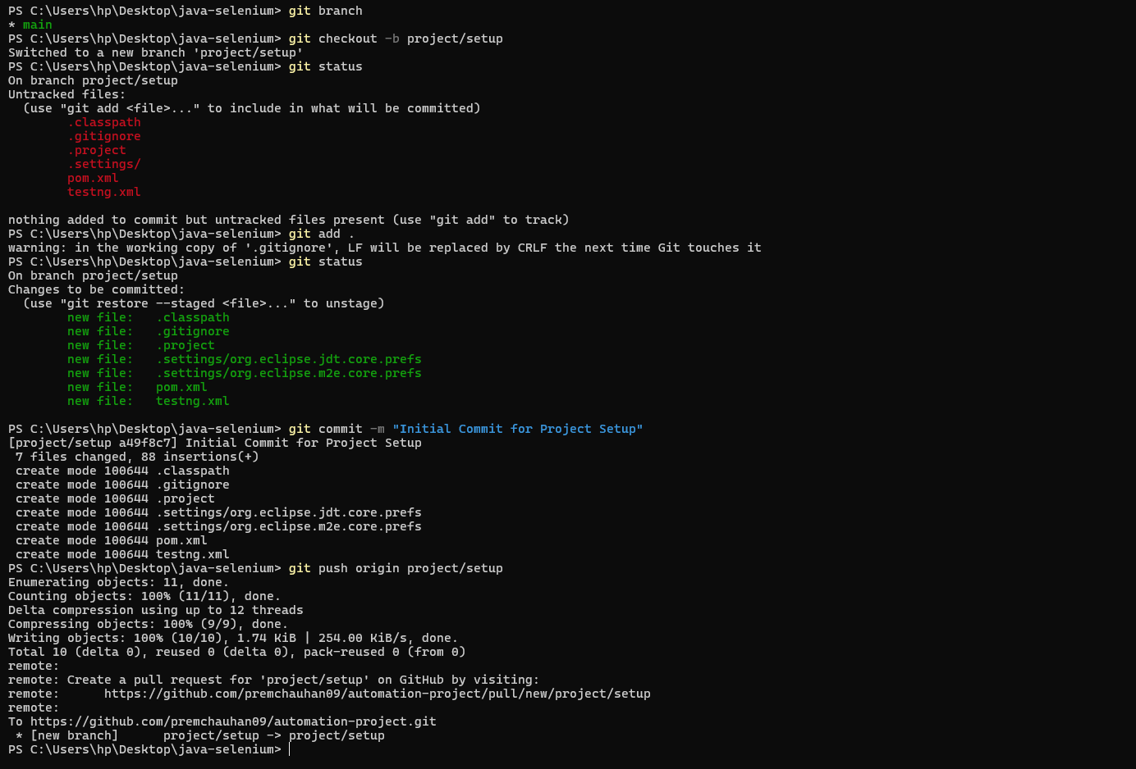
Git Commands
Created a new branch for feature development or changes.
Added modified or new files to the staging area.
Committed the changes with a descriptive message .
Pushed the branch and commits to the remote GitHub repository.

Slide 19
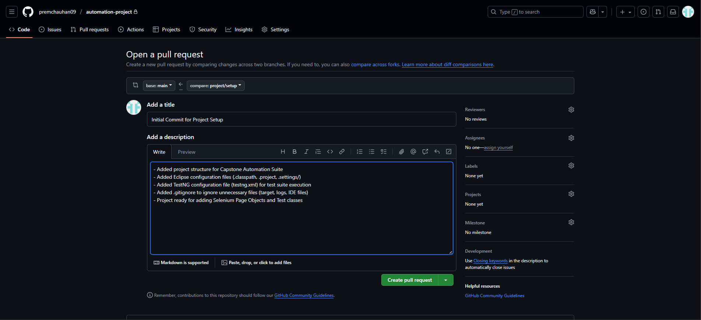
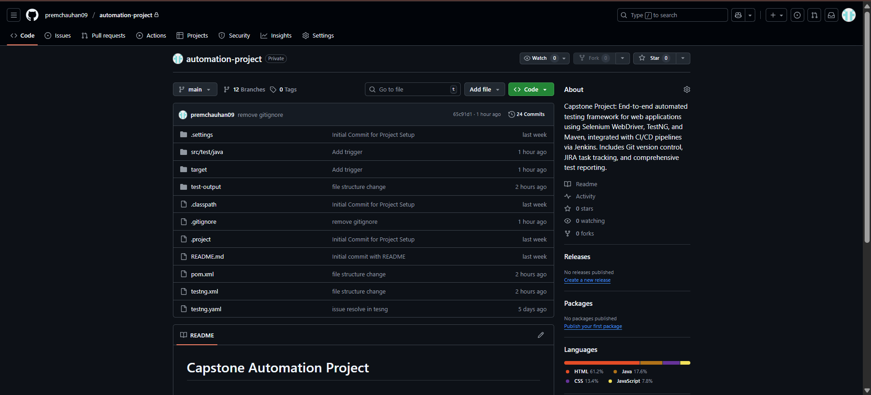
Repository
Creating a Pull request and add description.
Pushed Code showed into Git Repo
Complete repository with all project files and code.
Full commit history showing all changes and updates.

Slide 20
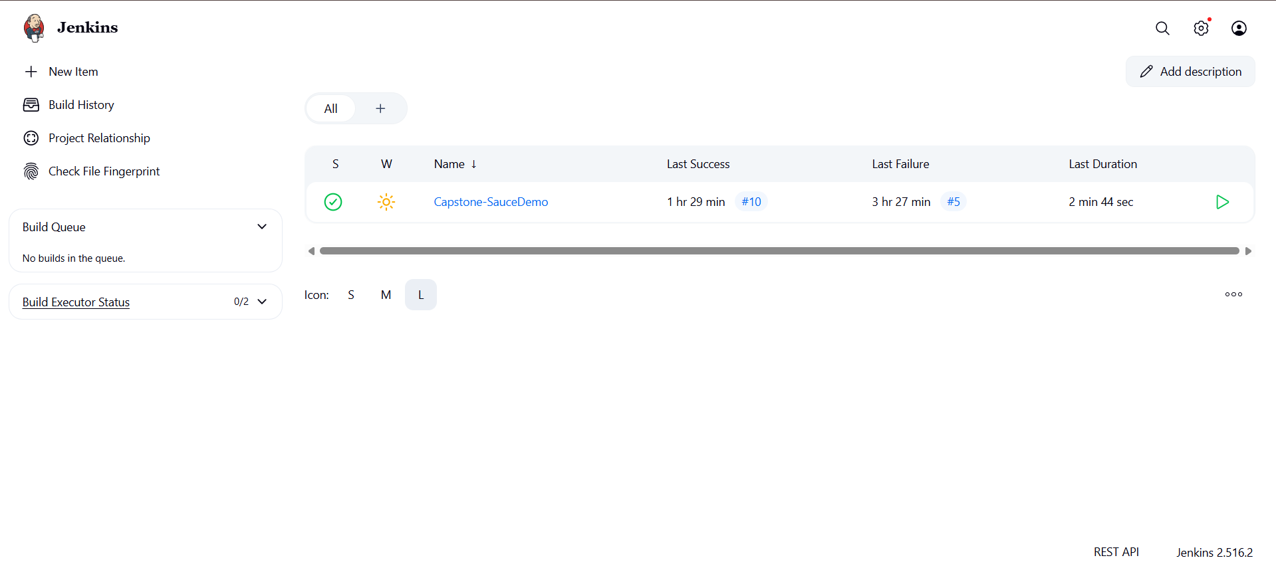
Jenkins
Integrate the Jenkins with github project.

Slide 21
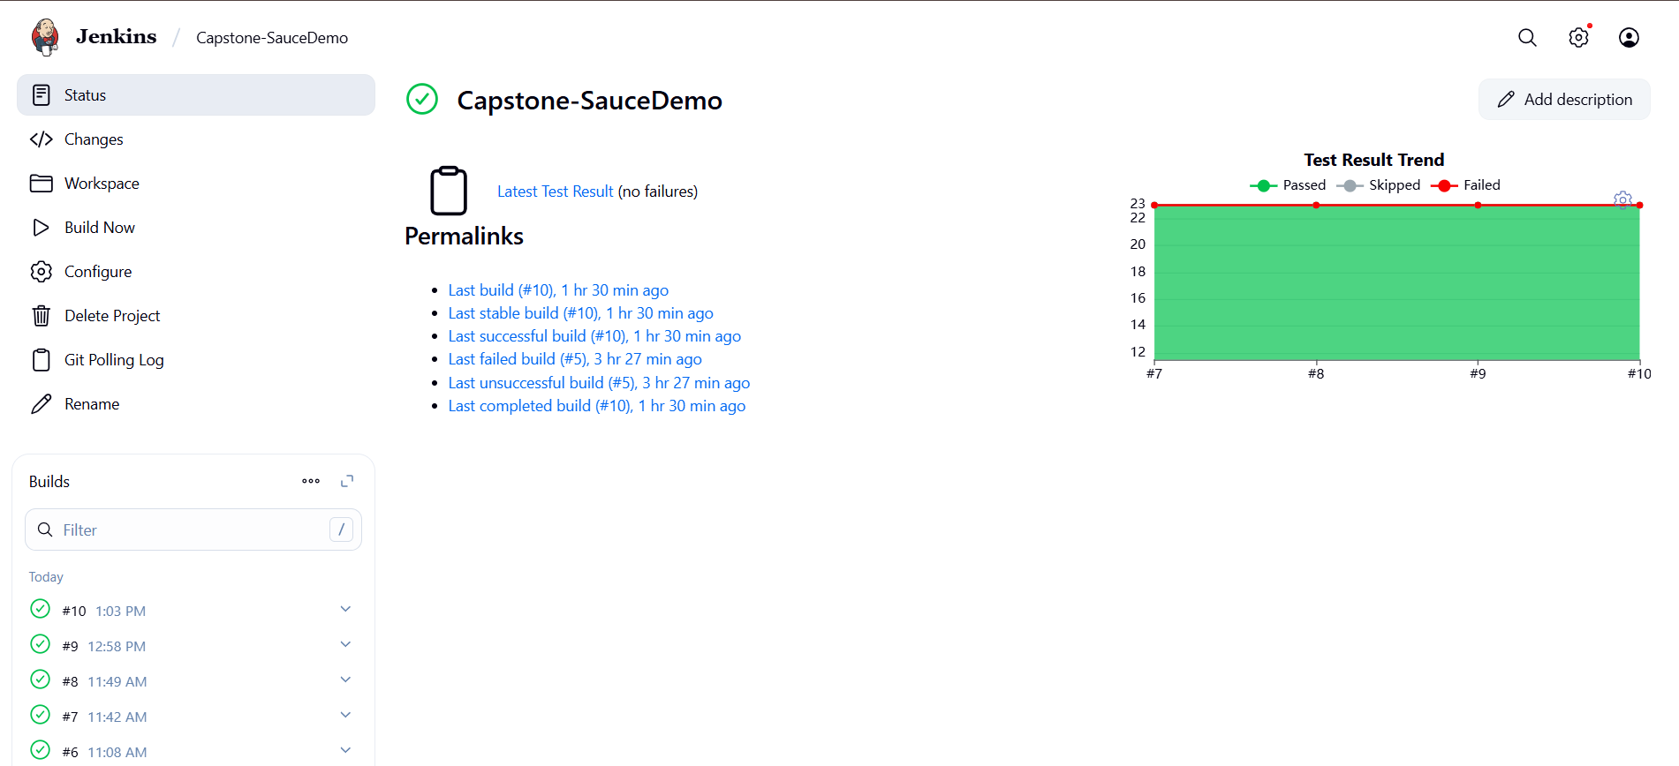
Test Result
Test Report
Using Graph
Showing Last build History

Slide 22
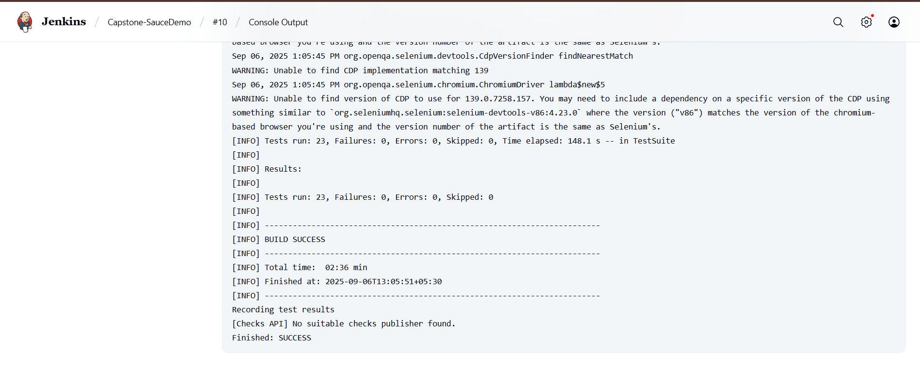
Console Output
Console Output Shows Build Success & How many test case fail and skip

Slide 23
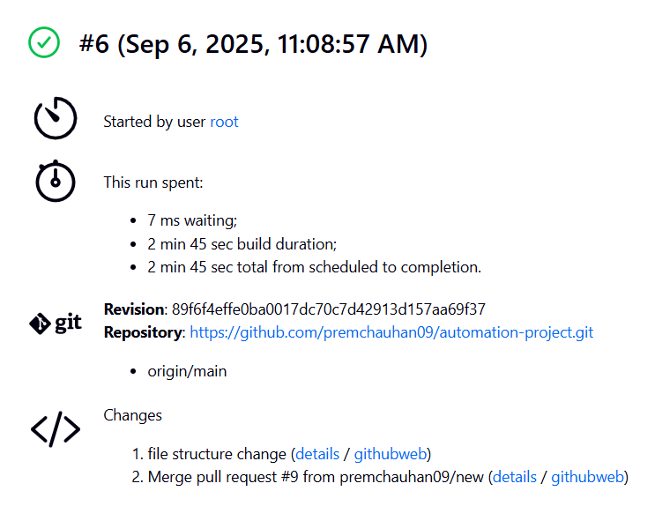
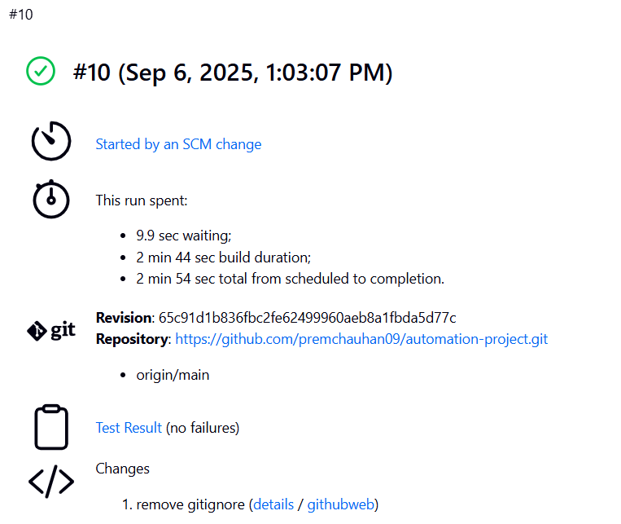
Jenkins - Triggering
Screenshot 1
Screenshot 2
Screenshot 1: Build triggered manually by the user.
Screenshot 2: Build triggered automatically every 5 minutes to check for new commits on Git; if any code is pushed, the build runs automatically.

Slide 24
THANK
YOU !

