Slide 1
Lending Club Case Study

Slide 2
Problem Statement
A large online loan marketplace, facilitating personal loans, business loans, wants to understand the driving factors (or driver variables) behind loan default, i.e. the variables which are strong indicators of default.
Aim of the Case Study
The aim of the case study is to identify applicants who are likely to default using EDA(Exploratory Data Analysis).

Slide 3
Analysis Approach
Data Preparation: Cleaning and preprocessing of the loan data.
Univariate Analysis: Investigated individual features such as loan amount, annual income, interest rate, etc.
Segmented Univariate Analysis: Analyzing a single variable within different subgroups of a dataset (e.g., Loan Amount segmented by Default Status).
Bivariate Analysis: Examined relationships between pairs of variables (e.g., loan status vs. interest rate).
Correlation Analysis: Measures the strength and direction of the relationship between variables.

Slide 4
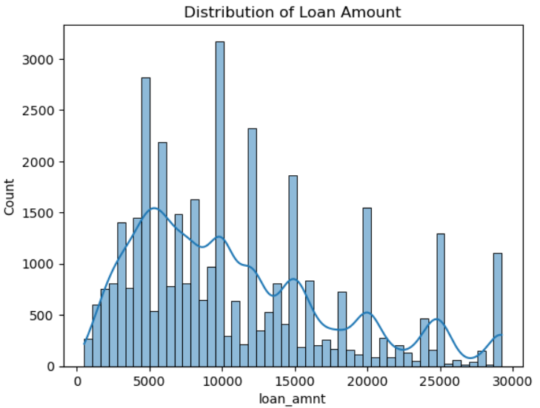
Univariate Analysis
Insights: The histogram suggests that while most loans are for smaller amounts, there are a significant number of larger loans, indicating a diverse range of borrowing needs.
Business Sense: The lender might need to adjust their risk assessment models to account for the higher loan amounts, as these could pose higher risks.

Slide 5
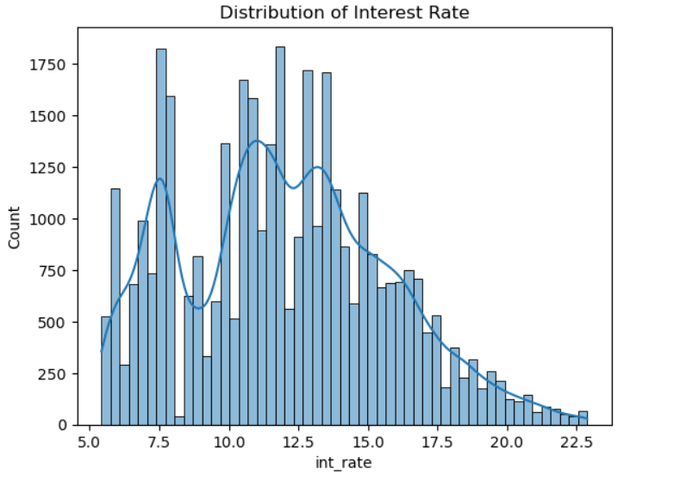
Univariate Analysis
Insights: The histogram suggests that while most loans have interest rates around 12.5%, there is a significant proportion of loans with higher rates.
Business Sense: Higher interest rates are often associated with higher risk borrowers. The lender should carefully assess the default risk associated with different interest rate segments.

Slide 6
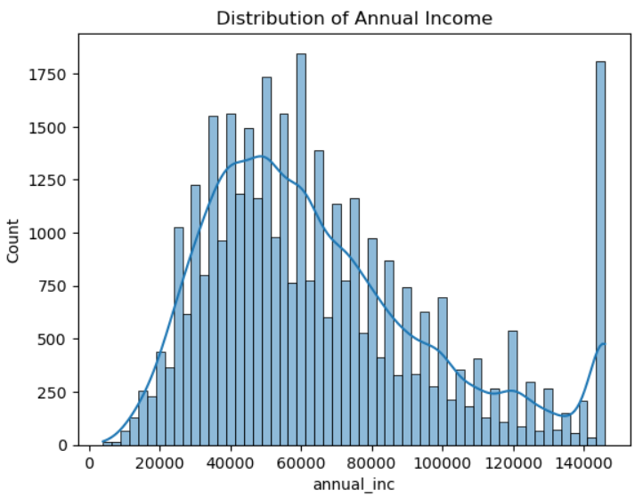
Univariate Analysis
Insights: The histogram suggests that while most borrowers have incomes around 60,000, there is a significant proportion of borrowers with higher incomes.
Business Sense: Higher income borrowers might have lower default risk. The lender could use income as a factor in their credit risk assessment.

Slide 7
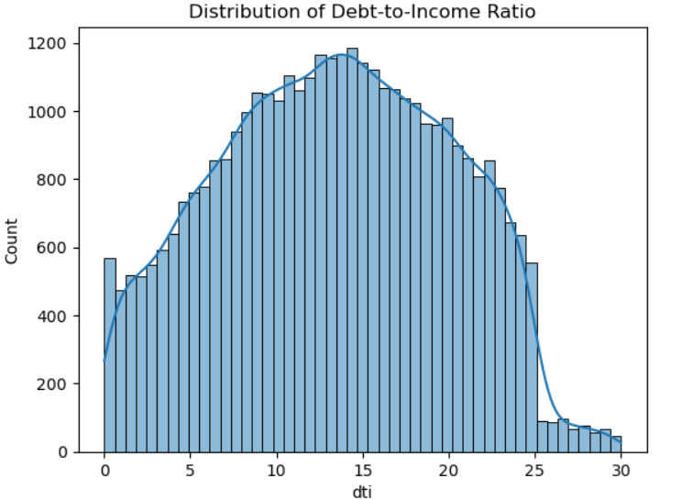
Univariate Analysis
Insights: The histogram suggests that while most borrowers have debt-to-income ratios around 15, there is a significant proportion of borrowers with higher ratios.
Business Sense: Higher debt-to-income ratios are often associated with higher default risk. The lender could use debt-to-income ratio as a key factor in their credit risk assessment.

Slide 8
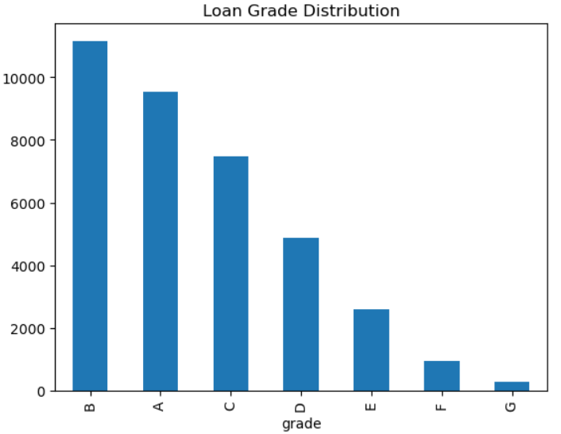
Univariate Analysis
Insights: The majority of loans are issued with grades B and A, indicating that most borrowers are considered to be in the lower-risk categories.
Business Sense: To minimize default rates and improve profitability, the lender appears to be focusing on lower-risk borrowers, which could be a strategic decision.

Slide 9
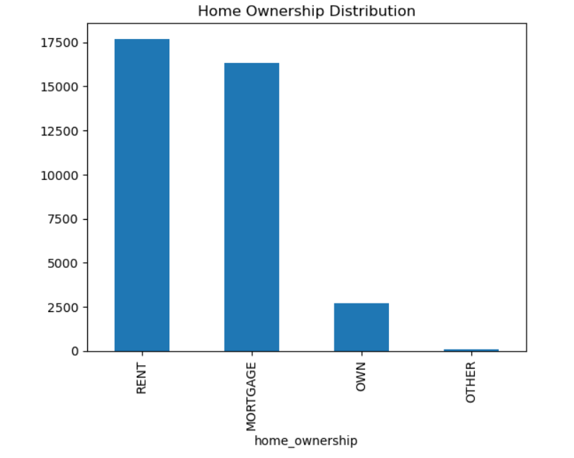
Univariate Analysis
Insights: The majority of borrowers are either renting or have a mortgage. These two categories account for the vast majority of the observations.
Business Sense: Home ownership might be considered a factor in credit risk assessment, as homeowners might be perceived as more stable and less likely to default.

Slide 10
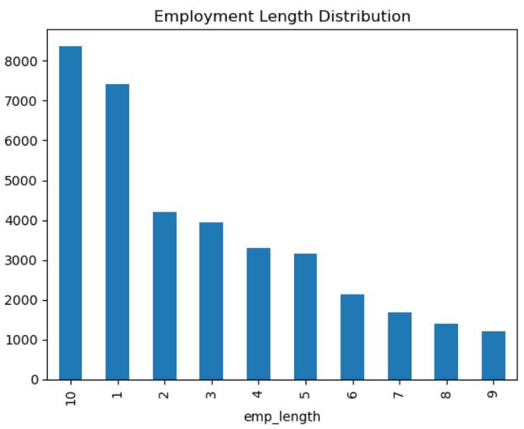
Univariate Analysis
Insights: The category "10" has the highest frequency, indicating that a significant portion of borrowers have been employed for 10 or more years.
Business Sense: Longer employment history might be considered a positive factor in credit risk assessment, as it suggests stability and financial responsibility.

Slide 11
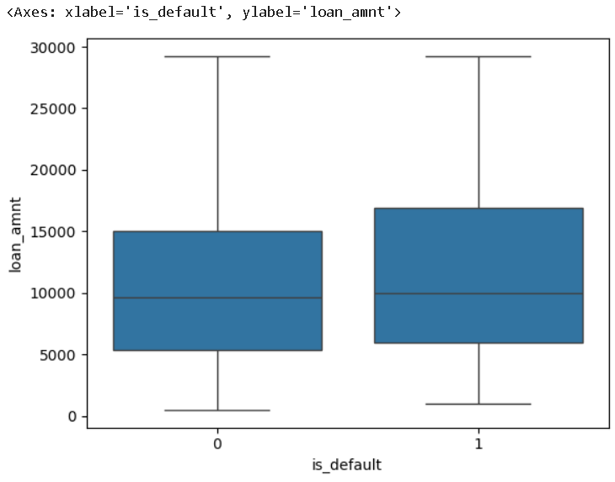
Segmented Univariate Analysis
defaulters (is_default = 1) and non-defaulters (is_default = 0)
Insights: The median interest rate for defaulters appears to be slightly higher than that for non-defaulters. This suggests that borrowers who defaulted on their loans might have been charged higher interest rates.
Business Sense: The slightly higher median interest rate for defaulters suggests that interest rate might be a factor influencing default risk.

Slide 12
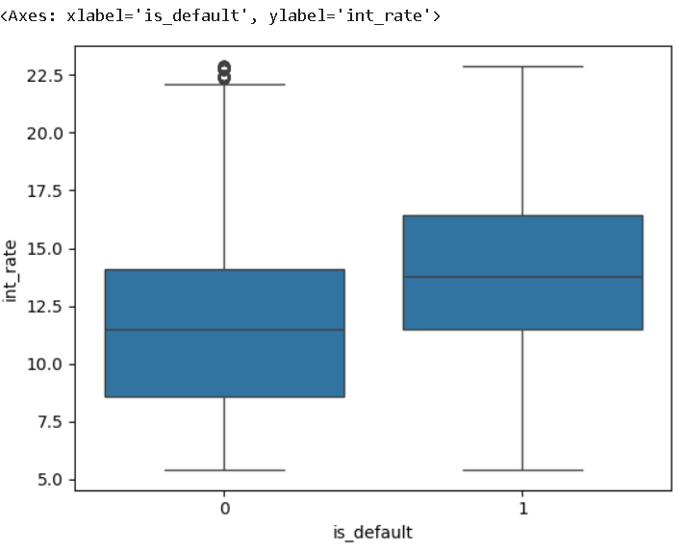
Segmented Univariate Analysis
defaulters (is_default = 1) and non-defaulters (is_default = 0)
Insights: The median interest rate for defaulters appears to be slightly higher than that for non-defaulters. This suggests that borrowers who defaulted on their loans might have been charged higher interest rates.
Business Sense: The slightly higher median interest rate for defaulters suggests that interest rate might be a factor influencing default risk.

Slide 13
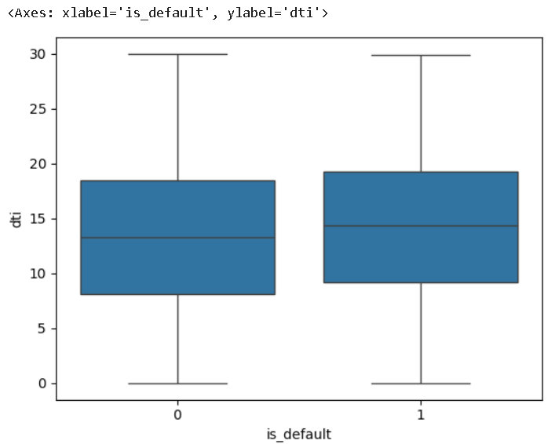
Segmented Univariate Analysis
defaulters (is_default = 1) and non-defaulters (is_default = 0)
Insights: The interquartile range (IQR) and overall spread of the data seem to be similar for both groups. This indicates that the variability in debt-to-income ratios is comparable between defaulters and non-defaulters.
Business Sense: The lender could consider incorporating debt-to-income ratio into their credit risk assessment.

Slide 14
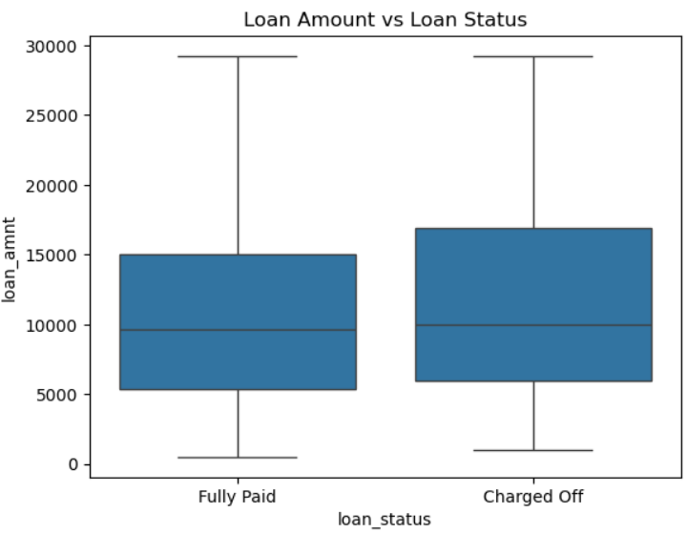
Bivariate Analysis
Insights: The median loan amount for "Charged Off" loans appears to be slightly higher than that for "Fully Paid" loans. This suggests that borrowers who defaulted on their loans might have tended to borrow larger amounts.
Business Sense: The lender could consider incorporating loan amount into their credit risk assessment models.

Slide 15
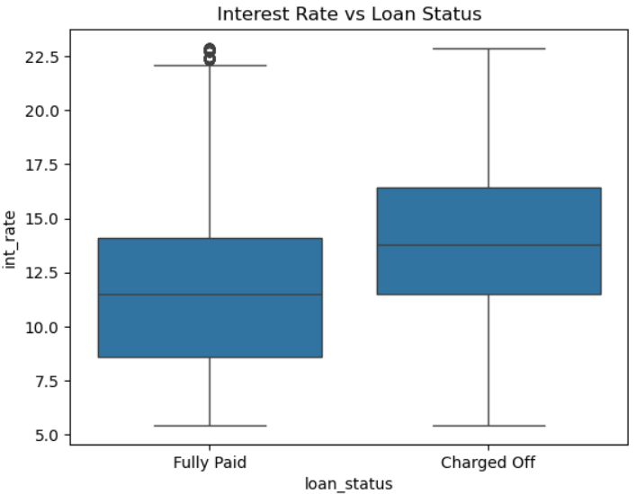
Bivariate Analysis
Insights: The interquartile range (IQR) and overall spread of the data seem to be similar for both groups. This indicates that the variability in interest rates is comparable between fully paid and charged-off loans.
Business Sense: The slightly higher median loan amount for defaulters suggests that loan amount might be a contributing factor to default risk.

Slide 16
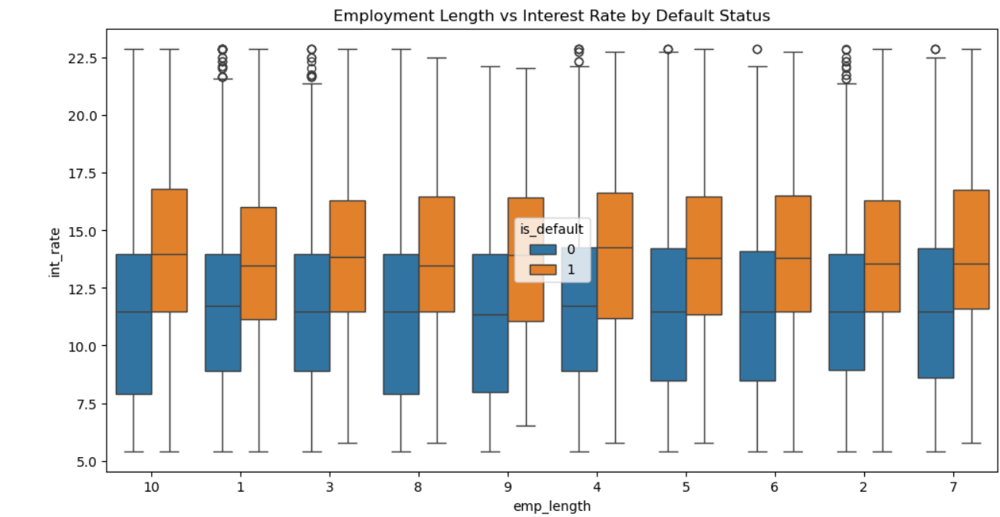
Bivariate Analysis
Insights: The boxplot shows that there is a slight overlap between the interest rates for defaulters and non-defaulters across most employment lengths.
Business Sense: The lender could consider incorporating employment length into their credit risk assessment models, especially if it shows a correlation with other variables.

Slide 17
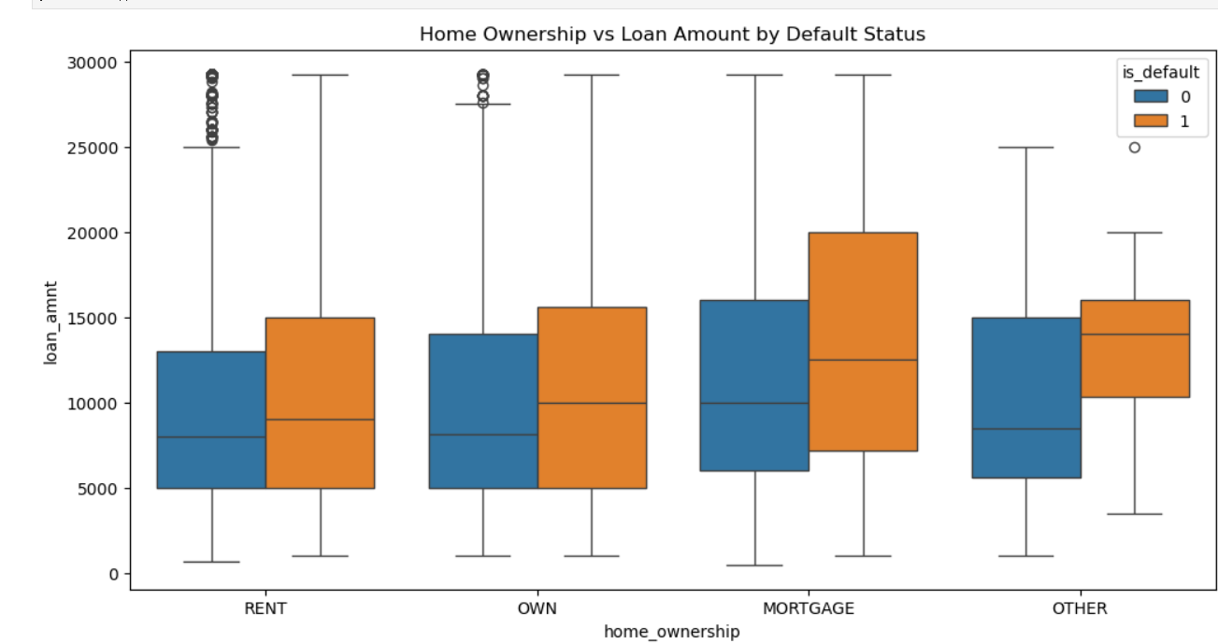
Bivariate Analysis
Insights: The median loan amounts for the "RENT" and "MORTGAGE" categories appear to be higher than for the "OWN" and "OTHER" categories. This suggests that borrowers who are renting or have a mortgage tend to borrow larger amounts.
Business Sense: The lender could consider incorporating home ownership into their credit risk assessment models, especially if it shows a correlation with other variables.

Slide 18
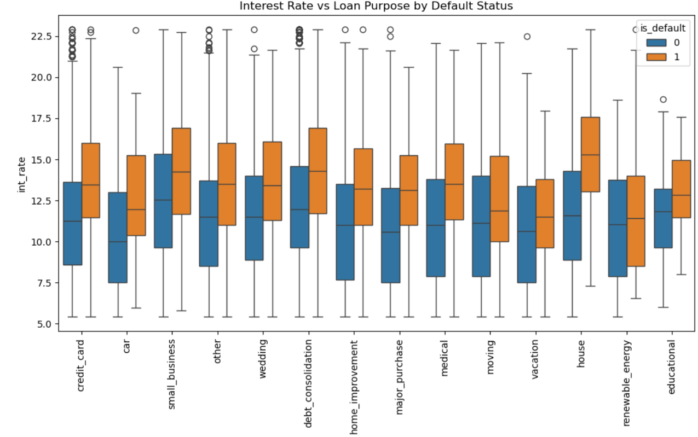
Bivariate Analysis
Insights: There are some variations in median interest rates across different loan purposes. Some purposes might have consistently higher or lower interest rates compared to others.
Business Sense: The lender could consider incorporating loan purpose into their credit risk assessment models.

Slide 19
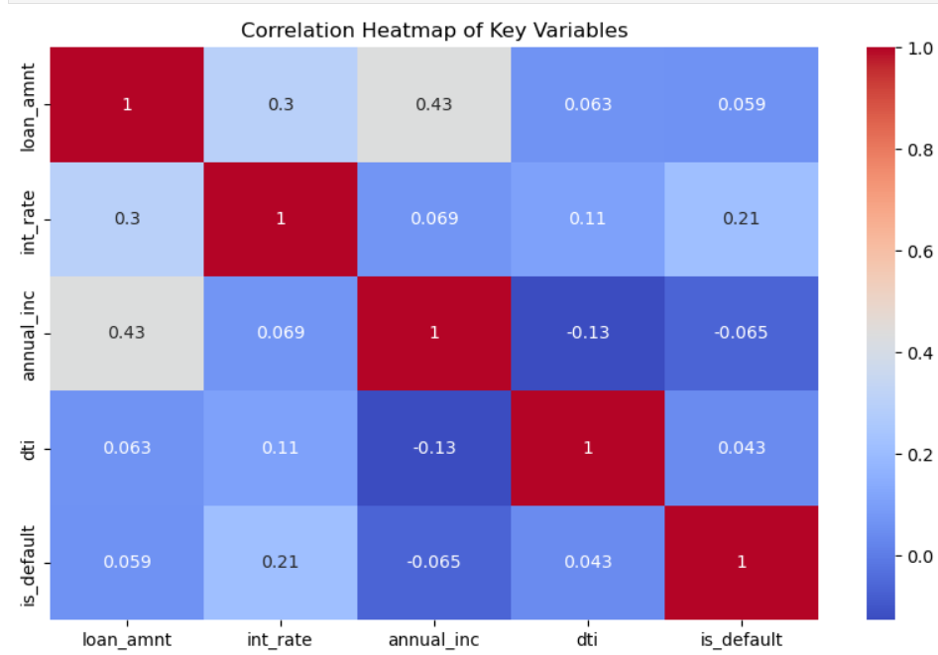
Correlation Analysis
Insights:
1.Strong Positive Correlation: loan_amnt and annual_inc have a strong positive correlation of 0.43, suggesting that borrowers with higher incomes tend to borrow larger amounts.
2. Weak Positive Correlations: There are weak positive correlations between loan_amnt and int_rate (0.3), and between annual_inc and int_rate (0.069). This might indicate that borrowers with higher incomes or larger loan amounts could be charged higher interest rates.
3. Negative Correlation: dti (debt-to-income ratio) and is_default have a negative correlation of -0.065. This suggests that borrowers with lower debt-to-income ratios might be less likely to default.
Business Sense: The lender could consider incorporating annual_inc and dti into their credit risk assessment models, as they seem to have some predictive power.

Slide 20
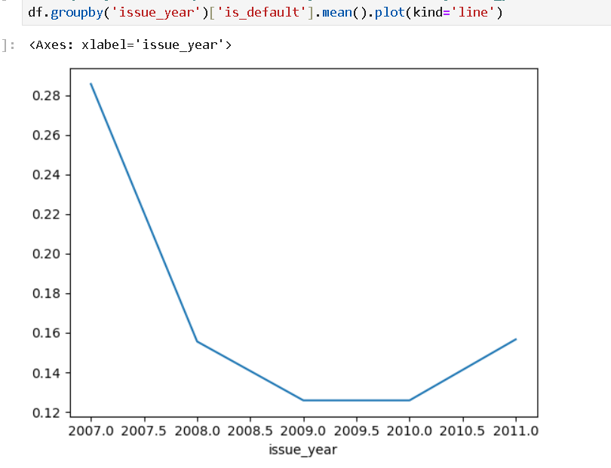
Date Analysis
Insights: The default rate appears to have decreased from 2007 to 2009, reached a low point around 2009, and then increased slightly in 2010 and 2011.
Business Sense: The lender could analyze the factors that contributed to the decline in default rates and incorporate those insights into their product development.

Slide 21
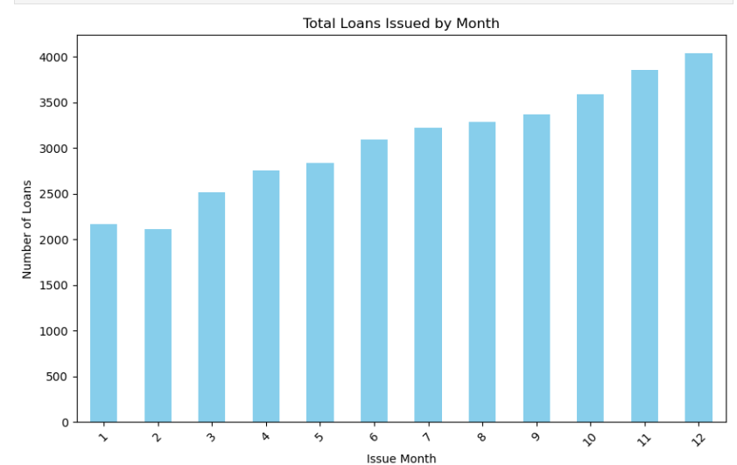
Date Analysis
Insights: The number of loans issued generally increases from month 1 to month 12, suggesting a growing trend in lending activity throughout the year.
Business Sense: The lender could analyze the factors driving the increase in loan demand to identify opportunities for product development or expansion.

Slide 22
Conclusion
In this analysis of Lending Club loan data, we aimed to identify the key factors influencing loan defaults through a comprehensive Exploratory Data Analysis (EDA).
The univariate and segmented univariate analyses revealed that factors such as loan amount, interest rate, employment length, and DTI are critical indicators of loan defaults. Combining these insights in the bivariate analysis further strengthened the findings, confirming that higher-risk borrowers typically took larger, higher-interest loans and had shorter employment histories or higher financial burdens.

