Slide 1
Payments System
Barclays Post Grad Induction

Slide 2
Team Members
Anuj Kotarkar
Prem Chhabria
Pranay Shridhar
Nishtha Sehgal
Rutuja More
Sravya Oruganti
Sumit Raut
Swapnil Ghule
Vaishnavi Deokate

Slide 3
Software Requirement
MySQL Workbench (Hibernate) - Database
PostMan (API creation)
Eclipse with maven (Spring Boot) - Implementation

Slide 4
Application Overview
To build a system for users to to make payment from the account to the biller, he / she can register the biller by selecting biller from master list and consumer number.
Biller is an entity (vendor / service provider) to whom payments can be made from bank by existing account holders. Each Biller will be uniquely identified by Biller Code. Bank will maintain a master list of billers.
All payment transactions would be recorded in transaction table with unique transaction reference / id.

Slide 5
Use Cases
System Roles (Actors)
Bank Manager
Account Holder
Use cases
Login
Role Bank Manager
Create New Bill
Role Account Holder
Delete / View Registered Billers.
Add New Biller
View Scheduled Bill Payments
Manual Payment
View Payments done for all or selected biller
Export Payments Data in CSV
Role System – Batch Job
Execute Auto pay – run once a day
Mail Provision

Slide 6
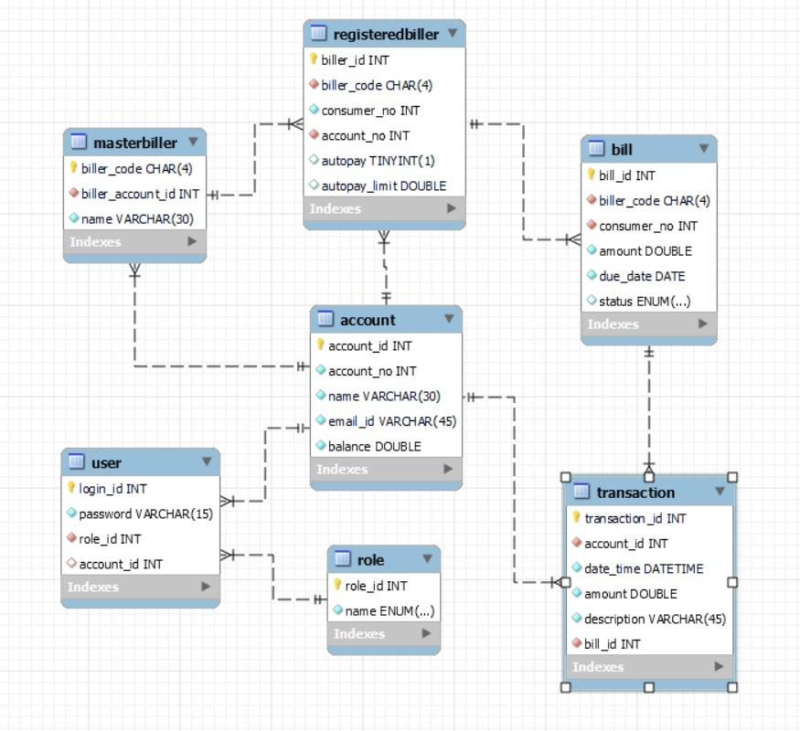
Database Schema

Slide 7
User Story
User Login
Access Master Billers
Bank manager: Create Bills
Account holder: Create Registered Billers (Auto Pay)
Account holder: View Registered Billers
Account holder: Delete Registered Billers
Account holder: View Bills/Scheduled Payments (Due Date)
Account holder: Manual Payment (Override Auto Pay)
Account holder: View/Export Past payments (date range / biller) (csv)
E-mail Provision: (3), (8)

Slide 8
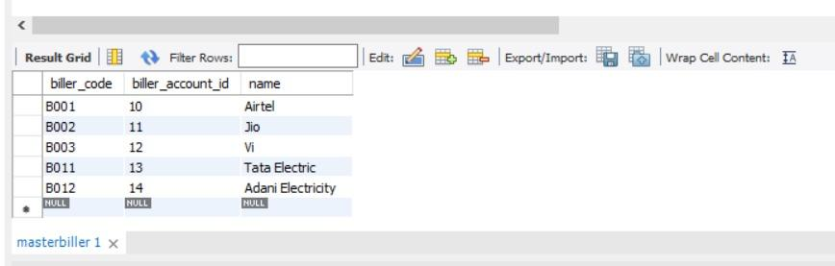
Tables and Features
Master List of Billers with the bank
Each Biller will be uniquely identified by Biller Code. Bank will maintain a master list of billers. (E.g Biller could be Mobile Service Provider (Airtel, Vi, Jio etc) or Electricity Companies etc

Slide 9
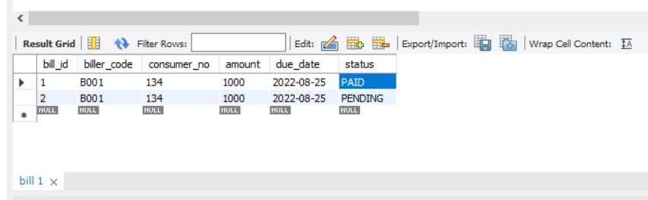
Tables and Features
Bank Manager will register a new bill by entering the following information Bill ID, Biller Code, Consumer Number, Amount, Due Date. New bills will have status of PENDING.
When bill payment is done account will be debited, Bill status will be set to PAID

Slide 10
Assumptions
State any assumptions you have made

Slide 11
The Architecture of the System
What are the major parts of the system?
What does each part do? it’s inputs? it’s outputs?
A picture would be nice here …

Slide 12
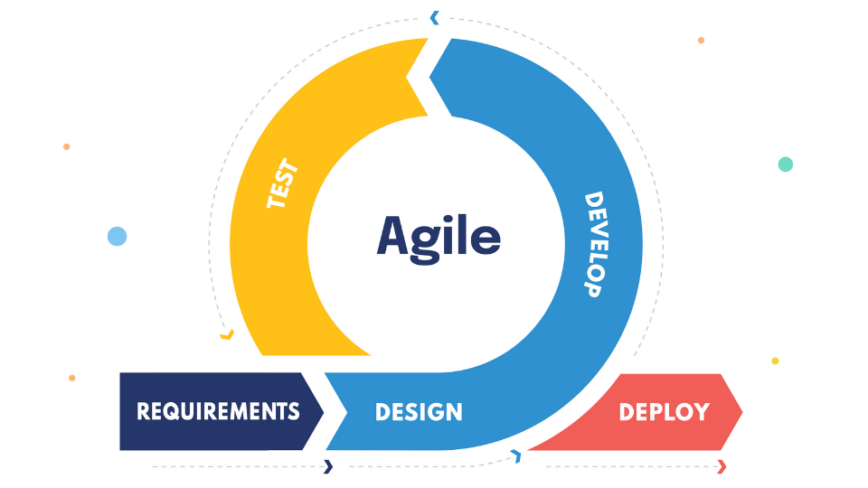
The Process - Methodology
The Agile methodology is a way to manage a project by breaking it up into several phases. It involves constant collaboration with stakeholders and continuous improvement at every stage.

Slide 13
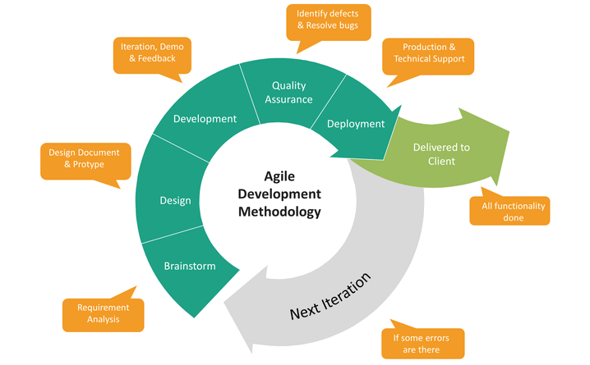

Slide 14
The Process - Methodology
What steps did you go through
Briefly define each step
Indicate how much time and effort went into the step (estimated per the project plan and actual)

Slide 15
Show Your Schedule
US ID | User Story Description | Start Date | End Date | User Story Point | Assignee | Status
1 | User Login | 23-08-2022 | 24-08-2022 | 1 | Group A | 3- Completed
2 | Access Master Billers | 23-08-2022 | 23-08-2022 | 2 | Group B | 3- Completed
3 | Bank manager: Create Bills | 23-08-2022 | 23-08-2022 | 3 | Group A | 3- Completed
4 | Account holder: Create Registered Billers (Auto Pay) | 23-08-2022 | 23-08-2022 | 3 | Group B | 3- Completed
5 | Account holder: View Registered Billers | 23-08-2022 | 23-08-2022 | 3 | Group B | 3- Completed
6 | Account holder: Delete Registered Billers | 23-08-2022 | 23-08-2022 | 3 | Group B | 3- Completed
7 | Account holder: View Bills/Scheduled Payments (Due Date) | 24-08-2022 | 24-08-2022 | 3 | Group A | 3- Completed
8 | Account holder: Manual Payment (Override Auto Pay) | 23-08-2022 | 23-08-2022 | 3 | Group C | 3- Completed
9 | Account holder: View/Export Past payments (date range / biller) (csv) | 23-08-2022 | 24-08-2022 | 3 | Group A | 3- Completed
10 | E-mail Provision: (3), (8) | 24-08-2022 | 24-08-2022 | 2 | Group C | 3- Completed

Slide 16
Additional enhancements - additional enhancements that could be made?
Customer Care/ Helpline
More Security

Slide 17
Project Dynamics -How did your team divide up the work?
Prem Chhabria Pranay Shridhar Sumit Raut Swapnil Ghule | User login, Bill creation and Payment interaction API
Anuj Kotarkar Nishtha Sehgal | Handled the database and User-Reg.biller interaction API
Rutuja More Sravya Oruganti Vaishnavi Deokate | Email notifications and .csv export feature

Slide 18
Project Dynamics -How did your team divide up the work?
A new entry for every member, a brief description as well
Team member 1:
Gathered user information, responsible for reverse engineering site
Team member 2:
Wrote proxy, designed intermediate database
Team member 3:
Did some other stuff

Slide 19
Lessons Learned
Describe the lessons that you learnt at the end of this project in the following manner:
Lesson 1:
Lesson 2:
Lesson 3:

Slide 20
Product Demo

