Slide 1


Shri Ramdeobaba College of Engineering and Management
Department of Computer Science & Engineering
Session 2026–2027 | Semester VII
MAJOR PROJECT
MEMORY-AUGMENTED TEMPORAL REASONING
FOR FLOOD VICTIM DETECTION
Dynamic Rescue-Priority Mapping from Drone Imagery
Presented By : Group No 7
Prem Baba (53)
Purva Bhoyar (57)
Adhishree Shiledar (01)
Palak Zade (68)
Guided By
Dr. Nisarg Gandhewar
(Associate Professor)

Slide 2
Introduction
The Landscape
The Reality
Our Solution
• Floods are among the most frequent and devastating natural disasters, affecting billions of people and causing large-scale loss of life every year.
• UAVs have become essential to disaster response — they survey inaccessible, submerged regions from above within minutes.
• Public aerial datasets — VisDrone, FloodNet, C2A — now make drone-based rescue AI genuinely trainable.
• Roads submerge and currents turn deadly — large flood-hit areas become physically unreachable on the ground.
• Responders lack real-time information on how many people are stranded and exactly where.
• From drone altitude victims are tiny and partly occluded — standard detectors frequently miss them.
• Existing UAV systems do one task in isolation and describe only the present moment — no memory, no ranking.
An integrated, temporally-aware drone pipeline that:• Detects stranded people, vehicles and animals — including tiny and occluded targets.
• Tracks every victim across frames with a stable identity.
• Remembers each victim’s evolving state — time stranded, movement, trend.
• Assesses flood severity around each victim group.
• Fuses everything into a ranked rescue-priority map — who to save first.

Slide 3
PROBLEM DEFINITION
The Core Issue: Perception Without Prioritization
SPECIFIC CHALLENGES IN UAV FLOOD RESPONSE
Tiny & Occluded Victim Loss
At 80–120 m altitude a person spans only a few pixels and is often hidden by roofs, trees or debris — standard detectors miss them, and one missed detection can cost a life.
No Temporal Awareness
Systems reason on single frames. They cannot tell how long a victim has been stranded, whether the group is moving, or whether the water around it is rising.
Severity-Blind Detection
Victim detection and flood-water segmentation are run as separate studies, so how dangerous a victim’s surroundings actually are never influences the response.
No Actionable Output
Output stops at bounding boxes, masks or counts. Teams are left to decide manually which of dozens of scattered locations to reach first.
Problem Statement: Existing UAV flood-response solutions largely stop at single-frame detection or segmentation and do not give rescue teams a temporally-informed, prioritized decision output. There is a need for a system that detects stranded victims — including small and occluded targets — from drone imagery, tracks them across time, remembers how their situation is changing, incorporates flood severity, and produces an interpretable dynamic rescue-priority map that guides responders to the highest-risk victims first.

Slide 4
Aim
To develop a drone-based system that detects, tracks and remembers stranded flood victims (humans, vehicles and animals), fuses flood-severity information from aerial imagery, and generates a dynamic rescue-priority map that guides rescue teams to the most critical locations first.
Objectives
• Aerial victim detection — build a detector for stranded humans, vehicles and animals, with dedicated handling of tiny and partially-occluded targets using slicing-aided inference (SAHI).
• Flood-domain adaptation — adapt a general aerial detector to flood conditions through two-stage training — pre-training on VisDrone, then fine-tuning on flood-specific imagery.
• Tracking with memory — track detected victims across frames and maintain a short-term memory of each victim’s evolving state — time stranded, movement and trend.
• Severity integration — integrate flood-severity segmentation so that victims located in more severely flooded areas are prioritized appropriately.
• Priority mapping — compute a rescue-priority score per location and generate a dynamic rescue-priority map together with a victim summary table and alerts.
• Rigorous evaluation — evaluate the system against baseline detectors and through ablation studies that measure each module’s individual contribution.

Slide 5
Literature Survey
Research Area | Key Work | Findings | Limitation / Gap
UAV Flood-Survivor Detection | Prabhu et al., "RescueNet: YOLO-based detection and counting of flood survivors," Model. Earth Syst. Environ., 2022 | YOLO-based detection and counting of flood survivors from UAV imagery; ~98% reported mAP | Single-frame only; no tracking, memory or rescue prioritization
Real-Time Flood Rescue Targeting | Zhao, Sui & Zhu, "Real-time rescue target detection based on UAV imagery," J. Geod. Geoinf. Sci., 2024 | Delineates flood extent and detects trapped pedestrians and vehicles in real time | No temporal tracking, no victim-state memory, no ranked priority output
Disaster Human- Detection Datasets | Nihal et al., "C2A: benchmarking a human detection dataset for disaster scenarios," ICPR, 2024 | Synthetic UAV disaster dataset; fine-tuning on it substantially improves SAR detection | General disaster, not flood-specific; detection only; synthetic/composite imagery
Post-Flood Scene Understanding | Rahnemoonfar et al., "FloodNet: high-resolution aerial imagery for post-flood scene understanding," IEEE Access, 2021 | High-resolution UAV dataset supporting flood segmentation, classification and VQA | Built for scene understanding, not victim detection, localization or ranking
Human Position Recognition on Water | Nikitin et al., "Evaluation of YOLO models for human position recognition with UAVs during a flood," Appl. Syst. Innov., 2025 | YOLO12 combined with optical flow and Kalman filtering for people on water; mAP ≈ 0.95 | Maritime / open-water focus; no victim memory or rescue-priority mapping

Slide 6
Literature Survey
Research Area | Key Work | Findings | Limitation / Gap
Rooftop Victim Detection | Fine-tuned deep models for people detection in UAV building images, Int. J. Appl. Earth Obs. Geoinf., 2025 | Fine-tuned YOLOv9 reaching ~87% MAP for people stranded on rooftops and in buildings | Detection only; no counting, tracking or decision-level output
Small-Object Detection Technique | Akyon, Altinuc & Temizel, "Slicing aided hyper inference and fine-tuning for small object detection," IEEE ICIP, 2022 | Slices images into overlapping tiles, greatly improving small-object detection accuracy | A technique, not a full rescue system; noticeably increases inference time
Multi-Object Tracking | Zhang et al., "ByteTrack: multi-object tracking by associating every detection box," ECCV, 2022 | Associates every detection box — high and low confidence — for robust identity retention | Generic tracker; no flood context, severity awareness or prioritization logic
Aerial Emergency- Scene Classification | Kyrkou & Theocharides, "Deep-learning-based aerial image classification for emergency response (AIDER)," CVPR-W, 2020 | Lightweight CNN classifying aerial disaster scenes — fire, flood, building collapse | Scene-level classification only; no victim localization, counting or ranking
Aerial Flood Scene Analysis (South Asia) | Hassan et al., "Aerial flood scene classification using fine-tuned attention-based architecture," arXiv:2411.00169, 2024 | YOLOv8 applied to detect humans and houses in South-Asian aerial flood imagery | Low human-detection accuracy (~67%); no tracking, memory or priority output

Slide 7
Research Gap
What’s Missing |  | Our Contribution
Temporal Blindness | Systems describe only the present frame — no record of how long a victim has been stranded or how the situation is changing. | Short-Term Memory Module | A per-victim state buffer (time stranded, movement, water trend) built on stable ByteTrack identities.
Tiny / Occluded Victims Missed | Standard detectors fail precisely on the smallest, partly-hidden targets — the most rescue-critical case. | SAHI + Two-Stage Training | Slicing-aided hyper inference at high resolution, with VisDrone pre-training followed by flood fine-tuning.
Severity-Blind Ranking | Flood-water segmentation is studied separately and never fused into victim prioritization. | Severity-Aware Fusion | U-Net water extent measured around each victim group feeds directly into the rescue-risk score.
No Decision-Level Output | Work ends at boxes, masks or counts, leaving teams to prioritize dozens of locations manually. | Dynamic Rescue-Priority Map | Ranked Critical → Low output with a victim summary table and automatic alerts for critical sites.
Single-Task Pipelines | Detection, tracking and segmentation are advanced in isolation, never assembled into one system. | First Integrated Pipeline | Detect → Track → Remember → Assess Severity → Rank, delivered as ONE end-to-end system.

Slide 8
Motivation
01
02
03
Social & Humanitarian
Technical Innovation
Feasibility & Impact
• Floods kill thousands every year — faster, prioritized rescue directly reduces deaths.
• Helps teams reach the unreachable when submerged roads and deadly currents rule out ground search.
• Protects the most vulnerable — children, the elderly and livestock stranded on rooftops.
• Turns raw drone footage into a decision a command centre can act on within minutes.
• The hardest technical problem — tiny, occluded victims — is also the most rescue-critical: difficulty and purpose align.
• No prior work combines detection, tracking, memory, flood severity and prioritization.
• Bridges computer vision, multi-object tracking and decision reasoning in one pipeline.
• Contributes to the AI-for-Disaster-Response research domain.
• Built entirely on proven, well-documented tools — YOLOv8, SAHI, ByteTrack and U-Net.
• Public datasets already exist — VisDrone, the Roboflow flood set and FloodNet.
• Deployable as a decision-support layer for NDRF-style rescue and disaster command centres.

Slide 9
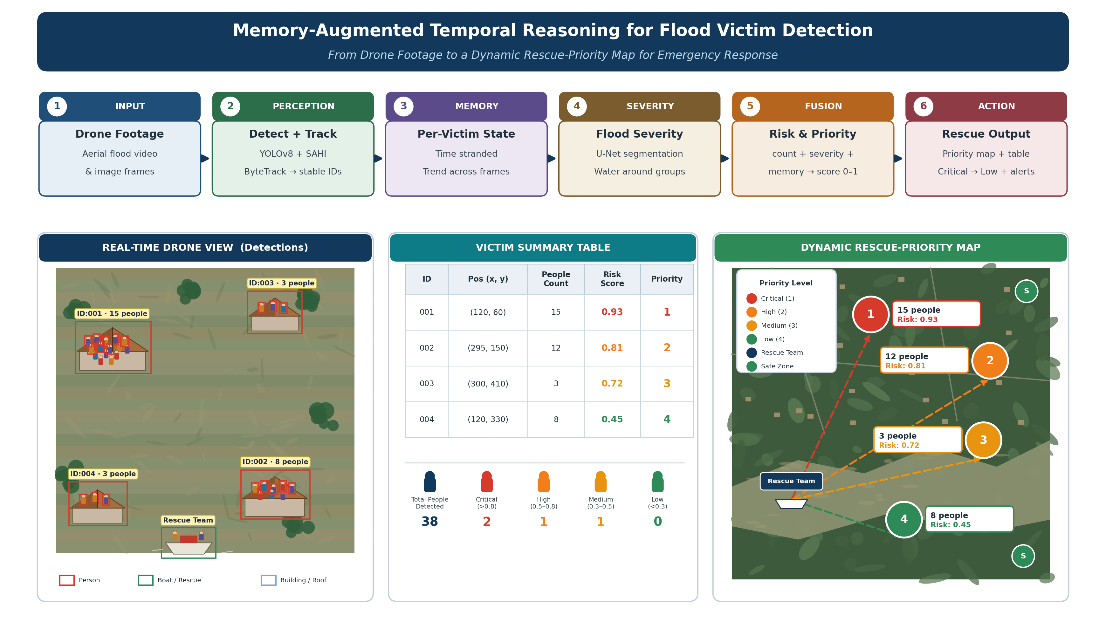

Slide 10
Proposed Plan of Work
PHASE 1
PHASE 2
PHASE 3
PHASE 4
PHASE 5
PHASE 6
Week 1
Week 2
Week 3 - 4
Week 5
Week 6 - 7
Week 8
Literature Review &
Requirements
Design &
Methodology
Detection +
Tracking
Memory +
Severity
Integration &
Testing
Documentation &
Final Submission
• Survey UAV flood-rescue literature
• Finalize problem and baselines
• Acquire VisDrone, Roboflow flood, FloodNet
• Set up Colab / GPU environment
• Freeze pipeline architecture
• Define module interfaces
• Fix class map: person / vehicle / animal
• Design the risk-scoring formula
• Convert annotations to YOLO format
• Stage-1 training on VisDrone
• Stage-2 fine-tune on flood data
• Integrate SAHI and ByteTrack
• Build per-victim memory buffer
• Prepare FloodNet water masks
• Train the U-Net severity model
• Implement risk & priority scoring
• Connect all five modules
• Render priority map & summary table
• Baseline and ablation studies
• Collect mAP, MOTA / IDF1, IoU
• Compile the evaluation report
• Record the demo video
• Publish documented Git repository
• Final report and presentation

Slide 11
Techstack
• Language: Python 3.10
• Detection: Ultralytics YOLOv8 + SAHI (slicing-aided hyper inference)
• Tracking: ByteTrack — multi-object tracking with stable victim IDs
• Segmentation: U-Net encoder–decoder for flood-severity estimation
• ML Framework: PyTorch (CUDA)
• Vision / Numeric: OpenCV, NumPy, Albumentations
• Datasets: VisDrone (base) · Roboflow flood set (fine-tune) · FloodNet (severity)
• Annotation & Conversion: Roboflow + custom VisDrone → YOLO format converters
• Memory & Fusion: Custom Python state buffer + weighted risk-scoring engine
• Visualization: Matplotlib / Folium — priority map, victim summary table, alerts
• Platform: Google Colab Pro / GPU-enabled workstation
• Version Control: Git / GitHub

Slide 12
Expected Results
• Flood-adapted victim detector — person / vehicle / animal detection on aerial flood imagery, with measurably higher small-object AP than a plain-YOLO baseline.
• Flood-severity segmentation model — U-Net producing per-region water-extent maps from FloodNet imagery, evaluated using IoU and mean IoU.
• Stable victim identity over time — ByteTrack maintaining a unique ID per victim across frames, reported through MOTA and IDF1.
• Integrated end-to-end pipeline — detect → track → remember → assess severity → rank, running continuously on aerial flood video.
• Dynamic rescue-priority map — colour-coded Critical → Low markers with a victim summary table (ID, position, count, risk, priority) and alerts for critical sites.
• Evaluation report — VisDrone-only vs flood fine-tuned, plain YOLO vs YOLO + SAHI, and ablations with and without memory and severity.

Slide 13
References
[1] B. V. B. Prabhu, R. Lakshmi, R. Ankitha, M. S. Prateeksha, and N. C. Priya, “RescueNet: YOLO-based object detection model for detection and counting of flood survivors,” Modeling Earth Systems and Environment, vol. 8, no. 4, pp. 4509–4516, 2022.
[2] B. Zhao, H. Sui, and Y. Zhu, “Real-time rescue target detection based on UAV imagery for flood emergency response,” Journal of Geodesy and Geoinformation Science, vol. 7, no. 1, pp. 74–89, 2024.
[3] R. A. Nihal, B. Yen, K. Itoyama, and K. Nakadai, “UAV-enhanced combination to application: Benchmarking of a human detection dataset for disaster scenarios,” in Proc. Int. Conf. Pattern Recognition (ICPR), 2024.
[4] M. Rahnemoonfar, T. Chowdhury, A. Sarkar, D. Varshney, M. Yari, and R. R. Murphy, “FloodNet: A high-resolution aerial imagery dataset for post-flood scene understanding,” IEEE Access, vol. 9, pp. 89644–89654, 2021.
[5] A. Nikitin et al., “Evaluation of YOLO models for human position recognition with UAVs during a flood,” Applied System Innovation, vol. 9, no. 1, 2025.
[6] “Fine-tuned deep models for people detection in UAV building images to aid flood rescue,” International Journal of Applied Earth Observation and Geoinformation, 2025.
[7] F. C. Akyon, S. O. Altinuc, and A. Temizel, “Slicing aided hyper inference and fine-tuning for small object detection,” in Proc. IEEE Int. Conf. Image Processing (ICIP), 2022, pp. 966–970.

Slide 14
References (contd.)
[8] Y. Zhang, P. Sun, Y. Jiang, D. Yu, F. Weng, Z. Yuan, P. Luo, W. Liu, and X. Wang, “ByteTrack: Multi-object tracking by associating every detection box,” in Proc. European Conf. Computer Vision (ECCV), 2022, pp. 1–21.
[9] C. Kyrkou and T. Theocharides, “Deep-learning-based aerial image classification for emergency response applications using unmanned aerial vehicles,” in Proc. IEEE/CVF Conf. Computer Vision and Pattern Recognition Workshops (CVPRW), 2020, pp. 517–525.
[10] I. Hassan et al., “Aerial flood scene classification using fine-tuned attention-based architecture for flood-prone countries in South Asia,” arXiv preprint arXiv:2411.00169, 2024.
[11] P. Zhu, L. Wen, D. Du, X. Bian, H. Fan, Q. Hu, and H. Ling, “Detection and tracking meet drones challenge,” IEEE Transactions on Pattern Analysis and Machine Intelligence, vol. 44, no. 11, pp. 7380–7399, 2021.
[12] O. Ronneberger, P. Fischer, and T. Brox, “U-Net: Convolutional networks for biomedical image segmentation,” in Proc. Int. Conf. Medical Image Computing and Computer-Assisted Intervention (MICCAI), 2015, pp. 234–241.
[13] G. Jocher, A. Chaurasia, and J. Qiu, “Ultralytics YOLOv8,” 2023. [Online]. Available: https://github.com/ultralytics/ultralytics
[14] N. Wojke, A. Bewley, and D. Paulus, “Simple online and realtime tracking with a deep association metric,” in Proc. IEEE Int. Conf. Image Processing (ICIP), 2017, pp. 3645–3649.

Slide 15
THANK YOU
Group No 7 · Prem Baba · Purva Bhoyar · Adhishree Shiledar · Palak Zade

