Slide 1


Software Requirement Specification (SRS) for Online Fresh Market Website
Under guidance of
Mr. Onkar Mirashe
Members: 1) Premkumar Danav (PRN:230340120167)
2) Ganesh Godse (PRN:230340120066)
3) Pranay Sonsare (PRN:230340120160)
4) Sukanya Suralkar (PRN:230340120205)
5) Samiksha Soor (PRN:230340120182)

Slide 2
Introduction
Purpose
The purpose of this document is to provide a comprehensive overview of the Online Fresh Market system's requirements. It aims to guide the development team in building a functional and reliable e-commerce platform that caters to the needs of different user roles: admin, supplier, customer, and delivery person.
Definitions, Acronyms, and Abbreviations
SRS: Software Requirements Specification
API: Application Programming Interface

Slide 3
Scope
The Online Fresh Market system will offer an intuitive and user-friendly interface for users to browse, purchase, and manage fresh products online. It will include features such as user registration and authentication, product management, category management, cart functionality, order placement and tracking, and user management.
Overall Description
Product Perspective
The Online Fresh Market website will consist of a React-based frontend, a Java Spring Boot backend, and a MySQL database. The front end and back end will communicate via RESTful APIs.

Slide 4
User Classes and Characteristics
Admin: Responsible for managing users, products, categories, and orders.
Supplier: Can add new products to the system to specific categories.
Customer: Can browse products, add them to the cart, place orders, and track order status.
Delivery Person: Can be assigned to orders and update their delivery status.
Operating Environment
The Online Fresh Market system will be developed using the following technologies:
Frontend: React JS
Backend: Spring Boot (Java)
Database: MySQL

Slide 5
Specific Requirements
User Registration and Authentication
Users should be able to register with the system by providing necessary information such as name, email, and password.
Users should be able to log in using their registered email and password.
User registration and login should be secure, with password hashing and protection against common security vulnerabilities.
User Management
Admin users should have the ability to view, add, edit, and delete users of all types.
User data should include fields like name, email, user type, and contact information.

Slide 6
Product Management
Suppliers should be able to add new products by providing details such as name, description, price, and category.
Products should have associated images, which can be accessed via the
/api/product/{productImageName} endpoint.
Customers should be able to view a list of all products and filter them by category.
Category Management
Admin users should have the ability to add, edit, and delete product categories.
Categories should have a name and description.

Slide 7
Cart Functionality
Customers should be able to add products to their cart along with quantities using the /api/user/cart/add endpoint.
Customers should be able to view their cart, see individual product details, update quantities, and remove items.
Customers should have the ability to clear their entire cart using the /api/user/clearcart endpoint.
Order Placement and Management
Customers should be able to place orders by selecting items from their cart using the /api/user/order endpoint.
Admin users should have the ability to assign delivery persons to orders using the /api/user/admin/order/assignDelivery endpoint.
Admin users should be able to update the delivery status of orders using the /api/user/admin/order/deliveryStatus/update endpoint

Slide 8
Order Tracking
Customers should be able to view their orders, including order status and delivery details, using the /api/user/myorder endpoint.
Delivery persons should be able to update the delivery status of orders they are assigned to.
Non-Functional Requirements
Performance: The system should handle concurrent user interactions without significant delays.
Security: User data and passwords should be stored securely using encryption and hashing techniques.
Usability: The user interface should be intuitive and responsive across different devices.
Scalability: The system should be designed to accommodate future growth in terms of users and products.
Reliability: The system should be available and functional with minimal downtime.

Slide 9
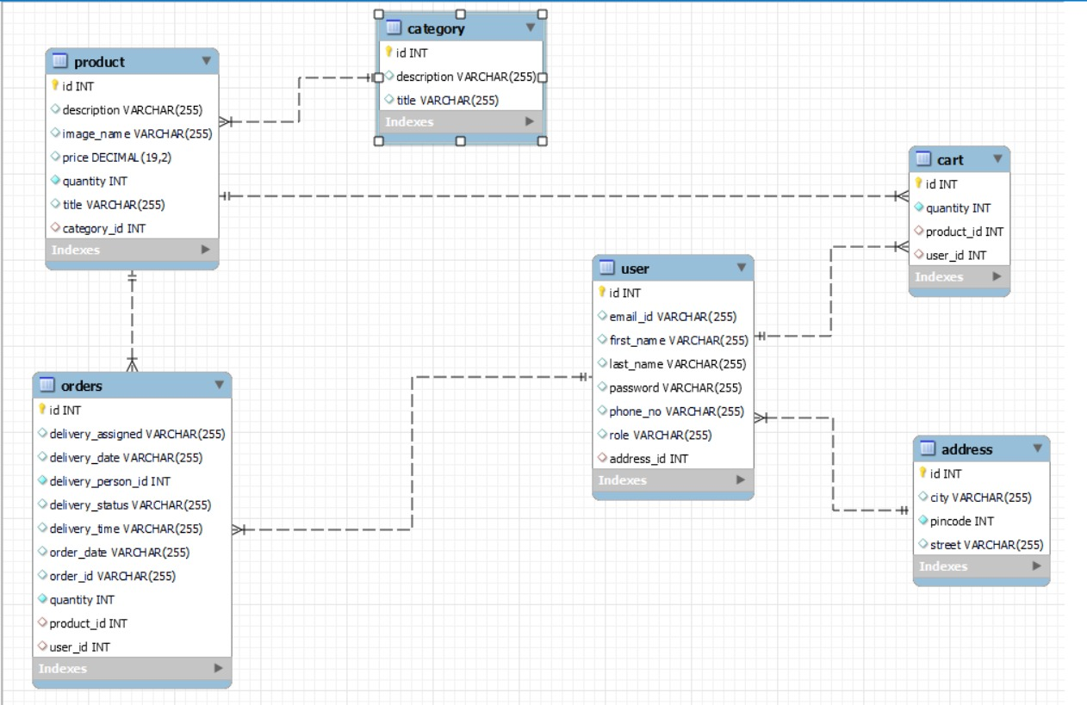
Appendices
ER-Diagram:

Slide 10
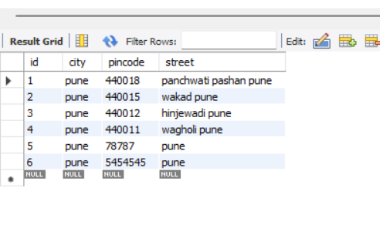
Database Interface Mockups
Address Table:

Slide 11
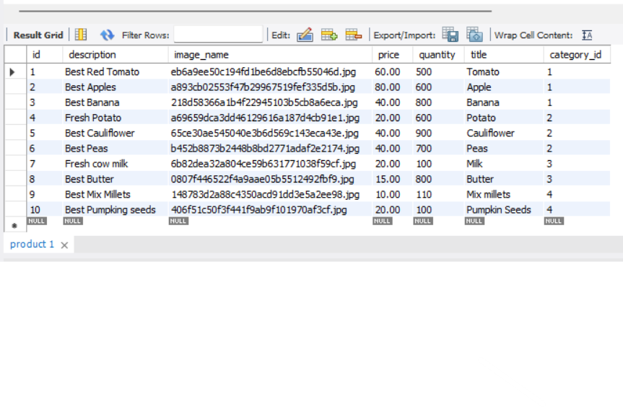
Product Table:

Slide 12
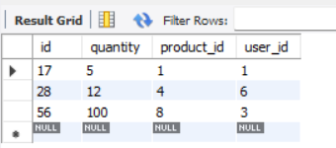
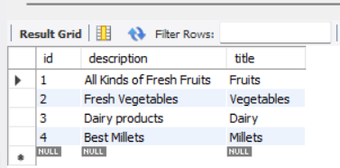
Cart Table:
Category Table:

Slide 13
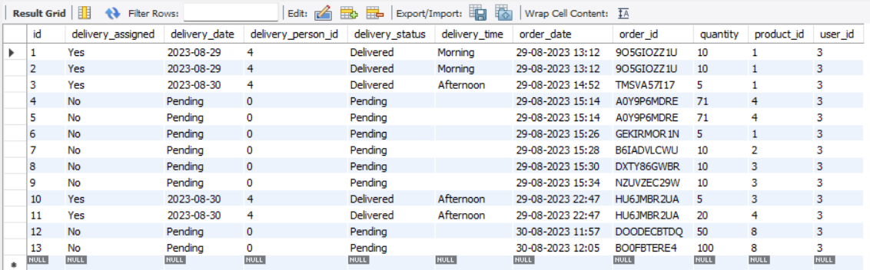
Orders Table:

Slide 14
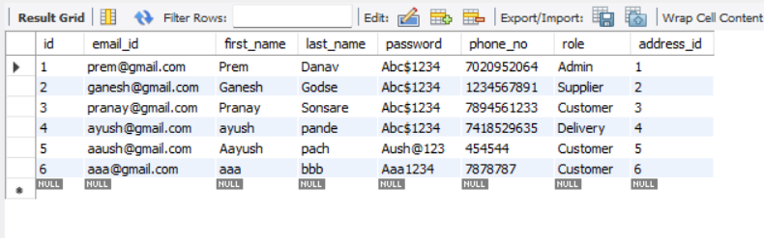
Users Table

Slide 15
Use Cases
User Registration and Authentication
Use Case: User Registration
Actors: Customer
Description: Customers can register on the platform by providing their details.
Preconditions: None
Flow:
Customer provides registration details.
System validates and stores the information.
System generates a unique user ID.
Postconditions: Customer is registered and can log in.
Use Case: User Login
Actors: Customer
Description: Registered customers can log in to their accounts.
Preconditions: Customer is registered.
Flow:
Customer enters login credentials.
System validates the credentials.
Customer gains access to their account.
Postconditions: Customer is logged in.

Slide 16
Product Management
Use Case: Add Product
Actors: Supplier
Description: Suppliers can add products to specific categories.
Preconditions: Supplier is registered.
Flow:
Supplier selects a category.
Supplier provides product details (name, price, description).
System validates and stores the information.
Postconditions: Product is added to the category.
Order Placement and Management
Use Case: Place Order
Actors: Customer
Description: Customers can place orders for items in their cart.
Preconditions: Customer is registered and has items in the cart.
Flow:
Customer reviews the cart.
Customer proceeds to checkout.
System calculates the total cost.
Customer confirms the order.
Postconditions: Order is placed.

Slide 17
Order Tracking
Use Case: Track Order
Actors: Customer, Delivery Person
Description: Customers and delivery persons can track the status of orders.
Preconditions: Order is placed and assigned to a delivery person.
Flow:
Customer or delivery person selects the order.
System displays the current status of the order.
Delivery person can update the status.
Postconditions: Order status is updated and visible to relevant parties.
User Interface Mockups
Include mockups of the user interfaces for various interactions, such as user registration, product browsing, cart management, and order tracking after competition.

Slide 18
Future Scope
JWT Security:
JWT Authentication: Implement JSON Web Token (JWT) authentication to enhance security and protect user data during login and API interactions.
Token Expiry and Refresh: Set token expiration and implement token refresh mechanisms to ensure secure and uninterrupted user sessions.
Role-Based Access Control: Utilize JWT claims to manage role-based access control, ensuring that users have appropriate permissions.
HTTPS Implementation: Deploy the system over HTTPS to encrypt data transmission and ensure secure communication between clients and the server.

Slide 19
Testing Strategies:
Automation Testing : Test the various functionalities using automation testing platform like selenium
Deployment Strategies :
Containerization (Docker): Containerize the application using Docker to ensure consistent deployment across different environments.
Continuous Integration and Deployment (CI/CD): Implement CI/CD pipelines to automate the build, test, and deployment processes, ensuring faster and reliable updates.
Load Balancing: Use load balancers to distribute incoming traffic across multiple server instances, enhancing system reliability and performance.

