Slide 1

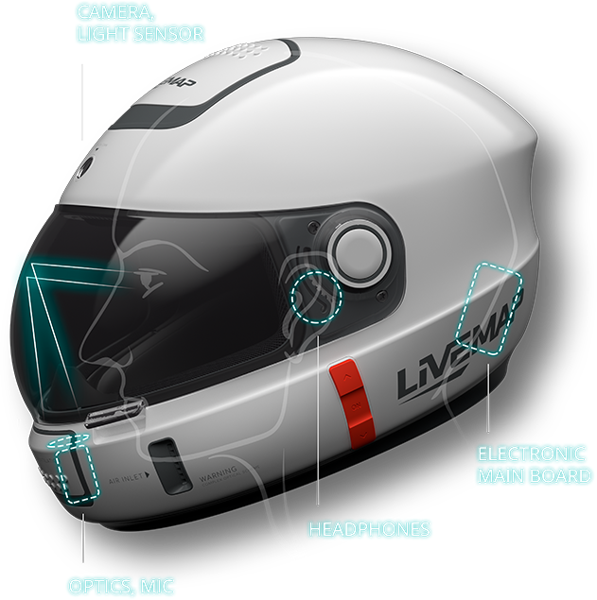
Pune Institute of Computer Technology
Saferide - "Helmet wear and alcohol detection system"
Group No. E5_1
22102 Aditi Zeminder
22112 Pranav Bhiungade
22117 Prem Deshmukh
22118 Shravani Deshmukh
Guide - Ms Bhakti Kadam

Slide 2

INTRODUCTION
"SafeRide" is an innovative and advanced technology designed to improve bike riders' safety.
This project has the potential to revolutionize safety in bike riding where risks of accidents are very high due to not wearing helmets and consuming alcohol while driving.
We will look into the technology used and the challenges faced during the development process.
This project aims to benefit the bike riders and prevent deaths due to accidents.

Slide 3
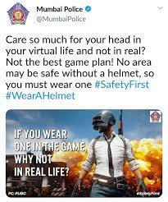
Motivation
During 2021, a total of 46,593 persons were killed due to non-wearing of helmet, of which 32,877(70.6%) persons were drivers and 13,716 (29.4%) were passengers and Non-wearing of helmet caused injuries to 93,763 persons.
In most countries, motorcycle riders are forced to wear the helmet and not over speed the vehicle, but the riders are still violating the rules. Riders are vulnerable to accidents and injuries, and even the slightest mistake can have severe consequences. While wearing a helmet is a crucial safety measure, it is not always enough to prevent accidents. Therefore, there is a need for a smart helmet that ensures the safety of the rider and checks for alcohol consumption.

Slide 4
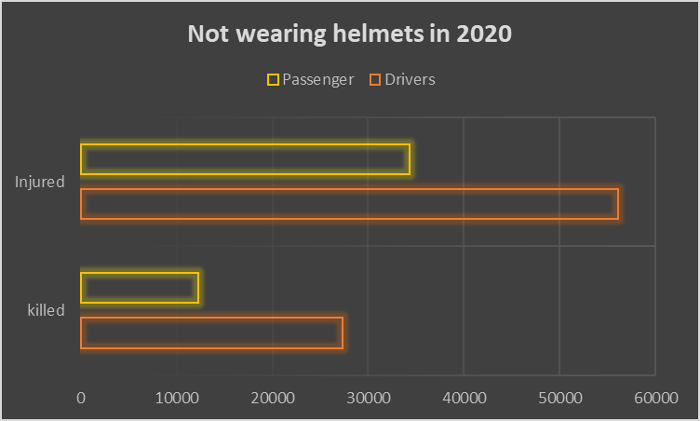
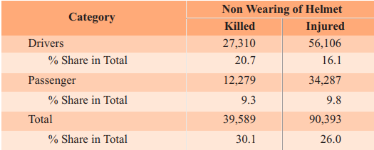
Statistics 2020
Data of Drivers and Passengers who died due to accidents in 2020
Source : Government of India Ministry of Road Transport and Highway Transport Research Wing (2020), “Road accidents in India 2020” [Online]

Slide 5
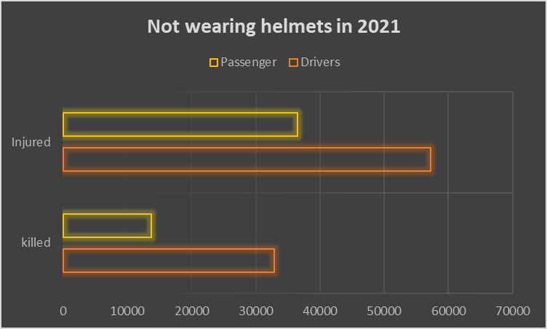
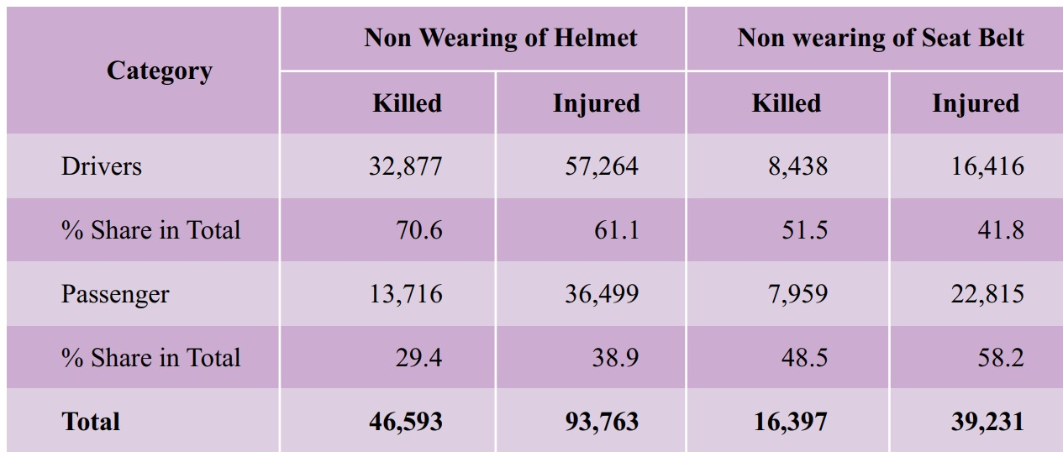
Statistics 2021
Data of Drivers and Passengers who died due to accidents in 2021
Source : Government of India Ministry of Road Transport and Highway Transport Research Wing (2021), “Road accidents in India 2021” [Online]

Slide 6
Literature Survey
The objective of the present invention was to develop a safety helmet for two-wheeler drivers that can provide safety and avoid road accidents. Various sensors are integrated for effective improvement in safety purposes.
The proposed invention is a smart helmet that is incorporated with an infrared sensor to sense the motion of the human head inside the helmet.
It checks whether the helmet is worn or not. The helmet is also equipped with alcohol sensors that sense alcohol consumption by analyzing human breath. The ignition will be conditioned on the level of alcohol content in the breath.
It fits with a piezo-electric sensor used to measure changes in acceleration, pressure, or force used to inform the system about the accident. Additionally, an ultrasonic sensor detects obstacles in the path to avoid any accidents

Slide 7

Problem Statement
Design a smart helmet integrating a force sensor and a breath analyzer to ensure safety of riders and prevent accidents caused by drunk driving.

Slide 8
OBJECTIVES
1) To study statistics and research papers on existing projects related to the smart helmet to realize the depth of a problem and to define a final problem statement.
2) To Explore various electronic components and sensors applicable to the proposed system. Decide the most feasible components and check their availability in the market.Getting familiar with the Arduino IDE and design logic for integrating the microcontroller and various sensors.
3) To design a circuit diagram and use available simulation software to check the reliability of the designed circuit diagram.
4) To test and debug the finalized circuit diagram for various cases.
5) To create a final report on the proposed system including the literature survey, circuit diagram, working, and conclusion.

Slide 9
BLOCK DIAGRAM
RECEIVER
(matching RFID)
ENGINE
MOTOR
ON/OFF
To check
Helmet wear
(Push button)
Transmitter
(sending RFID) `
ESP8266
Sensor to check
alcohol
(alcohol sensor MQ3)
ESP8266
DISPLAY
Notes:
The output of these components in the helmet will be input for the microcontroller which is embedded on the helmet. Then the processed data which is the output of the microcontroller of the helmet is sent to the bike module through the RF transmitter.

Slide 10
Hardware and Software Requirements
HARDWARE REQUIREMENTS :
To check Helmet Wear: Push Button
To check alcohol measure: Alcohol Sensor MQ3 [4753]
Microcontroller ESP8266 to interface the sensors, send and receive data.
FS1000A 433mHz Transmitter Receiver RF Radio Module, for wireless communication.
16x2 (1602) Character Green Backlight LCD Display to display appropriate messages.
150 RPM Single Shaft BO Motor - Straight to show how the motors of bike can be controlled (for the prototype)
SOFTWARE REQUIREMENTS :
Arduino IDE and ESP8266 library for interfacing the microcontroller with the sensors and different modules.

Slide 11

THANK YOU !

