Slide 1
Imagination is power!
Imagination is more important than knowledge. For knowledge is limited, whereas imagination embraces the entire world, stimulating progress, giving birth to evolution.
– Einstein

Slide 2


Introducing

Slide 3
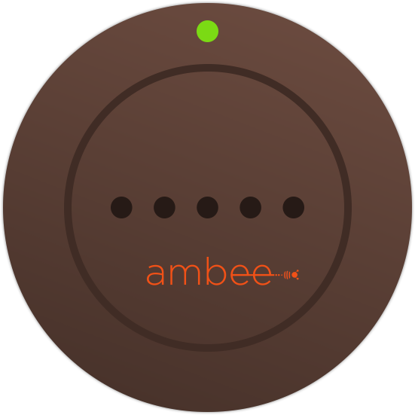


Form Factor
Sensors
Wrist Band
Clip-on
Buckle
Keychain
Freeform
Locket
Temperature & Humidity
Ultraviolet
Light
Sound
Dust
Pricing
Smartphone
Hardware: ₹1499
App: Free

Slide 4
Lifestyle Enhancements
Business Model
What to wear based on environment
Experiential zones
Happiness Index
Accessory as Gift
Social connects
Exploration & Discovery
Planning Trips & Outings
Health & Wellness
Family Preferences
Hardware ($)
App (Free)
Community (User Acquisition)
Context Aware Marketplace
Data Analytics
Differentiators
Ambience vs Weather tracking
Hyperlocal & Personal
Personal & Collective Insights
User Experience
Accessory Formfactor (Customizable)
Preventive Measures
Extensions
Uber API (book when raining)
Booking.com (sends preferences for experiential selling)
Masks (when outdoors and in pollution)
Out of Home Advertising (ordering coffee in rain, ice-cream in sun)
Etc…

Slide 5
Know better. Live well.
getambee.co
Prototype at: https://invis.io/QC3YKCH5G

