Slide 1
Introduction to Containers

Slide 2


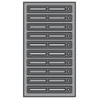
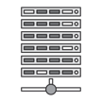



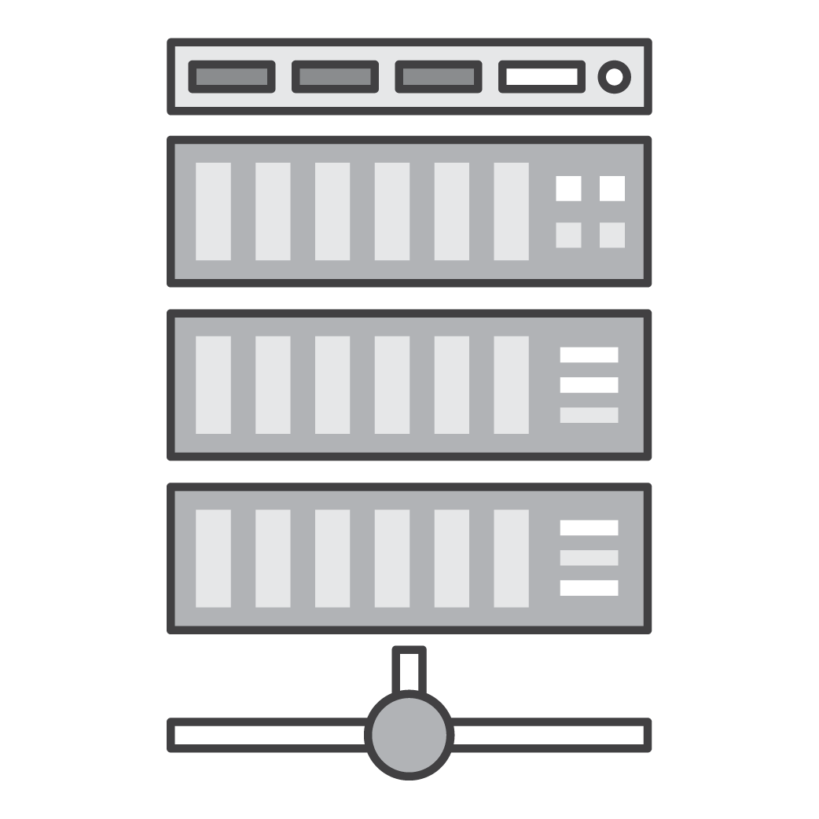
The Problem
Static website
Web fronted
Background workers
User DB
Analytics DB
Queue
 | Dev VM | QA Server | Single Prod Server | Onsite Cluster | Public Cloud | Contributor’s laptop | Customer Servers
Different application stacks
Different hardware deployment environments
How to run all applications across different environments?
How to easily migrate from one environment to another?
Notes:
How do you solve for all the different applications/queues/etc across of the different platforms (cloud, onsite, customer servers, etc)

Slide 3

The Solution
Static website
Web fronted
Background workers
User DB
Analytics DB
Queue
 | Dev VM | QA Server | Single Prod Server | Onsite Cluster | Public Cloud | Contributor’s laptop | Customer Servers
Unit of software delivery
Lightweight, portable, consistent
Deploy and run everywhere
Deploy and run anything
Notes:
Solutions requires something that can run anything everywhere, and is consistent, lightweight and portable.

Slide 4
What is a container?
A lightweight, stand-alone, executable package of software that includes all dependencies: code, runtime, system tools, system libraries, settings.
Containers isolate software from its surroundings
development and staging environments
help reduce conflicts between teams running different software on the same infrastructure.
Long history: chroot, FreeBSD Jails, Solaris Containers, OpenVZ, LXC
Docker simplified creation/management/operation of containers
Notes:
Containers were the solution to the problem.

Slide 5
What is a container?
Containers share a machine's OS kernel.
They start instantly and use less compute and RAM.
Images are constructed from filesystem layers and share common files. This minimizes disk usage and image downloads are much faster.
Notes:
Windows containers don't honor the cgroup RAM and CPU settings?
https://azure.microsoft.com/en-us/blog/containers-docker-windows-and-trends/

Slide 6
VMs VS. Containers
App A | App B | App C
Bins/Libs | Bins/Libs | Bins/Libs
Guest OS | Guest OS | Guest OS
Hypervisor
Host OS
Server (Host)
App A | App A | App B | App B | App C | App C
Bins/Libs |  | Bin/Libs
Content Manager (e.g. Docker)
Host OS
Server (Host)
VMs
Containers

Slide 7
Benefits
Portable runtime application environment
Package application and dependencies in a single artifact
Run different application versions (different dependencies) simultaneously
Faster development & deployment cycles
Better resource utilization

Slide 8
Use Cases
Consistent environment between Development & Production
Continuous Integration and Deployment
Service-Oriented Architectures / Microservices
Short lived workflows
Modernize Apps
Notes:
Makes it easier to build & deploy things more rapidly, because the environment is the same. Build the container in dev, push to test, release to prod. This can also be useful for customers running hybrid environments.
Makes it easier to keep consistent environments for SOAs or Micro-Services. Also, many of these services aren’t very resource intensive, so you can place them together on one instance.
Sometimes customers have short-lived workflows that need to setup environments (e.g. queue systems, CI jobs, etc.), which doesn’t always map too well to EC2’s per-hour billing model. Docker can be one workaround, allowing them to push & pop containers on to the instance.
Can be useful for isolated execution when testing user code. E.g. Go Playground or similar.

Slide 9
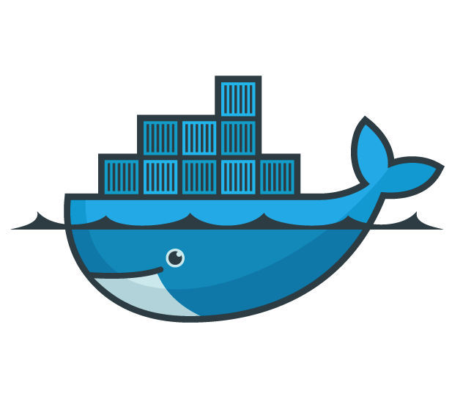
Docker
Lightweight container virtualization platform.
Tools to manage and deploy your applications.
Licensed under the Apache 2.0 license.
Built by Docker, Inc.
Notes:
Docker is a platform designed to help automate deployment of application containers.
It was built by the Docker, Inc., who were previously “DotCloud”, a PaaS platform.

Slide 10
Docker Platform =
Docker Engine + Docker Hub

Slide 11
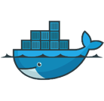


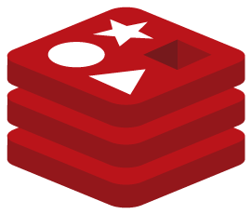

Docker Engine
Client
DOCKER_HOST
Registry
Docker daemon
Docker client
docker build
Docker daemon
docker pull
Containers
Images
docker run
Notes:
Image source - https://docs.docker.com/engine/docker-overview/ - docker-architecture

Slide 12
Docker Daemon
Runs on a host machine.
Builds images.
Runs containers.
Users interact with the daemon through the Docker client.

Slide 13
Docker Client
Docker binary.
Primary user interface to Docker.
Communicates back and forth with a Docker daemon.

Slide 14
Container Registry – Docker Hub
Cloud-based Docker registry
Library of public images (Official repositories)
Storage for your images (public and private repositories)
Automated image builds (commit to a GitHub or Bitbucket repository)

Slide 15
Container Registry – Docker Hub
https://hub.docker.com
<username>/foobar
ubuntu:14.04
User maintained repository
Top-level, Docker maintained repository
Image name
Image tag
Notes:
Images are stored in repositories, which are stored in registries. Docker Hub is the default public registry.
A tag collects together the images layers that make up that image.
Images can have multiple tags e.g. version number, codename, etc.

Slide 16
Docker Image
Read-only template
Used to launch container
Union file systems to combine
different layers into a single image
Docker images built from base
image, instructions to add layers on top
Instructions stored in Dockerfile
Writable
add NGINX
Container
add nodejs
Image
References
parent
image
Ubuntu
Image
Base image
bootfs
kernel

Slide 17
Container registries
A Docker registry stores Docker images
Docker Hub
Public registry that anyone can use, and Docker is configured to look for images on Docker Hub by default.
https://hub.docker.com/
Amazon EC2 Container Registry (Amazon ECR)
Fully managed Docker container registry
Makes it easy for developers to store, manage, and deploy container images

Slide 18
Docker Image
To build your own image, you create a Dockerfile with a simple syntax for defining the steps needed to create the image and run it.
Certain instructions in a Dockerfile create a layer in the image.
When you change the Dockerfile and rebuild the image, only those layers which have changed are rebuilt.
This is part of what makes images so lightweight, small, and fast, when compared to other virtualization technologies.
Creating Effective Images, video, slides
Notes:
https://docs.docker.com/develop/develop-images/dockerfile_best-practices/#dont-install-unnecessary-packages
In Docker 1.10 and higher, only the instructions RUN, COPY, ADD create layers. Other instructions create temporary intermediate images, and do not directly increase the size of the build.
In Docker 17.05 and higher, you can do multi-stage builds and only copy the artifacts you need into the final image. This allows you to include tools and debug information in your intermediate build stages without increasing the size of the final image.

Slide 19
Docker Image Layers
Container Layer – Read-write
Each layer represents an instruction in the image’s Dockerfile
Each layer except the top one is read-only
Last layer specifies what command to run within the container
Image Layers – Read-only

Slide 20
Container registry commands
docker login/logout
Login/logout of a Docker registry
docker pull or docker run
required images are pulled from your configured registry.
docker push
your image is pushed to your configured registry.
Notes:
Simple commands for working with registries.

Slide 21
Docker Image
A read-only template with instructions for creating a Docker container.
Often, an image is based on another image, with some additional customization.
e.g., you may build an image which is based on the Ubuntu image, but installs the Apache web server and your application, as well as the configuration details needed to make your application run.
Create your own images.
Use images created by others and published in a registry.
Notes:
https://docs.docker.com/engine/reference/commandline/images/#extended-description

Slide 22
Docker Workflows

Slide 23
Docker Workflows
Pull an image from Docker Hub
Build an image from a Dockerfile
Run a container
Inspect a container
Attach a volume to a container
Link containers

Slide 24
Pull an Image From Docker Hub
# Get the latest Ubuntu image $ docker pull ubuntu
# Get a specific version (14.04) of the Ubuntu image $ docker pull ubuntu:14.04
# List local images $ docker images

Slide 25
Build an Image From a Dockerfile
FROM ubuntu:14.04
RUN apt-get update
RUN apt-get install -y redis-server
EXPOSE 6379

Slide 26
Dockerfile Reference
FROM <image>:<tag> Sets the base image. Must be first instruction in Dockerfile.
RUN <command> Executes any commands in a new layer on top of the current image and commit the results.
CMD [“exec”, “param1”, “param2”] Sets the command to be executed when running the image.
ENTRYPOINT [“exec”, “param1”, “param2”] Configures a container that will run as an executable.

Slide 27
Dockerfile Reference
EXPOSE <port> Informs Docker that the container listens on the specified network ports at runtime.
ENV <key> <value> Sets the environment variable <key> to the value <value>.
ADD <src> <dest> Copies new files, directories or remote file URLs from <src> and adds them to the filesystem of the container at the path <dest>. *
COPY <src> <dest> Copies new files or directories from <src> and adds them to the filesystem of the container at the path <dest>. *
*ADD or COPY - https://docs.docker.com/engine/articles/dockerfile_best-practices/#add-or-copy

Slide 28
Dockerfile Reference
VOLUME <path> Creates a mount point with the specified name.
USER <user> Sets the user name or UID to use when running the image and for any RUN, CMD and ENTRYPOINT instructions that follow it.
ONBUILD [instruction] Adds to the image a trigger instruction to be executed at a later time, when the image is used as the base for another build.

Slide 29
Build an Image From a Dockerfile
# Build an image from a Dockerfile and tag it $ docker build -t <username>/myredis:v1 /path/to/Dockerfile
# Log into Docker Hub $ docker login
# Publish my image to Docker Hub $ docker push <username>/myredis:v1

Slide 30
Run a Container - Interactive
# Run a container from the Ubuntu image and execute bash $ docker run -t -i ubuntu /bin/bash
# Run a container with a specific name $ docker run -t -i —-name my_container ubuntu /bin/bash
# List running containers $ docker ps

Slide 31
Run a Container - Daemon
# Run a container from the Ubuntu image and execute an infinite loop $ docker run -d —-name my_daemon_container ubuntu /bin/bash -c “while true; do echo hello world; sleep 1; done”
# Get logs for daemonized container $ docker logs -f my_daemon_container

Slide 32
Run a Container - Ports
# Map port 6379 on the container to port 45000 on the host $ docker run -d —p 45000:6379 <username>/myredis:v1 redis-cli
# Map port 6379 on the container to a random port on the 127.0.0.1 interface on the host $ docker run -d —p 127.0.0.1::6379 <username>/myredis:v1 redis-cli
# List port mappings for the container $ docker port <container-id>
Notes:
-p allows us to bind the ports, in this case 6379 on the guest to 45000 on the host. If we just give it one number (6379), it will automatically pick a high port on the host.
We can also bind to interfaces, as in the 2nd example. Here’s we’re binding to a random port on the 127.0.0.1 interface.
We can also use docker port to find out which ports are bound, and then connect to that port on the host.
-P can be used to bind all ports exposed via the EXPOSE command.
Of course, you can bind the same port on the guest to the same port on the host, but given that it needs to be unique, things get messy with multiple containers.

Slide 33
Inspect a Container
# Return low-level information on a container $ docker inspect my_container
# Return true if the container is running $ docker inspect —f ‘{{.State.Running}}’ my_container

Slide 34
Mount a Volume Into a Container
# Mount the directory on the host to the same location on the container $ docker run -d -p 80 —-name mywebsite -v /var/www/html/website <username>/nginx nginx
# Mount the directory on the host to a specific location on the container and make it read-only $ docker run -d -p 80 —-name mywebsite -v /home/user/mywebsite:/var/www/html/website:ro <username>/nginx nginx
Notes:
We can create a volume in the Dockerfile using the VOLUME statement.
From the cli, we can use the -v flag to create a volume in the same way.
The -v option can also be used to bind a host directory to a guest one. If we want to make it read-only, we can set :ro on the end of the bind.
This is useful for things such as sharing code or data between containers, or for local dev & containerized test.

Slide 35
Mount a Volume Into a Container
# Mount a directory on the host into the container $ docker run -d -v /dbdata —-name dbdata <username>/database echo “data volume”
# Mount a volume from another container $ docker run -d —-volumes-from dbdata —-name db1 <username>/database
Notes:
Here we create a volume (/dbdata) on one container, and then use it on another container.
We could have multiple containers, all attached & writing to the same /dbdata dir if we wanted to.
This can be useful for things like back-up & restore. E.g. connect a container to the volumes, run the backup there, kill that 2nd container.
Another common practice is to log to that volume & have a 2nd container pull metrics from it.

Slide 36
Link Containers
# Run a PostgreSQL container $ docker run -d --name my_postgres_db postgres
# Run a web app container and link it to the PostgreSQL container $ docker run -d -P --name my_webapp --link my_postgres_db:db <username>/webapp python app.py

Slide 37
Questions?

