Slide 1
Car Rental system(OOP in python)
NAME:PREM KUMAR HEMBRAM
BSC SEMESTER 2ND 1 YEAR
VISVA BHARATI

Slide 2
2: Introduction
Programming is a way to solve real-world problems using computer. Python is a popular high-level programming language. Object-Oriented Programming (OOP) is a paradigm that organizes code around object. This project demonstrates a simple Car Rental System using OOP concepts in Python.
3 : What is OOP(Object-Oriented Programming)? It is a way of writing programs where you create objects that represent real-world things, and these objects have data (attributes) and behavior (methods).
Python supports OOP, and it’s one of the most powerful features of the language.

Slide 3
Key Concepts of OOP
Class
A blueprint or template to create objects.
Defines what attributes and methods an object will have.
Object
An instance of a class.
Represents a real-world entity created from the class blueprint.
Attributes
Variables that belong to an object (also called properties).
Methods
Functions that belong to an object.
Encapsulation
Hiding internal details and exposing only necessary parts.
Inheritance
One class can inherit features from another class.
Polymorphism
Objects can take on many forms; for example, the same method can behave differently depending on

Slide 4
4.OOP Concepts in This Project Class & Object:
We defined Car, Customer, and Rental as classes, and created their objects . Encapsulation: Data and methods are encapsulated inside classes . Constructor (_ init _): Initializes object properties when created. Methods: Define behaviors of object.
5: Classes in the Project
Car Class : Represents a car . Attributes: car _ id, model, rate _ per_ day, available . Method : _str_() to display car info.
Customer Class : Represents a customer . Attributes: customer _ id, name . Method: _str_() to display customer info.
Rental Class : Represents a rental transaction . Attributes: car, customer, days, total _cost .Methods :process _rental ()return _car ()

Slide 5
6: Code Snippets Car Class
Python Copy code class Car: def _init_(self, car _id, model, rate _per _ day): self .car _id = car _ id self .model = model self .rate _per _day = rate _per_ day self .available = True def _str_(self): status = "Available" if self . available else "Not Available" return f"Car {self .car _id}: {self .model } - {status}”
7: Code Snippets Customer Class:
Python Copy code class Customer: def _init _(self, customer _id, name): self .customer _id = customer _id self.name = name def _str_(self): return f“ Customer {self .customer _id}: {self.name}"

Slide 6
8: Code Snippets
Rental Class:
Python Copy code class Rental: def _init _(self, car, customer, days): self .car = car self .customer = customer self .days = days self .total_cost = car .rate_per_day * days def process_ rental(self): if self.car.available: self .car .available = False print(f"{self.customer.name} rented {self .car .model} for {self .days} days. Total cost: ${self.total _cost}") else: print(f"Sorry, {self .car .model} is not available.") def return _car(self): self .car. available = True print(f"{self.customer.name} returned {self .car .model}. Thank you!")

Slide 7
9: Sample Output
Car 1: Toyota Camry – Available Car
2: Honda Civic – Available Alice rented Toyota Camry for 3 days. Total cost: $150Car
1: Toyota Camry - Not Available Sorry, Toyota Camry is not available .Alice returned Toyota Camry. Thank you !Car
1: Toyota Camry – Available
10: Advantages of OOP (in this project)
Code is modular and easy to understand .Classes represent real-world entities .Code can be reused and maintained easily . Behavior and data are combined in one place.
11: Conclusion Implemented a simple Car Rental System using Python OOP . Learned how to define and use classes & objects .Practiced encapsulation and method creation .OOP makes code closer to real-world scenarios.

Slide 8
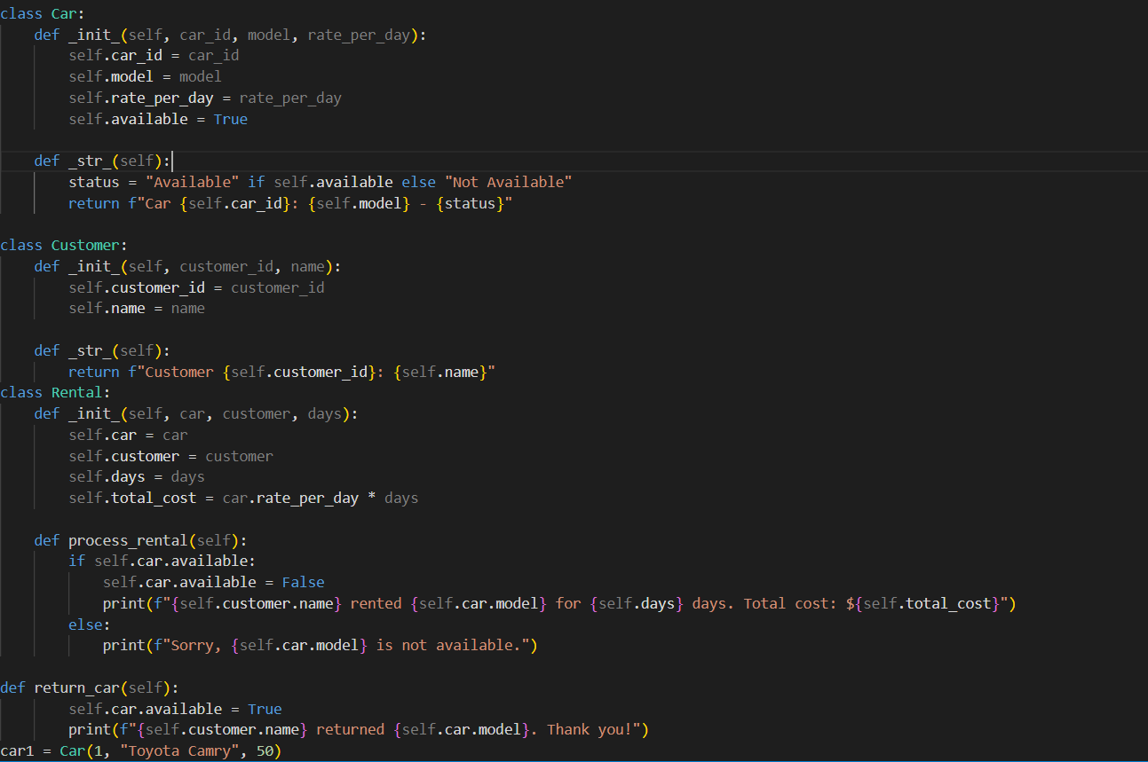

Slide 9
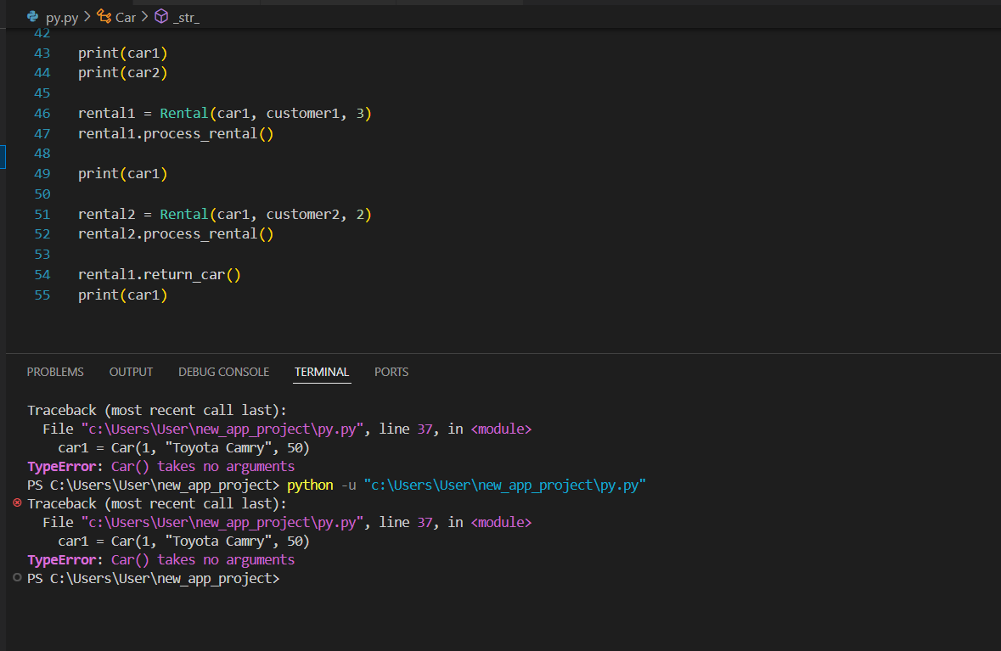
Output:
Car 1: Toyota Camry – Available Car
2: Honda Civic – Available Alice rented Toyota Camry
for 3 days. Total cost: $150
Car 1: Toyota Camry - Not Available Sorry, Toyota Camry
is not available . Alice returned Toyota Camry. Thank
you!
Car 1: Toyota Camry - Available

