Slide 1

Specialization: Computer Engineering
Group:1312A
Subject: Academic English
Student: İsmayilov Elgiz
Teacher:yusif suleymanov
Topic: Programming

Slide 2

Intro
Programming is the process of creating computer programs.
According to one of the founders of programming languages, Niklaus Wirth, “Programs = algorithms + data structures”.

Slide 3
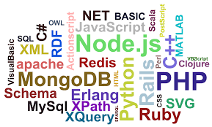
Programming language
Most of the work of programmers is related to writing source code, testing and debugging programs in one of the programming languages.

Slide 4
Tools
In the programming process, integrated development environments are currently widely used, which usually include:
code editor for entering and editing the text of programs;
debugger for debugging (search and elimination of errors);
translator for converting program text into machine representation;
a linker for building a program from several modules;
other service modules and tools.

Slide 5

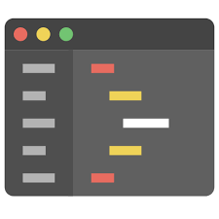
CODe editor
A text editor is an independent computer program or a component of a software package (for example, an integrated development environment source code editor or an input window in a browser) designed to create and modify text data in general and text files in particular.

Slide 6

debugger
A debugger (eng. debugger from bug, bug) is a computer program for automating the debugging process: finding errors in other programs, operating system kernels, SQL queries and other types of code.

Slide 7
Translator
Translator - a program or hardware that performs the translation of a program
Translation of a program is the transformation of a program presented in one of the programming languages into a program written in another language. The translator usually also performs error diagnostics, generates dictionaries of identifiers, prints out the text of the program, etc.

Slide 8
linker
Linker (also a link editor, from the English link editor, linker) is a tool program that performs linking

Slide 9
Vocabulary
According - Görə
Environment – mühit
highlighting - vurğulamaq
particular – xüsusi
performs - həyata keçirir

Slide 10
Diqqətinizə görə təşəkkürlər

