Slide 1

RMD Sinhgad School of Engineering Department of Computer & IT Engineering “Detection of Parkinson Disease”
Presented By: Rohit Thomare
Prem Khandelwal
Harshal Nahire
Ajinkya Kotwal
Guided By: Mrs. Shrutika Nalawade

Slide 2
Agenda
1. Introduction
What is Parkinson’s Disease?
About XGBoost
2. Technologies Used
3. Screenshot of your project
4. Conclusion

Slide 3
What is Parkinson’s Disease?
Parkinson’s disease is a progressive disorder of the central nervous system affecting movement and inducing tremors and stiffness.
It has 5 stages to it and affects more than 1 million individuals every year in India.
This is chronic and has no cure yet.
It is a neurodegenerative disorder affecting dopamine-producing neurons in the brain.

Slide 4
About XGBoost
XGBoost is a new Machine Learning algorithm designed with speed and performance in mind.
XGBoost stands for eXtreme Gradient Boosting and is based on decision trees.
In this project, we will import the XGBClassifier from the xgboost library; this is an implementation of the scikit-learn API for XGBoost classification.

Slide 5
Technologies used
Python Libraries such as scikite-learn, numpy , pandas and XGboost
XGB Classification
To build a model using an XGBClassifier. We’ll load the data, get the features and labels, scale the features, then split the dataset, build an XGBClassifier, and then calculate the accuracy of our model.
UCI ML Parkinson dataset

Slide 6
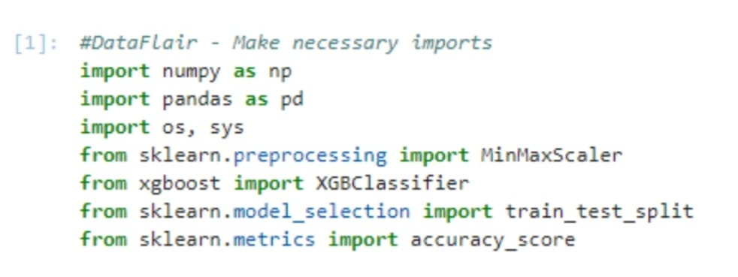
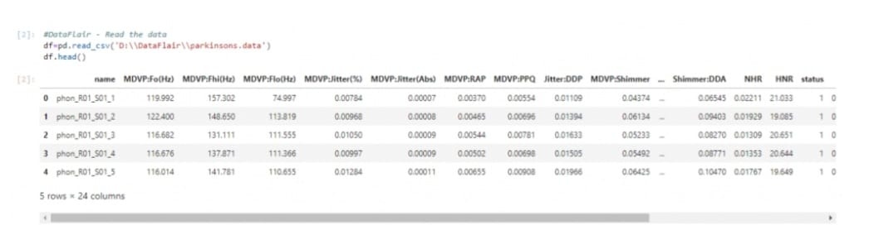
Steps for Detecting Parkinson’s Disease with XGBoost
1 . Make necessary imports
2. read the data into a Data Frame and get the first 5 records.

Slide 7
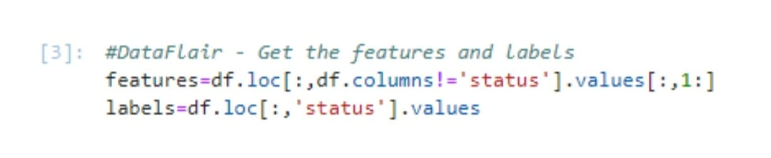
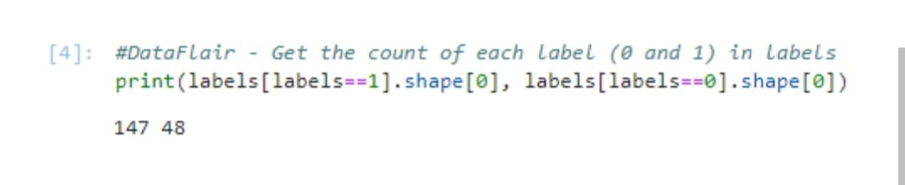
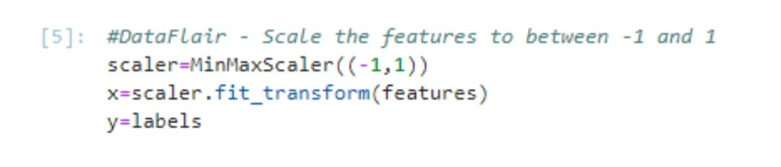
3.
4.
5.

Slide 8
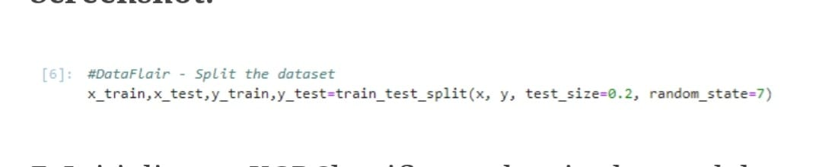
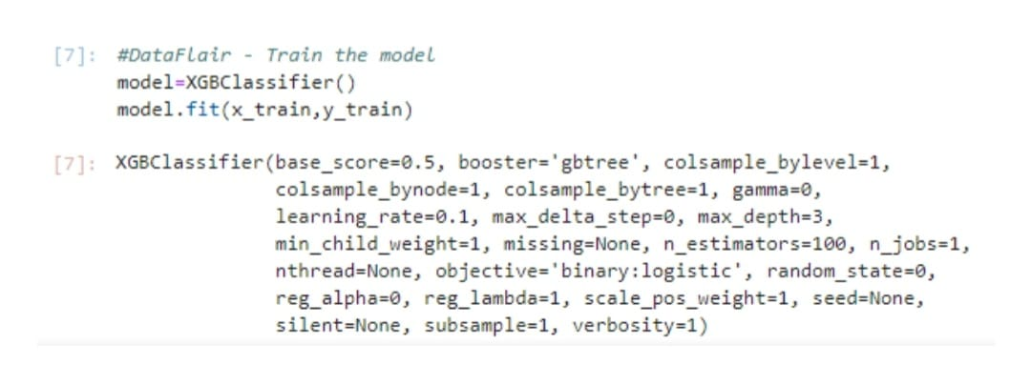
6.
7.

Slide 9
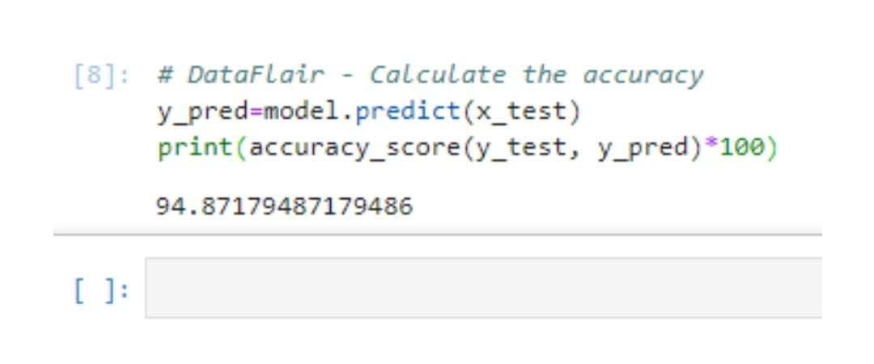
8.

Slide 10
Conclusion
In this mini project we will be able to detect Parkinson’s Disease in its early stages thus preventing any further consequences

Slide 11
Thank You

