Slide 1

Cybersecurity Suspicious Web Traffic Analysis
Full Project • Code • Charts • ML Models

Slide 2
Project Overview
• Dataset: AWS CloudWatch Threat Logs
• Goal: Detect anomalies and suspicious traffic patterns
• Tech: Python, Pandas, Sklearn, Matplotlib
• Models: IsolationForest + RandomForest
• Work: Cleaning, EDA, Feature Engineering, ML, Visualization

Slide 3
Data Import & Cleaning
df = pd.read_csv('/content/CloudWatch_Traffic_Web_Attack.csv')
df['creation_time'] = pd.to_datetime(df['creation_time'], utc=True)
df['end_time'] = pd.to_datetime(df['end_time'], utc=True)
df['src_ip_country_code'] = df['src_ip_country_code'].str.upper()

Slide 4
Feature Engineering
df['session_duration'] = (df['end_time'] - df['creation_time']).dt.total_seconds()
df['avg_packet_size'] = (df['bytes_in'] + df['bytes_out']) / df['session_duration']

Slide 5
IsolationForest Model
iso = IsolationForest(contamination=0.05, random_state=42)
df['anomaly_label'] = iso.fit_predict(df[['bytes_in','bytes_out','session_duration']].fillna(0))
df['anomaly'] = df['anomaly_label'].map({1:'Normal', -1:'Suspicious'})

Slide 6
RandomForest Classifier
df['is_waf_rule'] = (df['detection_types']=='waf_rule').astype(int)
X = df[['bytes_in','bytes_out','session_duration']].fillna(0)
y = df['is_waf_rule']
rf = RandomForestClassifier()
rf.fit(X_train, y_train)

Slide 7
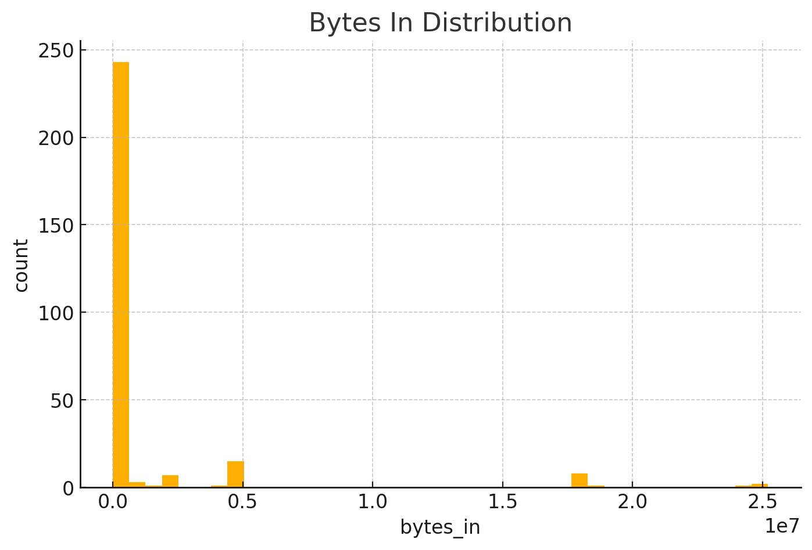
Chart: bytes_in_hist.png

Slide 8
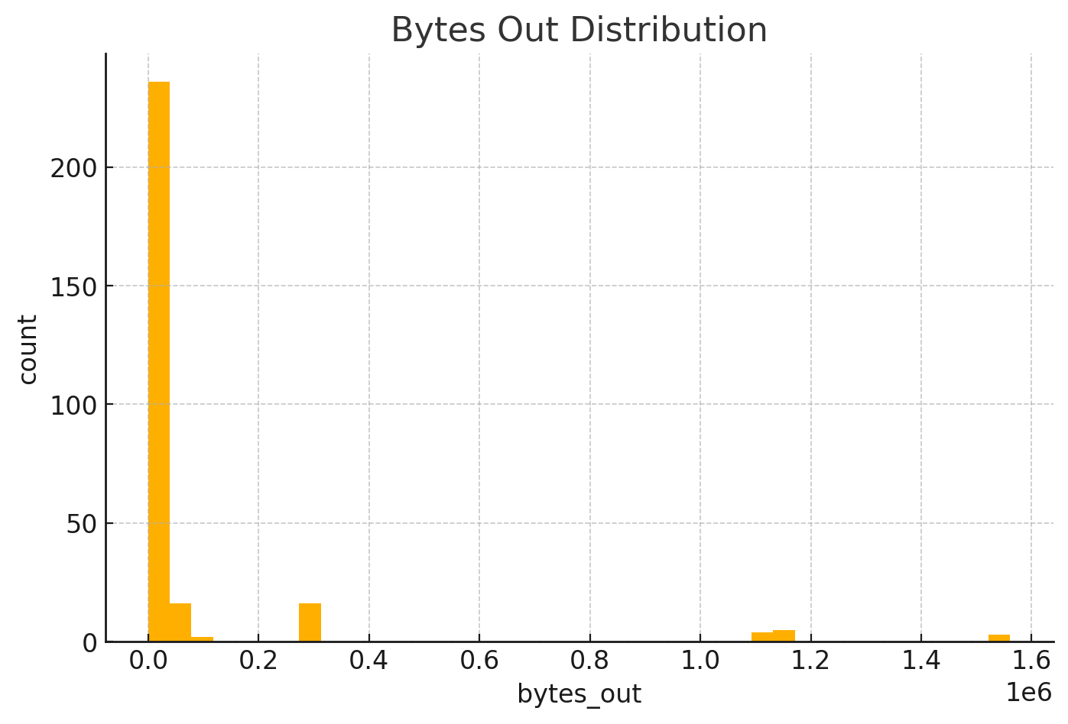
Chart: bytes_out_hist.png

Slide 9
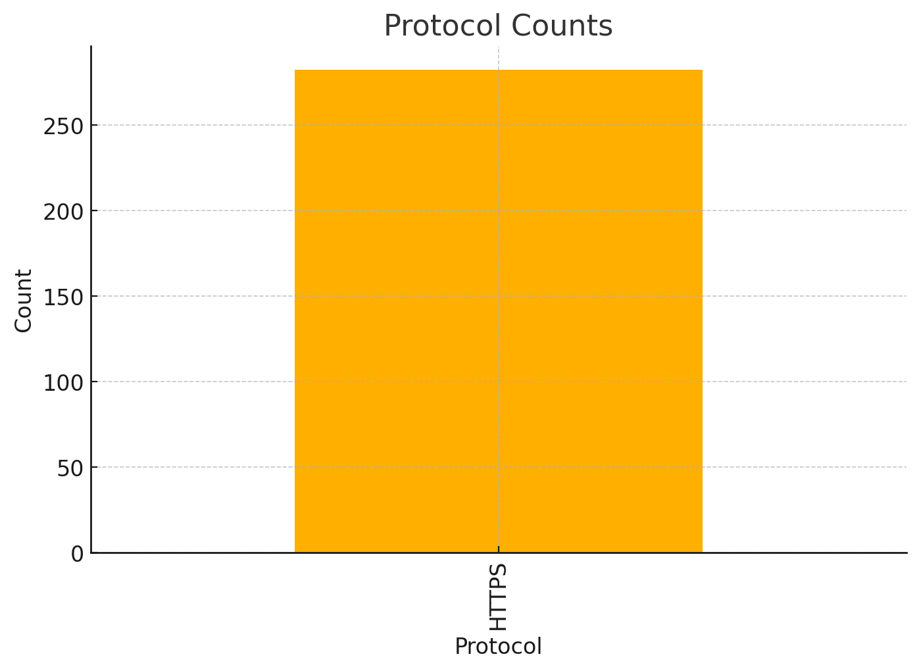
Chart: protocol_counts.png

Slide 10
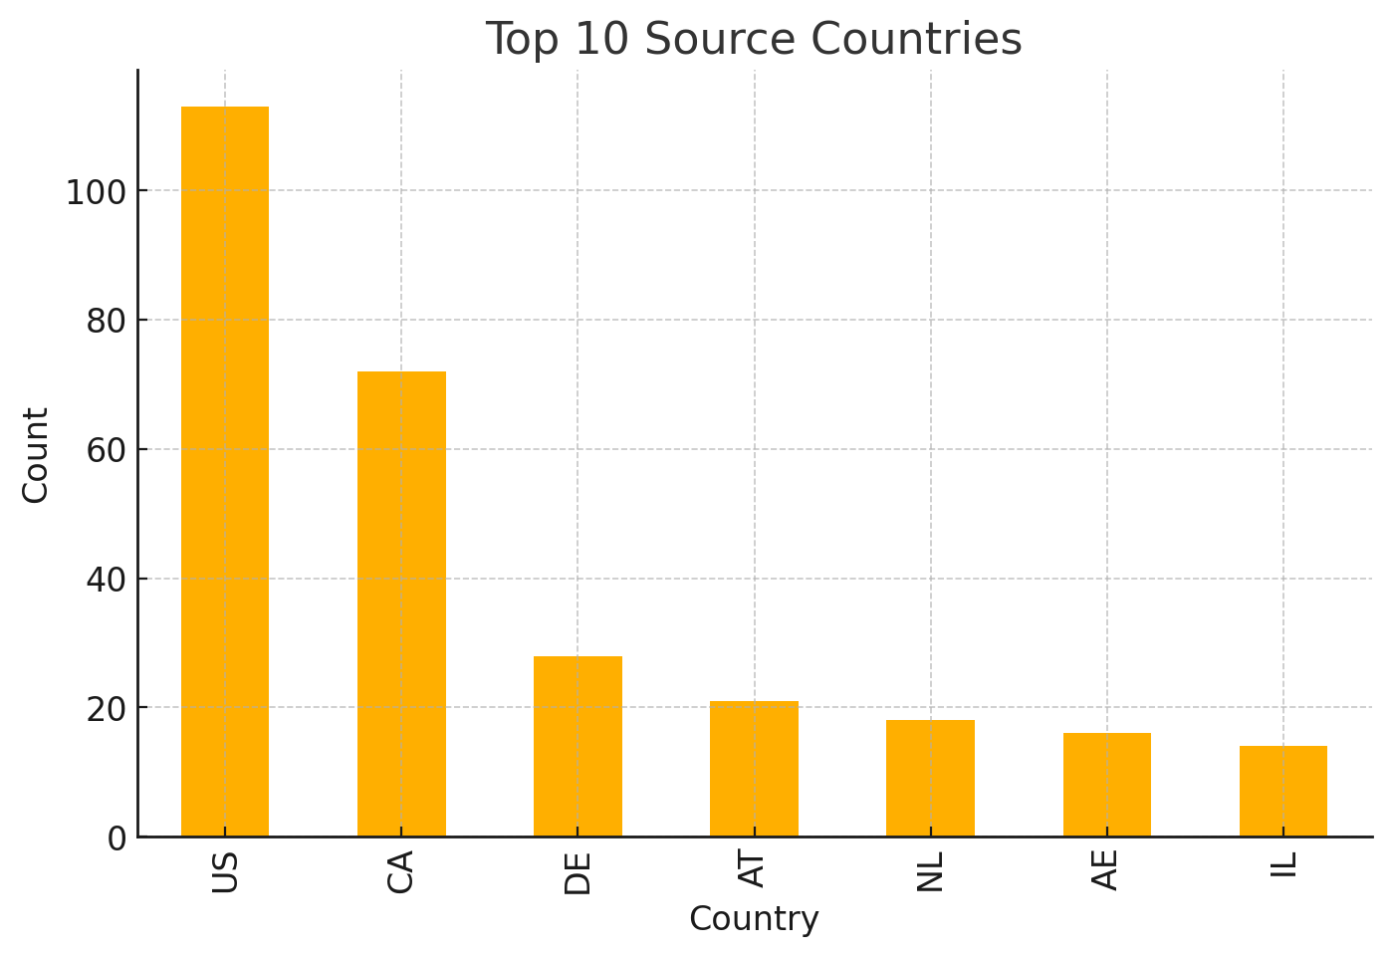
Chart: country_counts.png

Slide 11
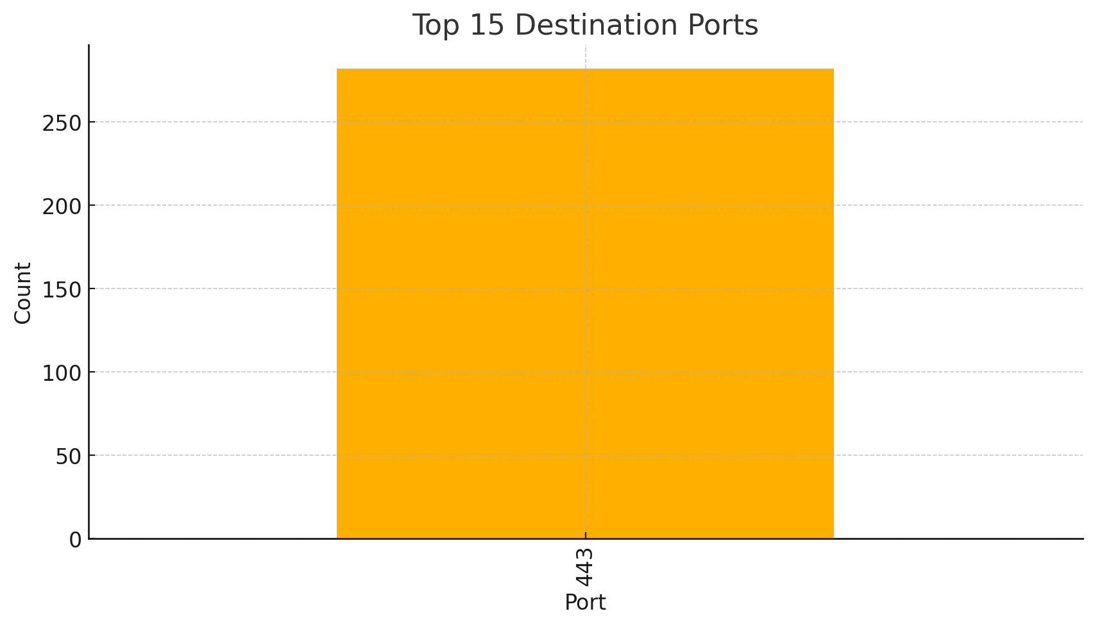
Chart: dst_port_top.png

Slide 12
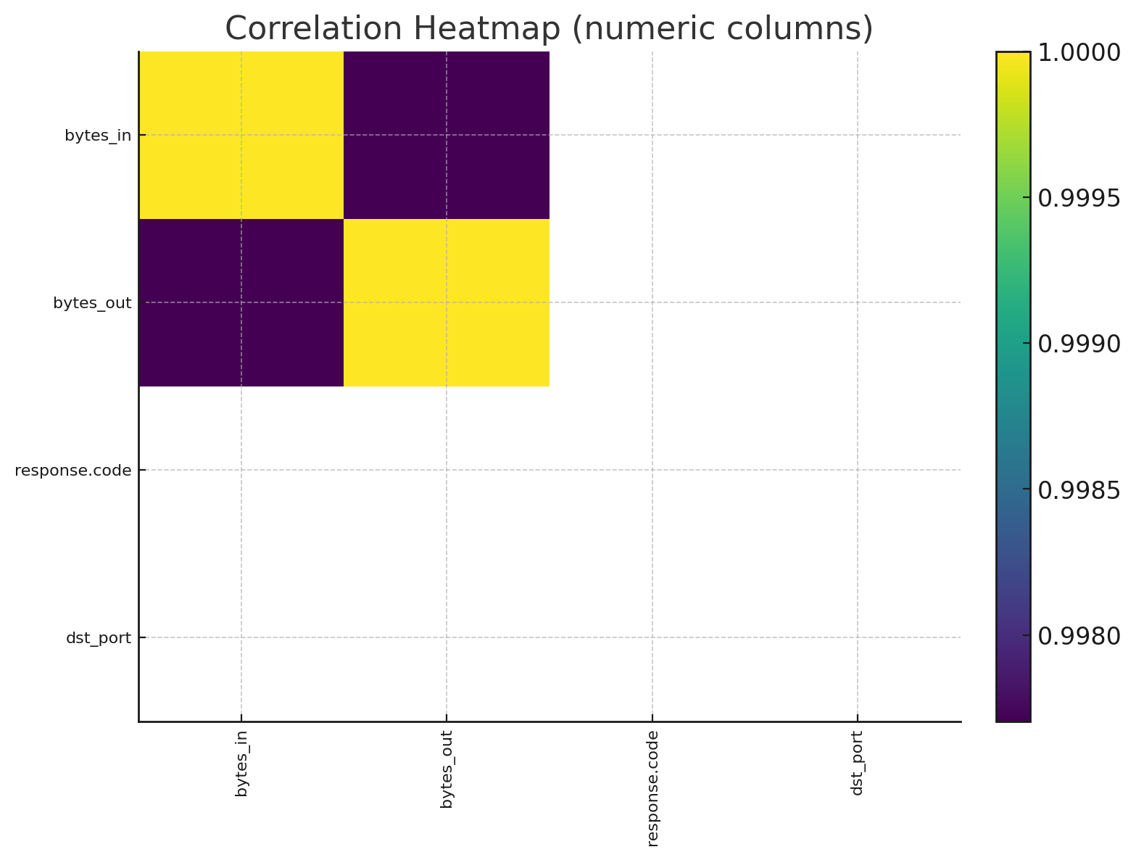
Chart: correlation_heatmap.png

Slide 13
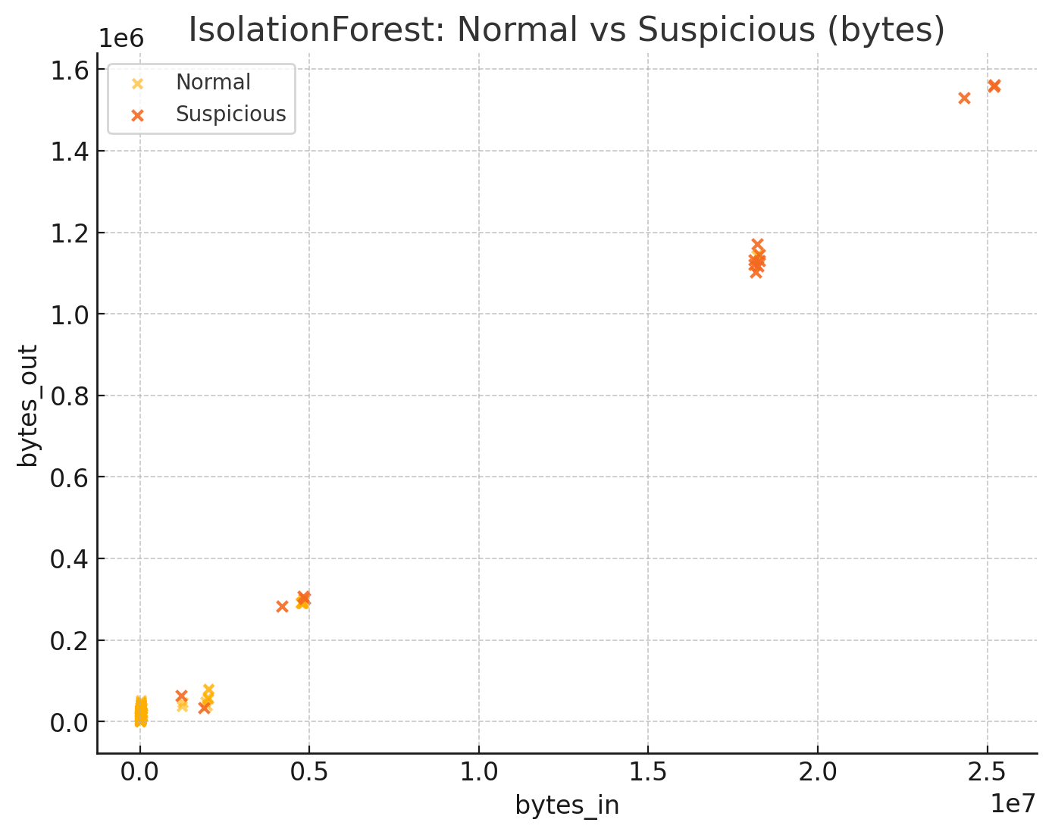
Chart: anomalies_scatter.png

