Slide 1

Colorado Motor Vehicle Sales Analysis
Professional PPT Report

Slide 2
Agenda
Dataset Overview
Exploratory Data Analysis (EDA)
Trend Analysis
County-Level Insights
Forecasting Summary
Conclusion & Recommendations

Slide 3
Dataset Overview
Focus: Colorado Motor Vehicle Sales
Years: 2008 to 2015
Total Records: 501
Columns: year, quarter, county, sales

Slide 4
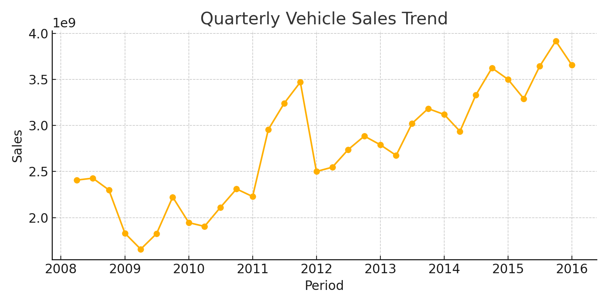
Quarterly Sales Trend

Slide 5
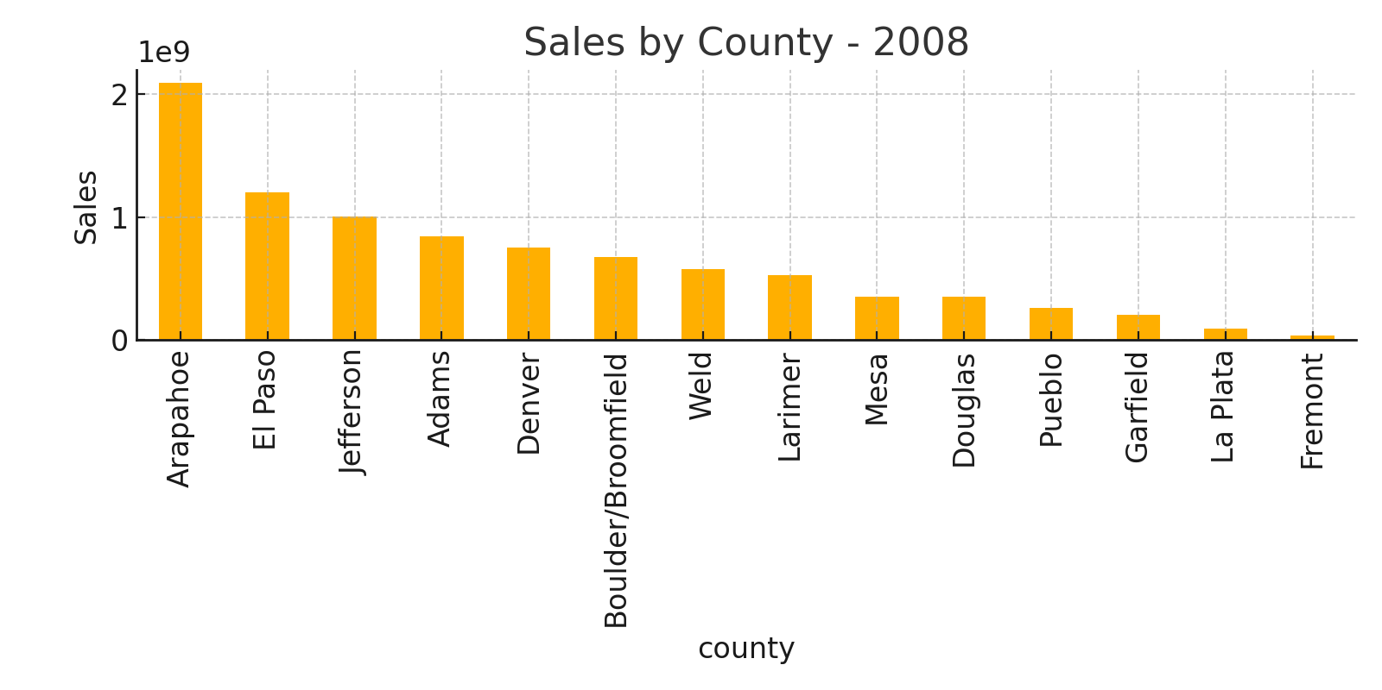
County-Level Sales Insights

Slide 6
Forecast Summary
Quarterly aggregated series prepared for time-series modeling.
SARIMAX / ETS models recommended due to strong seasonality.
Dataset contains ~32 quarters: suitable for basic seasonal forecasting.
Naive baseline also applied for comparison.

Slide 7
Conclusion & Recommendations
Vehicle sales show clear seasonal quarterly patterns.
County-level sales distribution is highly uneven.
Forecasting supports capacity planning and policy insights.
Suggested next steps: deeper ML models, anomaly detection, dashboard visualization.

