Slide 1
Premium Data Science Salary Analysis
By Premkumar
Made with Python

Slide 2
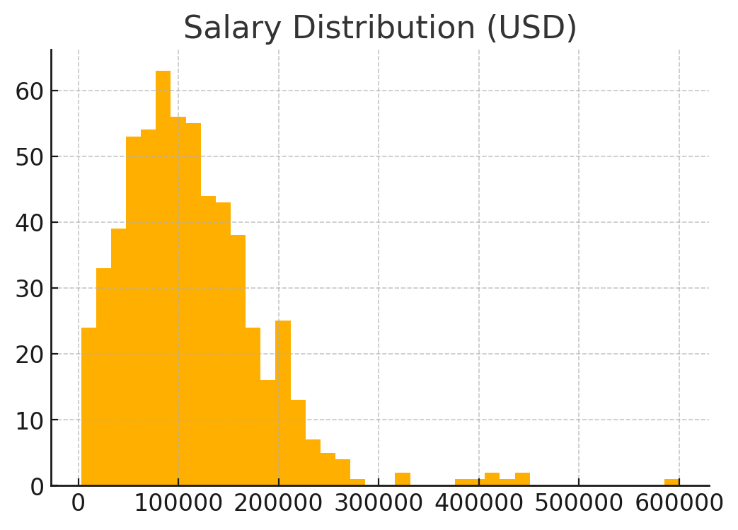
Salary Distribution

Slide 3
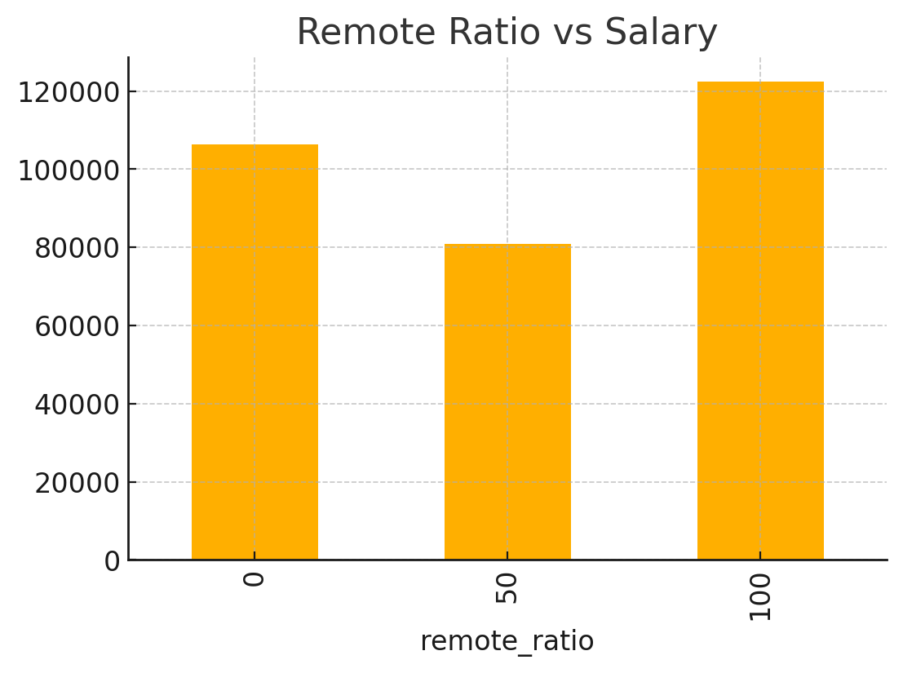
Remote Ratio vs Salary

Slide 4
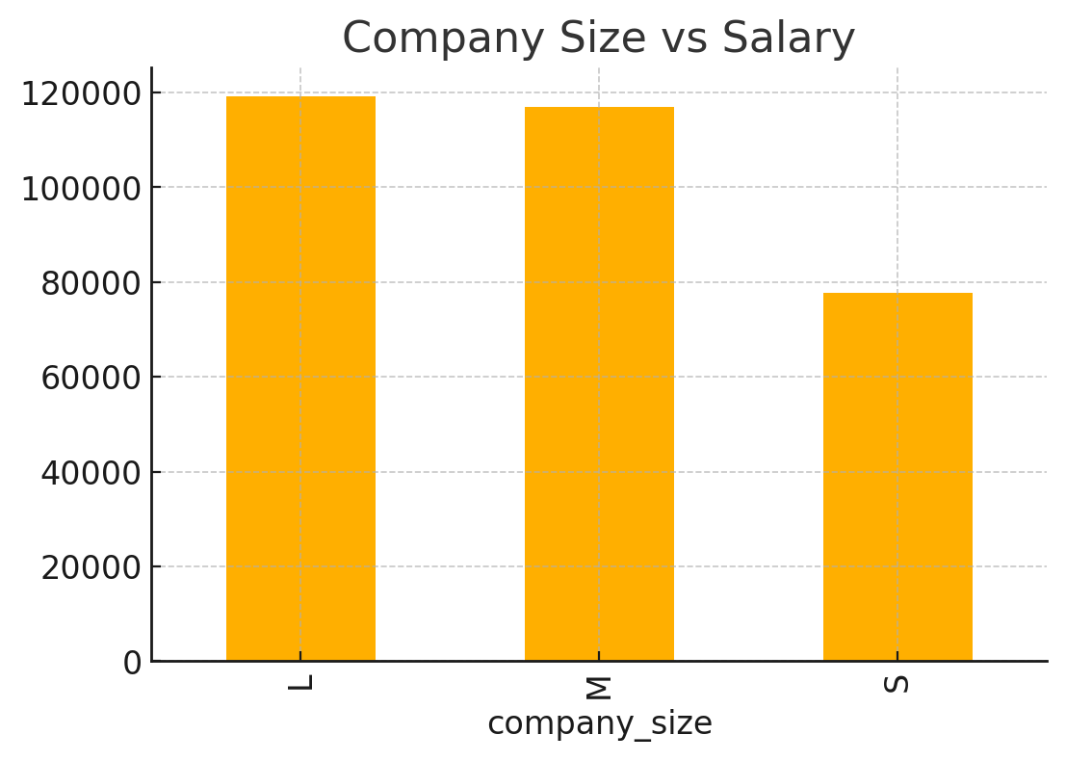
Company Size vs Salary

Slide 5
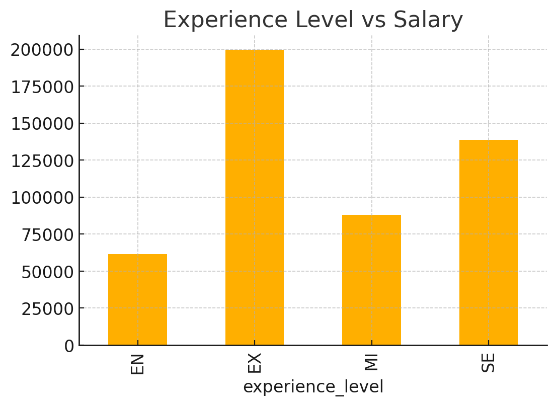
Experience Level vs Salary

