Slide 1
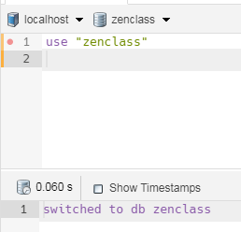
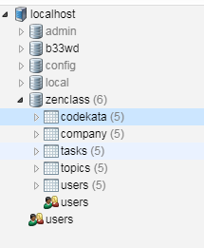
MongoDB_Day2_Assignment

Slide 2
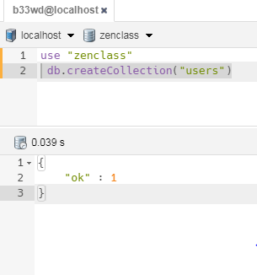
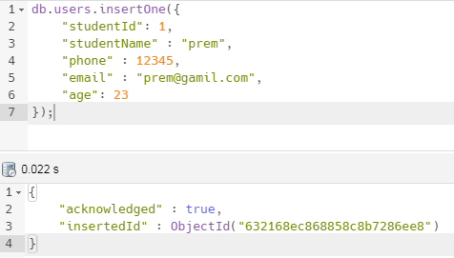
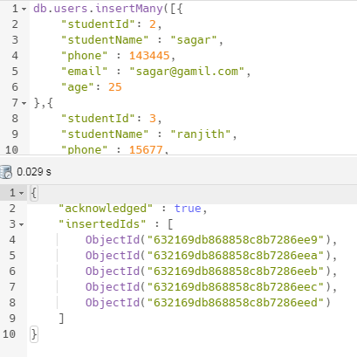

Slide 3
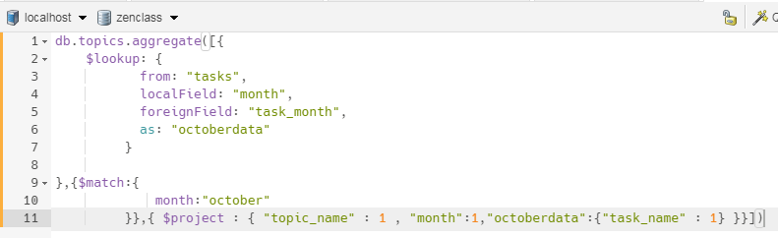
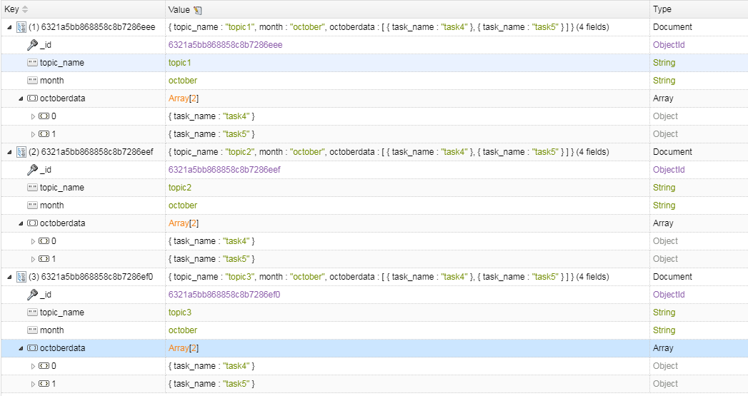
Q1.Find all the topics and tasks which are thought in the month of October.

Slide 4
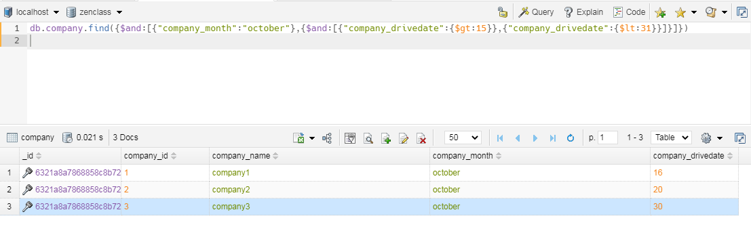
Q2. Find all the company drives which appeared between 15-oct and 31-oct.

Slide 5
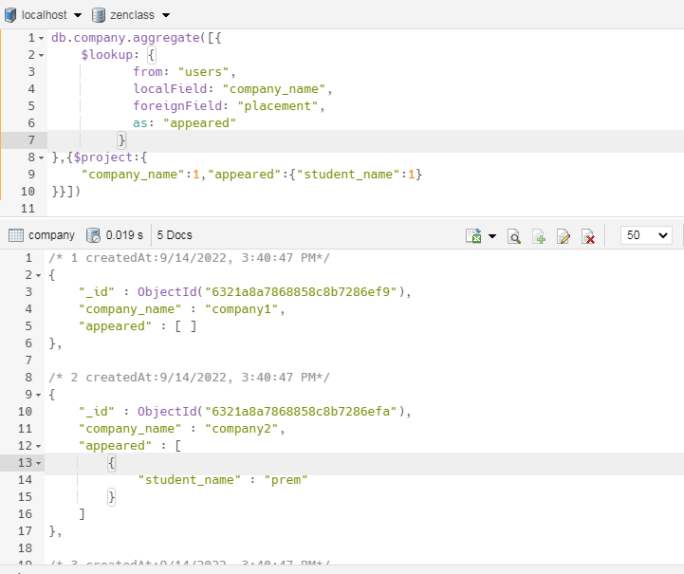
Q3.Find all the company drives and students who are appeared for the placement.

Slide 6
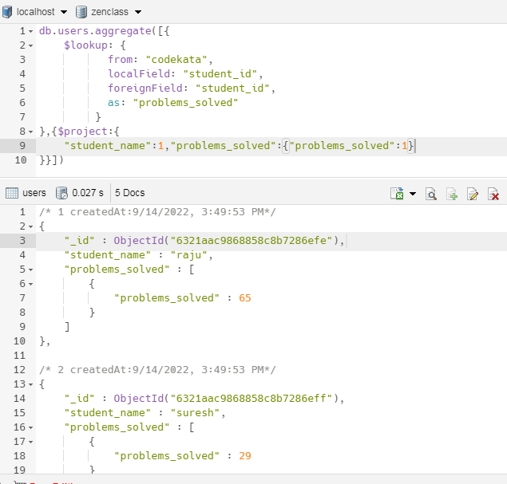
Q4.Find the number of problems solved by the user in codekata

Slide 7
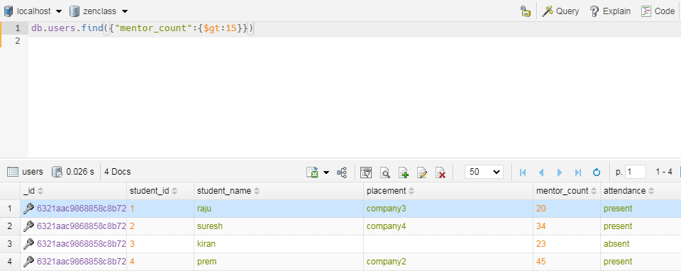
Q5. Find all the students with who has the mentee's count more than 15

Slide 8
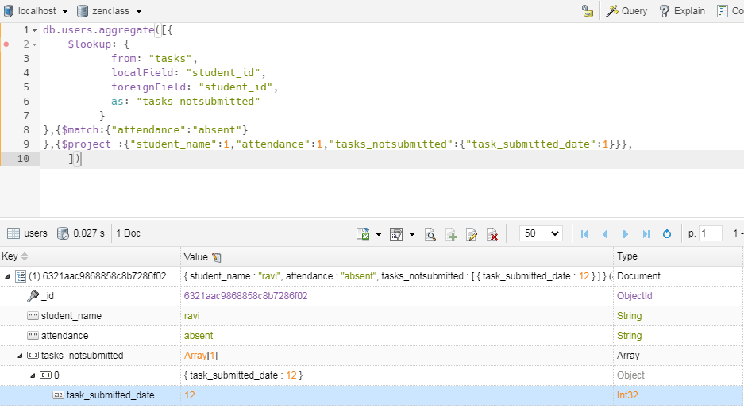
Q6.Find the number of users who are absent and task is not submitted between 15-oct and 31-oct

