Slide 1
Repository pattern

Slide 2
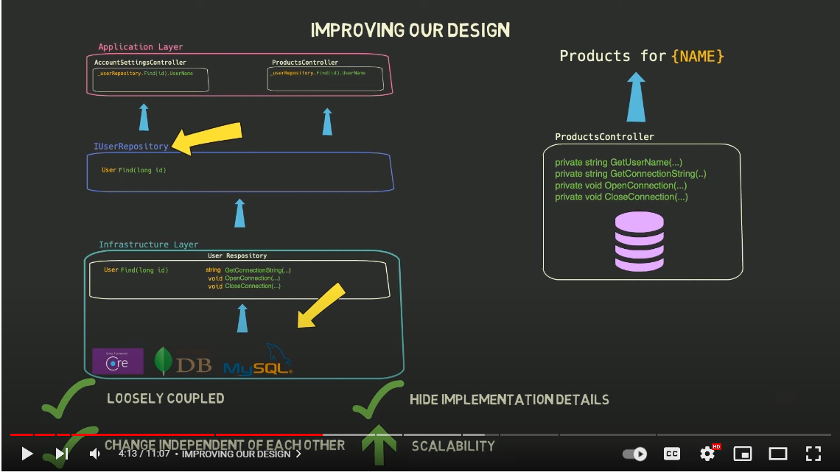

Slide 3
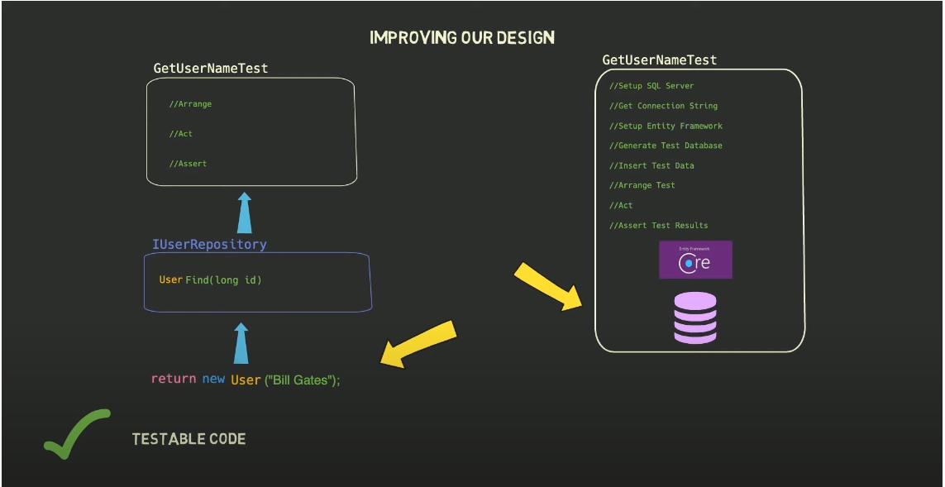

Slide 4
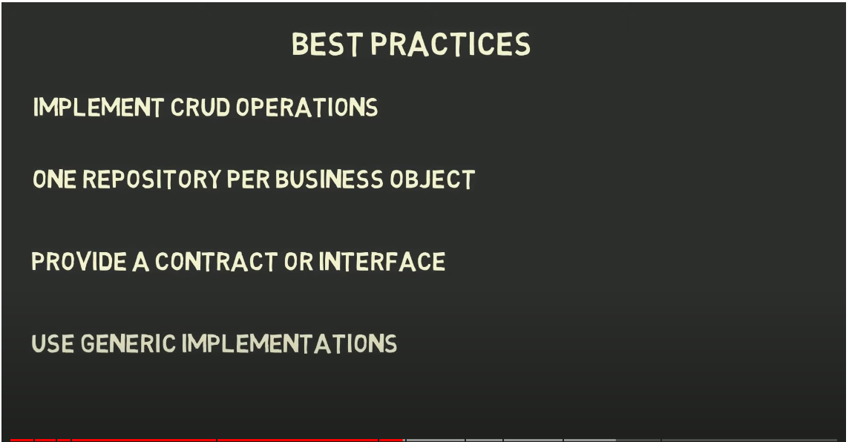

Slide 5
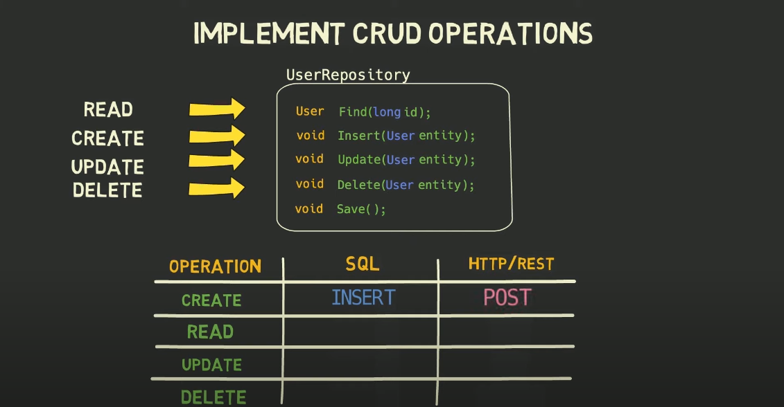

Slide 6
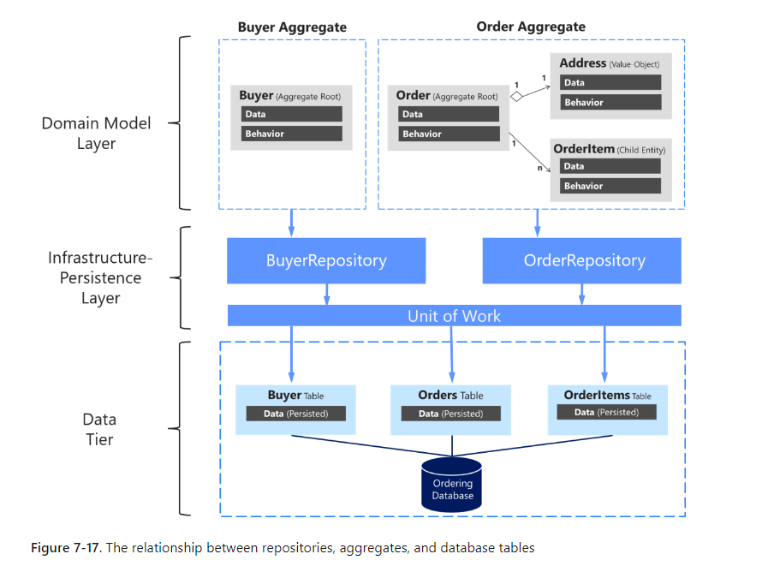
Microsoft Repository pattern

Slide 7
Reference
Repository_pattern-youtube
Microsoft_document

