Slide 1


Department of Computer Science and Engineering
RHEUMATOID ARTHTRITIS PREDICTION USING MACHINE LEARING
Mrs. M. Divya M.E.
Assistant Professor
PREM KUMAR D
2116220701204

Slide 2
Problem Statement and Motivation
Build a reliable system to predict the presence of Rheumatoid Arthritis using the given parameters.
Detection of Rheumatoid Arthritis at the early stage will lead to better outcome for the patients with the reduced healthcare costs and alleviates critical diagnostics.

Slide 3
Existing System
Current rheumatoid Arthritis prediction(RA) relies heavily on x ray or MRI imaging techniques. These methods often detect Rheumatoid Arthritis at advanced stages which delays the diagnosis. Machine learning models for RA prediction are limited by small datasets , manual selection and often predicts with low sensitivity. Much of these models are not build by using artificial neural networks

Slide 4
Objectives
Develop a Neural network Model: Build a artificial neural network with multiple hidden layers for better accuracy
Improvement for early diagnosis : Improve early detection of RA to enable timely treatment and better outcomes.
Better Hyperparameter Tuning : Setting up perfect learning rate, batch size and epochs is essentially done
Evaluate and Validate: For assessing model performance using metrics like ROC-AUC, classification report, and confusion matrix.

Slide 5
Abstract
Rheumatoid arthritis (RA) is a chronic autoimmune disorder which requires early diagnosis to prevent severe joint damage. This project develops a neural network model to predict RA using parameters in the blood, age and gender. The model employs data preprocessing techniques, including mean imputation and standardization, to handle missing values by filling the mean values. A sequential neural network with dropout layers and early stopping is trained to enhance accuracy and prevent overfitting. Evaluated using ROC-AUC, classification reports, and confusion matrices, the model to make sure that this model achieves better performance.RA) is a chronic autoimmune disorder requiring early diagnosis to prevent severe joint damage and improve patient outcomes. This project develops a neural network model to predict RA using clinical biomarkers from the APDDataset. The model employs data preprocessing techniques, including mean imputation and standardization, to handle missing values. A sequential neural network with dropout layers and early stopping is trained to enhance accuracy and prevent overfitting. Evaluated using ROC-AUC, classification reports, and confusion matrices, the model achieves reliable performance. An interactive user input system enables clinicians to predict RA status, facilitating early diagnosis and timely intervention for improved healthcare outcomes.

Slide 6
Proposed System
This project proposes a neural network-based system to predict rheumatoid arthritis (RA).The system preprocesses data with mean imputation and standardization to handle missing values. A sequential TensorFlow model with dense layers, ReLU activation, dropout and sigmoid output is trained with early stopping to prevent overfitting. Evaluated via ROC-AUC, classification reports, and confusion matrices, it ensures robust performance.

Slide 7
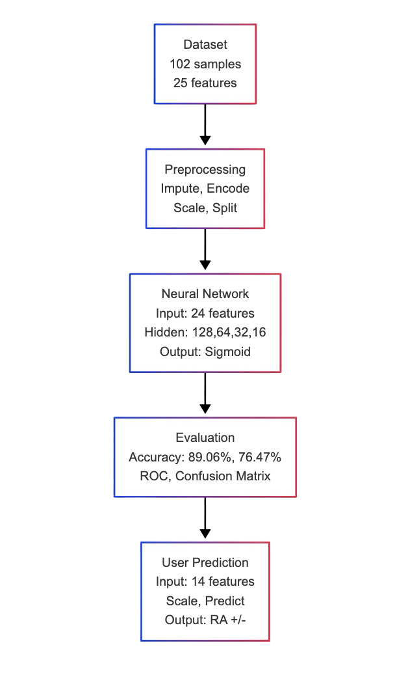
System Architecture

Slide 8
System Architecture
This flowchart outlines the workflow of a rheumatoid arthritis (RA) prediction model using a neural network. It begins with a dataset of 102 samples and 25 features, which undergoes preprocessing steps including imputation, encoding, scaling, and splitting into training and test sets. The neural network, with 11 input features, hidden layers of 128, 64, 32, and 16 neurons, and a sigmoid output, is then trained. The model's performance is evaluated, achieving a training accuracy of 89.06% and a validation accuracy of 76.47%, with ROC and confusion matrix analyses. Finally, a user prediction module takes 11 features as input, scales them, and outputs the RA status.

Slide 9
List of Modules for RA prediction using neural networks
Data Preprocessing
Filling null values
Labelling the categorical data
Dropping RA Column
RA Prediction using neural networks
Train-test Split
Model Training and Tuning
Model Exporting

Slide 10
Data Preprocessing
Filling the mean values
Confirming the shape
Labelling the categorical data
Scaling the data using standardScaler

Slide 11
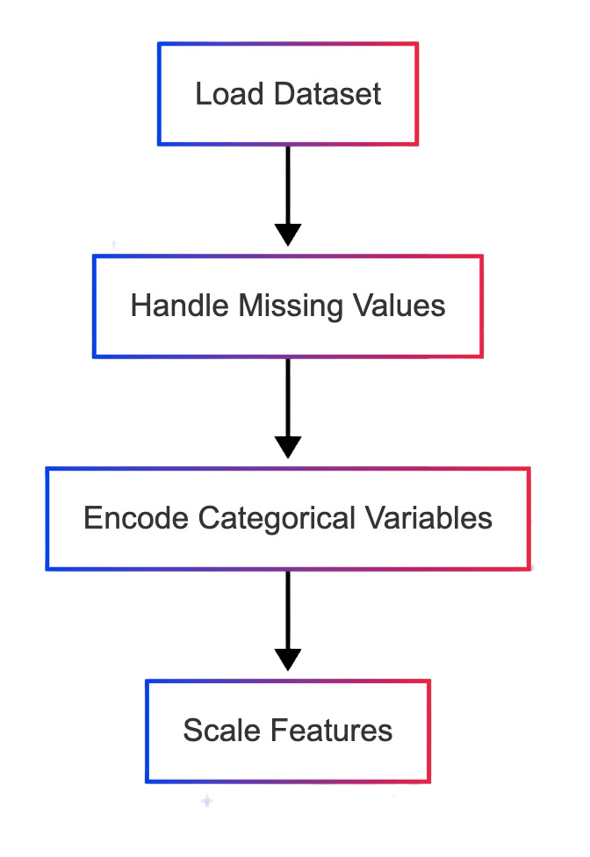
Flow Chart - Data Preprocessing

Slide 12
RA prediction using neural networks
Train-test split
Model training and tuning
Building neural network
Adding dense hidden layers
Compile the model

Slide 13
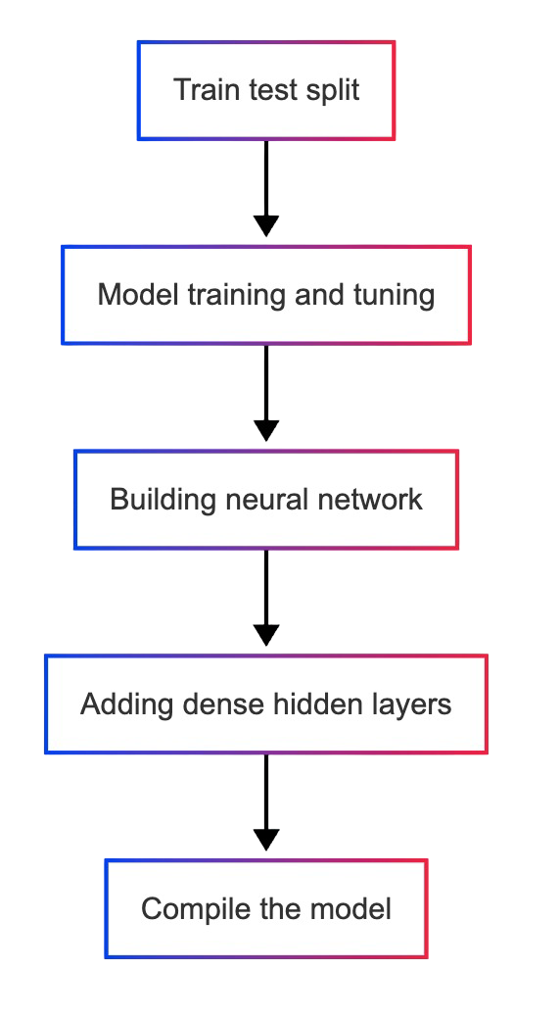
Flow Chart for Neural network

Slide 14
Implementation & Results of Module
The Rheumatoid Arthritis predictor model hence uses only the key parameters which is required for predicting and not all the random data and images. Hence the model is implemented using artificial neural networks with multiple layer of perceptrons. Users input their age gender and essential blood parameters which is required for prediction. Moreover plots such a Correlation heatMap, Confusion matrx, loss and accuracy graphs are plotted just to verify the strength of the model. Hence the result comes out to be 90.12% training and 76.59% validation accuracy. ROC-AUC is 0.4556, indicating Good performance.

Slide 15
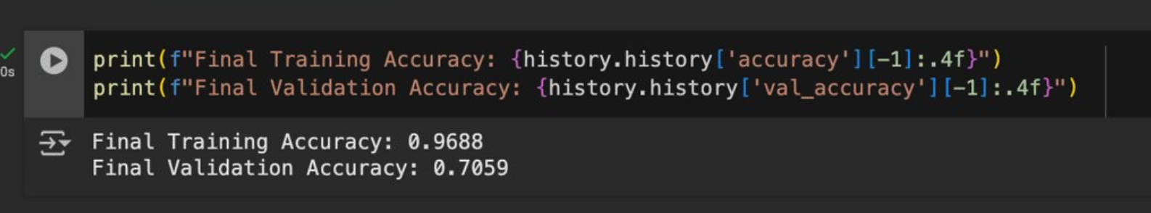
Training and Validation Accuracy

Slide 16
Conclusion & Future Work
Future enhancement can be done by developing a appealing and easy to use front end interface using by integrating with healthcare application where the blood parameters could be easily determined and hence the user can have a track because the only way for curing RA is early detection.

Slide 17
References
Agarwal, V., & Gupta, R. (2021). Machine Learning for Rheumatoid Arthritis Diagnosis: A Systematic Review. Journal of Medical Systems, 45(3), 1–12. https://doi.org/10.1007/s10916-021-01723-4
Chen, Z., Zhang, H., & Wang, L. (2022). Deep Learning Models for Early Detection of Rheumatoid Arthritis Using Biomarker Data. Frontiers in Artificial Intelligence, 5, 987654. https://doi.org/10.3389/frai.2022.987654
Kumar, A., & Singh, P. (2023). Predictive Modeling of Autoimmune Diseases Using Neural Networks. ITEGAM-JETIA, 9(44), 56–63. https://doi.org/10.5935/jetia.v9i44.912
Sharma, S., & Patel, N. (2024). Application of Random Forest and Neural Networks in Medical Diagnostics. SSRN Electronic Journal. https://doi.org/10.2139/ssrn.4567891
Zhang, Y., Li, X., & Liu, J. (2023). Improving Disease Prediction with Ensemble Machine Learning Models in Healthcare. Frontiers in Health Informatics, 4, 1012098. https://doi.org/10.1016/fhi.2023.1012098

Slide 18
Paper Publication Status
Yet to publish

Slide 19
Thank You

