Slide 1

MACHINE LEARNING
Heart Disease Prediction Using Logistic Regression,
SVM, and K-Nearest Neighbors
Team Members
T. Bhargava Sai Sunil | 2520030605
V. Prem Kumar | 2520030479
Under the Esteemed Guidance of
Jyothsna Datti — Professor, CSE
Department of CSE | Koneru Lakshmaiah Education Foundation (KLH) | A.Y. 2026–27

Slide 2
Agenda
01
Introduction & Problem Statement
02
Abstract & Software Requirements
03
Dataset Overview
04
Methodology / Workflow
05
Exploratory Data Analysis (EDA)
06
Correlation & Outlier Analysis
07
Models & Evaluation Metrics
08
Key Findings & Conclusion
Heart Disease Prediction — Machine Learning Project
1

Slide 3
Introduction
Heart disease is among the leading causes of death worldwide, claiming millions of lives every year.
Early identification of at-risk individuals plays a crucial role in reducing mortality and improving treatment outcomes.
Accurate diagnosis traditionally requires experienced physicians, multiple clinical tests, and considerable time.
Machine Learning can analyze large volumes of healthcare data and uncover hidden patterns that assist prediction.
This project applies three supervised algorithms — Logistic Regression, SVM, and KNN — to predict heart disease from patient clinical data.
Why it matters
17.9M+
deaths from cardiovascular
disease worldwide, per year
1,025
patient records used to train
and evaluate the models
3
ML algorithms compared:
LR, SVM, KNN
Heart Disease Prediction — Machine Learning Project
2

Slide 4
Project Abstract
Develops a heart disease prediction system using Logistic Regression, SVM, and K-Nearest Neighbors.
Uses a dataset of 1,025 patient records with 13 clinical and demographic features plus a target label.
Dataset is preprocessed: duplicate handling, feature/target separation, train-test split, and feature scaling.
All three models are trained and evaluated using Accuracy, Precision, Recall, F1-Score, Confusion Matrix, and ROC-AUC.
Results are compared to identify the most effective algorithm for this classification problem.
Intended as a decision-support tool for early risk identification — final diagnosis remains with qualified clinicians.
Heart Disease Prediction — Machine Learning Project
3

Slide 5
Software Requirements
Operating System
Windows 10/11, Linux, or macOS
Programming Language
Python 3.10 or later
IDE
Jupyter Notebook / Google Colab
Core Libraries
NumPy, Pandas — data handling
Visualization
Matplotlib, Seaborn
Modeling
Scikit-learn
Dataset
Heart Disease dataset (CSV, sourced from Kaggle)
Algorithms
Logistic Regression, SVM, K-Nearest Neighbors (KNN)
Heart Disease Prediction — Machine Learning Project
4

Slide 6
Dataset Overview
1,025 records • 14 columns • 0 missing values
age
Age (years)
thalach
Max heart rate achieved
sex
1 = male, 0 = female
exang
Exercise-induced angina
cp
Chest pain type (0–3)
oldpeak
ST depression (exercise)
trestbps
Resting blood pressure
slope
Slope of peak ST segment
chol
Serum cholesterol
ca
Major vessels (0–4)
fbs
Fasting blood sugar > 120
thal
Thalassemia type
restecg
Resting ECG result
target
0 = no disease, 1 = disease
Heart Disease Prediction — Machine Learning Project
5

Slide 7
Methodology / Workflow
1
2
3
Load & Inspect
Clean & Prepare
Explore (EDA)
Read heart.csv; check shape, dtypes, and summary statistics.
Check missing values; drop duplicate rows before modeling.
Univariate, bivariate, correlation & outlier analysis.
4
5
6
Split & Scale
Train Models
Evaluate & Compare
Train/test split; scale continuous features where required.
Fit Logistic Regression, SVM, and KNN classifiers.
Accuracy, Precision, Recall, F1-Score, ROC-AUC, Confusion Matrix.
Heart Disease Prediction — Machine Learning Project
6

Slide 8
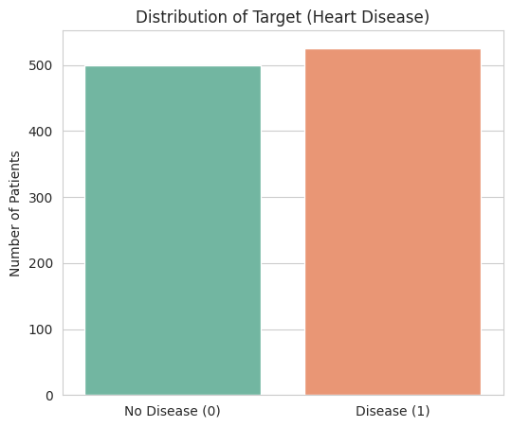
Target Variable Distribution
No Disease (0): 499 patients (48.7%)
Disease (1): 526 patients (51.3%)
Classes are fairly balanced (~51% vs 49%).
Accuracy-based metrics are reasonably reliable for evaluating models on this dataset, without needing heavy class-imbalance correction.
Heart Disease Prediction — Machine Learning Project
7

Slide 9
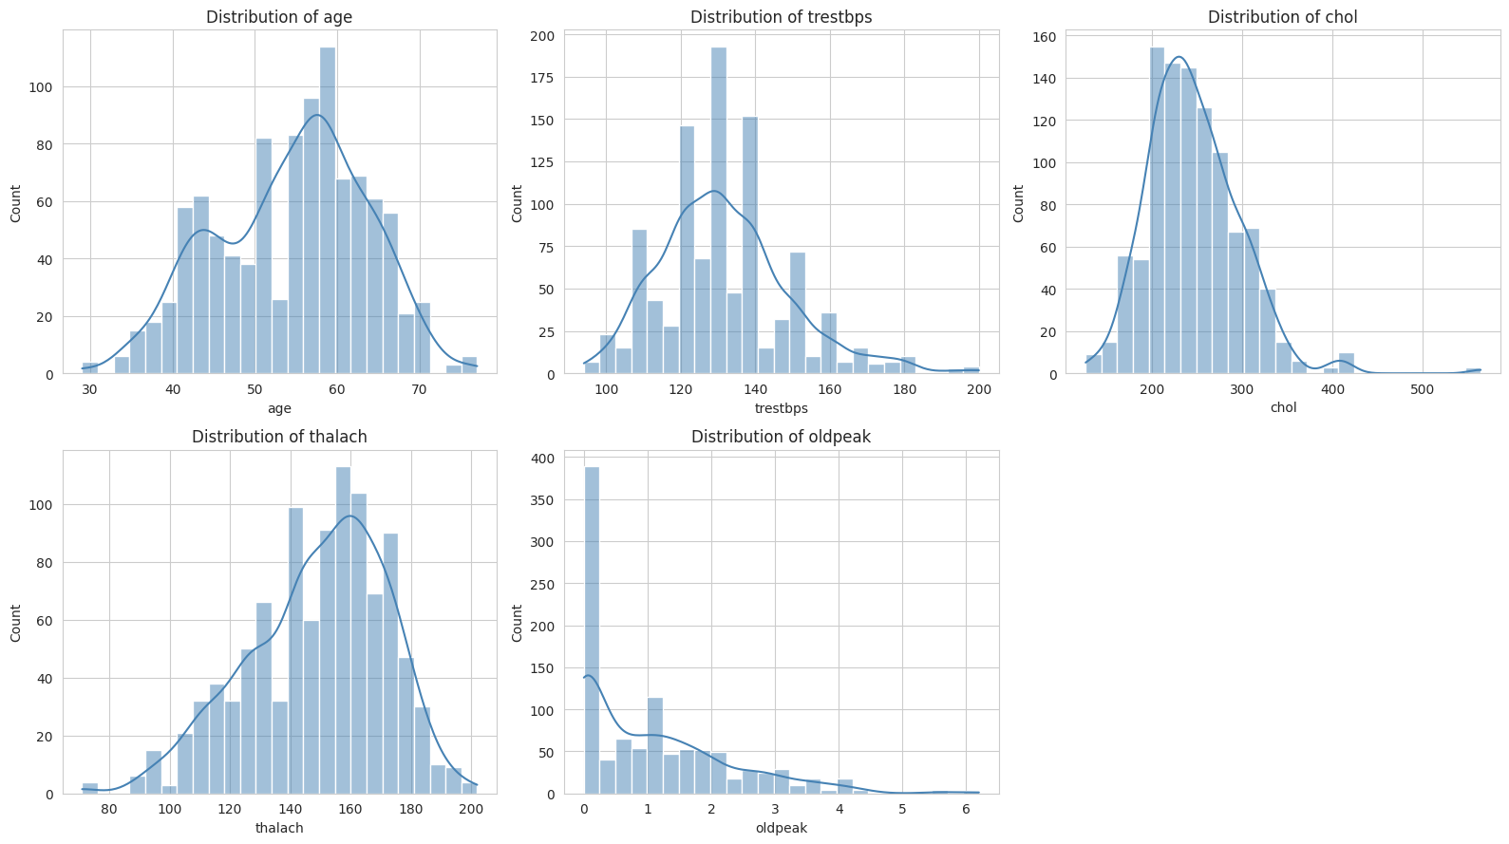
Numerical Feature Distributions
Heart Disease Prediction — Machine Learning Project
8

Slide 10
Numerical Features — Observations
age: roughly bell-shaped; most patients are between 45 and 65 years old.
trestbps (resting BP): right-skewed, peak around 120–140 mm Hg, with high outliers above 170.
chol (cholesterol): right-skewed, mostly 200–300 mg/dl, with a long tail of high values.
thalach (max heart rate): roughly normal, centered around 150–160 bpm, slightly left-skewed.
oldpeak (ST depression): heavily right-skewed with a large spike at 0 — many patients show no ST depression.
Heart Disease Prediction — Machine Learning Project
9

Slide 11
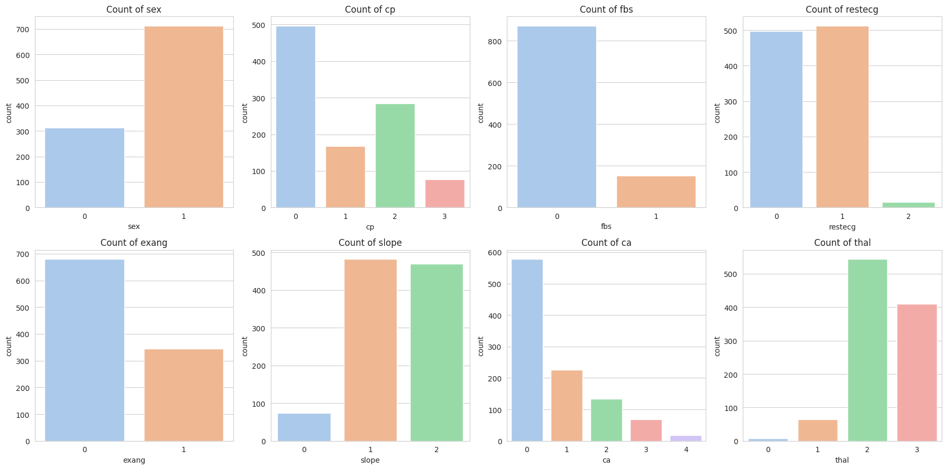
Categorical Feature Counts
Heart Disease Prediction — Machine Learning Project
10

Slide 12
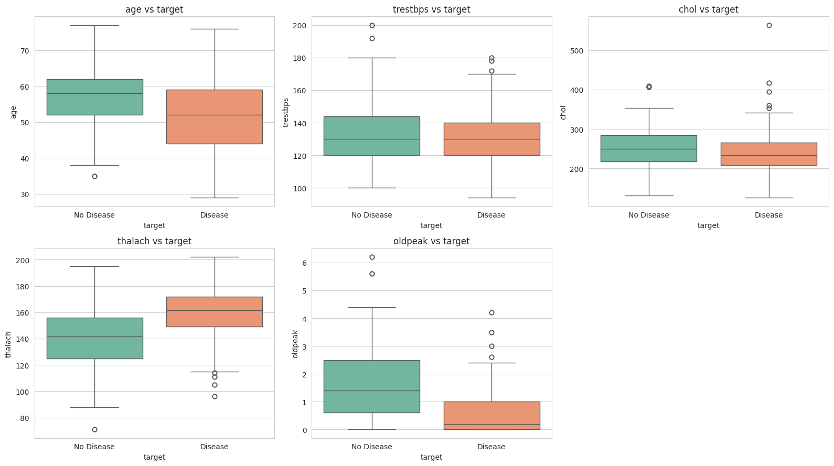
Numerical Features vs Target
Heart Disease Prediction — Machine Learning Project
11

Slide 13
Bivariate Insights — Numerical
thalach (max heart rate) is noticeably higher in patients with heart disease — a strong separating feature.
oldpeak is lower for patients with heart disease, and higher (with more high outliers) for those without.
age is slightly lower on average for the disease-positive group in this dataset.
trestbps and chol show only mild differences between the two target classes.
Heart Disease Prediction — Machine Learning Project
12

Slide 14
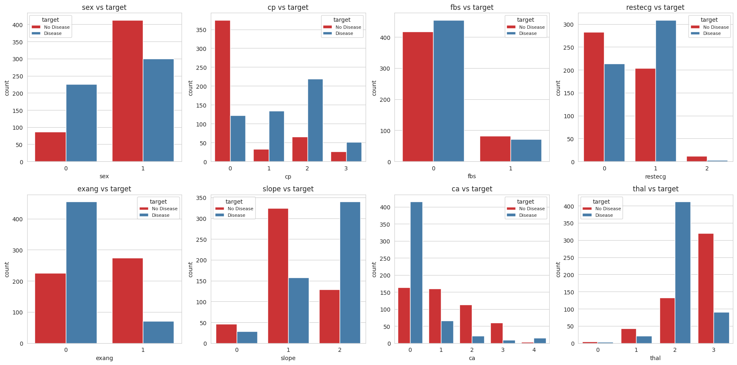
Categorical Features vs Target
Heart Disease Prediction — Machine Learning Project
13

Slide 15
Bivariate Insights — Categorical
cp (chest pain type): types 1–3 show much higher disease rates than type 0.
exang: patients without exercise-induced angina are disproportionately in the disease-positive group.
thal: thal = 2 is strongly associated with disease presence; thal = 3 leans toward no disease.
ca (major vessels): ca = 0 is strongly associated with disease presence; likelihood drops as ca increases.
sex: more males than females in the dataset; disease prevalence differs by sex, though less sharply than cp, thal, or ca.
Heart Disease Prediction — Machine Learning Project
14

Slide 16
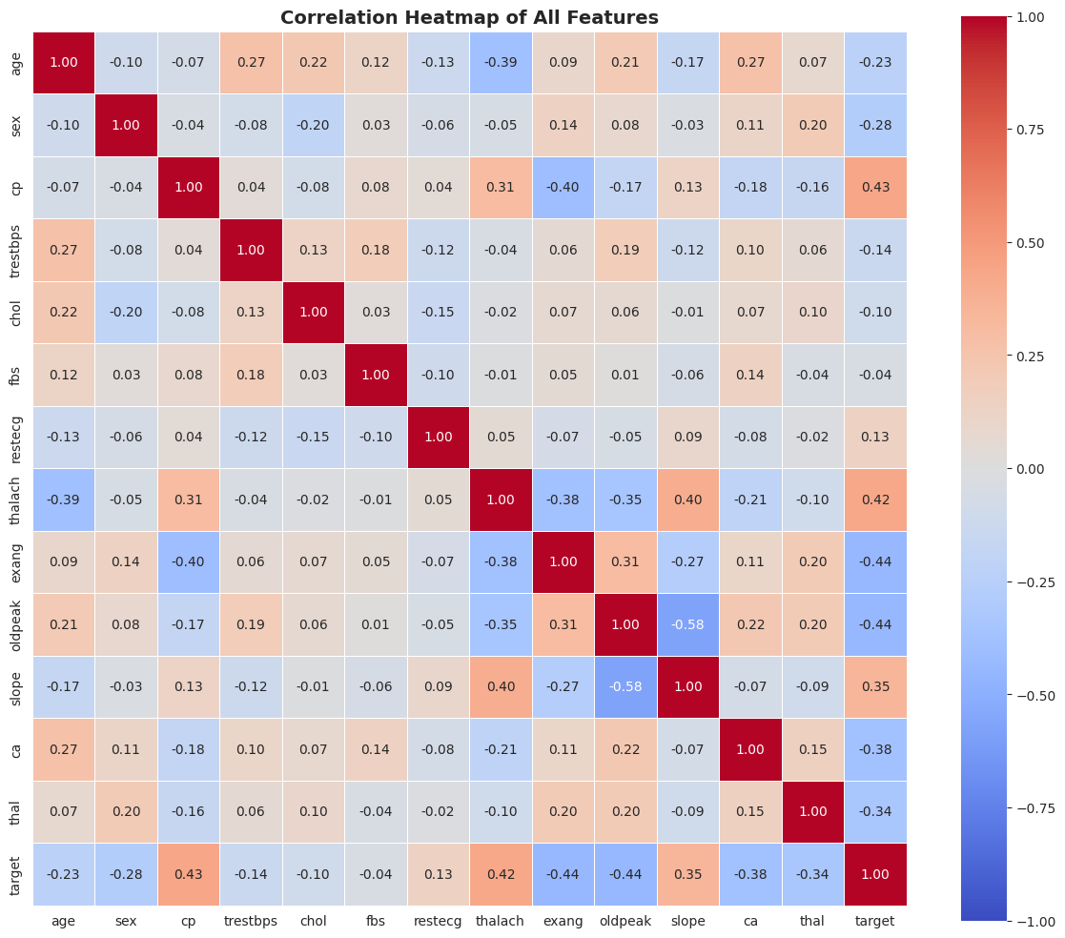
Correlation Analysis
Heart Disease Prediction — Machine Learning Project
15

Slide 17
Correlation — Key Takeaways
cp, thalach, and slope show the strongest positive correlation with target.
exang, oldpeak, ca, and thal show the strongest negative correlation with target.
No pair of independent features shows extreme multicollinearity (|r| > 0.8) — all features can reasonably be kept for modeling.
thalach and age are moderately negatively correlated — max heart rate tends to fall with age, matching physiology.
Heart Disease Prediction — Machine Learning Project
16

Slide 18
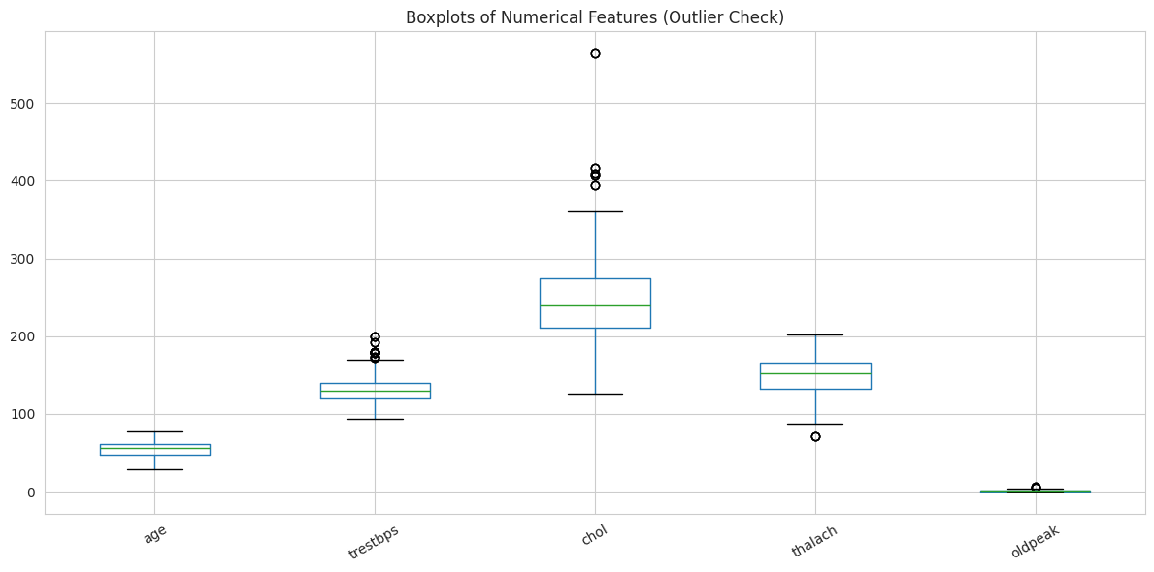
Outlier Detection (IQR Method)
Feature
Outliers
Valid Range
age
0
28.5 – 80.5
trestbps
30
90.0 – 170.0
chol
16
115.0 – 371.0
thalach
4
81.0 – 217.0
oldpeak
7
-2.7 – 4.5
chol and trestbps show the most high-end outliers — clinically plausible rather than data-entry errors.
Heart Disease Prediction — Machine Learning Project
17

Slide 19
Key EDA Findings
Clean Data
Balanced Target
Top Predictors
1,025 rows, 14 columns, zero missing values; 723 duplicate rows exist and should be dropped before modeling.
~51% disease vs 49% no disease — accuracy is a reasonably reliable metric.
cp, thalach, exang, oldpeak, ca, and thal show the strongest relationships with target.
No Severe Multicollinearity
Plausible Outliers
Next Steps
No feature pair exceeds |r| > 0.8, so all features can be retained for modeling.
High chol and trestbps values look clinically real; consider capping rather than removing.
Drop duplicates, scale continuous features, and one-hot encode multi-level categorical columns.
Heart Disease Prediction — Machine Learning Project
18

Slide 20
Models & Evaluation Metrics
Logistic Regression
Support Vector Machine (SVM)
K-Nearest Neighbors (KNN)
A linear model estimating the probability of heart disease from a weighted combination of clinical features. Fast, interpretable, and a strong baseline.
Finds the optimal separating boundary between disease / no-disease classes, effective in higher-dimensional feature space.
Classifies a patient based on the majority class among their k most similar patients in feature space.
Evaluated & Compared Using
Accuracy
Precision
Recall
F1-Score
Confusion Matrix
ROC-AUC
Heart Disease Prediction — Machine Learning Project
19

Slide 21
Conclusion & Future Scope
Summary
Future Scope
A clean, balanced 1,025-record heart disease dataset was analyzed and prepared for supervised classification.
Logistic Regression, SVM, and KNN are trained and compared using Accuracy, Precision, Recall, F1-Score, and ROC-AUC.
cp, thalach, exang, oldpeak, ca, and thal emerge as the most informative clinical predictors.
The resulting system can act as a decision-support tool for early risk identification, with final diagnosis always left to qualified healthcare professionals.
Drop duplicate records prior to final model training.
Apply feature scaling to continuous variables for distance- and margin-based models (KNN, SVM).
One-hot encode multi-level categorical columns (cp, restecg, slope, ca, thal) for linear/SVM models.
Explore ensemble methods (Random Forest, Gradient Boosting) for further accuracy gains.
Heart Disease Prediction — Machine Learning Project
20

Slide 22
Thank You
Questions & Discussion
T. Bhargava Sai Sunil (2520030605) • V. Prem Kumar (2520030479)
Guide: Jyothsna Datti, Professor, CSE | Department of CSE, KLH

