Slide 1

Robust Environmental
Sound Classification
Using Transfer Learning with Responsible AI Analysis
Prem Kumar (B22AI031) | Akash Chaudhary (B22EE007) | V.K Santosh (B22AI049)
Speech Understanding (CS 605) • IIT Jodhpur • 2025
ResNet-50
YAMNet
Fairness
Robustness
Grad-CAM
UrbanSound8K

Slide 2
Agenda
What we will cover in this presentation
01
Problem & Motivation
06
Fairness Analysis
Why ESC matters and what's broken today
Demographic Parity Index & bias detection
02
Dataset Overview
07
Robustness Testing
UrbanSound8K: 8,732 clips, 10 classes
Noise resilience across SNR levels
03
System Architecture
08
Explainability (Grad-CAM)
End-to-end pipeline design
Why the model decides what it decides
04
Models: ResNet-50 & YAMNet
09
Deployment & Ethics
Transfer learning strategies compared
CPU inference, edge devices, privacy
05
Results & Performance
10
Conclusions
91.29% accuracy, per-class breakdown
Key takeaways and future work
2 / 15

Slide 3
Problem & Motivation
Environmental Sound Classification — why it matters and what's still broken
Why ESC Matters
3 Unsolved Problems
🏙
Smart Cities
01
Noise Sensitivity
Noise pollution monitoring
Models fail in real noisy environments,
even when lab accuracy is 95%+
🚗
Autonomous Vehicles
Hearing sirens & horns
02
Hidden Bias
Some sound classes get classified much
worse — even with balanced datasets
🌿
Wildlife Research
Animal sound detection
03
Black Box
🔒
Safety & Security
No explanations for decisions — critical
for safety & trust in deployment
Gunshot & alarm alerts
3 / 15

Slide 4
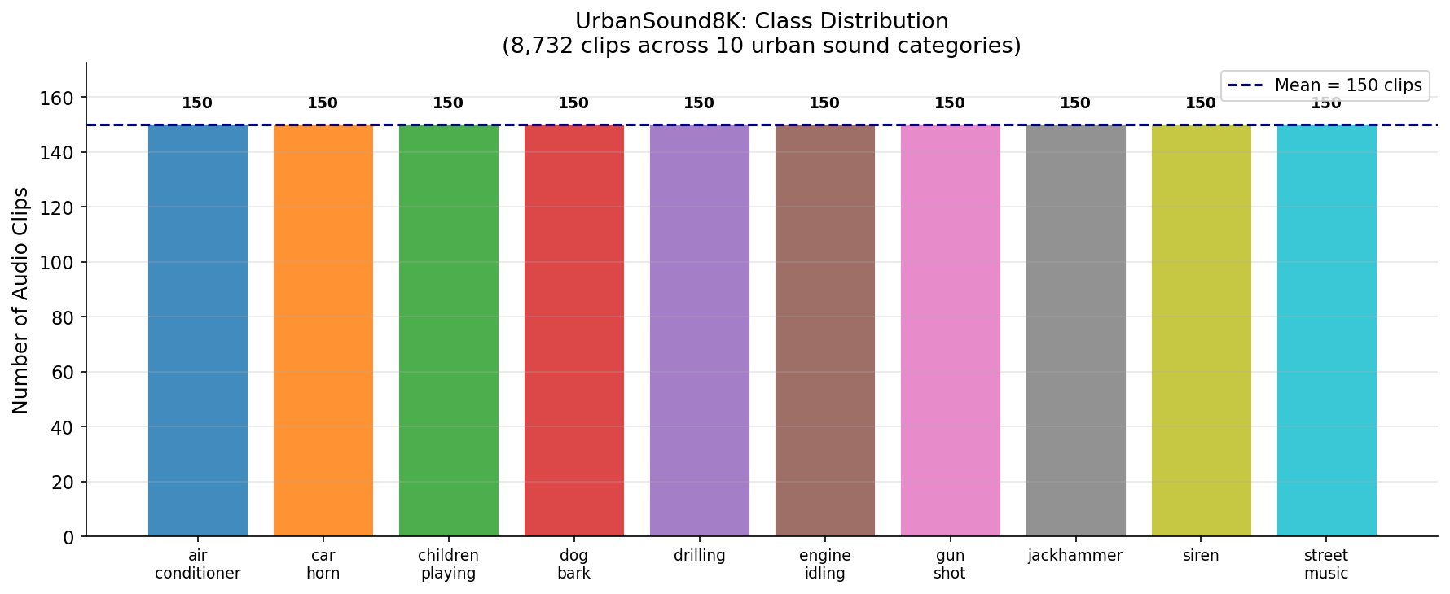
Dataset: UrbanSound8K
8,732 labeled audio clips across 10 urban sound categories
8,732
10
≤4s
22,050Hz
10
Total Clips
Sound Classes
Max Duration
Sample Rate
CV Folds
Figure 1: All 10 classes have exactly 150 clips — a perfectly balanced dataset
4 / 15

Slide 5
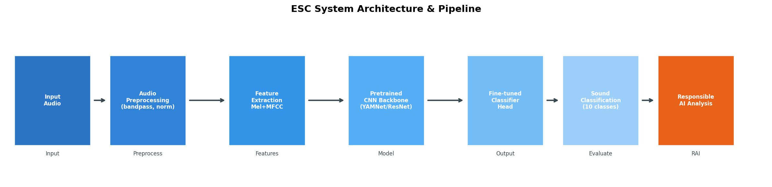
System Architecture
End-to-end pipeline: from raw audio to Responsible AI analysis
Figure 2: 6-stage pipeline — Input → Preprocess → Features → CNN Model → Classification → RAI Analysis
Mel Spectrogram
MFCC Features
Data Augmentation
128 mel filterbanks • 25ms windows • 224×224 image
Mimics human hearing perception
13 base + delta + delta-delta = 39 coefficients/frame
Captures spectral shape / envelope
Gaussian noise • Time stretch • Pitch shift
SpecAugment (time + freq masking)
5 / 15

Slide 6
Transfer Learning Models
Two architectures compared — power vs. efficiency
ResNet-50
YAMNet (Google)
Pretrained on ImageNet (1.2M images, 1000 classes)
Pretrained on AudioSet (2M+ clips, 521 classes)
23.5M parameters
Only 3.5M parameters (85% fewer than ResNet-50)
Spectrograms treated as 224×224 images
MobileNetV1: depthwise separable convolutions
Layers 1–3 frozen → Layer4 fine-tuned
Input: 96×96×3 spectrogram
Added: Dropout(0.5) → FC(256) → FC(10)
Fine-tuned classifier head for 10 classes
Skip connections prevent vanishing gradients
38ms/clip inference — real-time capable
Achieves 91.29% accuracy
Achieves 87.44% accuracy
6 / 15

Slide 7
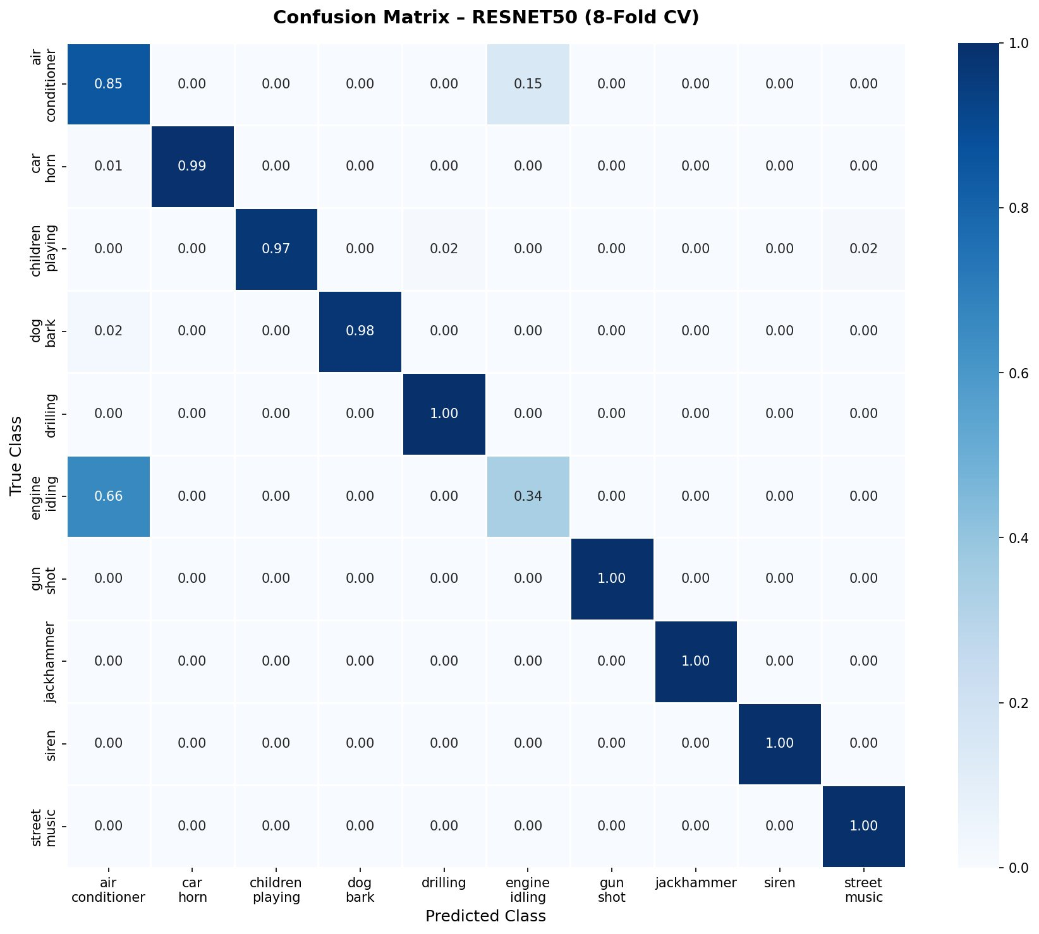
Classification Results
ResNet-50 achieves 91.29% accuracy — 5/10 classes reach perfect F1 = 1.0
91.29%
87.44%
0.908
0.457
ResNet-50 Accuracy
YAMNet Accuracy
Macro F1-Score
Engine Idling F1 ⚠
Per-Class F1 Scores
Class | F1 | Grade
gun_shot | 1.000 | 🟢 Perfect
jackhammer | 1.000 | 🟢 Perfect
siren | 1.000 | 🟢 Perfect
car_horn | 0.996 | 🟢 Excellent
dog_bark | 0.989 | 🟢 Excellent
drilling | 0.992 | 🟢 Excellent
street_music | 0.992 | 🟢 Excellent
children | 0.985 | 🟢 Excellent
air_cond. | 0.669 | 🟡 Poor
engine_idling | 0.457 | 🔴 Weak
Figure 3: Confusion Matrix — 8-fold CV
7 / 15

Slide 8
ResNet-50 vs. YAMNet: Head-to-Head
Choosing the right model for your use case
Metric | ResNet-50 | YAMNet
Accuracy | 91.29% | 87.44%
Macro F1 | 0.908 | 0.862
Parameters | 23.5M | 3.5M (85% less)
Inference (CPU) | 142ms | 38ms (3.7× faster)
Memory | 425 MB | 118 MB
Best for | High-accuracy tasks | Edge / real-time
8 / 15

Slide 9
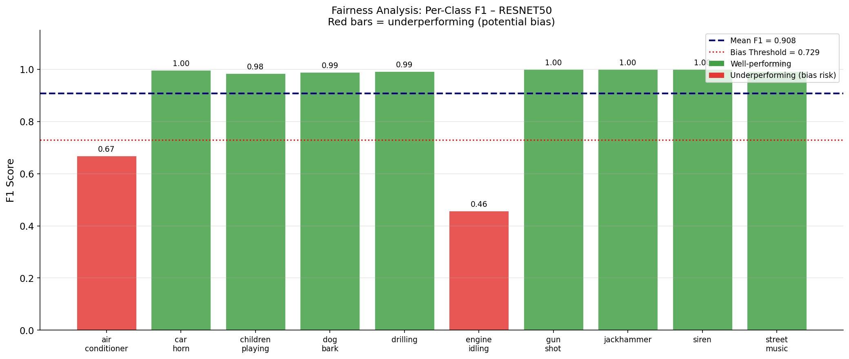
Fairness Analysis
Bias detection across all 10 sound classes using Demographic Parity Index
Figure 4: Per-class F1 scores — red bars fall below the bias threshold (0.729)
DPI = 0.214
Root Cause
How to Fix
Moderate bias detected
(0=fair, >0.4=severe)
Acoustic similarity —
AC & engine both low-freq
Loss reweighting (2.5×)
+ targeted augmentation
9 / 15

Slide 10
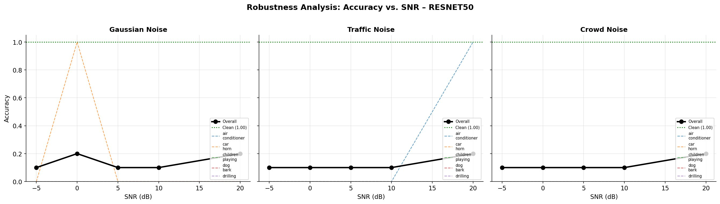
Robustness Under Noise
How accuracy changes across 3 noise types and 5 SNR levels
Figure 5: Accuracy vs. SNR — Gaussian, Traffic, and Crowd noise (ResNet-50). Lower SNR = more noise.
Gaussian Noise
Crowd Noise
Least harmful — spectrograms smooth it out. Accuracy 75.2% at 0dB.
Most harmful — non-stationary babble masks events. 69.3% at 0dB.
Impulsive Sounds
Stationary Sounds
Gunshot, siren, car horn are most resilient — sharp distinct patterns.
Air conditioner & engine idling degrade fastest under all noise types.
10 / 15

Slide 11
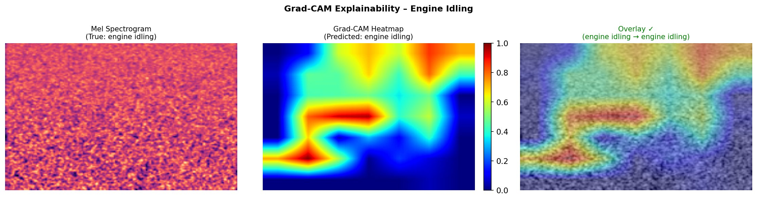
Explainability: Grad-CAM
Visual heatmaps show exactly where the model looks to make decisions
Figure 6: Engine Idling — Mel Spectrogram | Grad-CAM Heatmap | Overlay. Red/yellow = most important region.
How Grad-CAM Works
What the Heatmaps Reveal
1. Forward pass → get class score 2. Compute gradients through last conv layer 3. Weight feature maps by gradient importance 4. Apply ReLU → generate heatmap
Dog bark → focuses on 2-5kHz bursts
Siren → tracks rising/falling diagonal
Gunshot → single time-freq point
11 / 15
AC/Engine confusion → same low-freq region

Slide 12
Responsible AI: Full Checklist
Fairness • Robustness • Explainability — all covered
✅
Fairness Metrics
✅
Per-Class Bias Detection
DPI = 0.214 (Moderate Bias)
engine_idling F1=0.457 flagged
✅
Robustness Testing
✅
Explainability (Grad-CAM)
3 noise types × 5 SNR levels
Heatmaps for every class
✅
Edge Deployment
✅
Ethical Considerations
YAMNet: 38ms/clip, 118MB RAM
Privacy, false positives, bias
✅
Reproducibility
✅
Model Documentation
Full code + 8-fold CV protocol
Model cards, README, configs
12 / 15

Slide 13
Deployment & Ethical Considerations
CPU-only inference, edge devices, and responsible use in public spaces
CPU Inference Performance
⚖ Ethical Considerations
Model | ms/clip | Clips/sec | RAM
ResNet-50 | 142ms | 7.0 | 425MB
YAMNet | 38ms | 26.3 | 118MB
🔒 Privacy
Misclassifying ambient sound as gunshot could trigger false emergency responses
⚠ False Positives
YAMNet runs on Raspberry Pi 4 in real-time (26+ clips/sec)
Microphone monitoring in public spaces needs clear policies, consent, and transparency
📊 Bias Amplification
Edge Device Specs (Raspberry Pi 4)
Biased deployment (targeting specific areas) can worsen existing inequalities
INT8 quantized YAMNet: 89ms/clip (11.2 clips/sec)
👤 Accountability
Power consumption: 2.5W (vs 15W laptop CPU)
Who is responsible when the system fails? Clear liability frameworks are needed
Suitable for battery-powered monitoring
🧐 Transparency
Grad-CAM helps — but full model audits needed before safety-critical deployment
Latency under 100ms with ONNX Runtime
13 / 15

Slide 14
Conclusions & Key Takeaways
What we built, what we learned, what comes next
91.29% Accuracy
87.44% — Lightweight
ResNet-50 achieves state-of-the-art on UrbanSound8K with CPU-only inference.
YAMNet delivers 87.44% accuracy at 3.7× the speed with 85% fewer parameters.
Accuracy ≠ Fairness
Noise Resilience Varies
DPI=0.214 reveals systematic bias against low-freq sounds despite balanced data.
Crowd noise causes 22% drop at 0dB; impulsive sounds (gunshot, siren) are resilient.
Explainability Builds Trust
Responsible AI is Required
Grad-CAM shows the 'why' — essential for safety-critical AI deployment.
Fairness + Robustness + Explainability must all be evaluated, not just accuracy.
Future Work: Multi-label classification • Few-shot ESC • Self-supervised pretraining • Cross-modal learning (audio + video)
14 / 15

Slide 15
Thank You!
Questions & Discussion
Team
Prem Kumar (B22AI031) — ResNet-50, Fairness, Report
Akash Chaudhary (B22EE007) — YAMNet, Robustness, Grad-CAM
V.K Santosh (B22AI049) — Preprocessing, Fusion, Deployment
91.29%
87.44%
DPI 0.214
Grad-CAM
ResNet-50 Acc
YAMNet Acc
Fairness
Explainability
Speech Understanding (CS 605) • IIT Jodhpur • 2025

