Slide 1
Secure Data Hiding in Image Using Steganography
CAPSTONE PROJECT
Presented By:
Student Name : MISTRY PREMKUMAR SAHEBRAJ
College Name & Department : DEPT. OF COMPUTER ENGINEERING,
SHROFF SR ROTARY INSTITUTE OF CHEMICAL TECHNOLOGY

Slide 2
OUTLINE
Problem Statement
Technology used
Wow factor
End users
Result
Conclusion
Git-hub Link
Future scope

Slide 3
Problem Statement
With the rise of digital communication, ensuring secure message transmission is crucial. Traditional encryption techniques can be easily identified and targeted. This project leverages image-based steganography to embed messages within image pixels discreetly. By hiding messages in images, it enhances confidentiality and reduces the risk of detection. The approach ensures only authorized users can retrieve the hidden information using a password.

Slide 4
Technology used
Programming Language: Python
Platform Used: VS Code
Libraries: OpenCV, OS, String Handling
Concepts Used: Steganography, Image Processing, Cryptography Basics

Slide 5
Wow factors
Uses image pixels to store secret messages securely.
Password-protected decryption ensures only authorized users can retrieve the hidden message.
Minimal image distortion, making detection difficult.
Can be extended to video-based steganography for enhanced security.

Slide 6
End users
Government & Intelligence Agencies for secure data transmission.
Journalists & Whistleblowers to share sensitive information without detection.
Businesses & Corporates for confidential communication.
Individuals who require secure personal messaging.

Slide 7
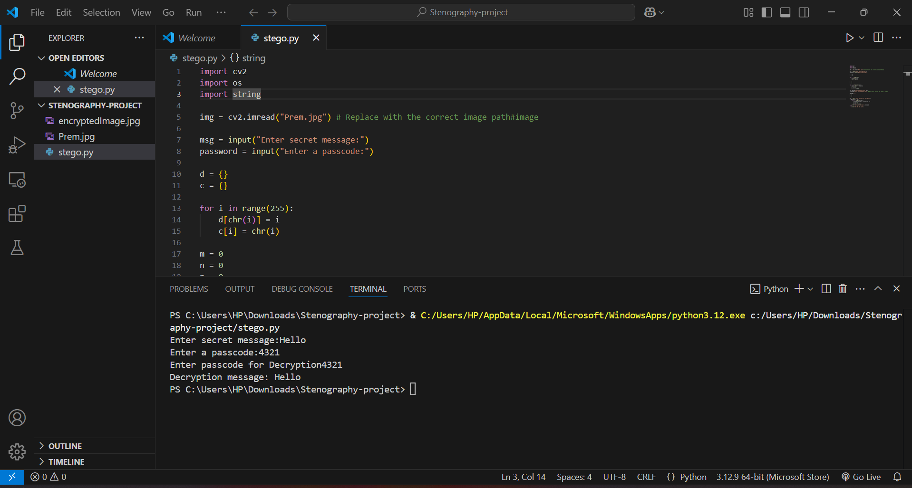
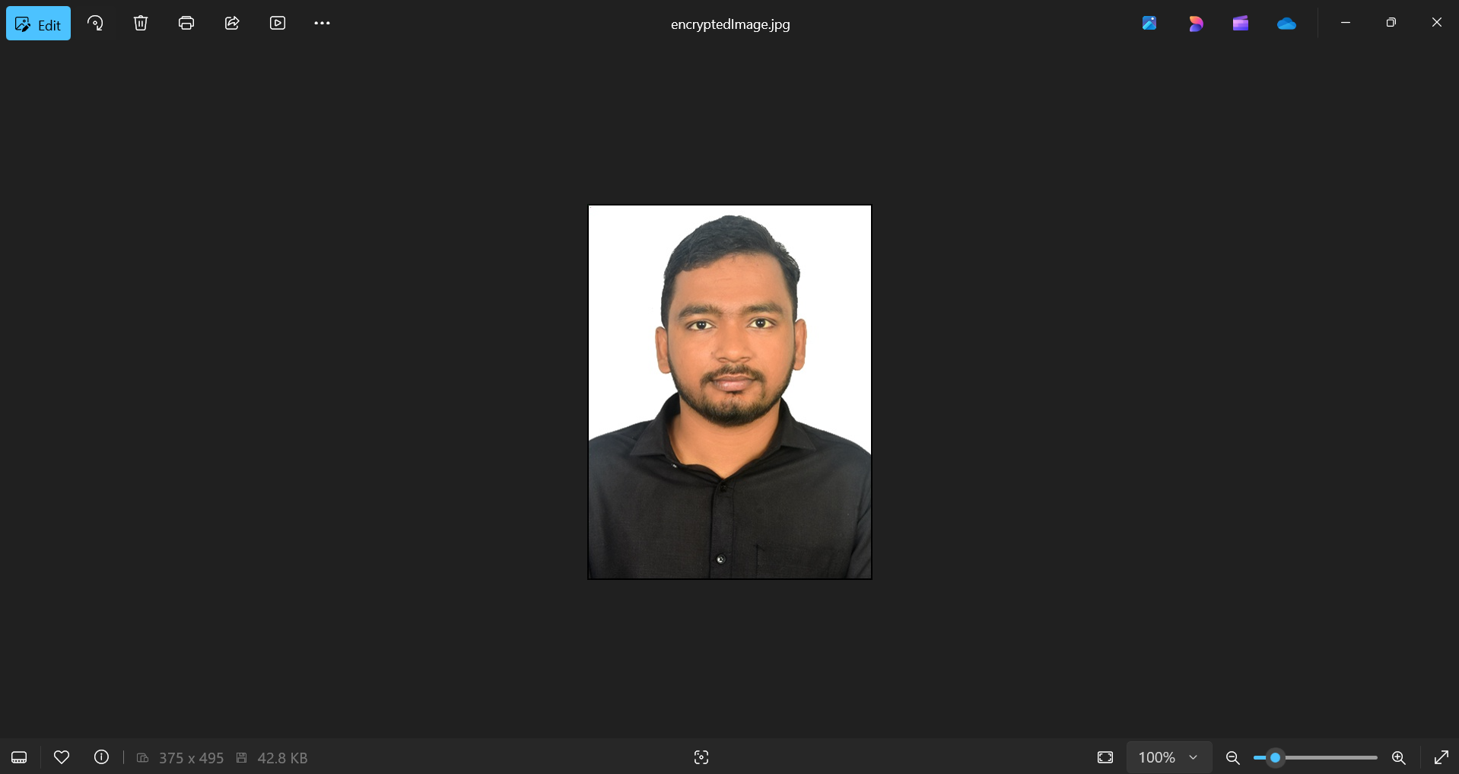
Results
Encrypted Image
Outcome

Slide 8
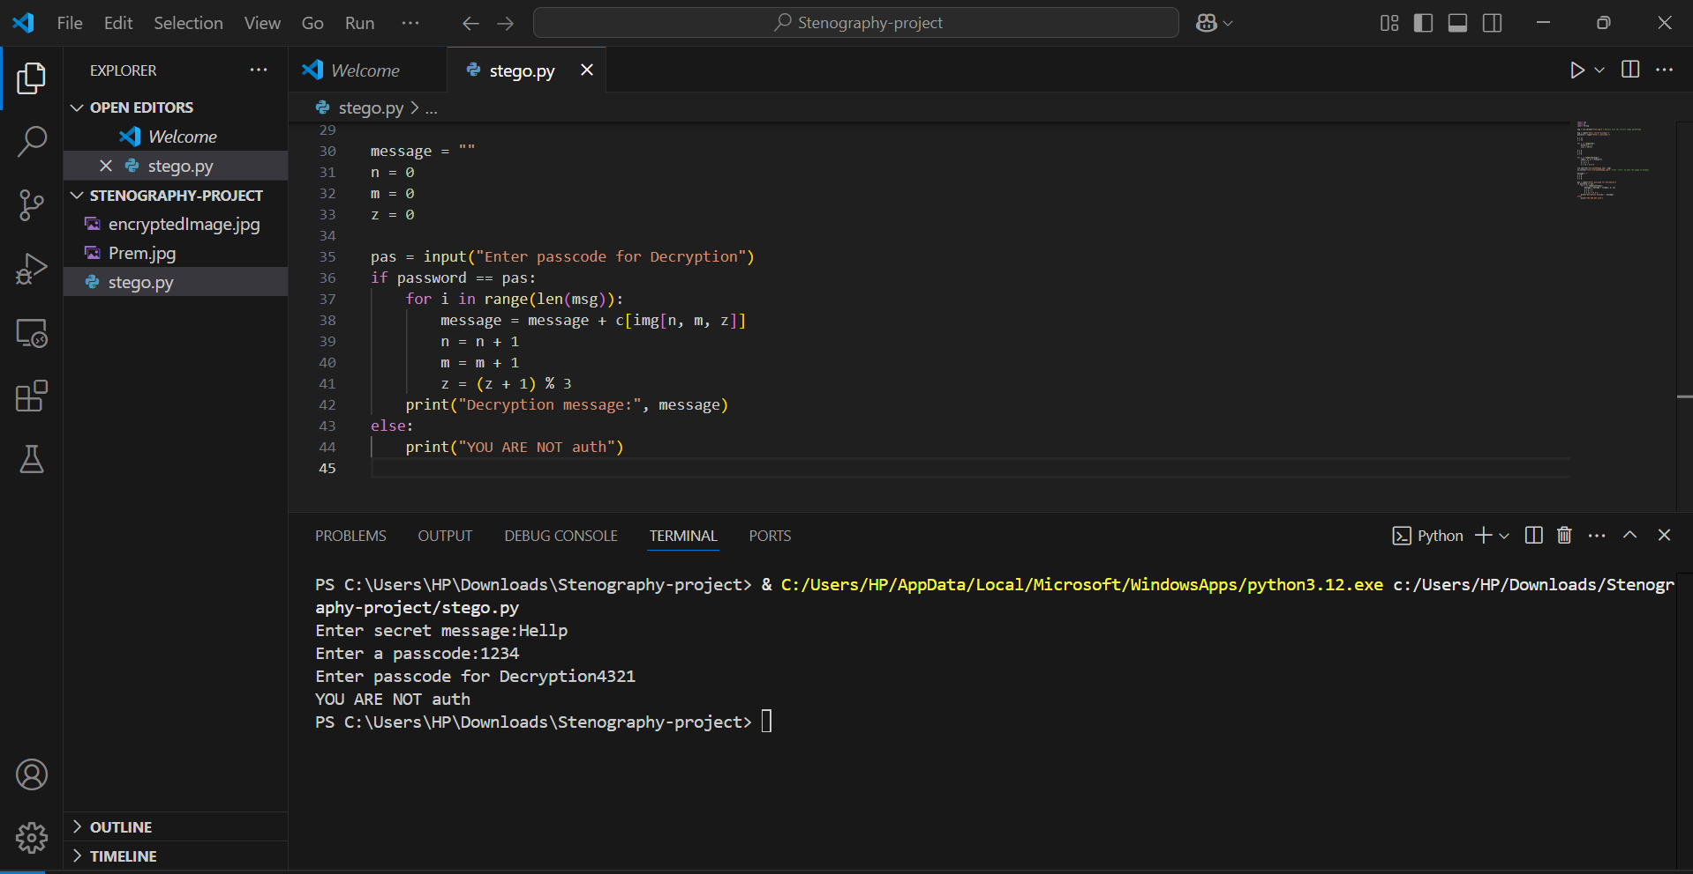
Results
Unauthorized Access

Slide 9
Conclusion
This project demonstrates the effectiveness of image-based steganography for secure communication. It ensures message confidentiality while maintaining image integrity. Password protection adds an extra layer of security. The approach reduces the risk of unauthorized access and detection.

Slide 10
GitHub Link
https://github.com/premkumarmistry/Secure-Data-Hiding-in-Image-Using-Steganography

Slide 11
Future scope(optional)
Implement AES encryption for an additional security layer.
Extend to video-based steganography for larger message storage.
Develop a GUI-based application for ease of use.
Optimize the storage algorithm to increase capacity while maintaining image quality.

Slide 12
THANK YOU

