Slide 1
IBM UNIVERSITY ENGAGEMENT PROJECT SUBMISSION
“EXPLORING THE POWER OF AGENTIC AI WITH IBM GRANITE AND IBM BOB”

Slide 2
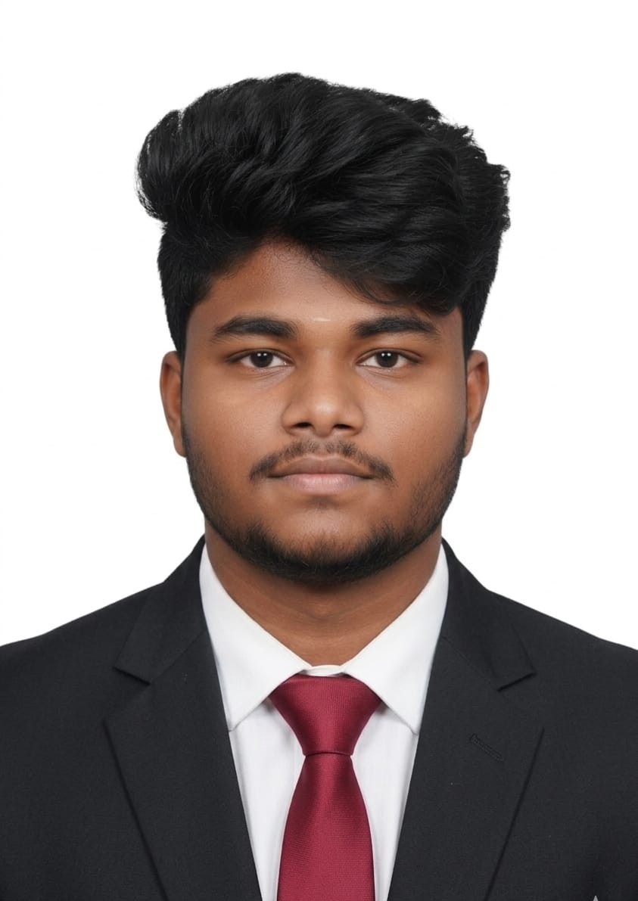
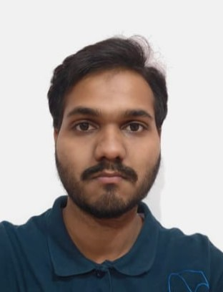
PROJECT TILE – “NUTRITION AGENT”
DOMAIN OF PROJECT – “HEALTHCARE”
STUDENT NAME | RECENT PASSPORT PHOTO | EMAIL ID | MOBILE NUMBER [WHATSAPP]
PREMKUMAR N
25cs167@rmkec.ac.in
7708625185

Slide 3
PROBLEM STATEMENT -
PROBLEM STATEMENT : NUTRITION AGENT
THE CHALLENGE –
In an era where health awareness is growing, individuals increasingly seek personalized nutrition guidance. However, most existing tools provide generic diet plans, lack real-time adaptability, and fail to consider a person's holistic lifestyle, cultural preferences, allergies, and evolving health conditions. Furthermore, dieticians and nutritionists face limitations in scaling personalized consultations due to time and resource constraints.
THE OBJECTIVE -
Generative AI presents a groundbreaking opportunity to revolutionize this space by enabling an intelligent, interactive, and adaptive virtual nutrition assistant. By leveraging natural language processing (NLP), multimodal understanding, and large-scale dietary databases, an AI-powered assistant can generate dynamic meal plans, recommend smart food swaps, and explain nutritional choices—all tailored to the individual. This project aims to develop “The Smartest AI Nutrition Assistant” using state-of-the-art generative AI models that:
• Understand user inputs via text, voice, or image (e.g., food photos, grocery labels)
• Generate personalized meal plans based on health goals, medical conditions, fitness routines, and preferences
• Offer contextual explanations (e.g., “Why is this food better?”)
• Adapt suggestions dynamically with continuous feedback
By integrating health data, food databases, and LLM-powered reasoning, the solution will bridge the gap between one-size-fits-all diet apps and in-person nutrition counselling—delivering an AI that thinks, learns, and cares like a real nutrition expert.

Slide 4
PROPOSED SOLUTION -
PROPOSED SOLUTION: AI-POWERED NUTRITION AGENT
The proposed solution is a multi-agent AI-powered Nutrition Agent built using IBM Bob, IBM watsonx.ai, and Granite Models to provide personalized, real-time dietary guidance. The system addresses challenges in diet planning, nutrition tracking, and preventive healthcare through an intelligent, modular architecture.
At its core, the solution uses a Retrieval-Augmented Generation (RAG) pipeline to fetch accurate nutritional data from trusted sources such as USDA and WHO datasets. This data is embedded and stored in a vector database, enabling the system to retrieve and summarize food nutrition details (calories, macros, vitamins) using Granite models.
The system consists of four key agents:
Nutrition Knowledge Agent retrieves and summarizes nutritional information using RAG.
Diet Recommendation Agent generates personalized meal plans based on user inputs such as age, health conditions, dietary preferences, and fitness goals.
Health Advisory Agent provides preventive health suggestions, including disease-specific diets (e.g., diabetes-friendly or heart-healthy plans).
Food Log & Feedback Agent allows users to log meals via text, voice, or images and delivers instant nutritional analysis with actionable feedback.
The solution includes a user-friendly dashboard (built with Streamlit or React) that visualizes daily and weekly nutrient intake, highlights deficiencies, and tracks progress toward health goals.
IBM Bob is used to orchestrate agent workflows, while watsonx.ai ensures scalable model deployment, embeddings, and AI governance. Granite models power reasoning, summarization, and personalization.
Overall, this solution delivers an end-to-end intelligent nutrition assistant that promotes healthier lifestyles through personalized insights, real-time feedback, and preventive healthcare recommendations.

Slide 5
TECHNOLOGY USED -
IBM BOB PLATFORM - For designing and orchestrating multi-agent workflows visually.
IBM GRAINTE MODEL - For Example – ibm_granite-4-h-small
– For natural language understanding, reasoning, and personalization.
IBM CLOUD – It provides the infrastructure to build, deploy, and scale the Nutrition Agent efficiently. IBM Cloud enables a reliable, secure, and scalable environment for deploying the Nutrition Agent.
IBM WATSONX.AI - For model deployment, embeddings, and AI governance

Slide 6
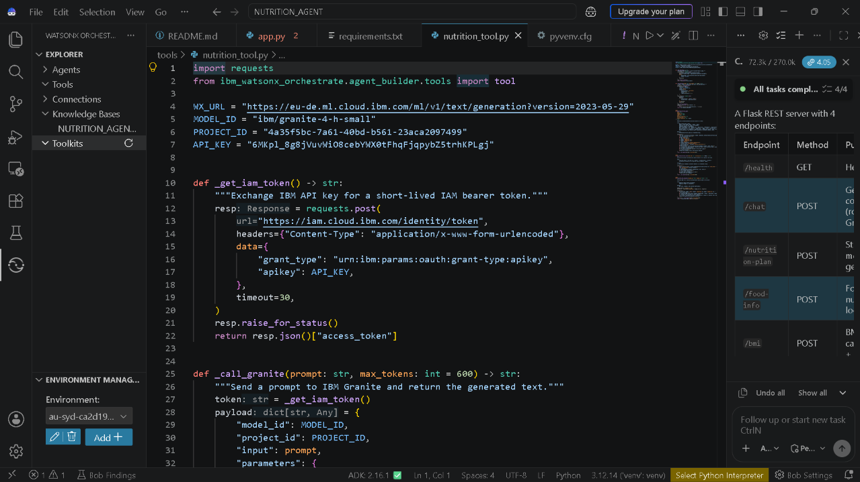
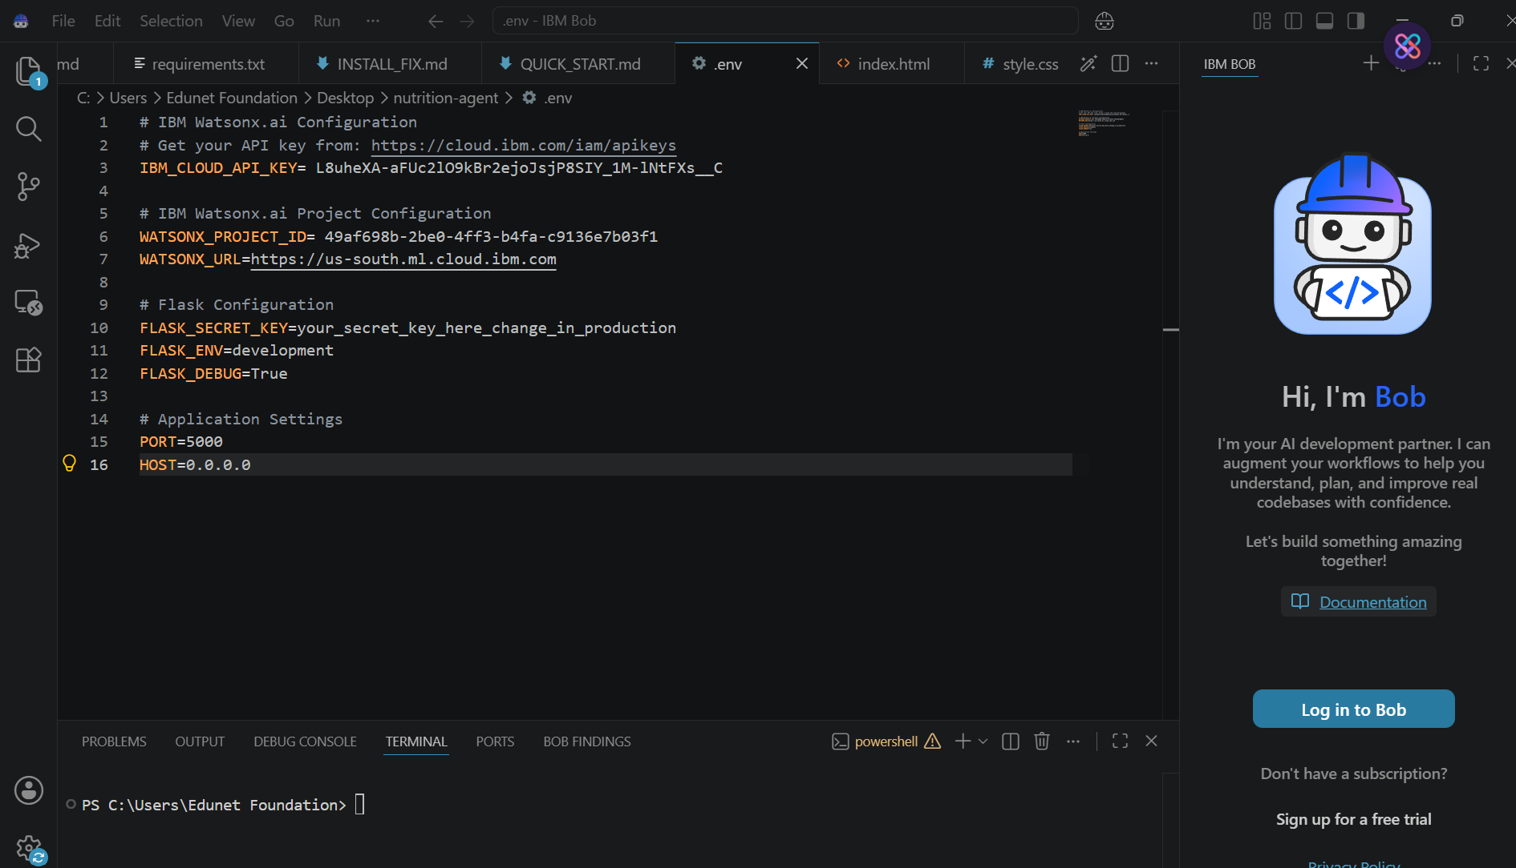
REQUIRED FILES CREATED USING IBM BOB -
README.md
app.py 2
Requirements.txt
Nutrition_tool.py
pyvenv
Index.html

Slide 7
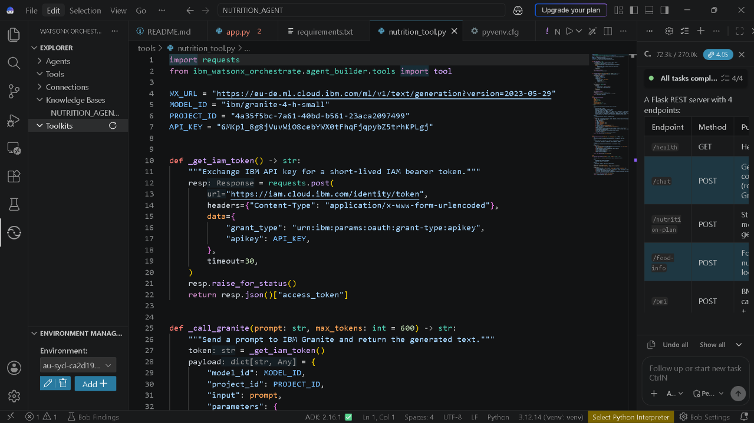
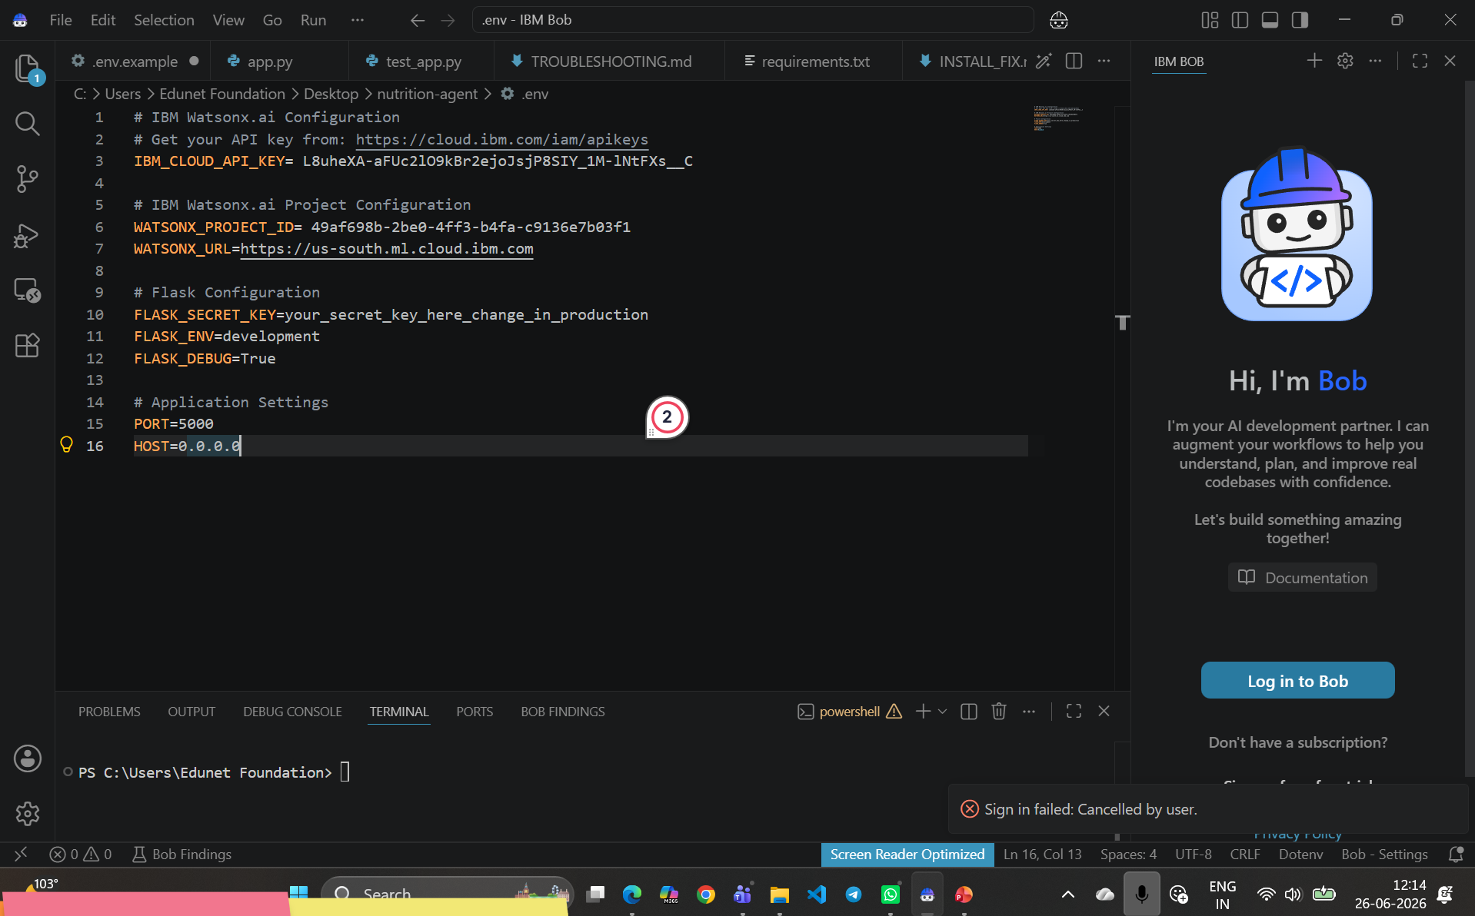
IBM BOB SCREENSHOTS:

Slide 8
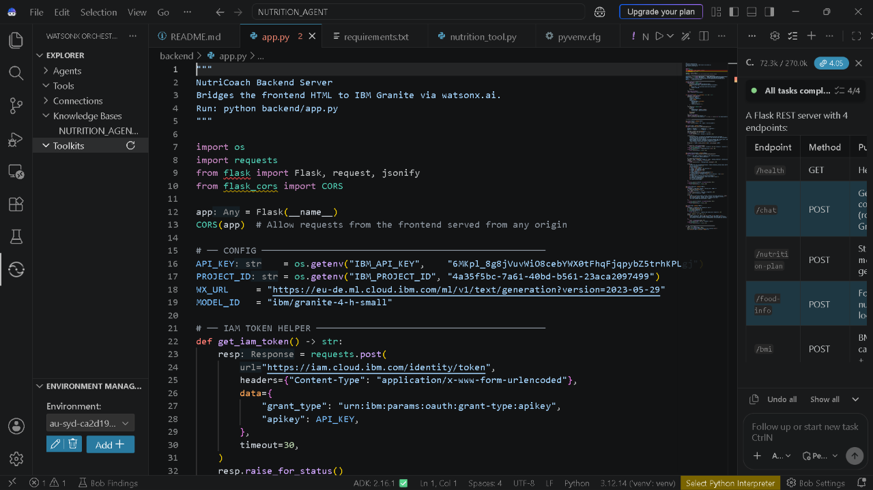
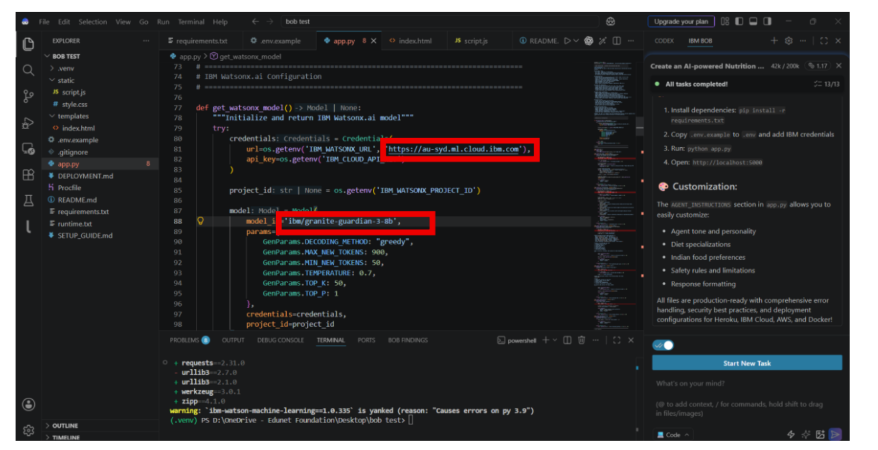

Slide 9
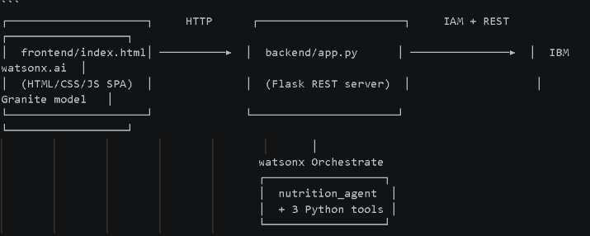
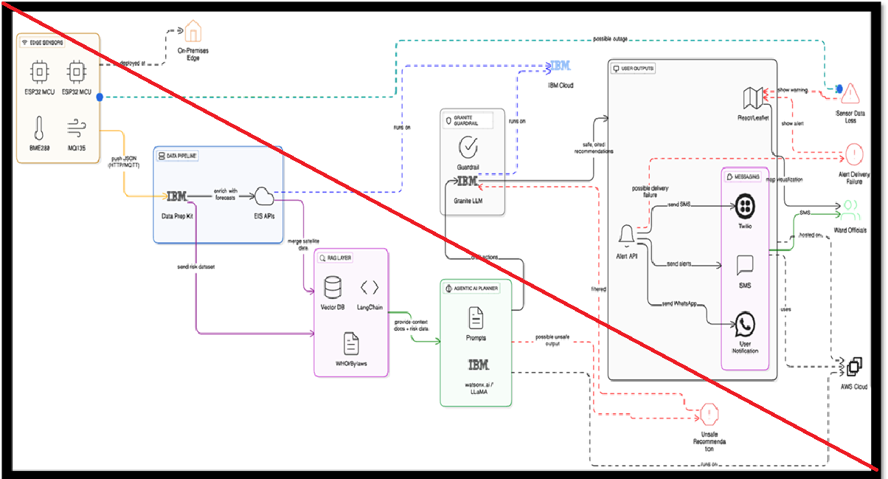
ARCHITECTURE BLUEPRINT FOR IBM BOB:

Slide 10

ROLE OF AGENTIC AI IN THE SOLUTION
ROLE OF AGENTIC AI IN NUTRITION AGENT
Agentic ai enables the nutrition agent to function as an intelligent, autonomous system rather than a simple chatbot. Using ibm watsonx.Ai and ibm granite models, it coordinates multiple specialized agents to deliver personalized nutrition guidance.
Each agent performs a specific role—such as retrieving nutritional data, generating diet plans, providing health advice, and analyzing food logs—while working collaboratively. This multi-agent approach ensures efficient task execution and accurate results.
Agentic ai also brings context awareness, understanding user details like age, health conditions, and fitness goals to generate tailored recommendations. It supports real-time adaptation, continuously updating suggestions based on user inputs like daily meals.
Additionally, agents communicate with each other, enabling better decision-making and improved outcomes.
Overall, agentic ai makes the system proactive, personalized, and goal-driven, acting like a smart digital nutritionist that helps users maintain a healthy lifestyle.

Slide 11
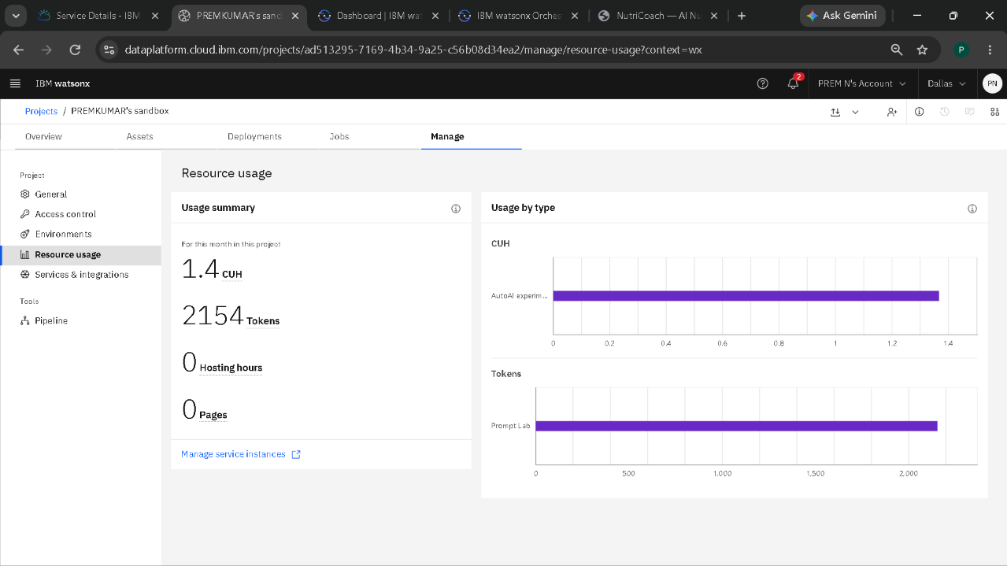
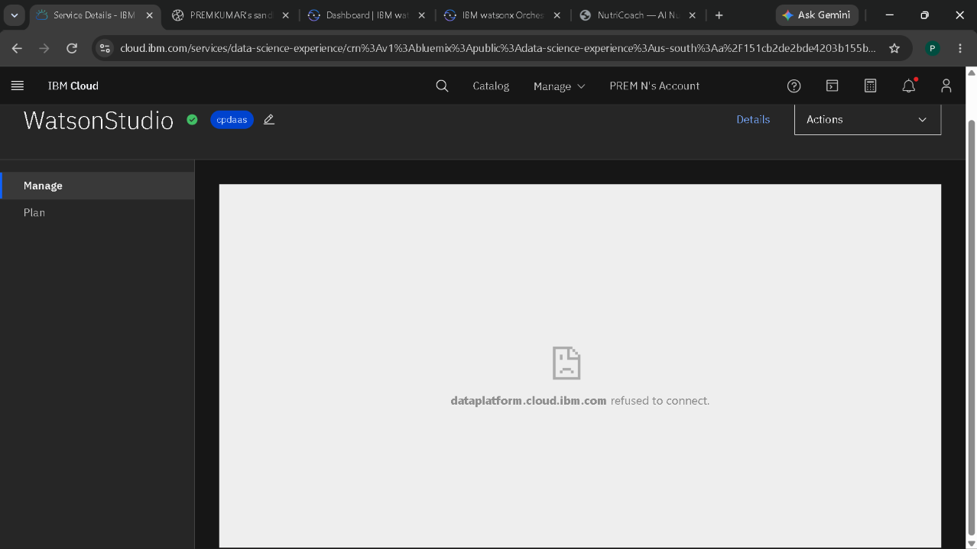


TOKEN USAGE
·
·
*NOTE :
~ While I creating my project by iBM BOB.
~ In my IBM Cloud, IBM watsonx Studio is not responding.
~ That’s why I used the Url,Model ID,Project ID, which id done in the online session class.
~ Kindly , Please accept this inconvinence.
·

Slide 12
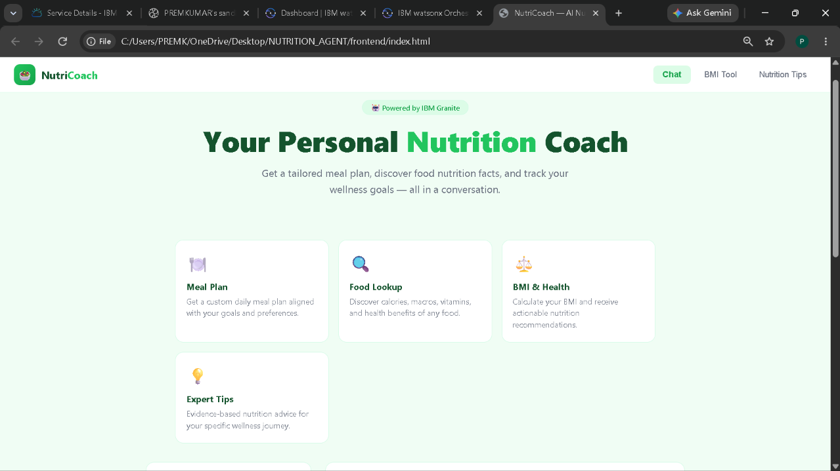
PROJECT OUTPUT SCREENSHOT
Please put IBM Bob output screenshots with 2-3 prompts.
You can take 2-3 more slides for each screenshot
·
·
·

Slide 13
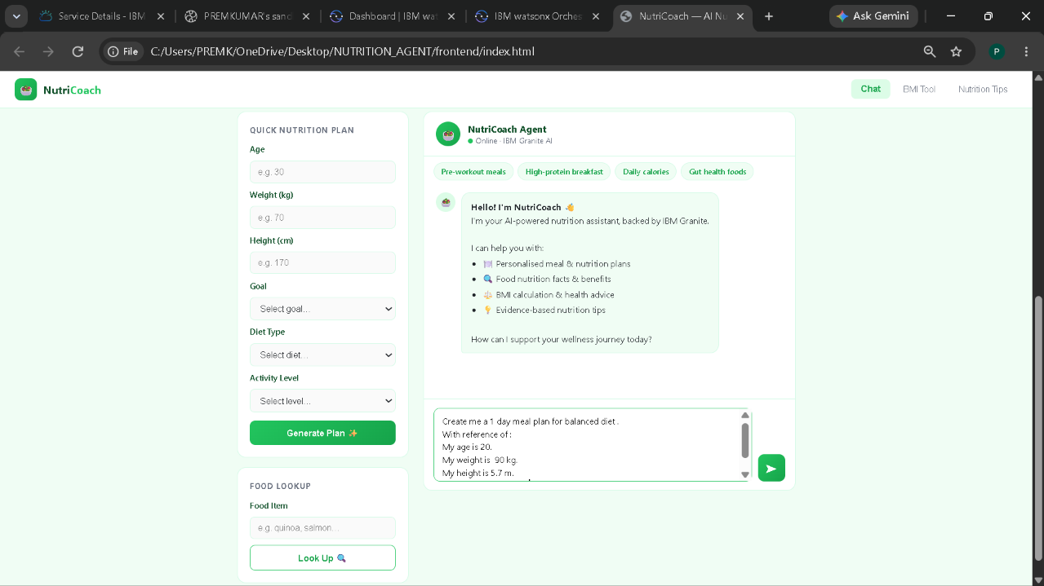
Project Output Screenshot
Please put IBM Bob output screenshots with 2-3 prompts.
You can take 2-3 more slides for each screenshot
·
·
·

Slide 14
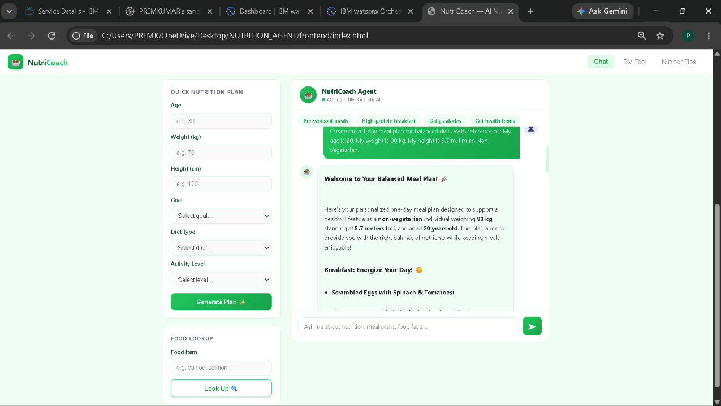
Project Output Screenshot
Please put IBM Bob output screenshots with 2-3 prompts.
You can take 2-3 more slides for each screenshot
·
·
·

Slide 15
NOVELTY AND UNIQUENESS
The proposed Nutrition Agent stands out by combining Agentic AI and personalization into a single intelligent system.
*Multi-Agent Intelligence – Instead of a single chatbot, multiple specialized agents collaborate to deliver accurate and context-aware nutrition guidance.
*Hyper-Personalization – Tailors diet plans based on health conditions, cultural preferences, and fitness goals.
*Real-Time Feedback Loop – Continuously adapts recommendations based on daily food logs and user behavior.
*Multi-Modal Input – Supports text, voice, and image-based meal tracking for better usability.
*Preventive Healthcare Focus – Goes beyond diet planning to provide disease-specific nutrition advice.
*Scalable & Enterprise-Ready – Built on IBM watsonx.ai with IBM Granite models, ensuring reliability and governance.
This makes the solution a smart, adaptive, and proactive digital nutritionist, not just a static diet recommendation tool.

Slide 16
GIT HUB LINK
https://github.com/premkumarn26/NUTRITION-AGENT.git
·
·
·

Slide 17
FUTURE SCOPE
1.INTEGRATION WITH WEARABLES & HEALTH DEVICES –
The system can be integrated with smartwatches and fitness trackers to collect real-time data such as steps, calories burned, heart rate, and sleep patterns. This will enable the Nutrition Agent to provide more accurate and dynamic diet recommendations based on actual user activity and health metrics.
2.AI-POWERED VOICE ASSISTANT & MULTILINGUAL SUPPORT –
Enhancing the system with a voice-enabled assistant and support for multiple languages will improve accessibility. Users can interact naturally in their preferred language, making the solution more inclusive and suitable for diverse populations, especially in regions with varied linguistic backgrounds.
·
·
·

Slide 18
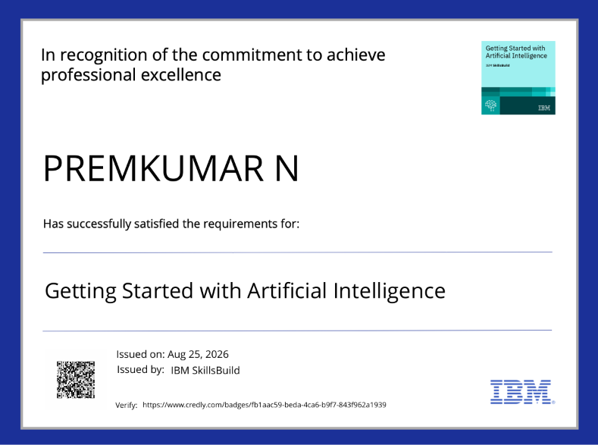
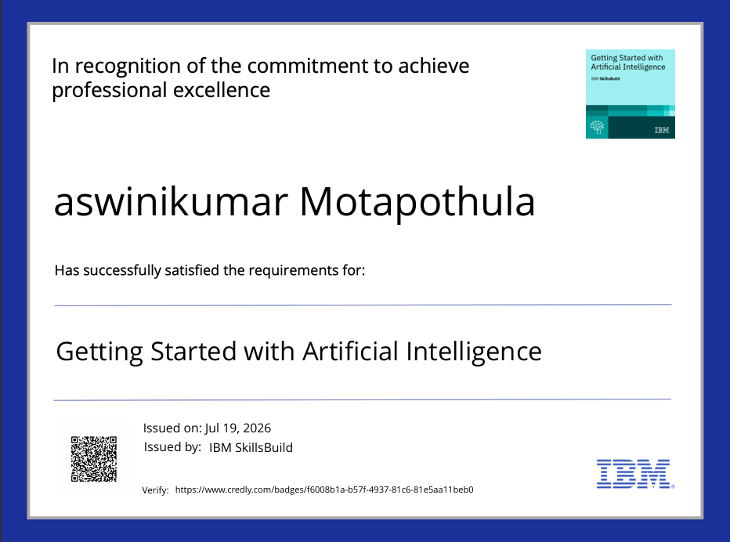
CERTIFICATES EARNED:

Slide 19
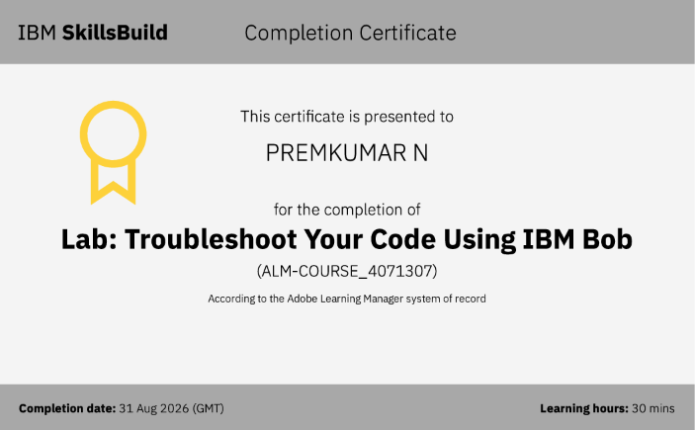

CERTIFICATES EARNED:​

Slide 20
THANK YOU!
“THANK YOU FOR YOUR TIME AND INTEREST”

