Slide 1

Department of Information Science and Engineering Acharya Institute of Technology
Soladevanahalli, Bengaluru 560 107
Project Phase 2 (BIS786) Presentation on
BreachShield: AI Powered OSINT Breach Detection & Dark Web Protection
Presented by
Dept of ISE
Group No | Name | USN
05 | Arvind D H | 1AY24IS400
 | Girishkumar | 1AY24IS404
 | Manoj | 1AY24IS406
 | Premkumar | 1AY24IS407
Guide Name: Prof. Sushma T.M. Designation: Assistant Professor, Dept. of ISE
Dept of ISE

Slide 2
Agenda
Abstract
Introduction
Problem Statement
Requirement Specification(Hardware & Software)
System Design (Data Flow Diagram , Class Diagram, Use Sequence Diagram)
Implementation (Modules and Functions)
References
Dept of ISE

Slide 3
ABSTRACT
BreachShield is an OSINT-based breach intelligence platform designed to help users determine whether their email address or phone number has been exposed in known data breaches while preserving privacy. The platform uses a k-anonymity search mechanism, allowing breach checks without transmitting the user's complete identifier to the server. Breach data is gathered from a locally maintained breach repository and supplemented with live OSINT information collected from Telegram sources. To ensure secure access, the system incorporates OTP-based authentication with email and SMS verification. BreachShield also provides administrative controls and SMS gateway integration for user verification and system management. By combining privacy-preserving search techniques, OSINT-driven data collection, and secure authentication, the platform offers a practical solution for breach awareness and exposure monitoring.
Dept of ISE

Slide 4
INTRODUCTION
• Data breaches and credential leaks occur frequently, exposing sensitive user information such as email addresses and phone numbers.
• Most users have no simple and privacy-preserving way to check whether their personal information has been compromised in a known data breach.
• Existing breach-checking services often require users to submit their complete email address or phone number to a third party, raising privacy concerns.
• OSINT sources such as public breach databases and Telegram-based leak channels contain valuable breach intelligence, but the information is often scattered across multiple platforms.
• BreachShield addresses these challenges by combining OSINT-based breach intelligence, privacy-preserving k-anonymity searches, secure OTP-based authentication, and centralized breach monitoring through a single user-friendly platform.
Dept of ISE

Slide 5
PROBLEM STATEMENT
• Most breach-checking services require users to submit their full email address or phone number to a third-party server, creating additional privacy concerns during the search process.
• Breach-related information is often distributed across multiple sources, making it difficult for users to access reliable and consolidated breach intelligence.
• Users need a secure method to verify whether their personal information has been exposed without unnecessarily revealing sensitive data.
• Many existing solutions provide limited privacy protection and lack secure mechanisms for controlled user access and verification.
• There is a need for a platform that combines privacy-preserving breach searches, OSINT-based breach intelligence, and secure OTP-based authentication within a single system.
Dept of ISE

Slide 6
REQUIREMENT SPECIFICATION
HARDWARE REQUIREMENTS
Development machine: Intel i5 / Ryzen 5 or higher, 8 GB RAM minimum (16 GB recommended for local model training)
Storage: 10 GB free disk space (source data, trained model checkpoints, local blockchain state)
Network connectivity for OSINT/Telegram source polling and package installation
Android device (optional): for the SMS gateway companion app, Android 8.0+
Dept of ISE

Slide 7
REQUIREMENT SPECIFICATION
SOFTWARE REQUIREMENTS
Frontend: React 19 (Create React App)
Backend: Node.js Express 5 JWT & OTP-based Authentication
OSINT Service: Python 3.13 , FastAPI ,Telethon (Telegram Client)
Database: MySQL 8.0 JSON-based Local Storage (Fallback)
Security & Authentication: crypt JWT
Development Tools: Git , npm , pip, Node Test Runner
Dept of ISE

Slide 8
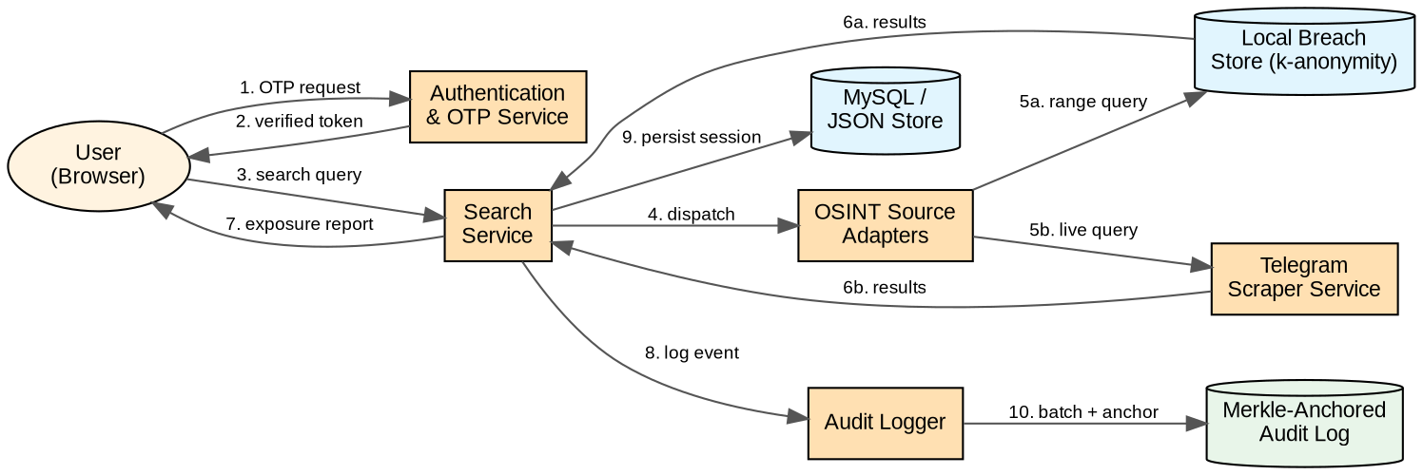
SYSTEM DESIGN – DATA FLOW DIAGRAM
Data Flow Diagram — Search, k-Anonymity Lookup and Audit-Anchoring Flow
Dept of ISE

Slide 9
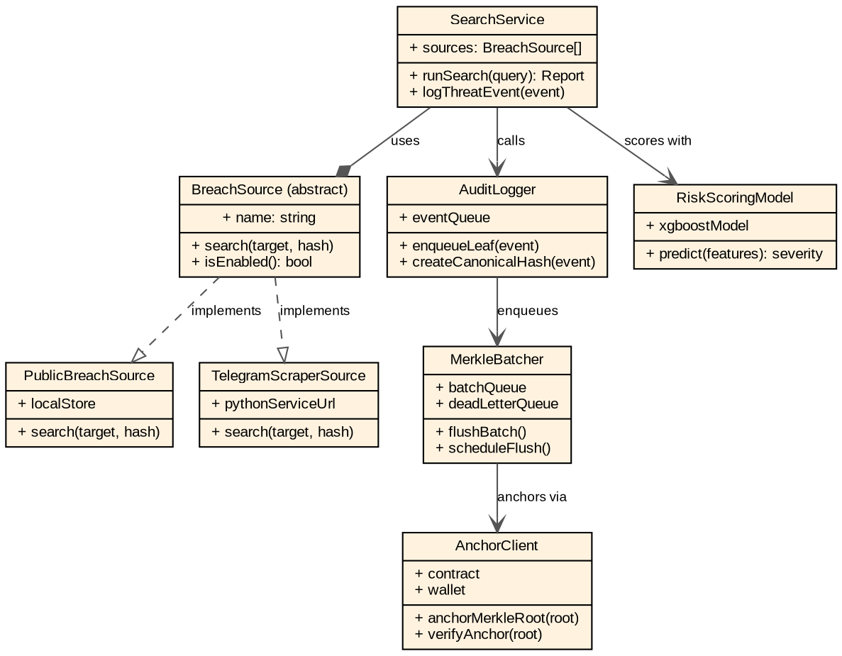
SYSTEM DESIGN – CLASS DIAGRAM
Class Diagram — Source Adapters, Search Service, Audit & Anchoring Layer
Dept of ISE

Slide 10
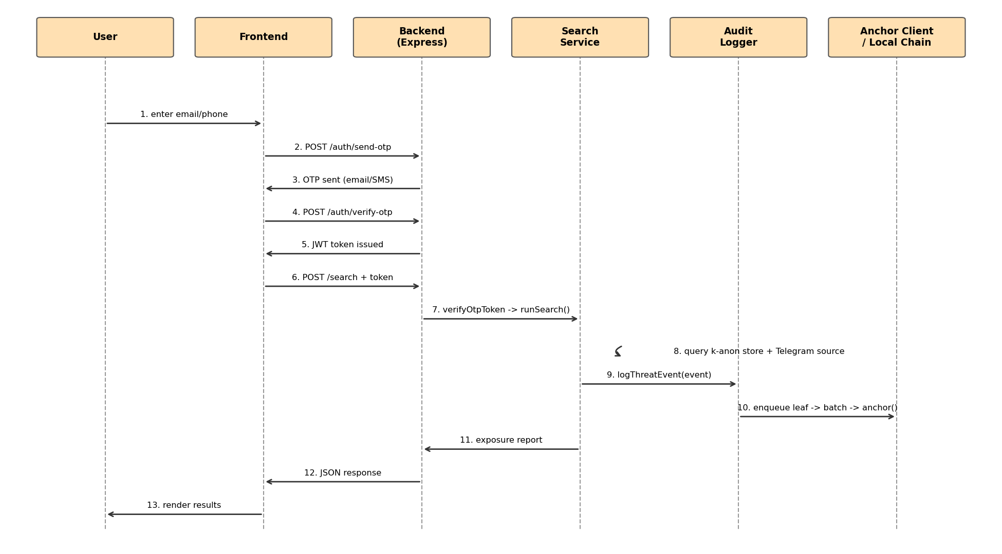
SYSTEM DESIGN – SEQUENCE DIAGRAM
Sequence Diagram — OTP Login, Search Request and Merkle Anchoring
Dept of ISE

Slide 11
IMPLEMENTATION
OSINT Source Module — Integrates live breach intelligence from Telegram using Telethon. Data is collected through a pluggable source architecture, allowing multiple OSINT sources to be added and queried independently.
• Authentication & OTP Module — Secure email/SMS OTP verification with bcrypt-hashed OTP storage, JWT-based session management, resend rate limiting, and account lockout protection against unauthorized access.
• k-Anonymity Search Module — Privacy-preserving breach search where only a hash prefix of the user's identifier is shared with the server. Candidate matches are returned, while exact verification is performed without exposing the complete identifier.
• Admin & Gateway Module — Role-based administrative controls with Android SMS Gateway integration for OTP delivery. Device registration and communication are secured using signed JWT tokens.
Dept of ISE

Slide 12
REFERENCES
[1] A. Aljofey, Q. Jiang, Q. Qu, M. Huang, and J.-P. Niyigena, "An effective phishing detection model based on character level CNN from URL," Electronics, vol. 9, no. 9, p. 1514, 2020.
[2] Z. Alshingiti, R. Alaqel, J. Al-Muhtadi, Q. E. U. Haq, K. Saleem, and M. H. Faheem, "A deep learning-based phishing detection system using CNN, LSTM, and LSTM-CNN," Electronics, vol. 12, no. 1, p. 232, 2023.
[3] Y. Su, "Research on website phishing detection based on LSTM RNN," in Proc. 2020 IEEE 4th ITNEC, 2020, pp. 284–288, doi: 10.1109/ITNEC48623.2020.9084799.
[4] O. K. Sahingoz, E. Buber, O. Demir, and B. Diri, "Machine learning based phishing detection from URLs," Expert Syst. Appl., vol. 117, pp. 345–357, 2019.
[5] N. Q. Do, A. Selamat, H. Fujita, and O. Krejcar, "An integrated model based on deep learning classifiers and pre-trained transformer for phishing URL detection," Future Gener. Comput. Syst., vol. 161, pp. 269–285, 2024.
[6] S. Alnemari and M. Alshammari, "Detecting phishing domains using machine learning," Appl. Sci., vol. 13, no. 8, p. 4649, 2023.
[7] C. Opara, Y. Chen, and B. Wei, "Look before you leap: Detecting phishing web pages by exploiting raw URL and HTML characteristics," Expert Syst. Appl., vol. 236, p. 121183, 2024.
[8] A. Karim, M. Shahroz, K. Mustofa, S. B. Belhaouari, and S. R. K. Joga, "Phishing detection system through hybrid machine learning based on URL," IEEE Access, vol. 11, pp. 36805–36822, 2023.
[9] E. A. Aldakheel, M. Zakariah, G. A. Gashgari, F. A. Almarshad, and A. I. A. Alzahrani, "A deep learning-based innovative technique for phishing detection using URLs," Sensors, vol. 23, no. 9, p. 4403, 2023.
[10] M. Sánchez-Paniagua, E. F. Fernández, E. Alegre, W. Al-Nabki, and V. González-Castro, "Phishing URL detection: A real-case scenario through login URLs," IEEE Access, vol. 10, pp. 42949–42960, 2022.
[11] Y. Liu et al., "Identifying, collecting, and monitoring personally identifiable information: From the dark web to the surface web," in Proc. 2020 IEEE ISI, 2020, doi: 10.1109/ISI49825.2020.9280540.
[12] M. Almukaynizi et al., "DarkMention: A deployed system to predict enterprise-targeted external cyberattacks," in Proc. 2018 IEEE ISI, 2018, pp. 31–36.
[13] R. Williams, S. Samtani, M. Patton, and H. Chen, "Incremental hacker forum exploit collection and classification for proactive cyber threat intelligence," in Proc. 2018 IEEE ISI, 2018, pp. 94–99.
[14] M. Schäfer, M. Fuchs, M. Strohmeier, M. Engel, M. Liechti, and V. Lenders, "BlackWidow: Monitoring the dark web for cyber security information," in Proc. 2019 11th Int. Conf. Cyber Conflict, vol. 900, 2019, pp. 1–21.
[15] S. Samtani, H. Zhu, and H. Chen, "Proactively identifying emerging hacker threats from the dark web: A diachronic graph embedding framework," ACM Trans. Privacy Security, vol. 23, no. 4, pp. 1–33, 2020.
[16] Z. Liu, Q. Wang, T. Wang, and Y. Yang, "Data integrity audit scheme based on quad Merkle tree and blockchain," IEEE Access, vol. 11, 2023, doi: 10.1109/ACCESS.2023.3240066.
[17] A. Ahmad, M. Saad, M. Bassiouni, and A. Mohaisen, "Towards blockchain-driven, secure and transparent audit logs," in Proc. 15th EAI MobiQuitous, 2018.
[18] A. Ahmad, M. Saad, and A. Mohaisen, "BlockTrail: A scalable multichain solution for blockchain-based audit trails," in Proc. 2019 IEEE ICC, 2019.
[19] A. Margheri and V. Sassone, "A prototype evaluation of a tamper-resistant high performance blockchain-based transaction log for a distributed database," in Proc. 2017 13th Eur. Dependable Comput. Conf., 2017.
[20] P. Zhang and J. Wang, "Blockchain based data integrity verification for large-scale IoT data," IEEE Access, vol. 7, pp. 164401–164411, 2019, doi: 10.1109/ACCESS.2019.2952847.
[21] R. C. Merkle, "A digital signature based on a conventional encryption function," in Advances in Cryptology—CRYPTO ’87, 1988.
[22] L. Sweeney, "k-anonymity: A model for protecting privacy," Int. J. Uncertainty, Fuzziness Knowledge-Based Syst., vol. 10, no. 5, pp. 557–570, 2002.
[23] K. El Emam and F. K. Dankar, "Protecting privacy using k-anonymity," J. Amer. Med. Inform. Assoc., vol. 15, no. 5, pp. 627–637, 2008, doi: 10.1197/jamia.M2716.
[24] "Analysis of privacy preserving k-anonymity methods and techniques," in Proc. 2011 3rd Int. Conf. Commun. Syst. Netw. Technol., IEEE, 2011.
[25] "Multi-level privacy preserving k-anonymity," IEEE Conf. Publication, IEEE Xplore, 2021.
[26] T. Chen and C. Guestrin, "XGBoost: A scalable tree boosting system," in Proc. 22nd ACM SIGKDD Int. Conf. Knowl. Discovery Data Mining, 2016, pp. 785–794, doi: 10.1145/2939672.2939785.
[27] "Extreme gradient boosting based tuning for classification in intrusion detection systems," in Proc. Int. Conf. Comput. Intell. Commun. Bus. Analytics, Springer, 2018.
[28] "Enhancing Internet of Things security using performance gradient boosting for network intrusion detection systems," Ain Shams Eng. J., ScienceDirect, 2024.
[29] "On using eXtreme Gradient Boosting (XGBoost) machine learning algorithm for home network traffic classification," in Proc. IEEE Conf., 2019, doi: 10.1109/access.
[30] OWASP Foundation, "Testing JSON Web Tokens," OWASP Web Security Testing Guide (WSTG), 2024. [Online]. Available: https://owasp.org/www-project-web-security-testing-guide/
Dept of ISE

Slide 13

Dept of ISE

Slide 14

Dept of ISE

