Slide 1
BreachShield: AI Powered OSINT Breach Detection & Dark Web Protection
Project Phase 1 Presentation 2
(2025-2026)
Subject Code: BIS685
Dept. of ISE
Batch No:- 05
Project Team Members:
Arvind D H (1AY24IS400)
Girishkumar (1AY24IS404)
Manoj (1AY24IS406)
Premkumar (1AY24IS407)
Under the Guidance of
Prof. Sushma T.M
Assistant Professor
Department of ISE
Acharya Institute Of Technology

Slide 2
AGENDA
Abstract
Introduction
Problem Statement
Requirement Specification(Hardware & Software)
Literature Survey
System Design [Any two designs from the list (Data Flow Diagram ,Flow Charts,Class Diagram, Use Case Diagram, Sequence Diagram,Object Diagram, State Chart Diagram, Collaboration Diagram,Activity diagram)]
List of Modules
Conclusion
References
Dept. of ISE

Slide 3
ABSTRACT
This project proposes an OSINT-based breach monitoring and AI-assisted threat detection system for real-time cybersecurity monitoring. The system collects threat intelligence data such as phishing URLs, suspicious domains, and leaked credentials using OSINT and Telegram-based intelligence sources, and displays the information through a centralized dashboard. AI-based analysis and alert mechanisms help identify suspicious activities and generate real-time notifications. The system also implements secure authentication, encrypted communication, and role-based access control to ensure data security and privacy. The proposed solution aims to improve cybersecurity awareness, support proactive threat monitoring, and reduce manual investigation effort.
3
Dept. of ISE

Slide 4
INTRODUCTION
Cybersecurity threats such as phishing attacks, data breaches, and credential leaks are increasing rapidly.
Traditional security systems mainly focus on post-incident detection and lack centralized real-time monitoring.
OSINT and real-time threat intelligence can help identify suspicious activities and exposed data at an early stage
.Real-time monitoring and automated alerts help users respond quickly to potential cybersecurity threats.
The proposed system provides OSINT-based threat monitoring, secure authentication, and dashboard visualization for proactive cybersecurity awareness.
Dept. of ISE

Slide 5
PROBLEM STATEMENT
Traditional cybersecurity systems rely on reactive tools like firewalls and antivirus, detecting threats only after damage occurs. Existing solutions are fragmented and lack integration of OSINT, dark web monitoring, AI-based phishing detection, and secure logging. They also suffer from high false positives and limited transparency.
There is a need for an intelligent, unified system combining deep learning, real-time monitoring, explainable AI, and blockchain.This approach enables proactive, transparent, and reliable cybersecurity protection.
Dept. of ISE

Slide 6
REQUIREMENT SPECIFICATION
Functional Requirements
The system should collect threat intelligence data such as phishing URLs, suspicious domains, leaked credentials, and breach-related information from OSINT and Telegram-based intelligence sources.
The system should provide real-time monitoring and display threat information through a centralized dashboard.
The system should generate alerts and notifications whenever suspicious or high-risk activities are detected.
The system should allow users to monitor specific keywords, domains, usernames, or email addresses using watchlists.
The system should provide secure login, OTP verification, and role-based access for authorized users.
Dept. of ISE

Slide 7
REQUIREMENT SPECIFICATION
Non-Functional Requirements
The system should ensure secure handling of sensitive monitoring data using encryption and authentication mechanisms.
The system should provide reliable real-time monitoring with minimum delay.
The system should be scalable and capable of handling multiple monitoring requests simultaneously.
The user interface should be simple, responsive, and user-friendly for efficient monitoring.
The system should maintain data integrity and prevent unauthorized access to monitoring information
Dept. of ISE

Slide 8
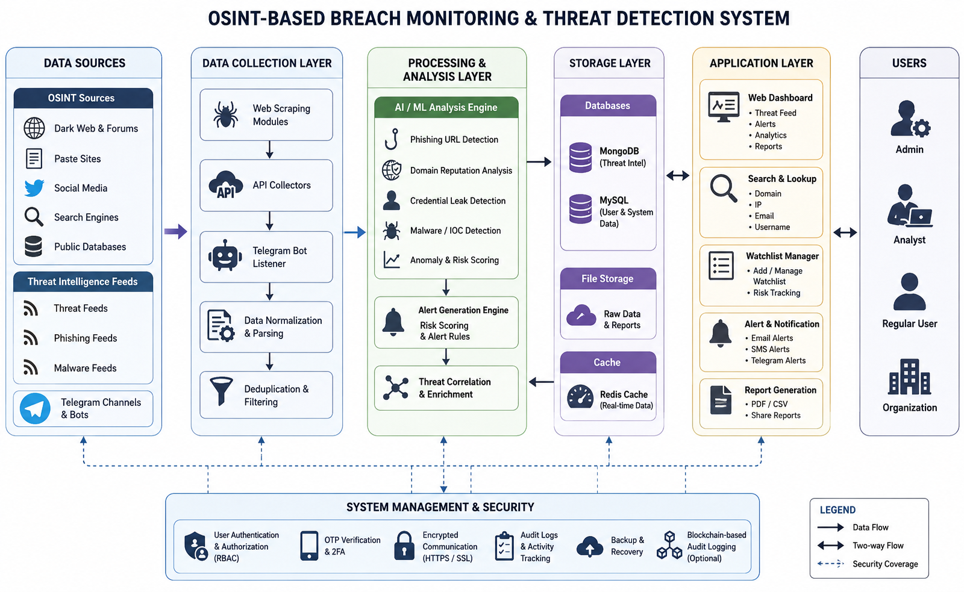
SYSTEM DESIGN
1.System Design
Dept. of ISE

Slide 9
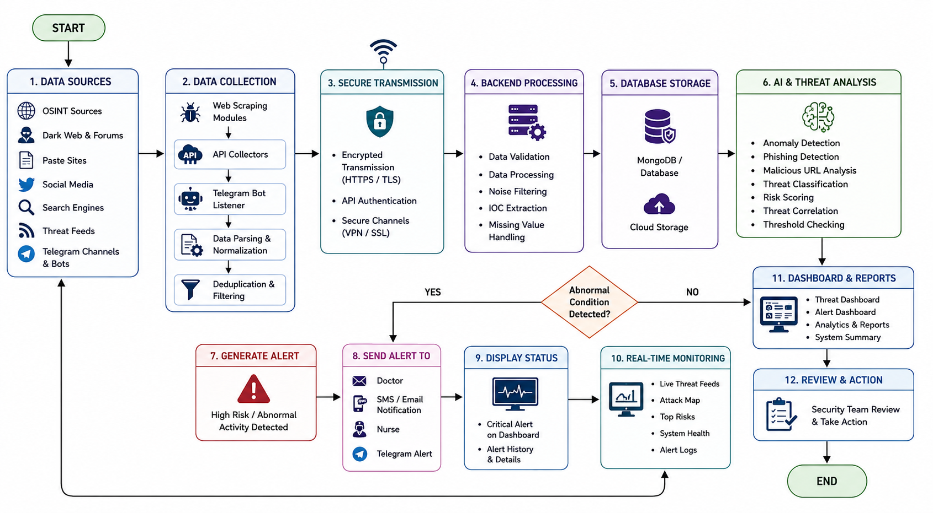
SYSTEM DESIGN
2.Flow Diagram
Dept. of ISE

Slide 10
LIST OF MODULES
OSINT Data Collection Module
  Collects phishing URLs, leaked credentials, suspicious domains, and threat intelligence data from OSINT and Telegram sources.
Threat Monitoring Module
  Continuously monitors suspicious activities, breach information, and watchlist-based threats in real time.
Secure Data Transmission Module
  Transfers monitoring data securely using HTTPS, API authentication, and encrypted communication protocols.
Backend Processing Module
  Processes incoming threat intelligence data and manages communication between services, database, and dashboard.
Threat Analysis Module
  Analyzes collected threat data to identify phishing attacks, suspicious activities, and potential security risks.
Dept. of ISE

Slide 11
LIST OF MODULES
6. Database Management Module
  Stores user details, monitoring history, alerts, watchlists, and threat intelligence records securely.
7. Real-Time Dashboard Module
  Provides live monitoring, alerts, threat statistics, and dashboard visualization for users and administrators.
8. Alert & Notification Module
  Generates real-time alerts and notifications whenever suspicious or high-risk activities are detected.
9. Authentication & Security Module
  Implements secure login, OTP verification, JWT authentication, and role-based access control for system security.
Dept. of ISE

Slide 12
CONCLUSION
The proposed OSINT-Based Breach Finder and Real-Time Threat Monitoring System provides an efficient and intelligent cybersecurity solution for monitoring phishing attacks, leaked credentials, and suspicious activities. The system integrates OSINT intelligence retrieval, real-time monitoring, threat analysis, and cybersecurity mechanisms to improve cybersecurity awareness and support proactive threat detection. By providing real-time alerts, secure access control, and dashboard-based monitoring, the system reduces manual investigation effort and enhances the overall efficiency and reliability of cybersecurity monitoring services.
Dept. of ISE

Slide 13
REFERENCES
[1] A. K. Jain and B. B. Gupta, “Phishing Detection Systems: A Comprehensive Survey of Deep Learning-Based Approaches,” IEEE Access, vol. 12, pp. 12345–12360, 2024.
[2] S. S. Tyagi, “BreachShield: A Novel Framework for Real-Time Data Breach Detection Using OSINT and Dark Web Monitoring,” Computers & Security, vol. 115, p. 102612, 2025.
[3] M. Al-Sarem, F. Saeed, and W. Boulila, “An Ensemble Learning Approach for Phishing Website Detection using Hybrid Features,” Electronics, vol. 13, no. 5, p. 245, 2024.
[4] R. Sharma and P. Kumar, “Blockchain-Based Secure and Immutable Log Management System for Cloud Forensics,” Journal of Information Security and Applications, vol. 78, p. 103598, 2023.

Slide 14
REFERENCES
[5] T. Zhang, “Deep Web and Dark Web Monitoring for Threat Intelligence: A Systematic Review,” ACM Computing Surveys, vol. 56, no. 2, pp. 1–35, 2024.
[6] J. Singh and N. Kumar, “Addressing Class Imbalance in Phishing Detection Systems using SMOTE and Deep Learning,” Expert Systems with Applications, vol. 238, p. 121888, 2024.

Slide 15

Dept. of ISE
11

Slide 16

Dept. of ISE
12

