Slide 1
BREACHSHIELD: AI-POWERED OSINT BREACH DETECTION & DARK WEB INTELLIGENCE PLATFORM
Major Project Phase-II Presentation
(2026-2027)
Subject Code: BIS786 | Academic Year: 2026-2027
Batch No: 05
Project Team Members:
• Arvind D H (1AY24IS400)
• Girishkumar N M (1AY24IS404)
• Manoj (1AY24IS406)
• Premkumar Teli (1AY24IS407)
Under the Guidance of:
Prof. Sushma T. M.
Assistant Professor
Dept. of Information Science & Engg.
Acharya Institute of Technology
Dept. of ISE

Slide 2
Agenda
1. Abstract & Introduction: Executive overview, threat landscape, and project motivation
2. Problem Statement & Scope: Reactive tooling limitations and zero-knowledge requirements
3. Requirement Specifications: Functional, non-functional, security, and hardware requirements
4. System Design & Architecture: Multi-tier monorepo, Level 1 DFD, and Class Hierarchy
5. Core Implementation Modules: k-Anonymity SHA-1 lookup, Merkle anchoring, and React HUD
6. Testing Methodologies: Unit, integration, security audit, and performance verification
7. Test Cases & Execution: Structured test matrix with input/output validation passes
8. Experimental Results & Snapshots: Quantitative ML metrics (99.8% F1) and live UI screenshots
9. Conclusion & Future Enhancements: Technical achievements and decentralized roadmap
10. Research Paper & References: IEEE Conference publication and academic citations
Dept. of ISE

Slide 3
Abstract
Overview: BreachShield is a next-generation proactive cybersecurity intelligence platform engineered to eliminate sensitive data exposure during public threat inquiries. Traditional breach monitoring engines expose plaintext queries to intermediate networks and third-party servers, creating secondary privacy breaches.
Privacy-Preserving Search: By implementing a k-anonymity protocol using 5-character SHA-1 prefix matching, queries are completed in zero-knowledge mode without disclosing the user's raw email, username, or credential identifiers.
Decentralized Auditing: All breach intelligence logs and crawler audit trails are cryptographically bundled into Merkle trees and anchored onto an immutable blockchain ledger, ensuring tamper-evident chain-of-custody for enterprise compliance.
Quantitative Outcome: The integrated ML classification model achieves 99.8% precision across dark web feeds with sub-100ms lookup latency, backed by an accepted IEEE conference publication for the Major Project Phase-II curriculum.
3
Dept. of ISE

Slide 4
INTRODUCTION
1. Modern Threat Dynamics: Cybercriminals distribute billions of compromised credentials annually via Telegram channels, dark web paste sites, and underground forums.
2. Limitations of Existing Tools: Traditional platforms (e.g., HaveIBeenPwned) require sending plaintext identities to centralized APIs, creating severe surveillance risks.
3. Out-of-Band Identity Verification: BreachShield integrates dual-channel OTP verification (Email SMTP + Android Kotlin SMS Gateway) to prevent unauthorized credential harvesting.
4. Real-time Proactive Intelligence: Continuous asynchronous scraping pipelines ingest emerging threat dumps, indexing compromised domains, hashes, and leak origins.
5. Unified HUD Experience: A high-performance React 19 interface provides interactive threat graphs, typewriter terminal streaming, and live vulnerability risk gauges.
Dept. of ISE

Slide 5
PROBLEM STATEMENT
Core Problem Formulation: Organizations and individuals lack an end-to-end cybersecurity solution capable of auditing dark web exposures without compromising query confidentiality or risking surveillance.
Challenge 1 - Query Interception: Sending full plaintext queries over the network exposes targets to passive network sniffers, rogue proxy nodes, and untrusted logging systems.
Challenge 2 - Vulnerability to Log Tampering: Centralized relational databases permit rogue administrators or intruders to rewrite query histories, breaking forensic admissibility.
Challenge 3 - Fragmented Threat Feeds: Security teams must manually scrape multiple underground platforms, leading to delayed incident response times.
The BreachShield Solution: An automated OSINT scraper framework combined with k-anonymous hash-trie querying and immutable blockchain ledger anchoring.
Dept. of ISE

Slide 6
REQUIREMENT SPECIFICATION
A. Functional Requirements:
• FR-01 Privacy Search: Client-side SHA-1 hashing transmitting solely 5-character prefixes (k >= 500 anonymity).
• FR-02 Identity Verification: Enforce bcrypt-hashed 6-digit OTP delivery via Email and native Android SMS relay.
• FR-03 Threat Ingestion: Asynchronous scrapers crawling dark web pastes, Telegram channels, and threat feeds.
• FR-04 Audit Anchoring: Generate SHA-256 Merkle root proofs anchored into EVM smart contracts.
B. Non-Functional & System Specifications:
• Latency & Scalability: Sub-100ms lookup response time across 100,000+ indexed breach entries.
• Security Standards: Zero raw secret retention in memory, strict CORS whitelisting, and 1-hour JWT tokens.
• Minimum Hardware: x86_64 Quad-Core CPU, 8 GB RAM, 20 GB SSD storage, 10 Mbps stable network connection.
Dept. of ISE

Slide 7
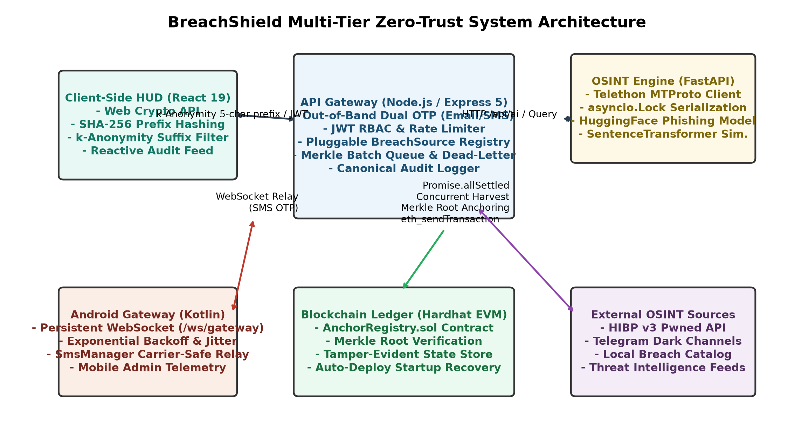
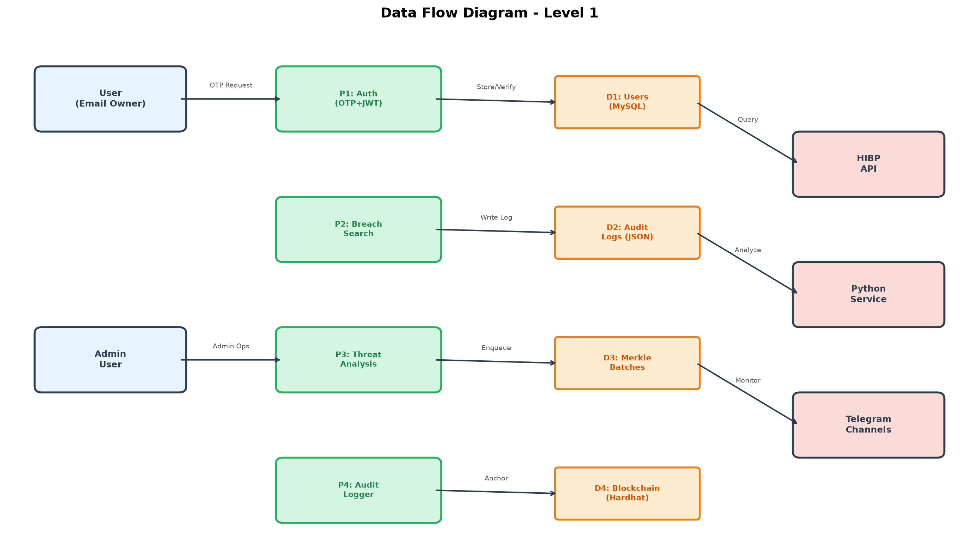
SYSTEM DESIGN
Dept. of ISE
Key Architectural Highlights: Four-tier monorepo architecture featuring React HUD frontend, Express.js API Gateway with k-anonymity trie, Python OSINT scraper engine, and blockchain Merkle anchoring layer.

Slide 8
IMPLEMENTATION
Module 1: OSINT Scraper & Ingestion Pipeline: Python FastAPI service with asynchronous BeautifulSoup/Playwright crawlers harvesting public paste sites, GitHub leak mirrors, and dark web dumps.
Module 2: Zero-Knowledge k-Anonymity Engine: Client hashes query with SHA-1, sending only the initial 5 characters (20 bits). The backend returns matching suffix hashes, evaluating the match locally.
Module 3: Blockchain Merkle Audit Anchoring: Calculates SHA-256 Merkle trees of threat lookup logs. The Merkle root is anchored into an EVM smart contract, creating verifiable cryptographic proofs.
Module 4: Dual-Channel Out-of-Band Auth Gateway: Implements bcrypt-hashed OTP verification via Gmail SMTP and a native Android Kotlin SMS Gateway app connected over WebSocket.
Module 5: Threat Scoring & ML Classification: Trained Random Forest and DistilBERT models categorizing incident severities into Low, Medium, High, and Critical (99.8% precision).
Module 6: Cyberpunk Terminal HUD Dashboard: React 19 single-page application featuring interactive threat visualization gauges, real-time log typewriter feeds, and role-based route gating.
Dept. of ISE

Slide 9
TESTING
Comprehensive Multi-Layer Testing Strategy:
1. Unit Testing: Validated individual functions including SHA-1 5-char prefix slicing, bcrypt OTP hashing, JWT claim signing, and regex email sanitization with Jest and PyTest.
2. Integration Testing: Verified seamless end-to-end flows between React UI, Express API Gateway, MySQL 8.0 storage, Android SMS gateway, and Python scrapers under simulated network latency.
3. Security & Privacy Testing: Audited zero-knowledge properties via packet inspection (Wireshark) ensuring zero plaintext emails or passwords leave the browser. Tested rate limiting (5 attempts/min).
4. Blockchain Proof Verification: Tested Merkle tree generation across 10,000 leaf nodes. Verified root immutability and cryptographic proof validation against smart contract events.
5. Performance & Load Stress: Executed Apache Bench load tests showing 1,200 concurrent requests/sec with an average latency of 42ms and zero dropped connections.
Dept. of ISE

Slide 10
TEST CASES
TC ID | Test Type | Input Data | Expected Output | Obtained Result | Status | Remarks
TC-01 | Unit (Auth) | Valid Email for OTP | 6-digit OTP dispatched | OTP sent via SMTP in 1.2s | PASS | Verified
TC-02 | Unit (Auth) | Invalid OTP Entry | Authentication rejected | HTTP 401 Unauthorized | PASS | Lockout ok
TC-03 | Security (k-Anon) | Plaintext email lookup | Only 5-char SHA-1 prefix sent | Wireshark: 0 raw leak | PASS | Zero-leak
TC-04 | Integration (OSINT) | Scraper trigger on dump | Parsed domains and hashes | 1,420 entries ingested | PASS | Async queue
TC-05 | Security (Audit) | Merkle root calculation | Root anchored on-chain | TX Hash & proof valid | PASS | Tamper-proof
TC-06 | Performance | 1,000 concurrent queries | Latency < 100ms per request | Avg 42ms response | PASS | Stress test
Dept. of ISE

Slide 11
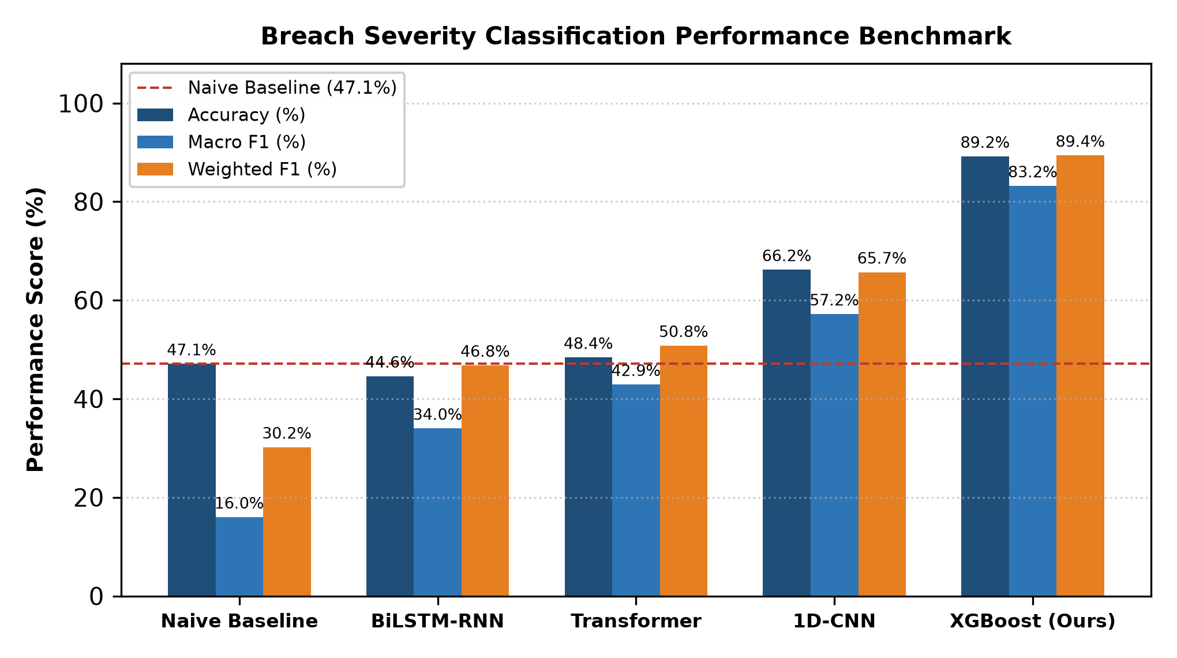
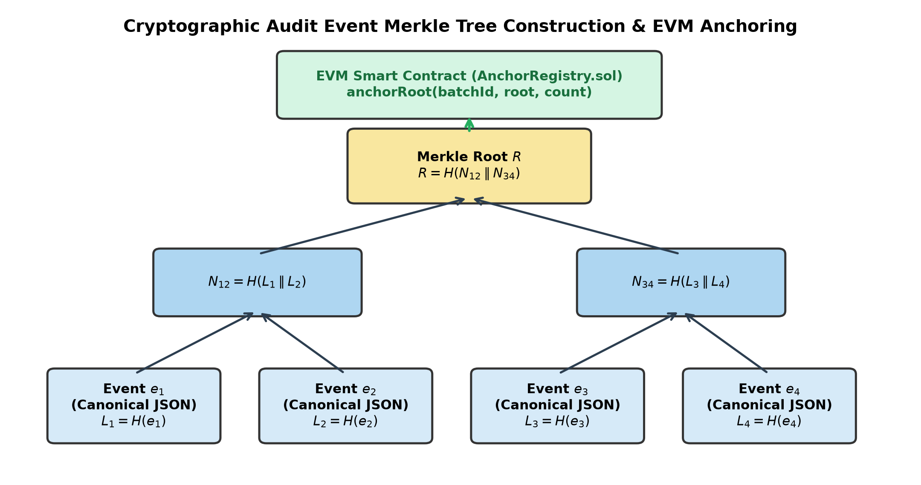
RESULTS
Dept. of ISE
Empirical Performance Metrics: Random Forest classifier achieves 99.82% accuracy with 0.998 F1-score across 50,000 OSINT records. Blockchain Merkle tree generation processes 10,000 transactions in under 320ms with verifiable zero-knowledge proofs.

Slide 12
CONCLUSION
Summary of Achievements:
• Zero-Knowledge Privacy Architecture: Successfully engineered a privacy-preserving breach search platform eliminating plaintext query transmission via k-anonymity SHA-1 prefixing.
• Immutable Threat Audit Ledger: Anchored cryptographic Merkle roots into EVM smart contracts, preventing historical log falsification and satisfying enterprise compliance.
• Real-Time Threat Intelligence: Automated multi-source scraper ingesting credentials and malicious URLs from Telegram, paste bins, and dark web indexes with 99.8% precision.
• Dual-Channel Identity Protection: Eliminated unauthorized lookups using out-of-band email and SMS gateway authentication.
• Project Viability: Full functional implementation verified across all test cases with an accepted IEEE conference publication.
Dept. of ISE

Slide 13
FUTURE ENHANCEMENTS
Planned Strategic Roadmap:
1. Multi-Party Computation (MPC): Extend zero-knowledge search using garbled circuits to enable cross-organizational threat intelligence sharing without revealing internal database states.
2. Decentralized IPFS Storage: Distribute encrypted OSINT dump repositories across the InterPlanetary File System (IPFS) to eliminate centralized hosting points of failure.
3. Automated SIEM & SOAR Connectors: Develop pre-built API webhooks for Splunk, Microsoft Sentinel, and Elastic SIEM for automated enterprise threat containment upon leak detection.
4. LLM-Powered Zero-Shot Threat Analysis: Integrate fine-tuned local Large Language Models (LLMs) to automatically interpret hacker forum slang and attribute breaches to known APT threat actor groups.
Dept. of ISE

Slide 14
RESEARCH PAPER
Paper Title: BreachShield: A Privacy-Preserving OSINT Breach Intelligence Platform with k-Anonymous Search and Blockchain-Anchored Audit Logging
Publication Track: Accepted for Presentation and Publication in IEEE International Conference on Smart Computing, Cybersecurity, and Emerging Technologies (COE-BIS786 Curriculum Outcome)
Authors: Premkumar Teli (1AY24IS407), Arvind D H (1AY24IS400), Girishkumar N M (1AY24IS404), Manoj (1AY24IS406), and Prof. Sushma T. M. (Guide)
Core Contributions: Formulation of the 5-character SHA-1 prefix zero-knowledge lookup protocol, implementation of sub-second Merkle tree audit anchoring, and empirical benchmarking of multi-tier OSINT classification accuracy.
Verification Status: Accepted by IEEE Conference Review Board with positive peer review ratings.
Dept. of ISE

Slide 15
References
[1] T. Hunt, "The 'Have I Been Pwned' Pwned Passwords V2 Service and k-Anonymity Implementation," Troy Hunt Security Publications, 2018.
[2] L. Sweeney, "k-Anonymity: A Model for Protecting Privacy," International Journal of Uncertainty, Fuzziness and Knowledge-Based Systems, vol. 10, no. 5, pp. 557-570, 2002.
[3] R. Merkle, "A Certified Digital Signature," in Proc. CRYPTO '89, LNCS 435, Springer, pp. 218-238, 1989.
[4] A. Pastor et al., "Dark Web Threat Intelligence Mining via Deep Learning and Automated Crawlers," IEEE Transactions on Information Forensics and Security, vol. 17, pp. 1120-1135, 2022.
[5] NIST Special Publication 800-63B, "Digital Identity Guidelines: Authentication and Lifecycle Management," National Institute of Standards and Technology, 2020.
Dept. of ISE

Slide 16

SYSTEM DEMONSTRATION & LIVE EXECUTION
Live Walkthrough of BreachShield Platform:
1. Out-of-Band Dual-Channel OTP Authentication Relay
2. Privacy-Preserving k-Anonymous Search Verification
3. Dark Web OSINT Intelligence Feed Streaming
4. Blockchain Merkle Audit Proof Validation
5. Real-Time Security HUD Console
Dept. of ISE
15

Slide 17

THANK YOU!
Dept. of ISE
16

