Slide 1


3RD YEAR PROJECT
UNDER THE SUPERVISION OF
DR SANJOY PRATIHAR
IIIT Kalyani, Department of Computer Science and Engineering

Slide 2
3RD YEAR PROJECT
UNDER THE SUPERVISION OF
DR SANJOY PRATIHAR
IIIT Kalyani, Department of Computer Science and Engineering

Slide 3
CONTRIBUTERS
NAME | ROLL NUMBER | REGISTRATION NUMBER
1) PREMNATH DEY | 39/CSE/17059 | 257
2) SRIJAN CHAKRABORTY | 39/CSE/17086 | 284
3) SUBHAM | 39/CSE/17088 | 286

Slide 4
PROBLEM STATEMENT
TO DESIGN A WEB BASED APPLICATION THAT RECOMMENDS A USER ABOUT THE FOOD TO BE TAKEN BASED ON CALORIE REQUIREMNETS USING DEEP LEARNING

Slide 5
MODULES USED
FLASK (WEB APPLICATION)
FASTAI (PYTHON MODULE FOR IMPLEMENTATION OF DEEP LEARNING ALGORITHMS AND COLLECTION OF ALL OTHER LIBRARIES LIKE PYTORCH FOR NLP AND COMPUTER VISIONS.)
PANDAS

Slide 6
THE WORKING
WE ARE WORKING ON A DATA SET TAKEN FROM FOOD101 ABOUT INDIAN GENERAL DISHES.
THE FOLLOWING FOOD APP IS AN UNSUPERVISED MODEL THAT USES K NEAREST NEIGHBOUR MODEL.

Slide 7
THE FOLLOWING FOOD APP SUGGEST A USER TO WHAT TO EAT ON THE BASIS OF HIS / HER NUTRIENTS AND CALORIE REQUIREMENTS.
THIS APP WILL PLOT THE NUTRIENTS REQUIRED AND THEN SUGGEST FOOD FOR BREAKFAST LUNCH AND DINNER.

Slide 8
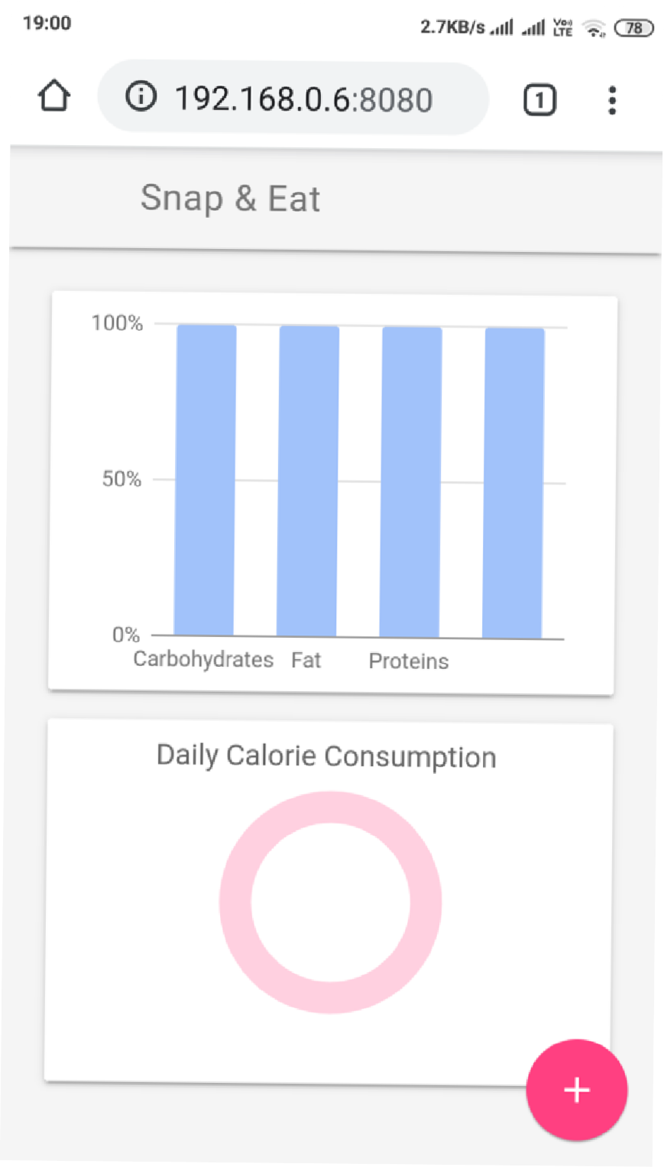
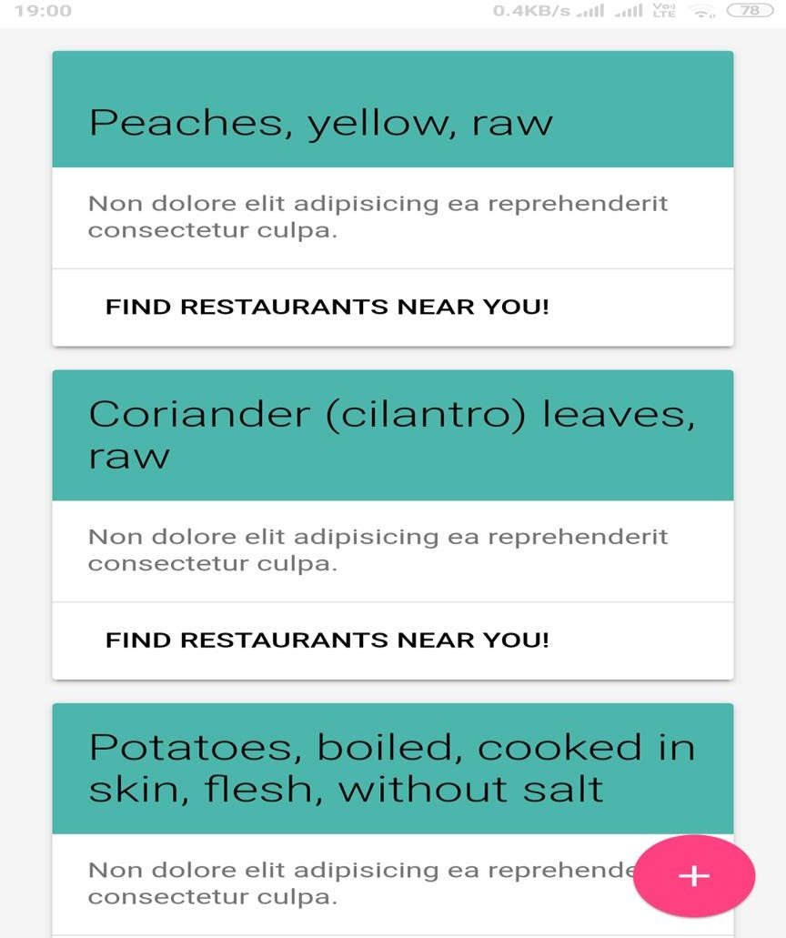
OUTPUT

Slide 9
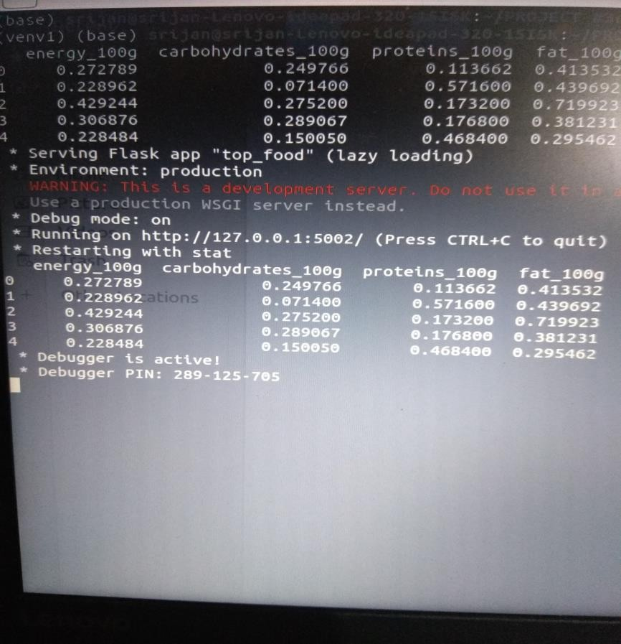
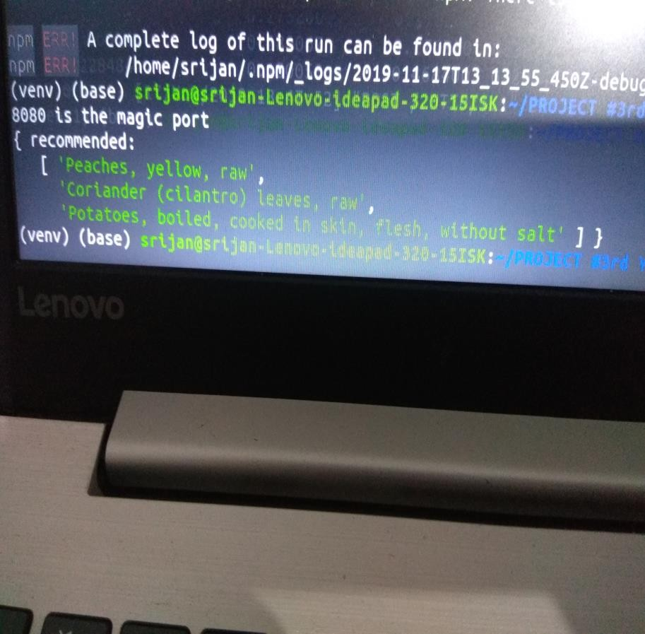

Slide 10
FUTURE SCOPE
USE OF OPEN CV AND CNN FOR FOOD PREDICTOR AND GIVING OUTPUT ABOUT THE CALORIES PRESENT IN THE FOOD ITEM.
BASED ON THE FOOD ITEM THE APP WILL SUGGEST THE DIET CORRESPONDING TO THE FOOD ITEM.

Slide 11
THANK YOU

