Slide 1
YOUNGER
PREDICTING AGE
WITH DEEP LEARNING
Prem Ananda
Springboard Data Science
Mentor: AJ Sanchez, Ph.D.
May 2021
Notes:
Thank you for being here and taking the time to listen to my presentation my name is Prem and I'm a data scientist finishing up my data science career track with springboard data science. The name of this project is younger predicting age with deep learning.

Slide 2
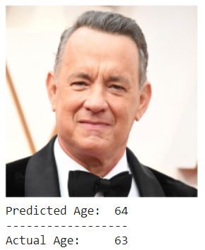
Executive Summary
Problem: to develop and evaluate image-based supervised models to predict the age of the person in a given image, using deep neural nets.
Hypothetical Stakeholder: A beauty company, ‘Younger’, requested an age predictor app to demonstrate the value of their ‘age-defying’ product line.
Results: Using a customized Convolutional Neural Network (CNN) and Transfer Learning, we were able to estimate a subject’s age from a photograph with an average error of about 7 years.
YOUNGER: PREDICTING AGE WITH DEEP LEARNING Springboard Data Science Prem Ananda May 2021
Notes:
Let's begin with a high-level overview in the form of an executive summary So what is the problem we are trying to solve? The problem is to develop and evaluate image based supervised models to predict the age of a person in a given image using deep neural Nets.
The hypothetical stakeholders is a beauty company named younger they've requested an age predictor app to demonstrate the value of their age divine product line.
The results using a customized convolutional neural network and transfer learning we were able to estimate a subject page from a photograph with an average error of about seven years.

Slide 3
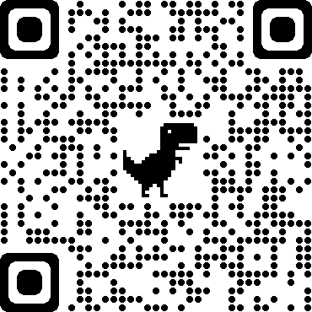
The Code
All project code is available on my Github repository:
https://github.com/premonish/YOUNGER
The project was developed in Python using appropriate libraries on Google Colab Pro to take advantage of fast GPU-based architecture.
TensorFlow and Keras were used for preprocessing and implementing the Convolutional Neural Network (CNN).
YOUNGER: GITHUB
YOUNGER: PREDICTING AGE WITH DEEP LEARNING Springboard Data Science Prem Ananda May 2021
Notes:
The code all of the project code is available on my GitHub repository here at github.com/premohnish/younger. This project was developed in Python using appropriate libraries under Google colab pro to take advantage of their fast GPU based architecture . Tensorflow and keras were used for preprocessing and implementing the convolutional neural network.

Slide 4
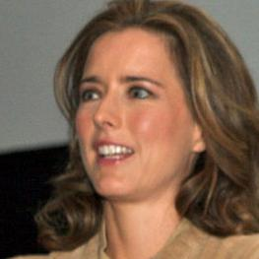
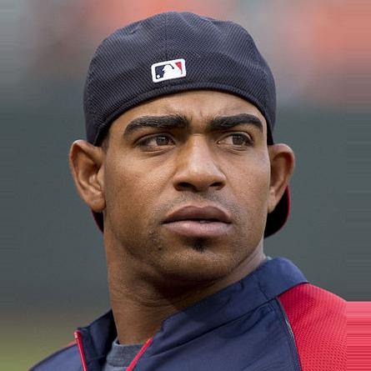
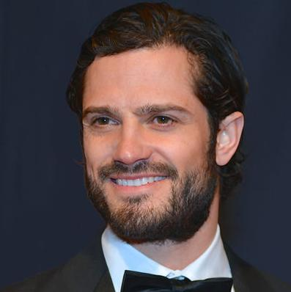
The Dataset
The dataset, “IMDB-WIKI – 500k+ face images With Age and Gender Labels,” related to this paper, is available for download for academic research only.
https://data.vision.ee.ethz.ch/cvl/rrothe/imdb-wiki/
Created from scraped images from IMDb and Wikipedia of famous people
Massive public dataset of people’s faces labeled with ages and gender
Images are centered and cropped
Photos from
“IMDB-WIKI” Dataset
YOUNGER: PREDICTING AGE WITH DEEP LEARNING Springboard Data Science Prem Ananda May 2021
Notes:
The data set the data set IMDb wiki 500K plus face images with age and gender labels related to this paper is available for download for academic research only.

Slide 5
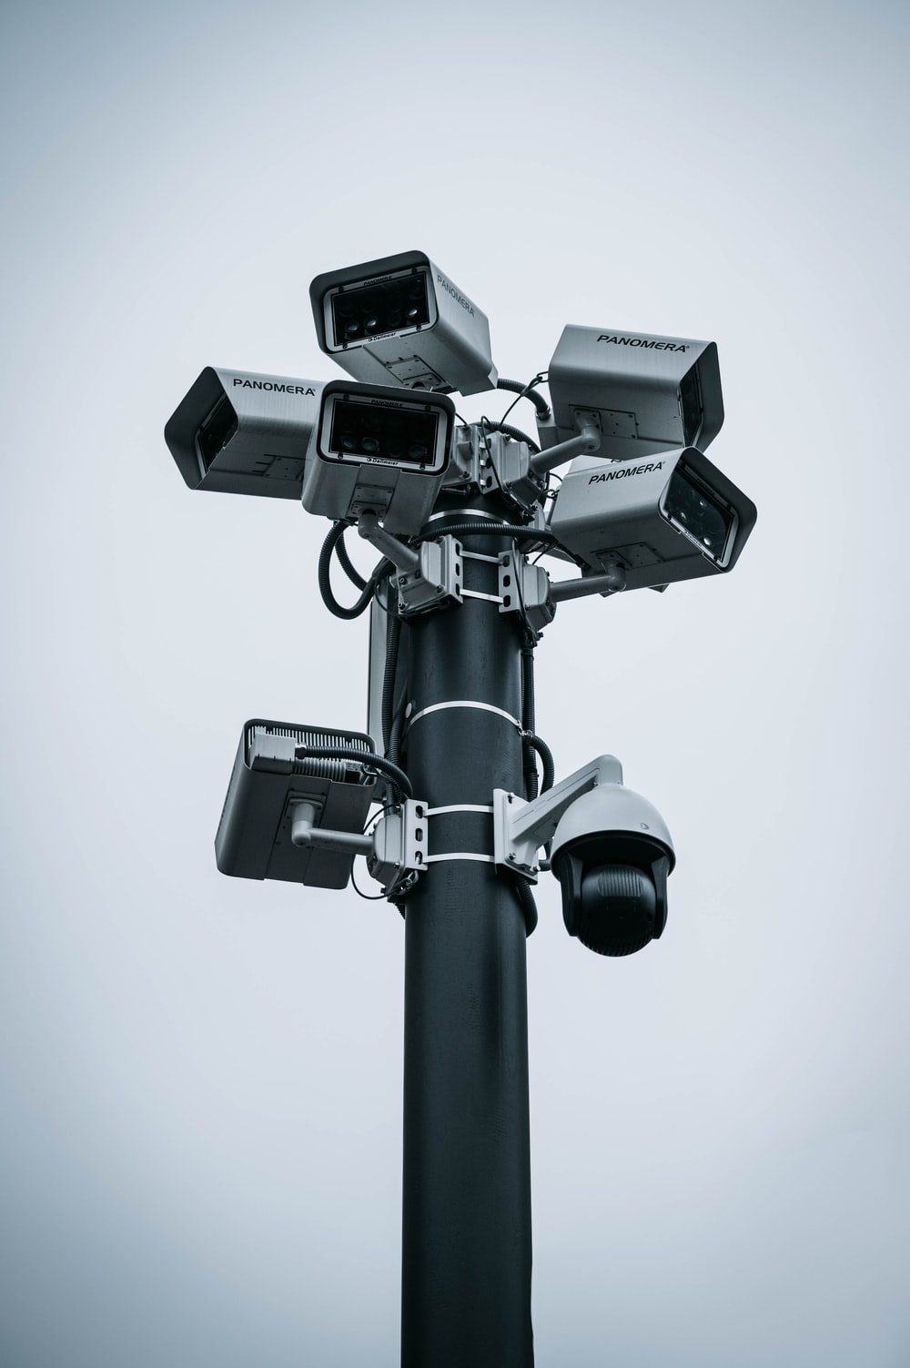
Practical Age Prediction
Marketing Applications
Ex: Quividi uses interactive signage which plays a specific ad/video based on age and gender
Law Enforcement
Estimating age to create a suspect profile
Access Control
Prevent underage access to prohibited materials – alcohol, nightclubs, cars, curfew enforcement, etc.
Photo by Milan Malkomes on Unsplash
YOUNGER: PREDICTING AGE WITH DEEP LEARNING Springboard Data Science Prem Ananda May 2021
Notes:
Practical age prediction so when do people actually use age prediction in practice well we have different use cases for example in marketing there are applications where a targeted video ad can be based on age specifically Quividi. Another example where we see age prediction being used or potentially being used is law enforcement so we can estimate age to create the profile of a suspect for example the suspect is a 24 year old male. Another practical use of age prediction is access control for example we were trying to control who can access certain prohibited materials such as alcohol purchasing alcohol I'm going to nightclubs nightclub entrance driving cars you can't drive a car under certain age obviously and curfew enforcement if we have cameras that can automatically detect a person's age it's easier to enforce curfew.

Slide 6
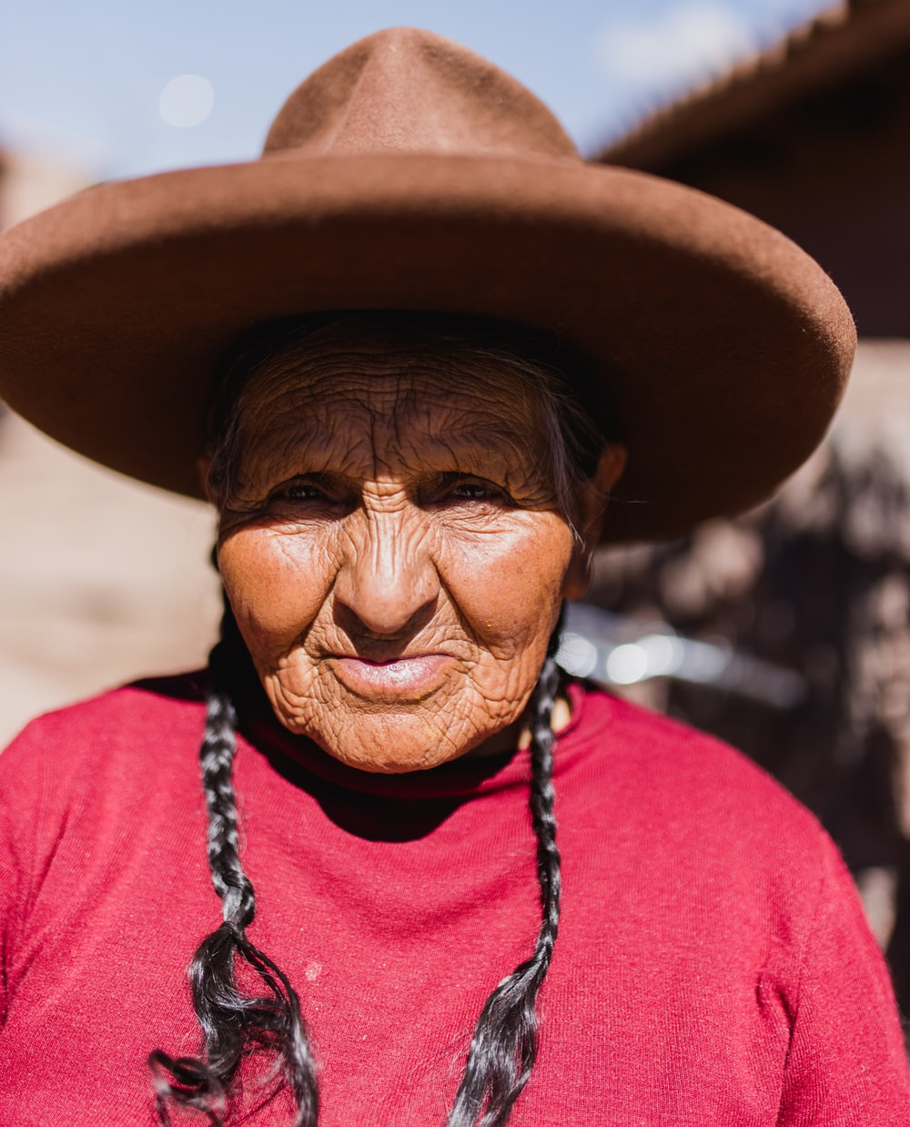
Challenges
Many factors affect apparent age including:
Makeup
Photo resolution
Photo processing (Filters)
Camera Angle
Lighting
Expression
Lifestyle:
Smoking, drinking, sun exposure, etc.
Photo by Persnickety Prints on Unsplash
YOUNGER: PREDICTING AGE WITH DEEP LEARNING Springboard Data Science Prem Ananda May 2021
Notes:
there are many challenges there are many challenges when dealing with predicting age from an image some of the many factors that affect that effect apparent age include makeup when someone wears makeup they can look a lot younger than they actually are for photo resolution if account if a camera is too high resolution people can look or actually older than they are when there's more detail there and if the photo is too low resolution it's hard to get a good amount of texture and detail which can skew results. Photo processing such as filters if you've ever taken a photo on Instagram you know that there's a lot of filters that are designed to make people look younger specifically more flattering or they take wrinkles away thus making you look younger than your actual age other factors include lighting xpression and the person a person can look a lot older than their age in real life due to lifestyle choices such as smoking can age your person drinking can age a person etc drug use so there are many things

Slide 7
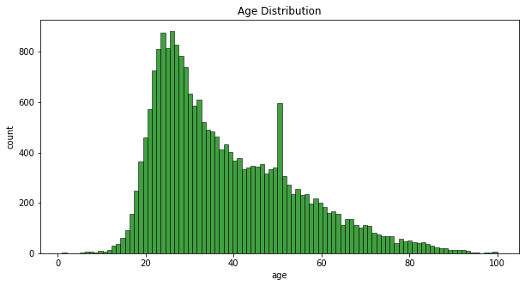
Dataset Challenges
Dataset is imbalanced.
Ages 0-7 and ages 81-100 are underrepresented .
We will focus on predicting for ages 8-80 only.
In the future, we can collect more data for underrepresented age classes.
YOUNGER: PREDICTING AGE WITH DEEP LEARNING Springboard Data Science Prem Ananda May 2021
Notes:
So we have this data set that was created and collected by researchers in computer vision and their intention was to create a data set the largest data set about creating age predictions and gender predictions. Some of the challenges of working with this data set like many datasets is this data set is imbalanced as we can see in in the histogram we have over representation of ages 20 to 60 and ages 0 to 7 and ages 81 to 100 are under represented. For the sake of this project we will narrow our focus on predicting for ages 8 to 80 only. In the future we can collect more data for under represented age classes

Slide 8
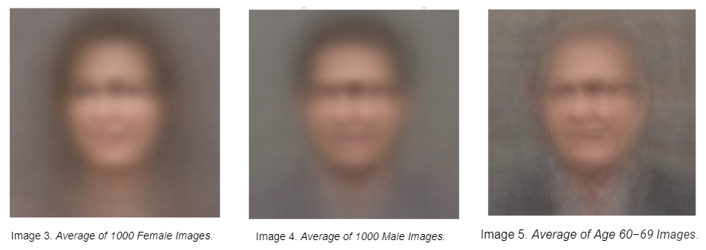
‘Average Face’ Images
To explore the dataset, we created composite images ‘averaging’ the pixel values across various subsets: 1,000 females, 1,000 males, and all images from age 60-69.
YOUNGER: PREDICTING AGE WITH DEEP LEARNING Springboard Data Science Prem Ananda May 2021
Notes:
Since this is a computer vision problem we don't go too much into exploratory exploratory data analysis as there is not much exploratory data analysis to do however we can investigate trends or similarities and patterns inherent in the raw images. So to explore commonality‘s among the data set we subset the data set into female images male images and we further subset by age by subsetting we were able to average the pixel values of 1000 female images and we were able to composite an image averaging the pixel values and creating an X exported image and we did the same for male images and we did the same for male and female images age 60 to 69. Upon looking at the faces we can observe a certain femaleness about the female images as one would expect where the face shape is marked by long hair on the side and the lips are lighter in color compared to the male images whereas the lips are darker the hair appears to be slightly darker and their eyebrows parrot appeared to be heavier. In the older 60 to 69 age category we can see what we would associate as elderly features specifically we can see that there is a head shape that is rounder there is evidence of thinner or lighter colored hair.

Slide 9
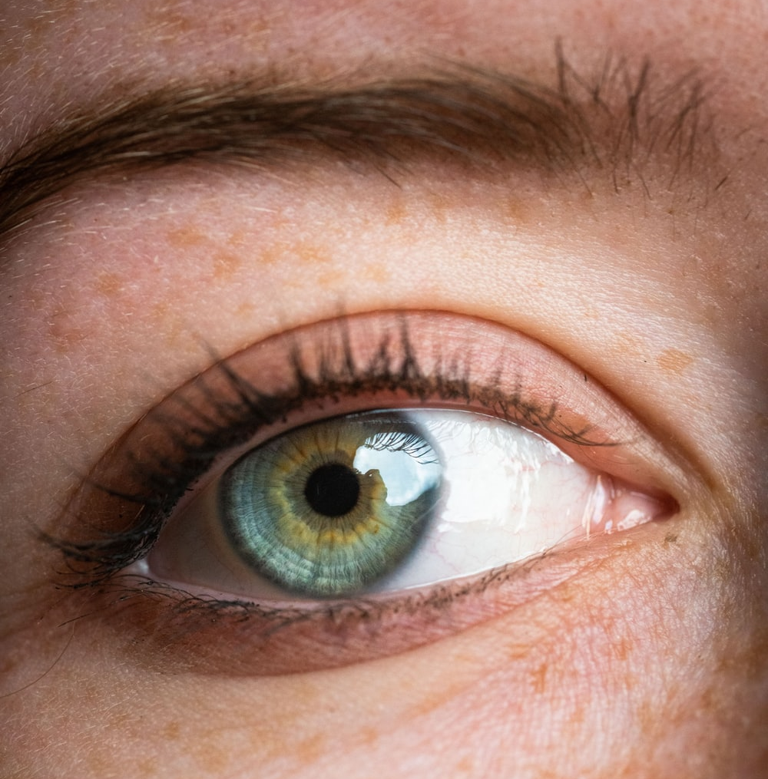
Convolutional Neural Networks
CNNs can achieve state-of-the-art results in image classification.
Modeled on the biological visual cortex of animals
Multi-layered feature extraction
Enhanced by large datasets, and GPU computing
Convolution uses matrix multiplication against a filter for feature extraction.
Transfer Learning can expedite related tasks.
Photo by Vincent Ledvina on Unsplash
YOUNGER: PREDICTING AGE WITH DEEP LEARNING Springboard Data Science Prem Ananda May 2021
Notes:
why did we choose convolutional neural networks to approach this problem. Convolutional known neural networks CNN's can achieve state of the art results in image classification in fact imagenet the annual competition for computer vision in classifying images the winners these days our always using convolutional neural networks ever since about 2012 when adeep CNN was used to achieve a 10% increase over the the next competitor. Convolutional neural networks are modeled on the biological visual cortex of animals. CNN's feature multilayered feature extraction where the first layers are extracting simple features such as a diagonal line and higher level layers are extracting features with greater complexities such as an eyeball. Convolutional neural networks are really made feasable and possible by GPU computing so these are graphics cards that allow really fast computation also fed by large datasets or big data the convolutional neural Nets can perform to their Max. Convolved features use matrix multiplication for feature extraction. Transfer learning can expedite related tasks. For example many of the implementations which are used through care OS and tensor flow actually allow for you to use an image net free chain pre trained model directly out of the box which means that you have the benefit of a previously trained network and you can transfer that hard one knowledge to a similar problem such as in this case face identification period

Slide 10
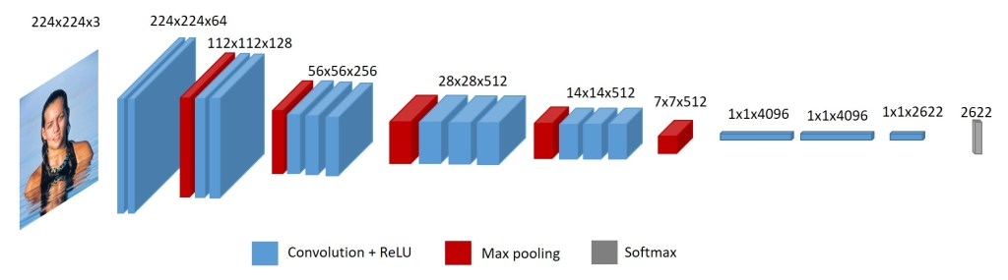
Convolutional Neural Networks
VGG-Face CNN Architecture
Created for face identity recognition by Oxford’s Visual Geometry Group (VGG)
Can identify 2,622 faces
Transfer Learning is possible since the task of age prediction has similar lower-level features (eyes, mouths, noses, head shapes, etc.).
VGG-Face Architecture Overview
Source:
https://sefiks.com/2018/08/06/deep-face-recognition-with-keras/
YOUNGER: PREDICTING AGE WITH DEEP LEARNING Springboard Data Science Prem Ananda May 2021
Notes:
why did we choose convolutional neural networks to approach this problem. Convolutional known neural networks CNN's can achieve state of the art results in image classification in fact imagenet the annual competition for computer vision in classifying images the winners these days our always using convolutional neural networks ever since about 2012 when adeep CNN was used to achieve a 10% increase over the the next competitor. Convolutional neural networks are modeled on the biological visual cortex of animals. CNN's feature multilayered feature extraction where the first layers are extracting simple features such as a diagonal line and higher level layers are extracting features with greater complexities such as an eyeball. Convolutional neural networks are really made feasable and possible by GPU computing so these are graphics cards that allow really fast computation also fed by large datasets or big data the convolutional neural Nets can perform to their Max. Convolved features use matrix multiplication for feature extraction. Transfer learning can expedite related tasks. For example many of the implementations which are used through care OS and tensor flow actually allow for you to use an image net free chain pre trained model directly out of the box which means that you have the benefit of a previously trained network and you can transfer that hard one knowledge to a similar problem such as in this case face identification period

Slide 11

Performance Metrics
MAE – Mean Absolute Error – De facto performance metric for age prediction in literature
MAPE – Mean Absolute Percentage Error
Test Set Classification Accuracy
Test Set Classification Loss
(categorical cross entropy)
Photo by Thom Milkovic on Unsplash
YOUNGER: PREDICTING AGE WITH DEEP LEARNING Springboard Data Science Prem Ananda May 2021
Notes:
So what are the performance metrics when talking about age prediction. The defacto performance metric for age prediction in the literature and in academia is Mae mean absolute error so we will use this as our main performance metric ma E is the mean absolute error so that is all the errors minus the actual values take the absolute value of that and find the mean. Ma E gives a sense of the overall correctness or error of the model. MAPE is mean absolute percentage error and this gives us a sense of relative error in terms of percentages how far are we off the mark. And additionally we will track test set classification accuracy and test set classification loss. In this case our loss function is categorical cross entropy

Slide 12

Model Constants
Fix constants for model comparison:
Epochs = 200
Batch Size = 128
Training Set = 3,525
Test Set = 1,512
Training Set : Test Set Ratio = 70:30
Photo by Julius Drost on Unsplash
YOUNGER: PREDICTING AGE WITH DEEP LEARNING Springboard Data Science Prem Ananda May 2021
Notes:
In developing the model we will set some constants to make it easier to compare different models with one another specifically we will set the number of epoch's to 200 the batch size to 128 the training set is 3525 images and the test set is 1512 images the training set to test set ratio is 70 to 30.

Slide 13
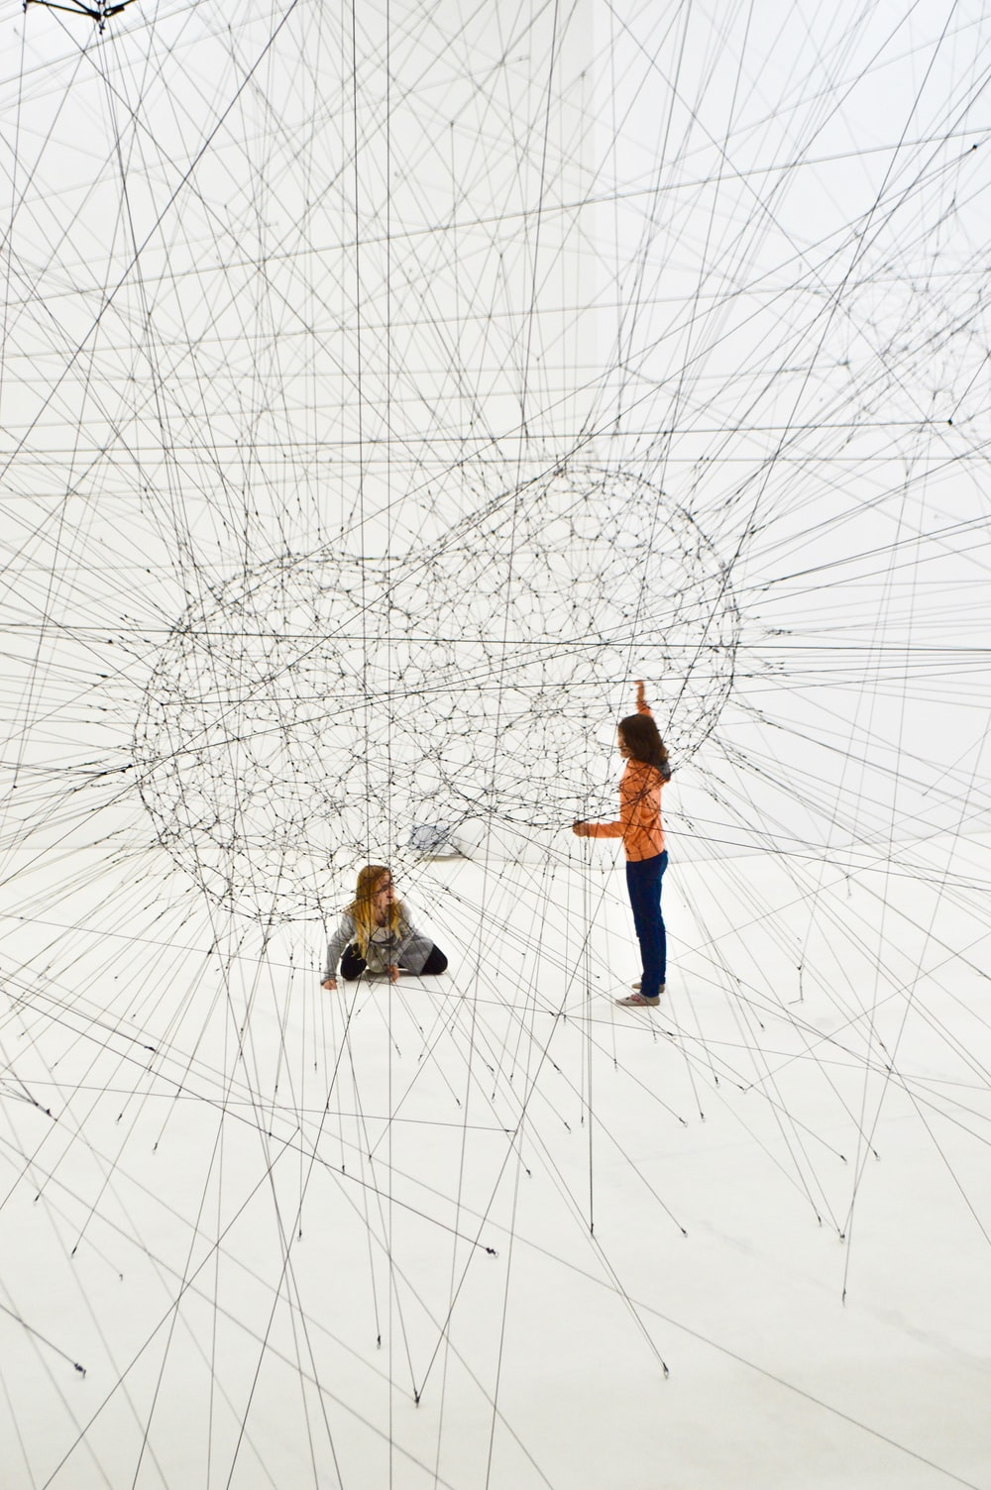
Model Overview
CNN 1 = VGG-Face ‘out of the box’ with SGD optimizer
CNN 2 = VGG-Face with Adam optimizer
CNN 3 = VGG-Face with Adam optimizer with pretrained weights
CNN 4 = VGG-Face with Adam optimizer with pretrained weights & data augmentation
Photo by Clarisse Croset on Unsplash
YOUNGER: PREDICTING AGE WITH DEEP LEARNING Springboard Data Science Prem Ananda May 2021
Notes:
We went through many different iterations and model variations and permutations. In the end we focused on for models with greater and greater degrees of complexity. The first model is our baseline model which takes advantage of a VGG face architecture directly out of the box meaning uncustomized with an SGD optimizer stochastic gradient descent. The next model we used was a VGG face model with an atom optimizer the next is a VGG face with pre trained weights and finally for CNN four we used a VGG face model with adam optimizer with pre trained weights and data augmentation

Slide 14
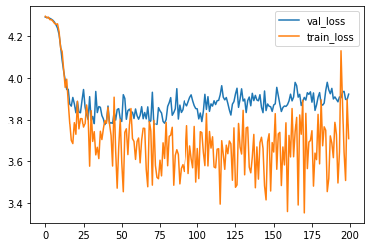
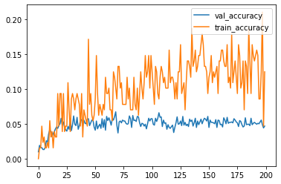
CNN 1 - Baseline Model
CNN 1 = VGG-Face ‘out of the box’ with SGD optimizer
Fig 1. CNN1 Training Set / Test Set Loss
Fig 2. CNN1 Training Set / Test Set Accuracy
Observations
The Baseline model has an MAE of 11.22, MAPE of 44.43%, Test Set Accuracy of 4.69%, and Test Set Loss of 3.92303.
We can observe the training set diverge from the validation set on accuracy and loss, possibly indicating overfitting.
Test Set Model Performance Metrics
 | MAE | MAPE | Test Accuracy | Test Loss
CNN 1 | 11.22 | 44.43% | 0.04696 | 3.92303
CNN 2 | 7.94 | 25.50% | 0.08466 | 4.31565
CNN 3 | 7.78 | 25.23 % | 0.06019 | 3.65387
CNN 4 | 7.54 | 24.74 % | 0.06878 | 3.59017
YOUNGER: PREDICTING AGE WITH DEEP LEARNING Springboard Data Science Prem Ananda May 2021

Slide 15
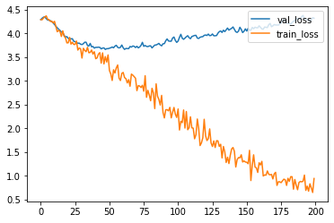
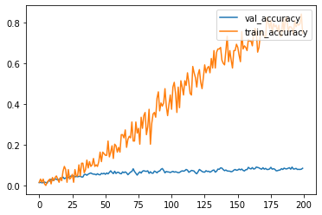
CNN 2
CNN 2 = VGG-Face with Adam Optimizer
Observations
The CNN 2 model has an MAE of 7.94 and MAPE of 25.50% a vast improvement from the baseline model on both metrics. The Test Set Accuracy is up to 8.466%. However, the Test Set loss increased which is not a good sign.
Observing Figure 3 and Figure 4, there is an early divergence of the Training Set from the Test Set which may indicate more extreme overfitting than the baseline model.
Fig 3. CNN2 Training Set / Test Set Loss
Fig 4. CNN2 Training Set / Test Set Accuracy
Test Set Model Performance Metrics
 | MAE | MAPE | Test Accuracy | Test Loss
CNN 1 | 11.22 | 44.43% | 0.04696 | 3.92303
CNN 2 | 7.94 | 25.50% | 0.08466 | 4.31565
CNN 3 | 7.78 | 25.23 % | 0.06019 | 3.65387
CNN 4 | 7.54 | 24.74 % | 0.06878 | 3.59017
YOUNGER: PREDICTING AGE WITH DEEP LEARNING Springboard Data Science Prem Ananda May 2021

Slide 16
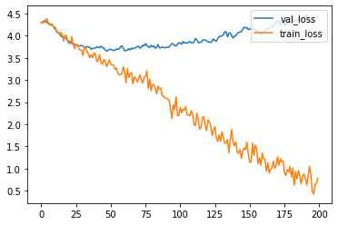
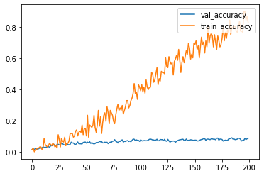
CNN 3
CNN 3 = VGG-Face with Adam Optimizer with pretrained weights
Fig 5. CNN3 Training Set / Test Set Loss
Fig 6. CNN3 Training Set / Test Set Accuracy
Observations
The CNN 3 model has a slightly improved MAE of 7.78, MAPE of 25.23% and Test Set Loss of 3.65387. However, the Test Set Accuracy has decreased to 6.019%.
Again, Figures 5 and 6 indicate overfitting.
Test Set Model Performance Metrics
 | MAE | MAPE | Test Accuracy | Test Loss
CNN 1 | 11.22 | 44.43% | 0.04696 | 3.92303
CNN 2 | 7.94 | 25.50% | 0.08466 | 4.31565
CNN 3 | 7.78 | 25.23 % | 0.06019 | 3.65387
CNN 4 | 7.54 | 24.74 % | 0.06878 | 3.59017
YOUNGER: PREDICTING AGE WITH DEEP LEARNING Springboard Data Science Prem Ananda May 2021

Slide 17
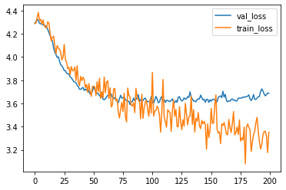
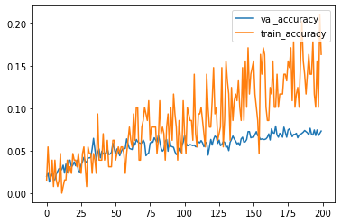
CNN 4
CNN 4 = VGG-Face with Adam Optimizer with pretrained weights & data augmentation
Fig 7. CNN4 Training Set / Test Set Loss
Fig 8. CNN4 Training Set / Test Set Accuracy
Observations
The CNN 4 model has an improved MAE of 7.54, MAPE of 24.74% and Test Set Loss of 3.59017. The Test Set Accuracy has improved to 6.878%.
In Figure 7, the Training Set Accuracy and the Test Set Accuracy moving together.
Similarly, in Figure 8, the Training Set Loss and the Test Set Loss moving together until around 100 epochs.
These are good signals that the model is not overfitting.
We selected this as our “best” model to solve our age prediction problem.
Test Set Model Performance Metrics
 | MAE | MAPE | Test Accuracy | Test Loss
CNN 1 | 11.22 | 44.43% | 0.04696 | 3.92303
CNN 2 | 7.94 | 25.50% | 0.08466 | 4.31565
CNN 3 | 7.78 | 25.23 % | 0.06019 | 3.65387
CNN 4 | 7.54 | 24.74 % | 0.06878 | 3.59017
YOUNGER: PREDICTING AGE WITH DEEP LEARNING Springboard Data Science Prem Ananda May 2021

Slide 18
Model Performance Comparison
Test Set Model Performance Metrics
 | MAE | MAPE | Test Accuracy | Test Loss
CNN 1 | 11.22 | 44.43% | 0.04696 | 3.92303
CNN 2 | 7.94 | 25.50% | 0.08466 | 4.31565
CNN 3 | 7.78 | 25.23 % | 0.06019 | 3.65387
CNN 4 | 7.54 | 24.74 % | 0.06878 | 3.59017
CNN 4 demonstrates the best performance on all metrics except Test Accuracy where CNN 2 performs best.
YOUNGER: PREDICTING AGE WITH DEEP LEARNING Springboard Data Science Prem Ananda May 2021

Slide 19

Business Results
CNN 4 achieved an MAE of 7.54 years.
The average age prediction is 7.54 years away from the actual value.
The estimator can be improved with more balanced training data.
Photo by Markus Spiske on Unsplash
YOUNGER: PREDICTING AGE WITH DEEP LEARNING Springboard Data Science Prem Ananda May 2021

Slide 20
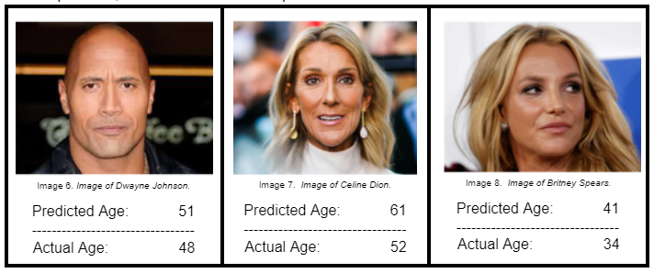
App Demo
YOUNGER: PREDICTING AGE WITH DEEP LEARNING Springboard Data Science Prem Ananda May 2021

Slide 21
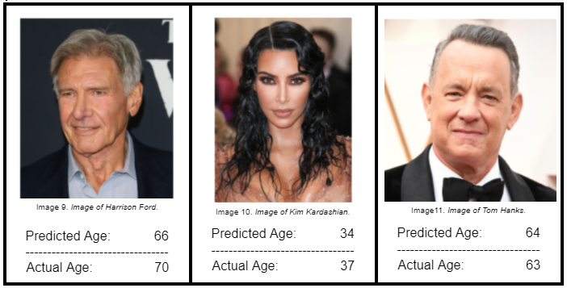
App Demo
YOUNGER: PREDICTING AGE WITH DEEP LEARNING Springboard Data Science Prem Ananda May 2021

Slide 22
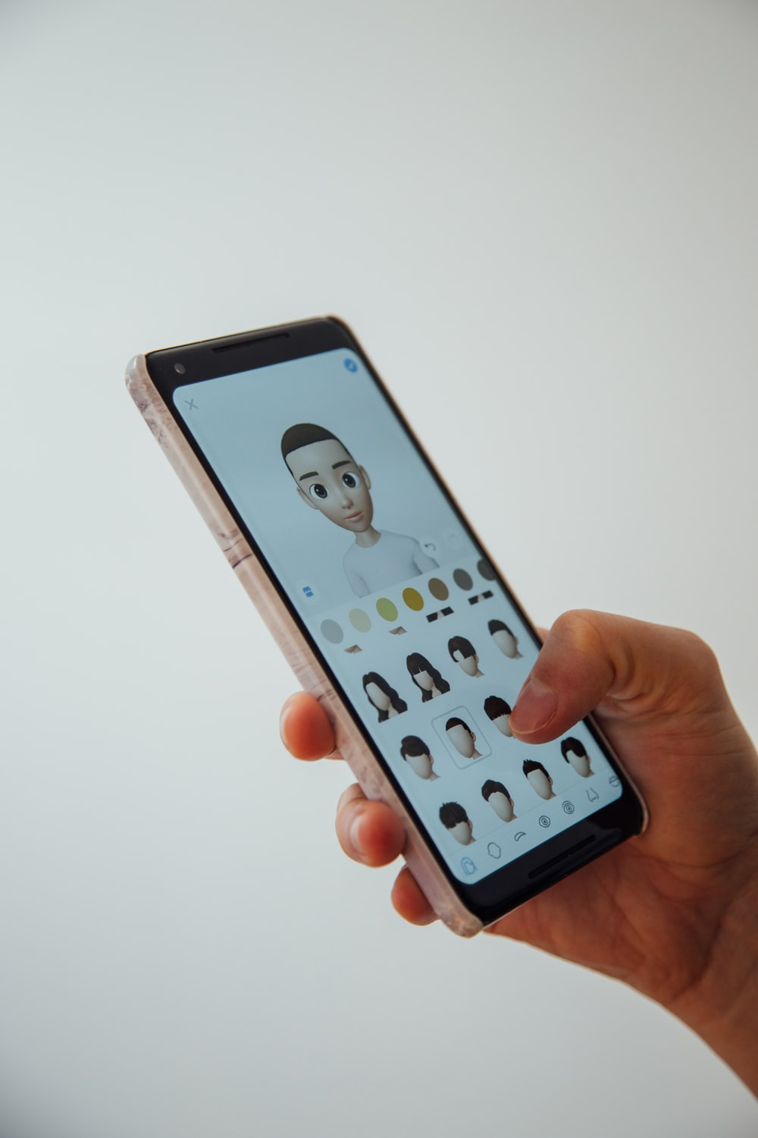
Conclusion
We were able to create a functional image-based age predictor model using open-source software, a massive public dataset, and free cloud-based GPUs.
Python, TensorFlow, Keras, Google Colab, etc., enable a very exciting world of AI innovation open to many people willing to learn.
Public source code and public datasets further research and can enable new learners to develop faster.
Photo by Charles Deluvio on Unsplash
YOUNGER: PREDICTING AGE WITH DEEP LEARNING Springboard Data Science Prem Ananda May 2021

Slide 23
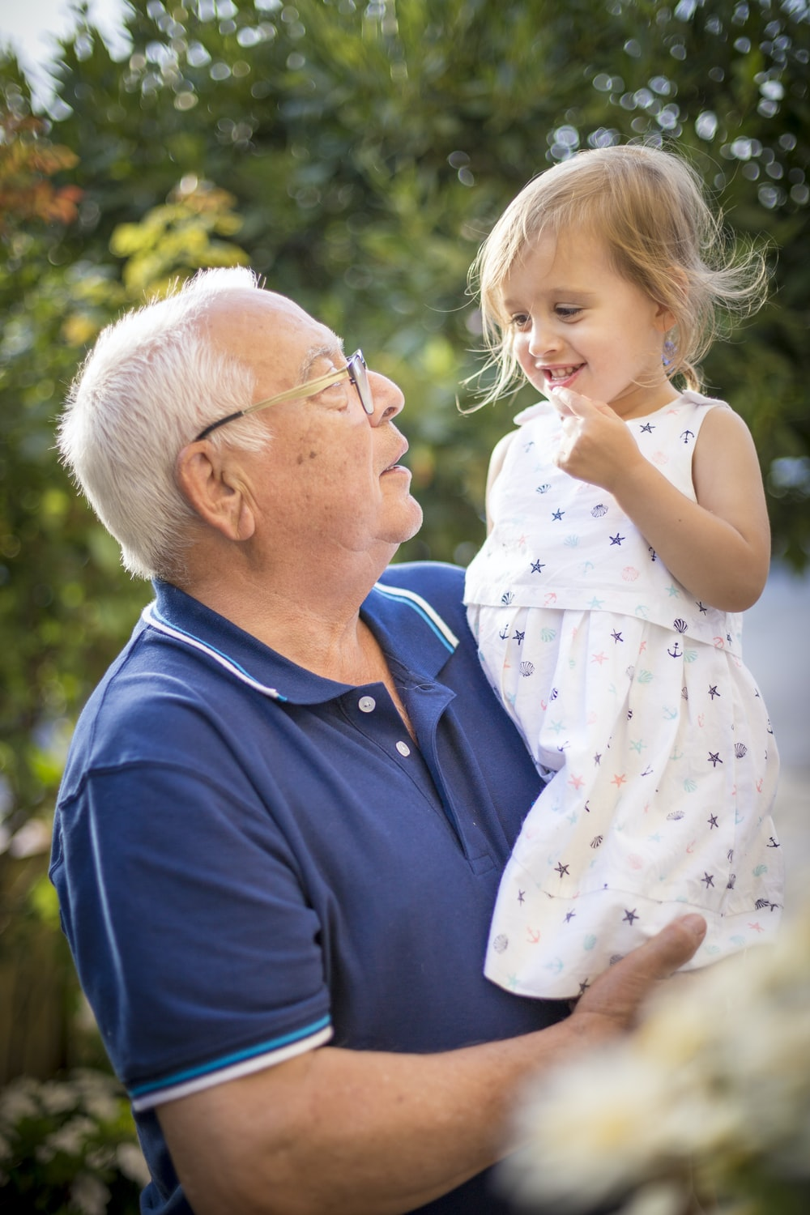
Recommendations
We recommend to our client that we create the beta version of our app with disclaimer that the model will be optimized over time.
We recommend that we focus on high-quality and greater quantity of data to create a more robust predictor for a wider age range.
We would like to do a survey of other pretrained models and how well they perform with our age prediction problem.
Photo by Isaac Quesada on Unsplash
YOUNGER: PREDICTING AGE WITH DEEP LEARNING Springboard Data Science Prem Ananda May 2021

Slide 24

Future Work
Data Acquisition – expand data set to include more people age 0–8 and 81–100.
More high-quality data would increase the model’s performance and generalizability
Experiment with other pretrained CNN models and fine-tune the promising models
Photo by Egor Vikhrev on Unsplash
YOUNGER: PREDICTING AGE WITH DEEP LEARNING Springboard Data Science Prem Ananda May 2021

Slide 25

Lessons Learned
We are in a very exciting time in history where people can build impressive tools using open-source software.
Python, TensorFlow, Keras, Colab and public datasets can accomplish the seemingly impossible.
Class imbalance has been one of the most difficult challenges to overcome on this project. Downsampling and data augmentation were both used to address class imbalance.
Keep it simple. Beware of feature creep.
Photo by Hannah Olinger on Unsplash
YOUNGER: PREDICTING AGE WITH DEEP LEARNING Springboard Data Science Prem Ananda May 2021

Slide 26

Acknowledgements
I’d like to thank my incredible Springboard Data Science Mentor, AJ Sanchez, Ph.D. Chief Data Scientist and Principal Software Engineer at Exodus Software Services, Inc., for patiently guiding me along in this project.
Also, my wife is pretty cool. Thank you for your inspiration, Pinky!
Photo by Howie R on Unsplash
YOUNGER: PREDICTING AGE WITH DEEP LEARNING Springboard Data Science Prem Ananda May 2021

Slide 27
YOUNGER
THANK YOU
FOR YOUR TIME!
Question or Comments?
Email: prem@prem5.com
linkedin.com/in/prem-ananda/
YOUNGER: GITHUB
Prem Ananda
Springboard Data Science
Mentor: AJ Sanchez, Ph.D.
May 2021
PREDICTING AGE
WITH DEEP LEARNING
Notes:
Thank you for being here and taking the time to listen to my presentation my name is Prem and I'm a data scientist finishing up my data science career track with springboard data science. The name of this project is younger predicting age with deep learning.

Slide 28
References 1/2
Rothe, R., Timofte R., Van Gool, L. (2015). IMDB-WIKI – 500k+ Face Images with Age and Gender Labels. Retrieved on May 10, 2021, from https://data.vision.ee.ethz.ch/cvl/rrothe/imdb-wiki/.
Rothe, R., Timofte, R., Van Gool, L. (2016). Deep expectation of real and apparent age from a single image without facial landmarks. Retrieved on May 10, 2021, from https://data.vision.ee.ethz.ch/cvl/publications/papers/articles/eth_biwi_01299.pdf.
Parkhi, O., Vedaldi, A., Zisserman, A. (n.d.). VGG Face Descriptor. Retrieved on May 10, 2021, from https://www.robots.ox.ac.uk/~vgg/software/vgg_face/.
Krizhevsky, A., Sutskever, I., and Hinton, G.E. (2012) ImageNet Classification with Deep Convolutional Neural Networks. In NIPS, pages 1106–1114, 2012.
LeCun, Y., Boser, B., Denker, J.S., Henderson, D., Howard, R.E., Hubbard, W., and Jackel, L.D. (1989). Backpropagation Applied to Handwritten Zip Code Recognition. In Neural Computation, vol. 1, no. 4, pp. 541–551.
Mathias, M., Benenson, R., Pedersoli, M., and Van Gool, L. (2014). Face Detection without Bells and Whistles. In Proc. ECCV. Retrieved on May 10, 2021, from https://link.springer.com/content/pdf/10.1007%2F978-3-319-10593-2_47.pdf.
Serengil, S. (2019). Apparent Age and Gender Prediction in Keras. Retrieved on May 10, 2021, from https://sefiks.com/2019/02/13/apparent-age-and-gender-prediction-in-keras/.
Abadi, M., et al. 2016. TensorFlow: A System for Large-Scale Machine Learning. In 12th USENIX Symposium on Operating Systems Design and Implementation (OSDI’16), pp. 265–283. Retrieved on May 10, 2021, from https://www.usenix.org/system/files/conference/osdi16/osdi16-abadi.pdf.
Chollet, F., & others. (2015). Keras. GitHub. Retrieved on May 10, 2021, from https://github.com/fchollet/keras.
Van Rossum, G. and Drake Jr, F. L. (1995). Python Reference Manual. Centrum voor Wiskunde en Informatica Amsterdam.
YOUNGER: PREDICTING AGE WITH DEEP LEARNING Springboard Data Science Prem Ananda May 2021

Slide 29
References 1/2
McKinney, W.. (2010). Data Structures for Statistical Computing in Python. In Proceedings of the 9th Python in Science Conference (Vol. 445, pp. 51–56).
Deng, J., Dong, W., Socher, R., Li, L., Li, K., and Fei-Fei, L. (2009). Imagenet: A Large-Scale Hierarchical Image Database. In 2009 IEEE Conference on Computer Vision and Pattern Recognition, pp. 248–255.
Kluyver, T., et al. (2016). Jupyter Notebooks – a publishing format for reproducible computational workflows. In F. Loizides & B. Schmidt (Eds.), Positioning and Power in Academic Publishing: Players, Agents and Agendas, pp. 87–90.
Agarwal, P. (2020). Age Detection Using Facial Images: traditional Machine Learning vs. Deep Learning. Towards Data Science. Retrieved on May 10, 2021, from https://towardsdatascience.com/age-detection-using-facial-images-traditional-machine-learning-vs-deep-learning-2437b2feeab2.
Parkhi, O., Vedaldi, A., and Zisserman, A. (2015). Deep Face Recognition. British Machine Vision Conference. In Xianghua Xie, Mark W. Jones, and Gary K. L. Tam, editors, Proceedings of the British Machine Vision Conference (BMVC), pages 41.1-41.12.
Chauhan, Nagesh, (2019). Predict Age and Gender Using Convolutional Neural Network and OpenCV. KDnuggets. Retrieved on May 10, 2021 from https://www.kdnuggets.com/2019/04/predict-age-gender-using-convolutional-neural-network-opencv.html
Sharma, Sagar (2017). Epoch vs. Batch Size vs Iterations. Towards Data Science. Retrieved on May 10, 2021 from https://towardsdatascience.com/epoch-vs-iterations-vs-batch-size-4dfb9c7ce9c9.
West, Jeremy; Ventura, Dan; Warnick, Sean (2007). Spring Research Presentation: A Theoretical Foundation for Inductive Transfer. Brigham Young University, College of Physical and Mathematical Sciences. Archived from the original on 2007-08-01. Retrieved May 10, 2021.
Serengil, S. (2019). Deep Face Recognition with Keras. Retrieved on May 10, 2021, form https://sefiks.com/2018/08/06/deep-face-recognition-with-keras/.
YOUNGER: PREDICTING AGE WITH DEEP LEARNING Springboard Data Science Prem Ananda May 2021

Slide 30
YOUNGER
PREDICTING AGE
WITH DEEP LEARNING
Prem Ananda
Springboard Data Science
Mentor: AJ Sanchez, Ph.D.
May 2021
Notes:
Thank you for being here and taking the time to listen to my presentation my name is Prem and I'm a data scientist finishing up my data science career track with springboard data science. The name of this project is younger predicting age with deep learning.

