Slide 1
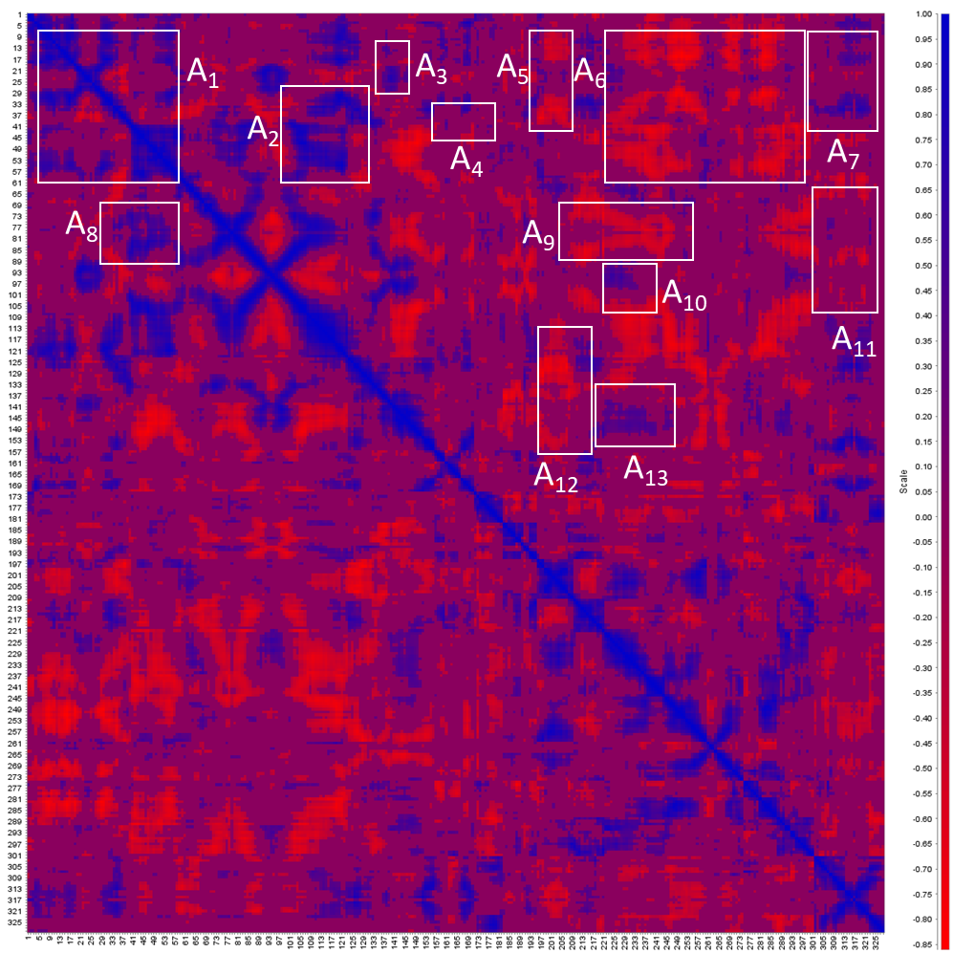
Compound 268
Notes:
A1

Slide 2
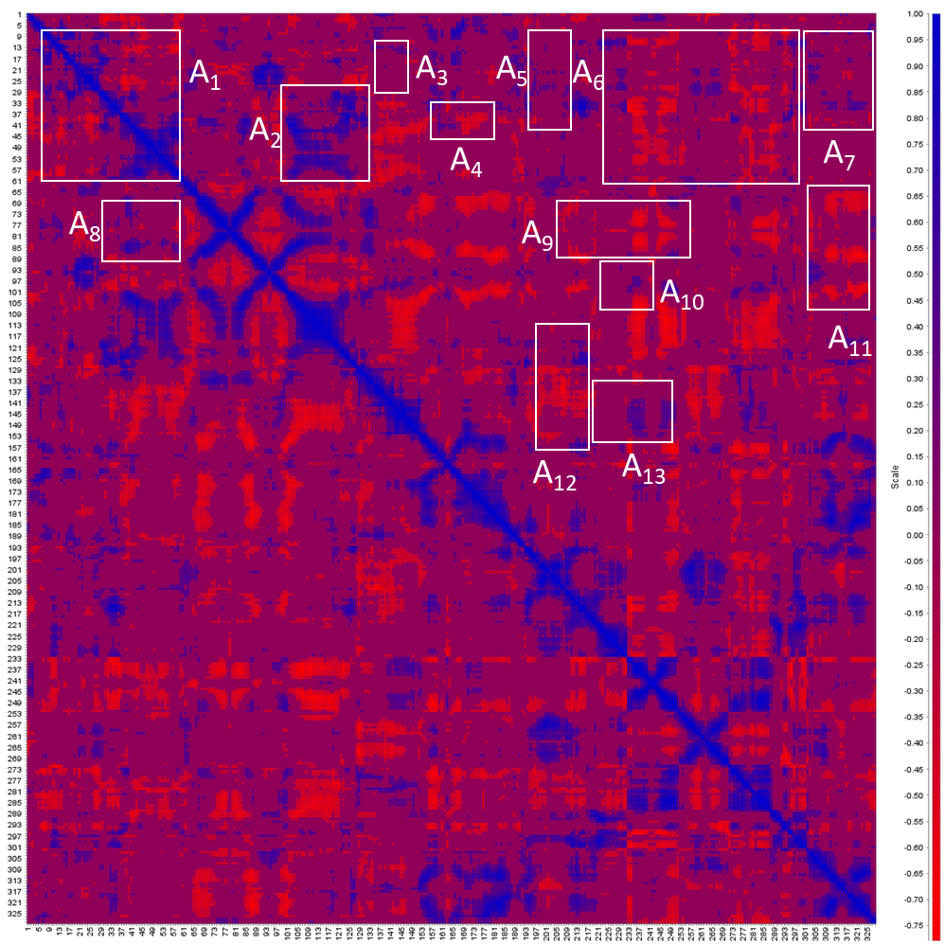
PepstatinA

