Slide 1
PETITE ICICI An Artificial Intelligence based banking gamification for Children
Assistant Director
Gamechangers_EV
Team members
Nirmal Satyendra (ASSISTANT DIRECTOR, Edgeverve systems ltd.)
Prem sai (MTS, Edgeverve systems ltd.)
Mandeep gill (MTS, Edgeverve systems ltd.)
Arul jeba (MTS, Edgeverve systems ltd.)
Sampath kumar (MTS, Edgeverve systems ltd.)

Slide 2
The Problem
ICICI spends lot of money in advertising, Most of these advertising is targeted at an audience who already have opinions.
The idea we propose is to catch the Next Generation early and Embed Brand ICICI into them. So that when they grow up, bank means ICICI to them.
Target Audience
Children between 5 - 12 years

Slide 3
Business Value
PETITE ICICI, an Artificial Intelligence powered gamification and a banking application for the children, will:
Engage children in virtual banking activities
Instill sense of fiscal responsibility into them
Increase deposits into ICICI by children's parents
Give them virtual awards via gamification and instill the sense of ICICI as a giver and caretaker.
Embed Brand ICICI as THE BANK into their minds

Slide 4
How are we different ?
Perfect mix of gamification and real life utility
Artificial Intelligence based approach that changes the gamification rules based on individual profile
Children have control of their expenditure but under parental supervision
Can be used in both virtual mode ( virtual currency ) and real currency
Both parents and children are engaged in gamification

Slide 5
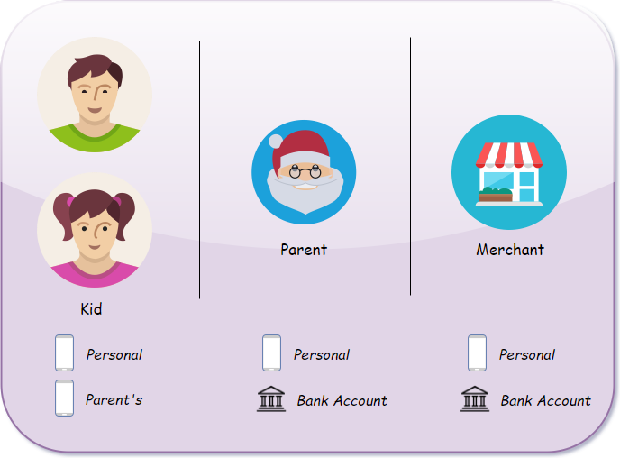
Registration
An app user can register as one of the following –
Kid - providing Personal Mobile and Parent’s Mobile
Parent - providing Personal Mobile and ICICI Account Number
Merchant - providing Personal Mobile and ICICI Account Number
Kids & Parents will be linked on the basis of Mobile Number (which can be authenticated)

Slide 6
Interface
Kids
Parents
Check piggy bank for available balance
Request parent for money
Spend money at Shops supporting App Merchants (QR code, Mobile)
Transfer money to friends
Investment, money locked for certain period
Reward points, generated from monthly saving
Transaction History
Approve children’s request for money
Send money to children
Monitor child transactions
Block/Unblock child account
Merchants
Accept money, by providing QR code/ Mobile Number
Transaction History

Slide 7
Money Flow & Reward System
When a parent sends money to kid, virtual money is created for a child
Actual transaction only happens, when a kid transfers money
Money transfer to a Merchant
Kids virtual money is checked for available balance
Transaction happens between parent’s account and merchant’s account
Money transfer to a Friend
Kids virtual money is checked for available balance
Transaction happens between parent’s account of the two kids involved
Reward System, uses Machine Learning techniques to find trends in kids savings while taking monthly allowance, account balance, expenditure frequency & various other factors into consideration.

Slide 8
Architecture
Application Frontend – developed using react-native, various clip-arts were created using Adobe Illustrator.
Application Backend - developed on loopback, ICICI Access token is securely encrypted and stored in the database.
Database - MongoDB was used to store persisted data related to the App, Users.
ICICI APIs used –
Fund Transfer API
Bank Account Summary
Authentication Service, Participant Data Mapping

