Slide 1
MapReduce and Apache Spark
Premsai Athemane
248261D
athemane.24@cse.mrt.ac.lk

Slide 2


Apache Spark is much faster than Hadoop MapReduce.
Hadoop MapReduce is designed for batch processing, while Apache Spark is more suited for real-time data processing and iterative analytics.
Apache Spark has a more user-friendly programming interface and supports multiple languages, while Hadoop MapReduce requires developers to write code in Java.
Apache Spark's Resilient Distributed Datasets (RDDs) offer better fault tolerance than Hadoop MapReduce's Hadoop Distributed File System (HDFS).
Apache Spark has a more extensive ecosystem and integrates well with other big data tools, while Hadoop MapReduce is primarily designed to work with Hadoop Distributed File System (HDFS).

Slide 3
Demo - AWS
Year wise carrier delay from 2003-2010
Year wise NAS delay from 2003-2010
Year wise Weather delay from 2003-2010
Year wise late aircraft delay from 2003-2010
Year wise security delay from 2003-2010
Calculate total delay for the particular year by delay category

Slide 4
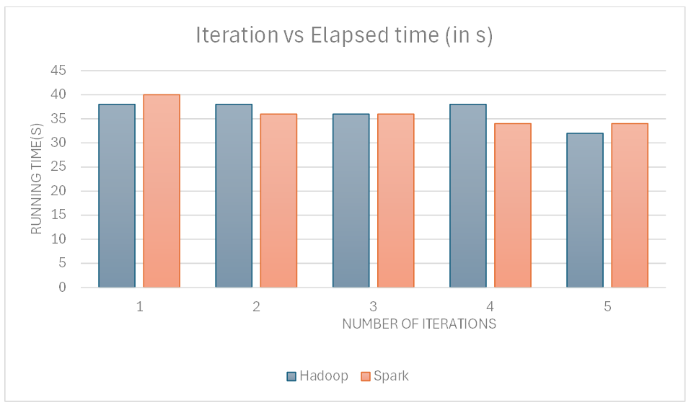
Results

Slide 5
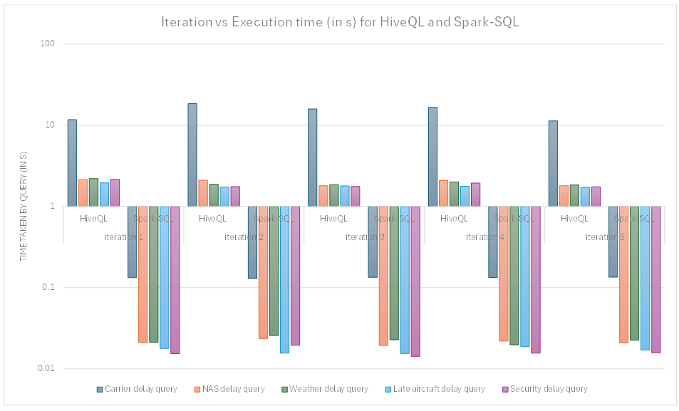

Slide 6
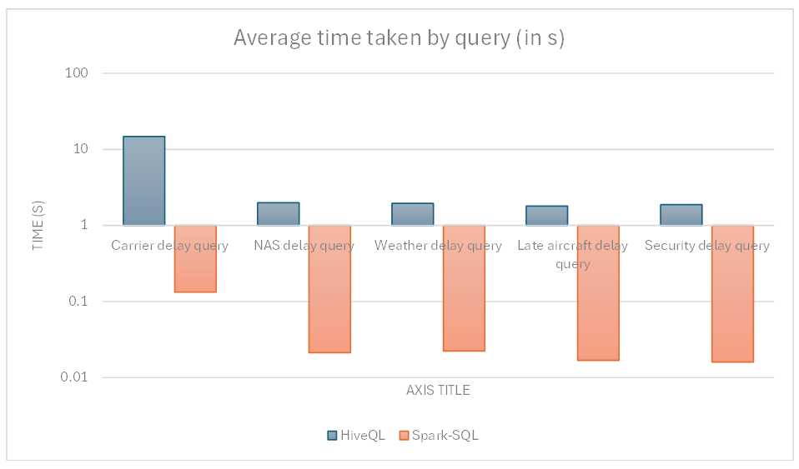

Slide 7
 | Ease of use | Fast processing
MapReduce | Requires more lines of code Writing a MapReduce program can be more complex and less intuitive. Debugging and testing MapReduce programs can be more challenging | Faster than traditional systems Disk-based processing slows down processing
Spark | Provides high-level making it more accessible and easier to use Support multiple languages | Faster compared to MapReduce because of in-memory data processing

Slide 8
Thank you
Premsai Athemane
248261D
athemane.24@cse.mrt.ac.lk

