Slide 1

DEPARTMENT OF COMPUTER SCIENCE AND ENGINEERING
AI BASED WEARABLE DEVICES FOR NON INVASIVE ANAEMIA DETECTION
Name of Students:
SAKTHI MUGESH A (220071601213) PREM SAI B (220071603001)
Supervisor:
DR.B. DHANALAKSHMI (Professor/CSE)
Domain of Project : ARTIFICIAL INELLIGENCE AND MACHINE LEARNING IN
HEALTHCARE
01

Slide 2
DEPARTMENT OF COMPUTER SCIENCE AND ENGINEERING
INTRODUCTION
• Anaemia is a widespread health condition that often remains undetected due to the need for invasive and periodic blood tests.
• With the growth of wearable devices, continuous health data such as heart rate, activity, and sleep patterns are now easily available.
• This project aims to leverage wearable health data and machine learning techniques to identify potential anaemia risk at an early stage.
• The system acts as a decision-support and wellness monitoring tool, providing preliminary risk insights rather than medical diagnosis.
02

Slide 3
DEPARTMENT OF COMPUTER SCIENCE AND ENGINEERING
EXISTING SYSTEM
• Anaemia detection in the existing system mainly relies on laboratory-based blood tests, such as hemoglobin level analysis.
• These tests are invasive, time-consuming, and require hospital or clinical visits,
making frequent monitoring difficult.
• Anaemia is usually detected only after symptoms become noticeable, leading to delayed diagnosis and treatment.
• There is no continuous or automated monitoring system using daily health and fitness data for early anaemia risk detection.
03

Slide 4
DEPARTMENT OF COMPUTER SCIENCE AND ENGINEERING
PROPOSED SYSTEM
■ The proposed system uses wearable health data such as heart rate, activity levels, and sleep patterns collected through fitness bands.
■ Health data exported from Google Fit is processed and analyzed using machine learning algorithms.
■ The system identifies potential anaemia risk at an early stage in a non-invasive and automated manner
■ It acts as a decision-support and wellness monitoring tool, providing risk insights without replacing medical diagnosis.
04

Slide 5
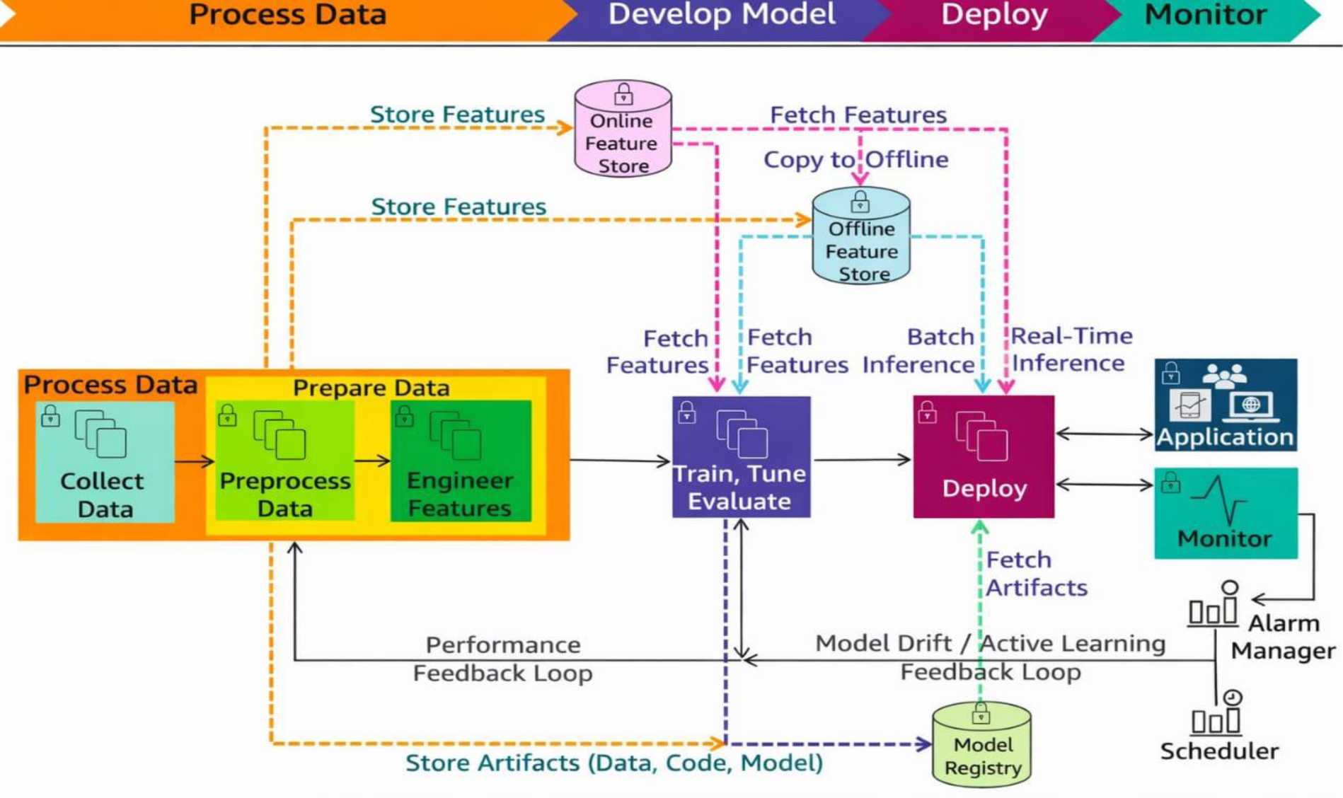
DEPARTMENT OF COMPUTER SCIENCE AND ENGINEERING
ARCHITECTURE DIAGRAM-DESIGN
05

Slide 6

DEPARTMENT OF COMPUTER SCIENCE AND ENGINEERING
ALGORITHMS:
1. Logistic Regression
• Used for binary classification (Anaemia Risk / No Risk).
• Calculates the probability of anaemia based on health features like heart rate and activity level.
• Simple, efficient, and easy to interpret for medical-related analysis.
06

Slide 7
DEPARTMENT OF COMPUTER SCIENCE AND ENGINEERING
ALGORITHMS:
2. Random Forest Classifier:
• An ensemble learning algorithm that uses multiple decision trees
• Improves prediction accuracy by reducing overfitting.
• Works well with non-linear and complex health data patterns.
07

Slide 8
DEPARTMENT OF COMPUTER SCIENCE AND ENGINEERING
ALGORITHMS:
3. Support Vector Machine (SVM):
• Separates data using an optimal decision boundary (hyperplane).
• Effective for datasets with clear margins between classes.
• Provides good accuracy for anaemia risk classification.
08

Slide 9
DEPARTMENT OF COMPUTER SCIENCE AND ENGINEERING
MODULE DESCRIPTION
MODULE 1: WEARABLE DATA ACQUISITION MODULE
PURPOSE
Collect real-time physiological measurements from the user using a smartwatch or wearable device.
Sync daily activity parameters such as steps, heart rate (if available), and sleep patterns to Google Fit for centralized data access.
Provide reliable raw data for anemia risk prediction.
ALGORITHMS / TECHNICAL METHODS USED
Google Fit REST API – Retrieves daily activity metrics (steps, heart rate, sleep duration) using authenticated access tokens.
OAuth 2.0 Authentication Flow – Ensures secure, user-approved access to Google Fit data.
Time-Series Extraction Logic – Aggregates last 24-hour metrics for model input.
OUTCOME
Daily wearable health data is successfully collected and stored for further processing.
Generates a structured dataset required for anemia risk prediction.
09

Slide 10
DEPARTMENT OF COMPUTER SCIENCE AND ENGINEERING
MODULE DESCRIPTION:
MODULE 2: DATA PREPROCESSING & FEATURE ENGINEERING MODULE
PURPOSE
Clean and process the raw data obtained from the wearable device.
Convert irregular sensor readings (steps, HR, sleep) into meaningful numeric features.
Handle missing, noisy, or incomplete wearable data.
ALGORITHMS / TECHNICAL METHODS USED
Data Cleaning & Normalization – Removes invalid entries and standardizes feature scales.
Aggregation Functions – Computes total steps, average heart rate, and total sleep hours.
Synthetic Feature Generation – Creates additional indicators such as activity intensity or fatigue score.
OUTCOME
Produces a clean, structured input feature vector:
[heart_rate, steps, sleep_hours]
10

Slide 11
DEPARTMENT OF COMPUTER SCIENCE AND ENGINEERING
MODULE DESCRIPTION:
MODULE 3: MACHINE LEARNING MODEL TRAINING MODULE
PURPOSE
Train a predictive model to classify users as Anemia Risk or Normal based on wearable data patterns.
Learn physiological signatures correlated with fatigue, low activity, and altered HR patterns.
ALGORITHMS USED
Logistic Regression – Baseline classifier for binary anemia prediction using physiological features.
Random Forest Classifier – Ensemble model to capture non-linear relationships and
improve prediction robustness.
Class Weight Balancing – Resolves imbalance between normal vs anemic samples.
Train-Test Split Logic – Evaluates performance using accuracy, precision, recall, and confusion matrix.
OUTCOME
Successfully trained ML model saved as anemia_model.pkl.
Achieves high recall for anemia detection, ensuring no-risk cases are missed.
11

Slide 12
DEPARTMENT OF COMPUTER SCIENCE AND ENGINEERING
MODULE DESCRIPTION:
MODULE 4: DAILY ANEMIA RISK PREDICTION MODULE
PURPOSE
Use daily wearable data to automatically predict anemia risk.
Provide early warning and health monitoring based on activity and physiology trends.
ALGORITHMS USED
Model Loading & Inference – Loads the saved ML model and generates predictions on daily inputs.
Probability-Based Risk Scoring – Calculates likelihood of anemia (e.g., 0.82 risk probability).
Threshold Classification – Converts probability into binary labels:
  0 — Normal
  1 — Anemia Risk
OUTCOME
Provides a daily anemia status update.
Enables continuous monitoring without clinical tests.
12

Slide 13
DEPARTMENT OF COMPUTER SCIENCE AND ENGINEERING
MODULE DESCRIPTION:
MODULE 5: DATA STORAGE & HEALTH LOGGING MODULE
PURPOSE
Maintain a unified daily health log by storing all wearable-derived parameters in a single structured file.
Enable long-term monitoring of user activity patterns and anemia risk trends.
ALGORITHMS / METHODS USED
CSV Consolidation Logic – Combines daily steps, heart rate (if available), sleep duration, and the predicted anemia risk into a single row per day.
Append-Based Logging Mechanism – Automatically appends new daily entries to daily_health_log.csv without overwriting previous records.
Timestamping & Daily Indexing – Uses system date to ensure each entry corresponds to one complete day of activity.
OUTCOME
Generates a single consolidated file (daily_health_log.csv) containing daily wearable metrics and anemia predictions.
Enables trend analysis, visualization, and continuous health monitoring.
13

Slide 14
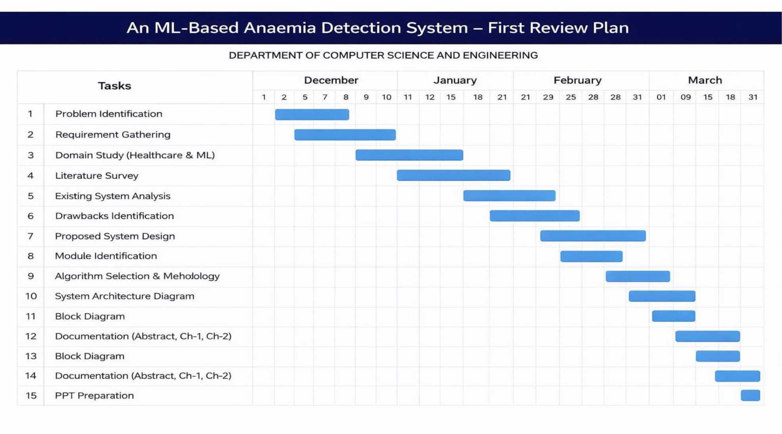
DEPARTMENT OF COMPUTER SCIENCE AND ENGINEERING
B.S. Abdur Rahman'
*9 Crescent
GANTT CHART:
Institute of Science & Technology
OwmfliJ CO bo U^i.^rniCy y/j 3 of Chi) UCC A_{c}c. 195$
14

