Slide 1

FINAL REVIEW
Dairy & Milk Cooperative Management System
T.Jaswanth Reddy | 2520030284
S.Prem Sai | 2520030561
V.Nitish Chowdhary | 2520030179
Under the Guidance
of
Dr. Y Prasanthi
Assistant Professor
Department of Computer Science and Engineering
KONERU LAKSHMAIAH EDUCATION FOUNDATION

Slide 2
GROUP NUMBER:6
Name of Candidate | Role
T.Jaswanth Reddy (2520030284) | Team Lead / Backend (Node.js, Express, MySQL)
S.Prem Sai (2520030561) | Frontend Development (React.js) & UI/UX
V.Nitish Chowdhary (2520030179) | Database Design & Payment Integration

Slide 3
ABSTRACT
Dairy cooperative outlets still record stock, sales and payments in paper registers, so shortages and unpaid sales are found late or never.
The Dairy & Milk Cooperative Management System is a web platform for cooperative admins and outlet merchants to manage products, stock, point-of-sale billing, cash and UPI payments, and invoices.
Every sale runs as a saga: stock is reserved with row locks, payment is verified, and the invoice, sale, items and payment are saved in one ACID transaction.
SQL views compare stock received, sold and available, and amounts billed versus collected, to flag discrepancies automatically.
Built with React (Vite), seven Node.js/Express microservices behind an API gateway, and MySQL.

Slide 4
INTRODUCTION
A dairy cooperative supplies milk, curd, paneer, ghee and buttermilk to small outlets run by merchants.
Each merchant receives stock, sells it across a morning or evening shift and settles the money with the cooperative.
UPI and low-cost web technology now make it practical for even small outlets to bill and collect digitally.
Our project digitises this merchant side of the cooperative and keeps stock, sales and payments consistent with each other.
Developed for the course Database Systems Engineering and Distributed Backend Development (25CS1302E).

Slide 5
EXISTING SYSTEM
Incoming stock is written in registers or spreadsheets, updated irregularly.
Bills are handwritten or skipped; multi-item totals are calculated by hand.
Cash and UPI receipts are not linked to individual sales.
Revenue is known only after an end-of-day or end-of-week tally.
No automatic check between stock received, stock sold and money collected, so leakage goes unnoticed.

Slide 6
PROBLEM STATEMENT
Stock on the shelf cannot be compared with what should be there.
A sale that was never paid for looks the same as one that was.
Two quick sales of the last unit can oversell stock.
Management has no live view of revenue or anomalies across outlets.
Problem: design a database-backed, multi-user web system that records every stock entry, sale and payment consistently and detects stock and payment discrepancies automatically.

Slide 7
PROPOSED SOLUTION (CONTRIBUTION)
Role-based web app for Admin / Owner and Merchant users with JWT login.
Multi-item POS with prices always taken from the server, never from the browser.
Cash and Cashfree UPI payments, each payment linked to its sale.
Stock reserved under SELECT … FOR UPDATE with a 5-minute expiry, so overselling is not possible.
Invoice, sale, line items and payment saved in one ACID transaction; failures are compensated (stock released, payment refunded).
SQL views flag stock and payment discrepancies on the admin dashboard.

Slide 8
OBJECTIVES
Design a normalised MySQL schema with keys and integrity constraints.
Record multi-item sales atomically.
Prevent overselling with row-level locking and reservations.
Accept cash and UPI payments with server-side pricing.
Detect stock and payment discrepancies automatically using SQL views.
Provide role-based dashboards with live revenue and stock.
Structure the backend as microservices behind an API gateway (Saga pattern).

Slide 9
MODULES
Authentication – login with email or merchant code, JWT, role-based access
Merchant Management – shops, shifts, activate / deactivate
Products & Quality – catalogue, official prices, fat %, SNF %, grade
Stock & Inventory – stock inflow, available quantity, reservations
Point of Sale – multi-item billing, tax, discount, invoice
Payments – cash, Cashfree UPI order / verify / refund, ledger
Reporting – executive dashboard, revenue, stock and payment discrepancies
Recovery – resumes or compensates interrupted sales

Slide 10
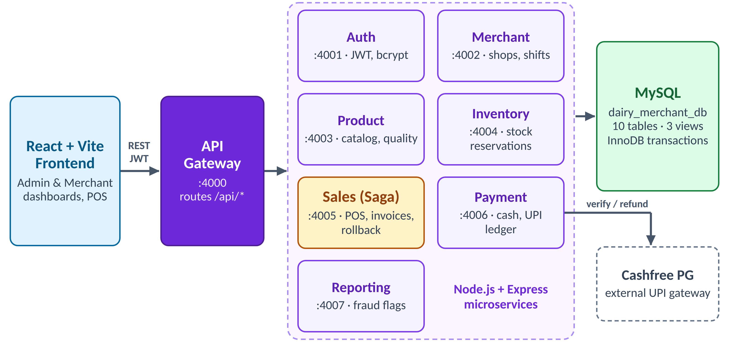
SYSTEM ARCHITECTURE
React frontend → API Gateway (:4000) → 7 microservices → MySQL; Cashfree for UPI

Slide 11
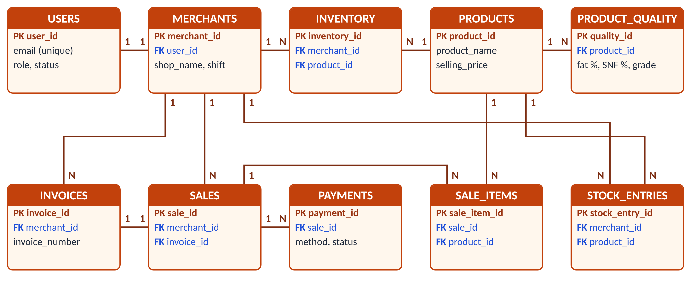
ER DIAGRAM
10 core tables of dairy_merchant_db with primary keys, foreign keys and cardinalities

Slide 12
DATABASE DESIGN
Normalised to 3NF: product and merchant details stored once and referenced by key.
Constraints: PRIMARY / FOREIGN KEY, UNIQUE (email, merchant code, invoice no., merchant–product), CHECK (quantity > 0, amount ≥ 0), ENUM statuses.
Indexes on sales(merchant_id, sale_date), stock_entries(merchant_id, product_id), sale_items(product_id), payments(payment_status).
Views:
  vw_stock_discrepancy – (incoming − sold) − actual stock
  vw_payment_discrepancy – billed − successful payments
  vw_merchant_revenue – sales and revenue per merchant
Supporting tables for the saga: saga_instances, inventory_reservations.

Slide 13
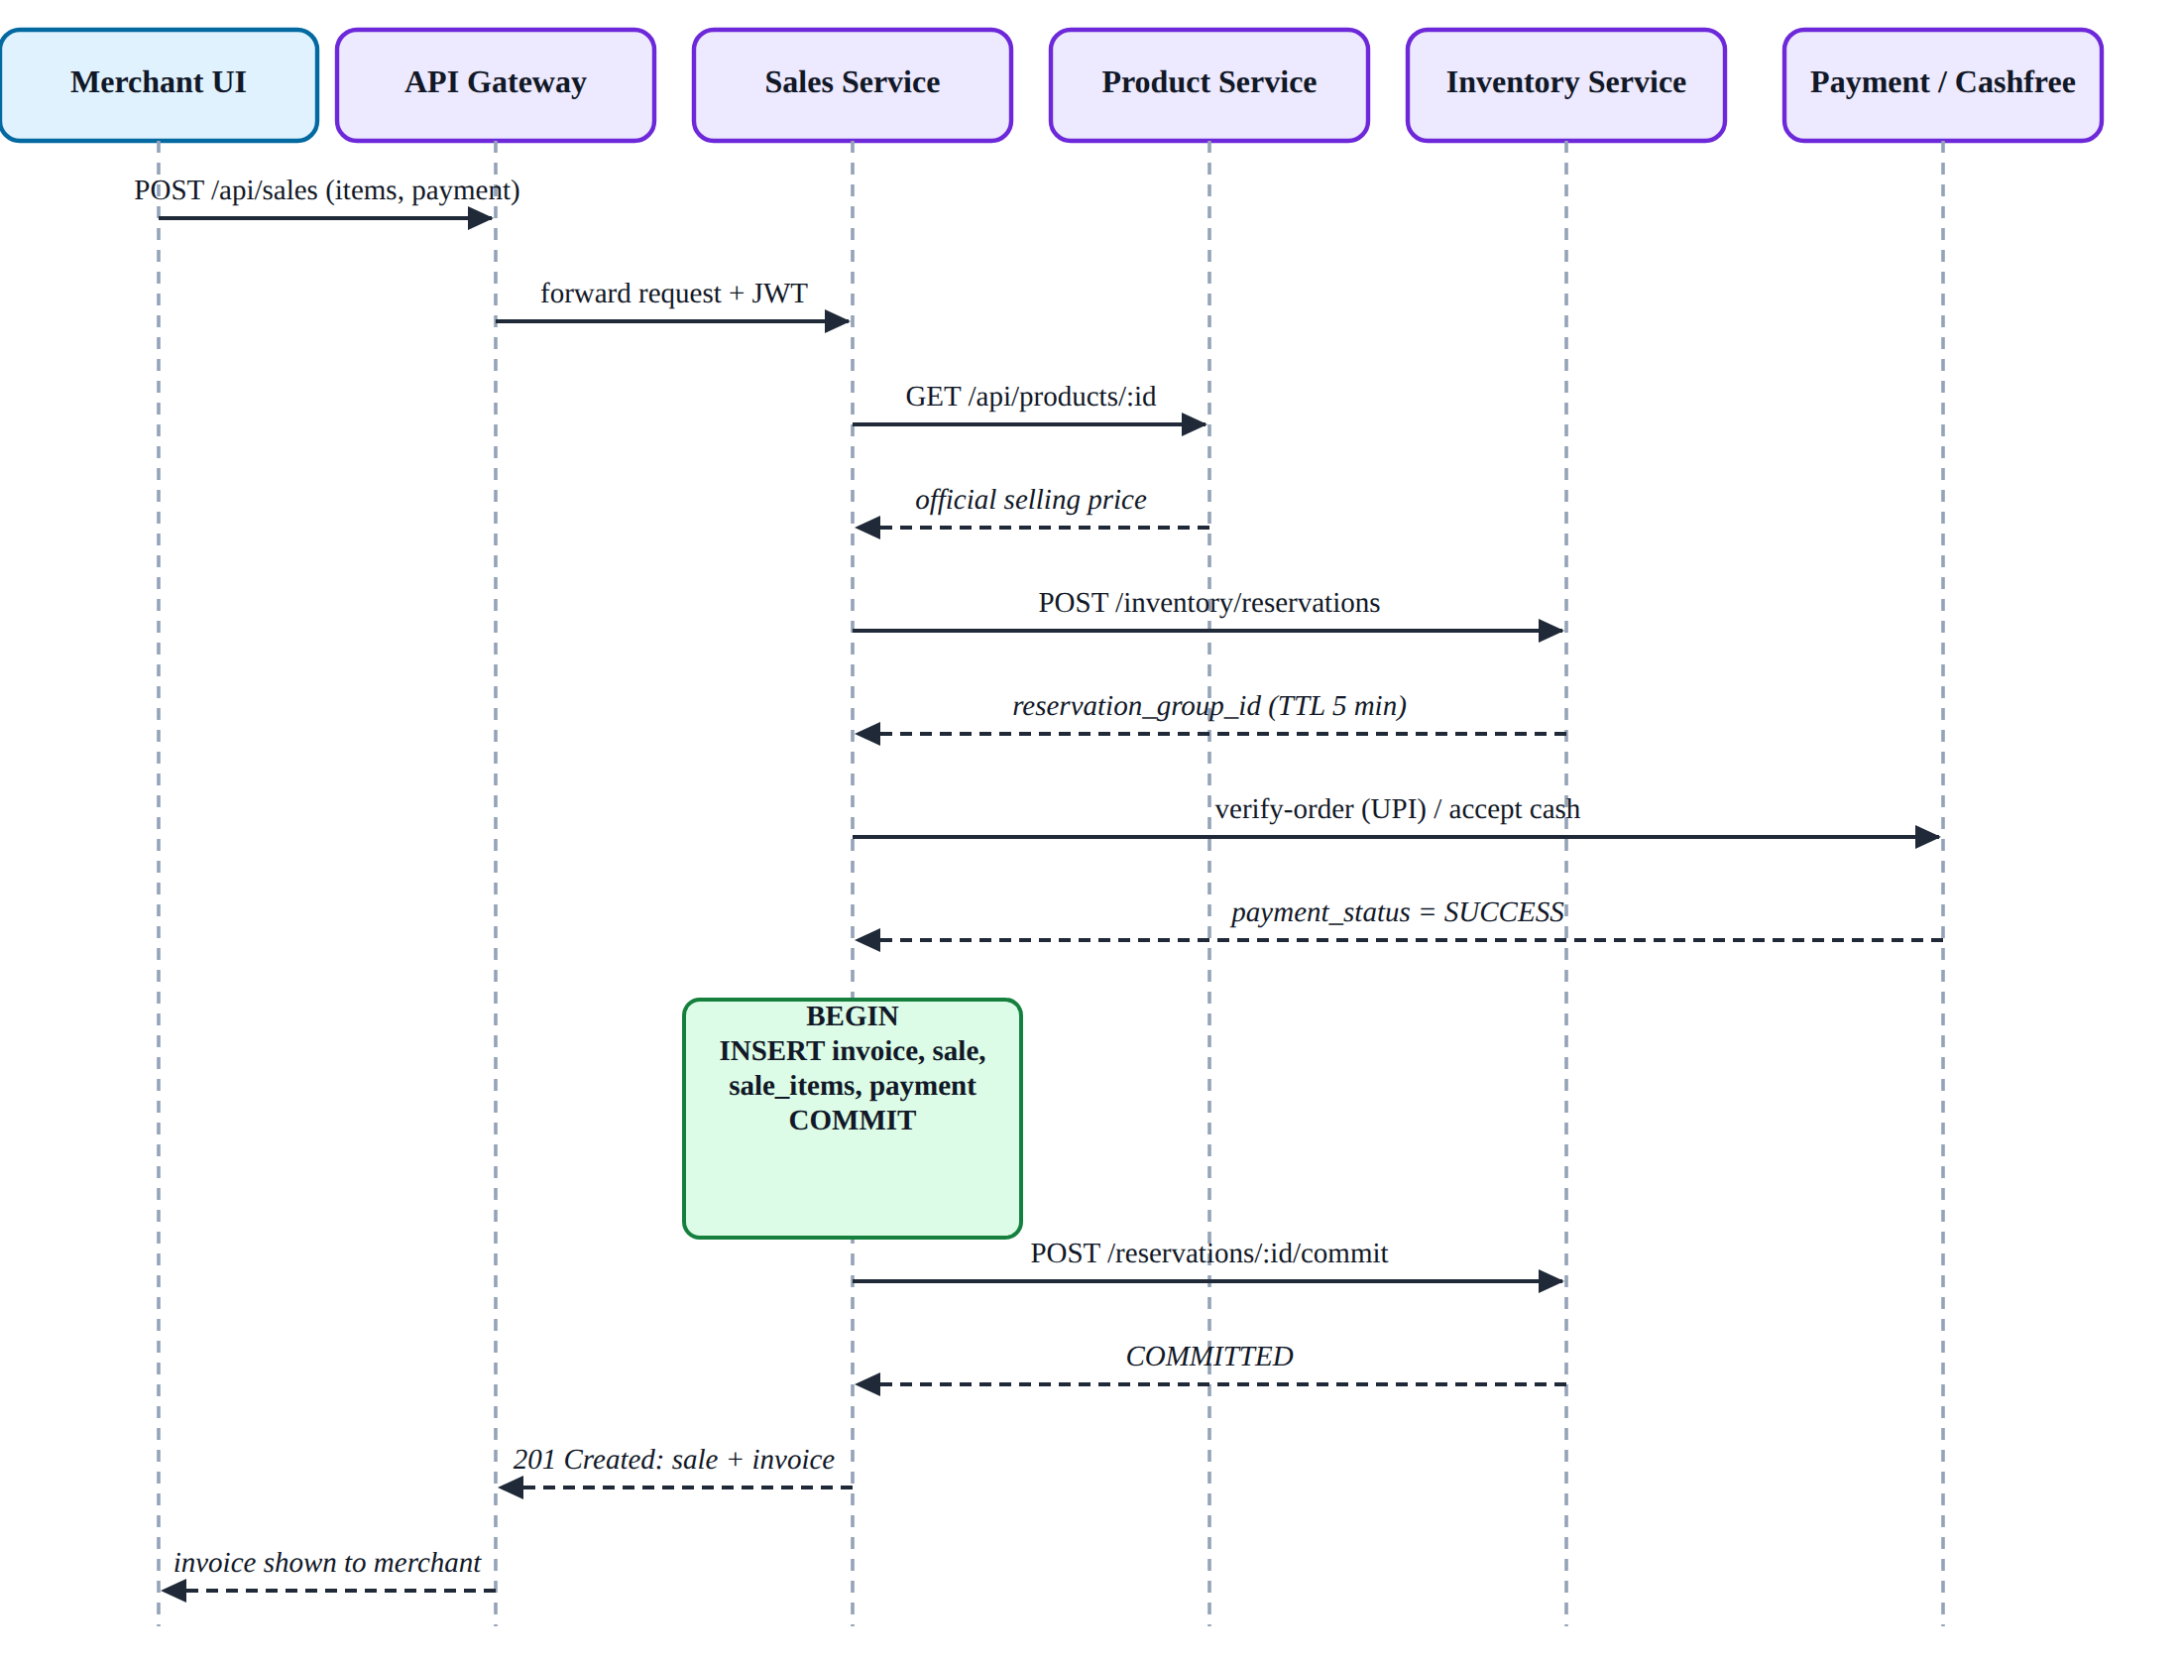
SALE WORKFLOW
Service calls for one successful sale

Slide 14
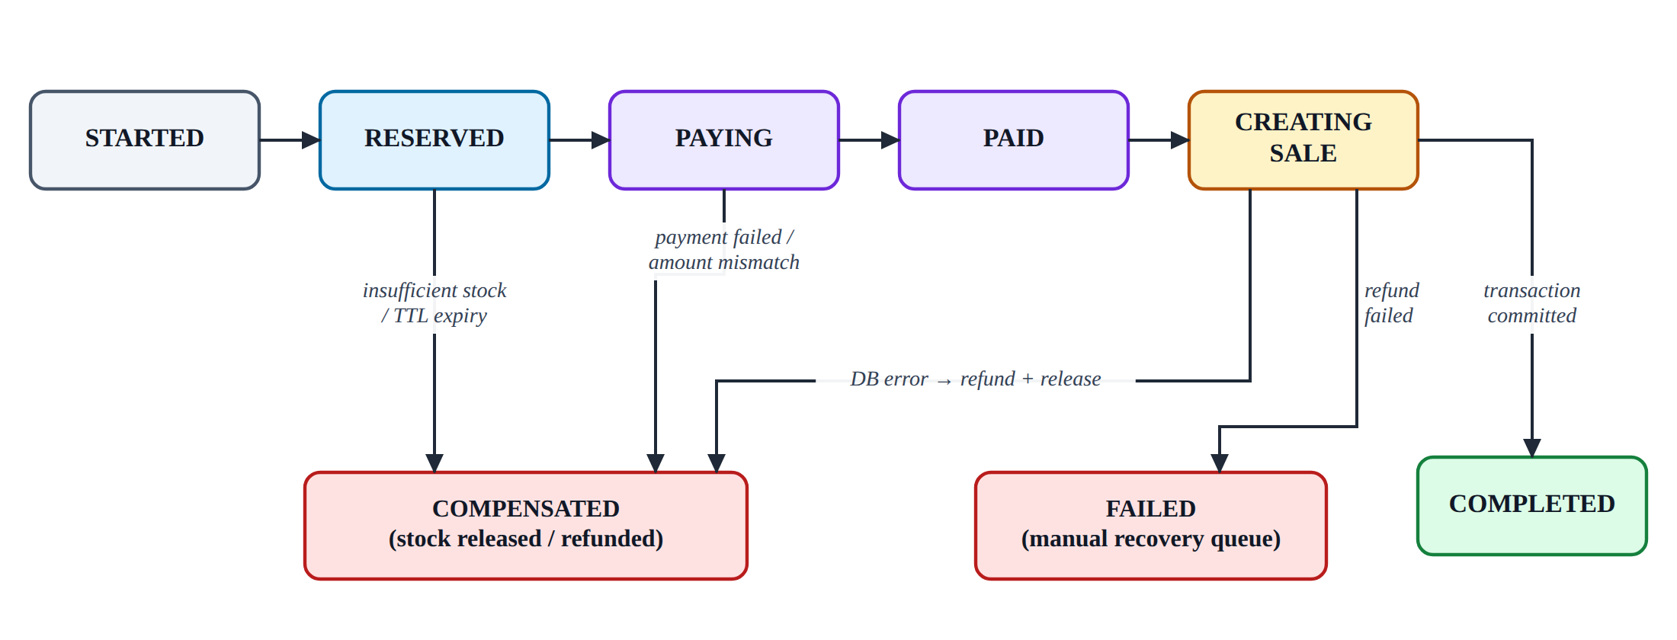
SAGA – CONSISTENCY ACROSS SERVICES
Each step is a local transaction; a failure triggers compensation: release reserved stock, refund UPI payment.
A recovery job every 30 s completes or compensates interrupted sales; payments without a sale are listed as orphans.

Slide 15
SOFTWARE REQUIREMENTS
Frontend: React 18, Vite 5, React Router, Axios
Backend: Node.js, Express.js – 7 microservices + API Gateway
Database: MySQL 8.0 (InnoDB)
Authentication: JWT, bcrypt
Payments: Cashfree Payment Gateway (sandbox)
Tools: VS Code, Git & GitHub, Postman, MySQL Workbench, Draw.io
Hardware: dual-core CPU, 4 GB RAM (8 GB recommended), any modern browser

Slide 16
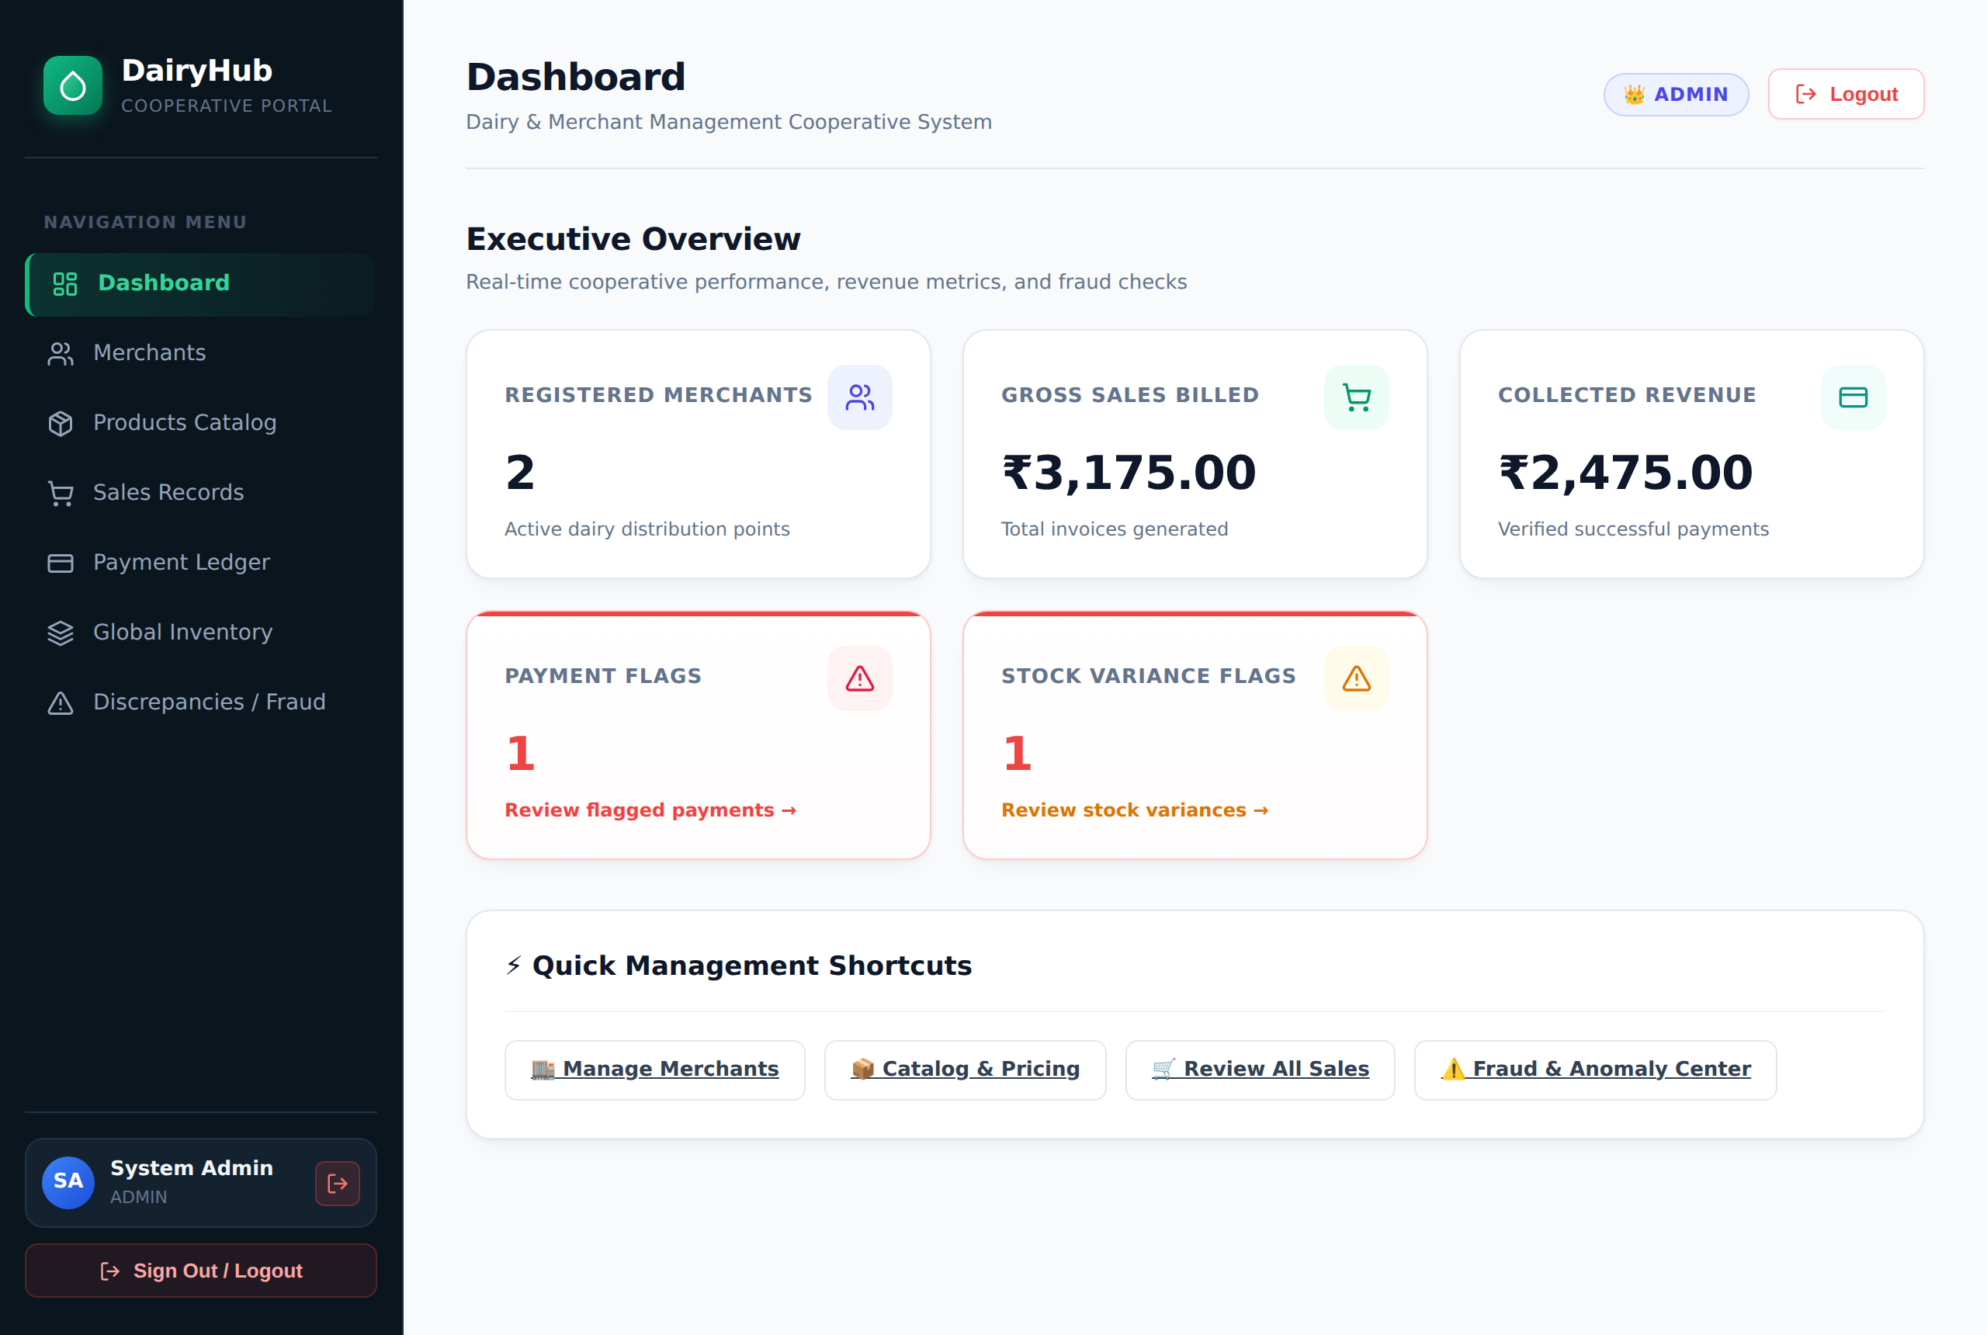
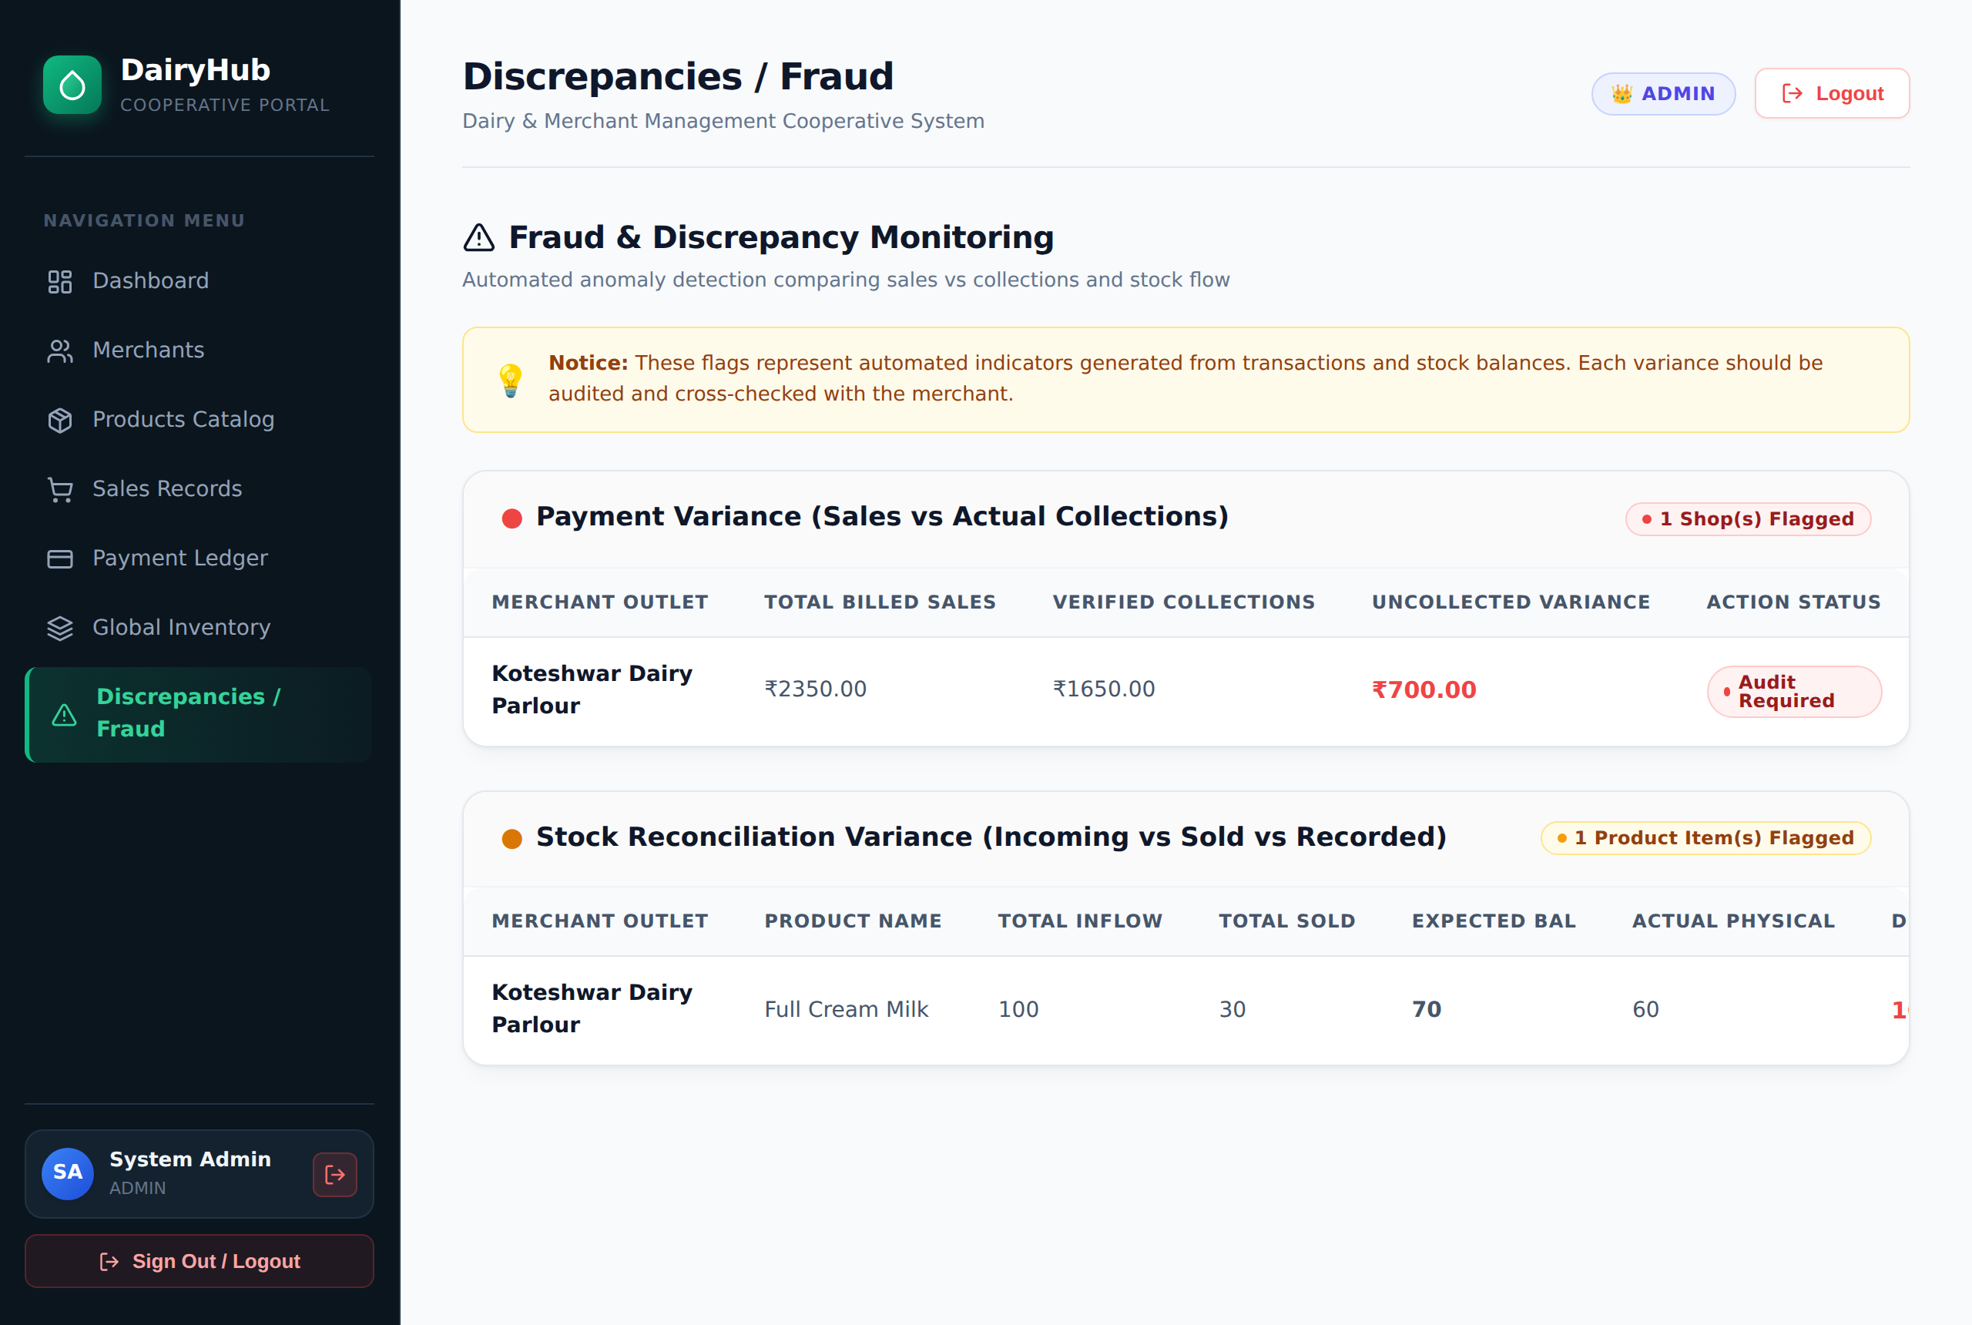
IMPLEMENTATION – ADMIN
Executive overview with fraud flags
Stock and payment discrepancy report

Slide 17
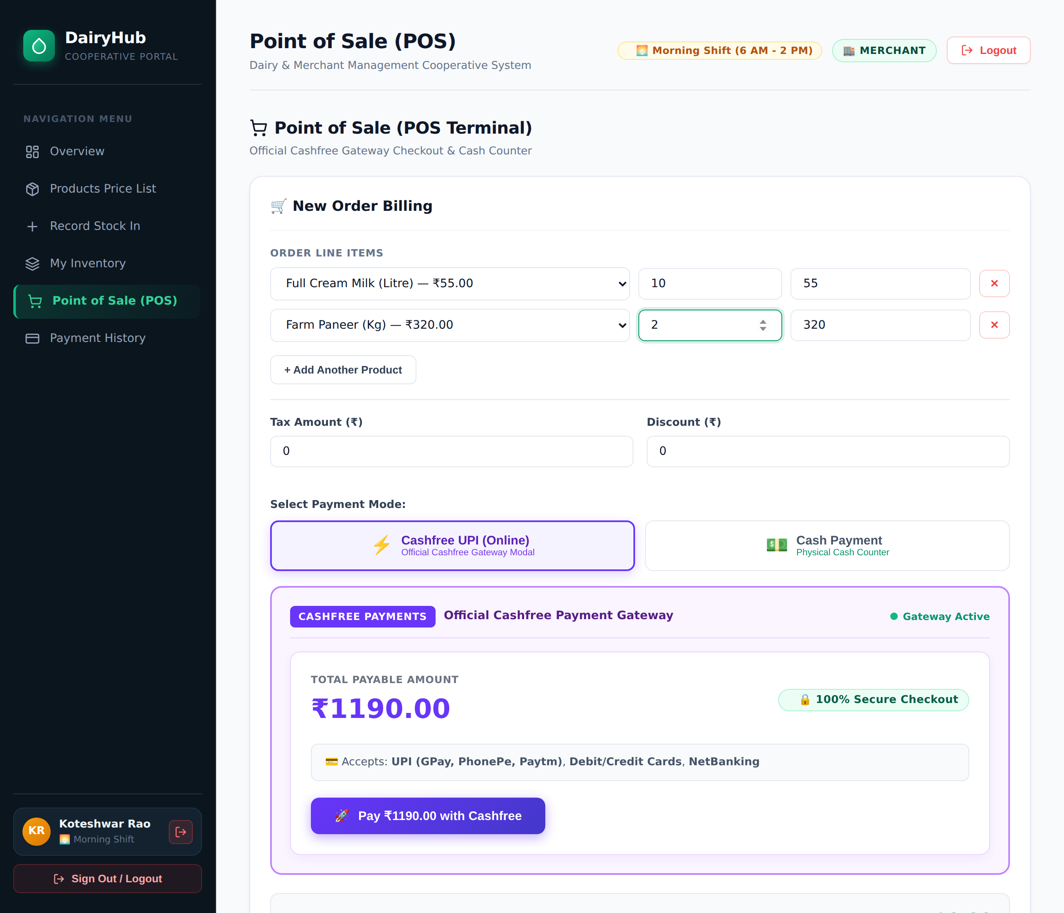
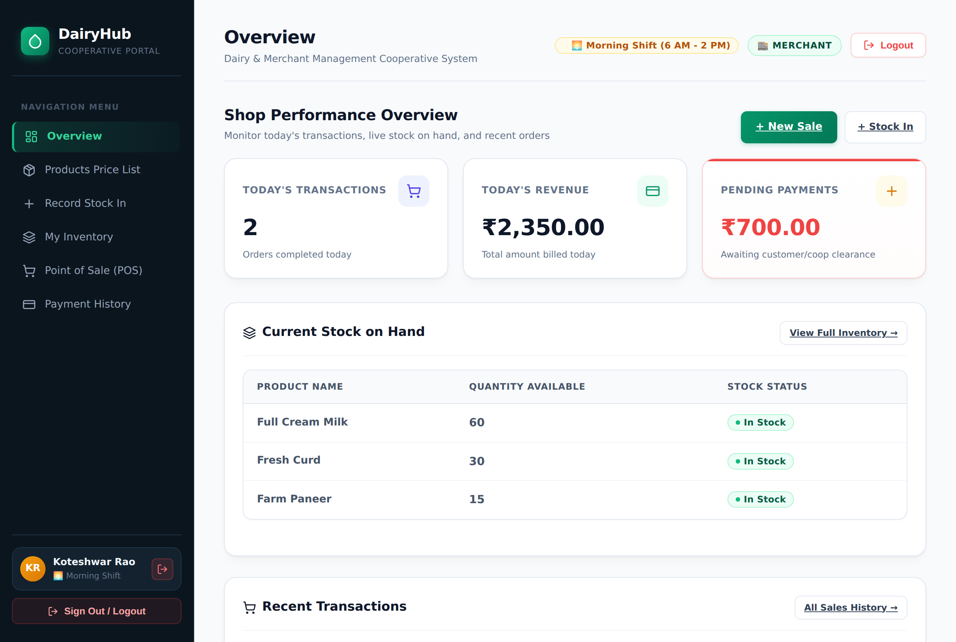
IMPLEMENTATION – MERCHANT
Merchant shop overview
Point of sale with Cashfree UPI

Slide 18
RESULTS & TESTING
Working application with 13 screens for admins and merchants.
Overselling blocked: a sale larger than available stock is rejected and nothing is saved.
Prices edited in the browser are ignored; the server bills at catalogue price.
Seed data correctly flags a ₹700 payment shortfall and a 10-unit stock shortfall.
Integration test suites cover saga recovery and compensation, reporting, gateway cutover, and service failure and restart.

Slide 19
CONCLUSION AND FUTURE SCOPE
The system gives a cooperative one platform for stock, billing, payments and invoices across outlets.
Transactions, row locks and the Saga pattern keep stock, sales and payments consistent.
SQL views replace manual reconciliation with automatic discrepancy flags.
Future Scope:
  Farmer milk collection with Fat/SNF-based rates and payment statements
  Email / SMS alerts for low stock and flagged discrepancies
  Docker deployment, CI/CD pipeline and production Cashfree keys
  Mobile app for merchants

Slide 20
REFERENCES
A. Silberschatz, H. F. Korth, S. Sudarshan, Database System Concepts, 7th ed., McGraw-Hill, 2019.
R. Elmasri, S. B. Navathe, Fundamentals of Database Systems, 7th ed., Pearson, 2016.
H. Garcia-Molina, K. Salem, “Sagas,” Proc. ACM SIGMOD, 1987.
C. Richardson, Microservices Patterns, Manning, 2018.
MySQL 8.0 Reference Manual – dev.mysql.com/doc
React, Express.js and Cashfree developer documentation

Slide 21
THANK YOU

