Slide 1
B.TECH MINI PROJECT REVIEW
Question Bank Management
System Using Advanced String
Matching Algorithms
TEAM MEMBERS
SURISETTI PREM SAI – 2520030561 MOHIT VENKAT SAI – 2520030106
DEPARTMENT
COURSE
ACADEMIC YEAR
Computer Science & Engineering
DSA-3
[2025 – 2029]

Slide 2
Abstract
Project Overview
Educational institutions manage thousands of questions spanning multiple subjects and semesters, and manual searching through these large repositories is slow, inconsistent, and error-prone. This project presents a console-based Question Bank Management System that applies advanced string matching algorithms to search, organize, and retrieve questions quickly and accurately. By combining exact-match techniques with approximate matching, the system delivers reliable results even when queries are imprecise.
The application offers keyword search, intelligent filtering by subject, unit, and difficulty, automatic duplicate question detection, and fuzzy search suggestions for near-matching queries, all through a simple menu-driven console interface. Together, these capabilities significantly reduce the time faculty and students spend locating relevant questions, while keeping the question bank clean, organized, and easy to maintain.

Slide 3





Problem Statement
CURRENT PROBLEMS
Manual searching is time-consuming
Locating relevant questions by hand across large banks wastes valuable faculty time.
PROPOSED SOLUTION
Develop a console-based Question Bank Management System powered by advanced string matching algorithms that enables fast searching, automatic duplicate detection, and efficient management of academic question banks.
Duplicate questions are difficult to identify
Repeated questions accumulate unnoticed, reducing question bank quality.
Poor keyword search
Existing tools offer limited or unreliable text-matching capability.
Large question banks are hard to manage
Thousands of entries across subjects and semesters overwhelm manual upkeep.
Lack of intelligent search mechanisms
KMP · Rabin-Karp · Levenshtein Distance
No fuzzy matching or smart filtering to handle imprecise queries.
3

Slide 4













Proposed Functionalities
Core modules and features of the console application
Admin Login
Faculty Login
Student Login
Add / Edit / Delete Questions
Subject-wise Search
Unit-wise Search
Keyword Search
Difficulty Filter
Previous Year Question Filter
Duplicate Question Detection
Fuzzy Search Suggestions
Search History
Interactive Console Menu

Slide 5
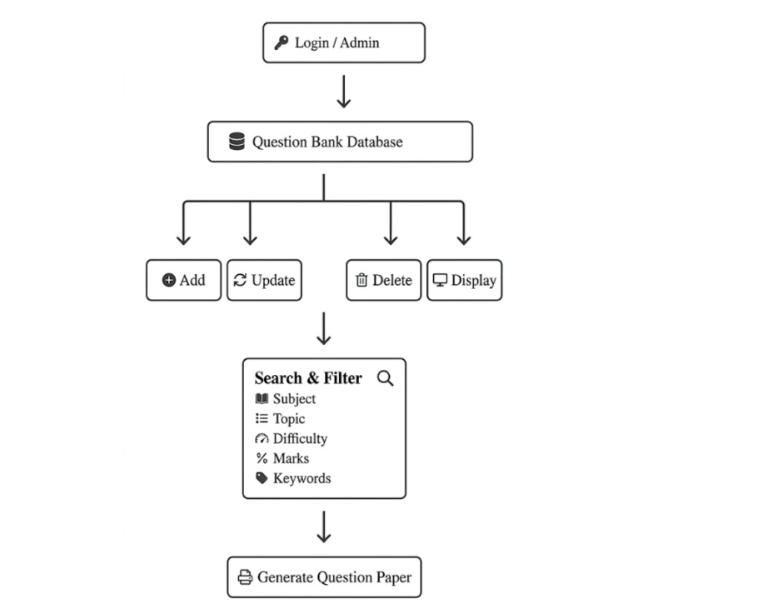

Slide 6




Tools & Technologies
Technology stack powering the console-based application
Core Language
Database
Advanced Algorithms
Development Tools
Java
(Console-based
application)
MySQL
Knuth-Morris-Pratt (KMP)
Rabin-Karp
Levenshtein Edit Distance
IntelliJ IDEA
VS Code
Git & GitHub

Slide 7







Expected Outcome
Anticipated impact of the Question Bank Management System
Fast and efficient question searching
Reduced duplicate questions
Intelligent fuzzy search suggestions
Organized digital repository
Improved productivity for faculty
Better learning experience for students
Easy maintenance and scalability

